Slide 1

IILM UNIVERSITY, GREATER NOIDA
INTERNSHIP REPORT PRESENTATION
CodSoft
Artificial Intelligence Virtual Internship
A hands-on internship in rule-based systems, game-playing agents, and recommendation engines
Akshat Shivhare
Roll No. 2410030905 | B.Tech CSE, 3rd Year
July – August 2026

Slide 2






ABOUT THE STUDENT
Candidate Profile
ROLL NUMBER
2410030905
Akshat
Shivhare
INSTITUTE
IILM University, Greater Noida, U.P.
B.Tech – Computer Science & Engineering
PROGRAMME
B.Tech CSE, Batch 2024–2028 (5th Sem)
INTERNSHIP DOMAIN
Artificial Intelligence — CodSoft
DURATION
4 Weeks | 10 July – 10 August 2026
CodSoft AI Virtual Internship • Akshat Shivhare
02

Slide 3



ABOUT THE PROGRAM
CodSoft: Code. Create. Succeed.
CodSoft is a tech education and software development platform that helps aspiring developers turn theoretical knowledge into practical expertise. Through virtual internships, project-based curriculums, and AI-driven career tools, it provides a complete ecosystem for hands-on skill building.
ISO Certified
MSME Registered
AI-Driven Career Tools
ISO 9001:2015 certified organization delivering structured, quality-assured internship programs.
A recognized Micro, Small & Medium Enterprise running skill-based virtual internship tracks.
Resume builder, ATS score checker, AI interview coach, and portfolio builder for career growth.
CodSoft AI Virtual Internship • Akshat Shivhare
03

Slide 4



PROBLEM STATEMENT
From Theory to Working AI Applications
Students often learn AI concepts — pattern matching, adversarial search, recommender logic — only in theory, with little practice building complete, working applications end to end. This internship closed that gap by requiring three independently designed and delivered AI projects.
The internship addressed this gap across three problem categories:
→
→
Conversational Agents
Adversarial Game Play
Recommendation Systems
Rule-based dialogue logic
Search & decision-making
Similarity-based filtering
CodSoft AI Virtual Internship • Akshat Shivhare
04

Slide 5





PROJECT OBJECTIVES
What the Internship Set Out to Achieve
Rule-Based NLP
Game Theory & Search
Recommendation Techniques
Implement pattern-matching logic for a conversational chatbot.
Apply the Minimax algorithm to build an unbeatable Tic-Tac-Toe agent.
Use content-based / collaborative filtering to suggest movies.
Python Implementation
Version Control
Task Completion
Translate AI concepts into clean, working Python code.
Maintain and document each project in its own GitHub repository.
Successfully deliver a minimum of three internship tasks.
CodSoft AI Virtual Internship • Akshat Shivhare
05

Slide 6





TECHNOLOGIES & TOOLS
The Toolkit Behind the Internship
Python
Pattern Matching
Minimax Algorithm
Game Trees
Core programming language
Rule-based intent detection
Adversarial game search
State-space evaluation
Content-Based Filtering
Collaborative Filtering
Git & GitHub
VS Code / Python IDE
Similarity-driven suggestions
Preference-based ranking
Version control & hosting
Development environment
CodSoft AI Virtual Internship • Akshat Shivhare
06

Slide 7




SYSTEM ARCHITECTURE
From User Input to AI Output
Input Layer
User query, board move, or preference is captured via the console interface.
Processing Layer
Task-specific logic runs — rule matching, Minimax search, or similarity filtering.
Decision Layer
The system determines the best response, move, or ranked recommendation list.
Output Layer
A chatbot reply, the AI's next move, or a movie list is returned to the user.
Version Control Layer
Source code and docs for each task are maintained in a dedicated GitHub repo.
CodSoft AI Virtual Internship • Akshat Shivhare
07

Slide 8

METHODOLOGY
Three Tasks, Three AI Techniques
Selected from five available options, each task was independently designed, coded, and documented before being pushed to a dedicated public GitHub repository.
TASK 1
TASK 2
TASK 3
Rule-Based Chatbot
Tic-Tac-Toe AI
Movie Recommendation System
Responds to user inputs using predefined rules and pattern-matching (if-else logic) to identify intents and generate replies — a first look at NLP and conversation flow.
An unbeatable AI agent built with the Minimax algorithm, exhaustively evaluating game states to play optimally against a human opponent.
Suggests movies based on user preferences using content-based and collaborative filtering to identify similarity between titles and users.
CodSoft AI Virtual Internship • Akshat Shivhare
08

Slide 9

EXPECTED OUTCOMES
Skills & Capabilities Gained
Ability to design and implement rule-based / pattern-matching logic for a conversational chatbot
Practical understanding of adversarial search, game theory, and the Minimax algorithm
Hands-on exposure to building a recommendation system using filtering techniques
Improved proficiency in Python and translating AI concepts into working applications
Experience maintaining version-controlled, publicly documented repositories on GitHub
Successful completion of the minimum three required tasks for internship certification
CodSoft AI Virtual Internship • Akshat Shivhare
09

Slide 10
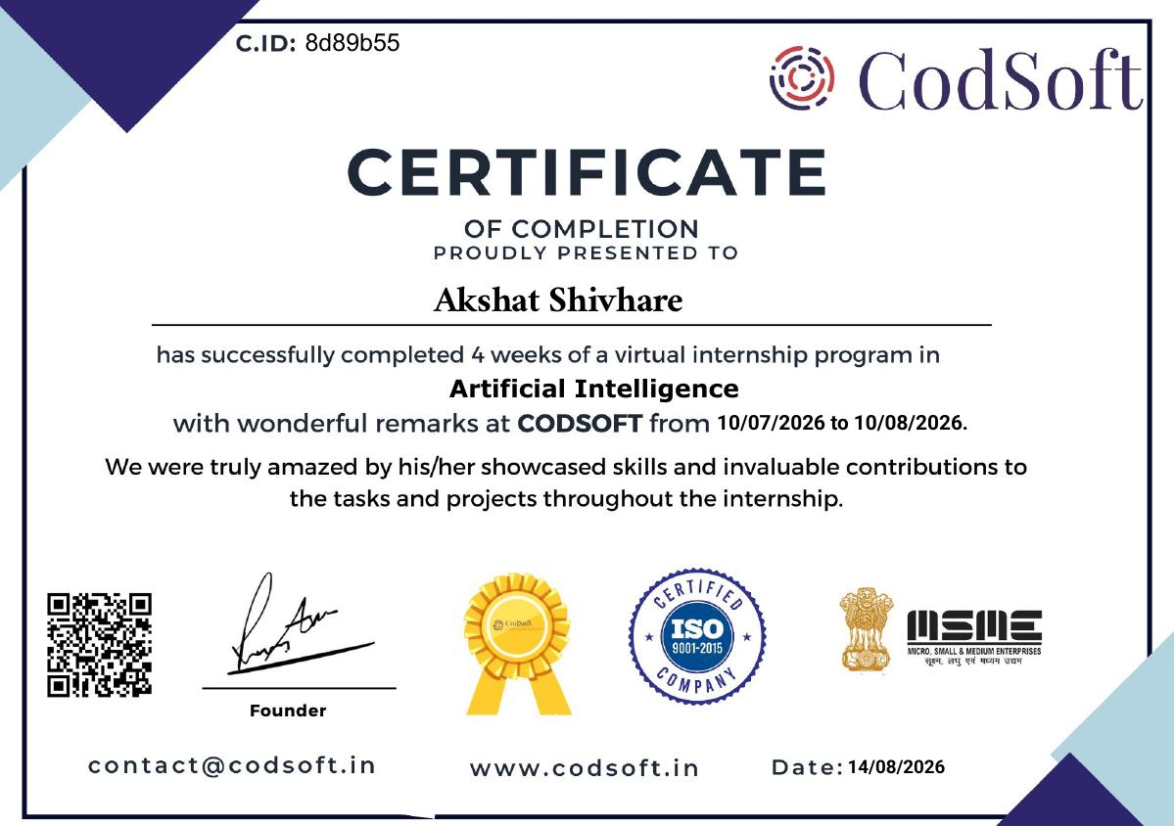




CERTIFICATION
Successfully Completed
INTERNSHIP DOMAIN
Artificial Intelligence
CERTIFICATE ID
8d89b55
TASKS COMPLETED
3 of 5 (minimum required: 3)
DURATION
4 Weeks | 10 Jul – 10 Aug 2026
CodSoft AI Virtual Internship • Akshat Shivhare
10

Slide 11

PROOF OF WORK
Project Repositories
Each completed task is documented and version-controlled in its own public GitHub repository, as required by the CodSoft submission guidelines.
Rule-Based Chatbot
Tic-Tac-Toe AI
Movie Recommendation System
github.com/anshkr12/Rule-Based-Chatbot
github.com/anshkr12/Tic-Tac-Toe
github.com/anshkr12/Movie-Recommendation-System
CodSoft AI Virtual Internship • Akshat Shivhare
11

Slide 12
Thank You
CodSoft Artificial Intelligence Virtual Internship
Akshat Shivhare
Roll No. 2410030905 | IILM University, Greater Noida

