Slide 1

NORTHBRIDGE
TECH
DIGITAL PRODUCT STUDIO
We build digital
solutions that move.
From your idea to a scalable digital product.
Web • Mobile • Cloud • UI/UX • Integrations • Digital Marketing
northbridgetech.group
Technology that bridges ideas and growth.
01
Notes:
[Sources]
- Content adapted from the user-provided NorthBridgeTech_Services_Animated_Style_Deck.pptx.
- Visual on this slide was generated with Microsoft Copilot.
[/Sources]

Slide 2
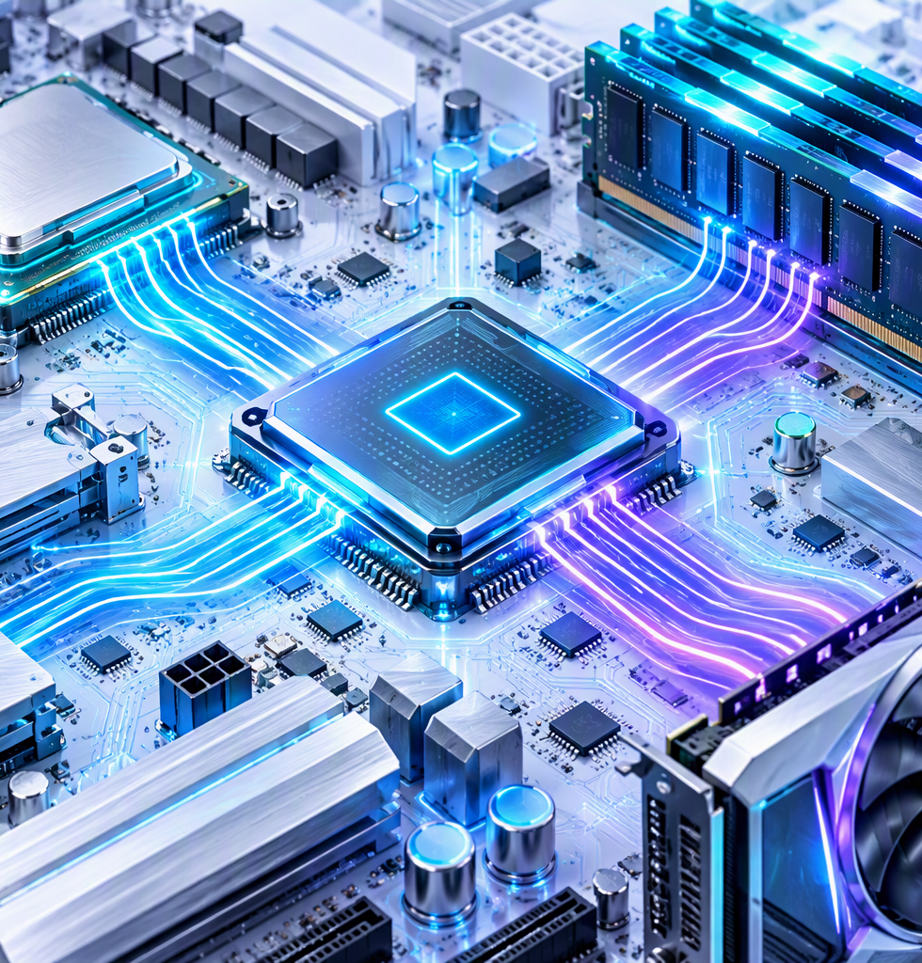
NORTHBRIDGE
TECH
WHY NORTHBRIDGETECH
The idea behind our name.
A technology name inspired by connection, speed and coordination.
A northbridge is a legacy computer chip on a motherboard that handles high-speed tasks and manages communication between the CPU, system memory, and graphics cards.
NORTH • BRIDGE • TECH
Our name reflects the same principle: connecting critical parts so technology can work together smoothly.
CONNECTION • PERFORMANCE • TECHNOLOGY
02
Notes:
[Sources]
- Content adapted from the user-provided NorthBridgeTech_Services_Animated_Style_Deck.pptx.
- Visual on this slide was generated with Microsoft Copilot.
[/Sources]

Slide 3
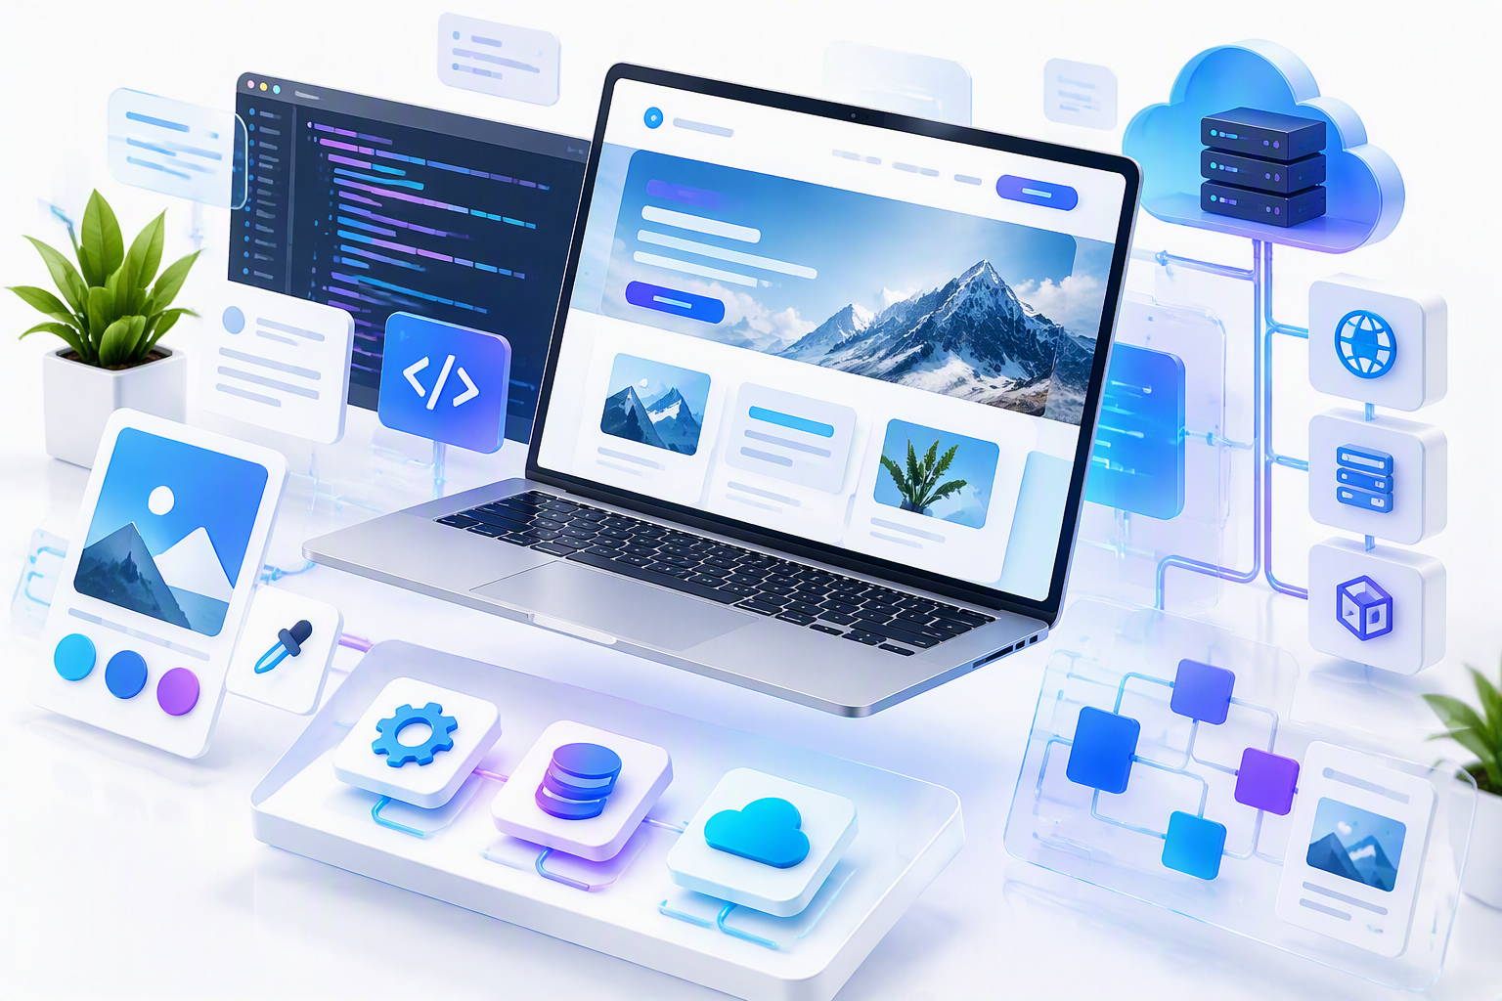
NORTHBRIDGE
TECH
OUR SERVICES
One technology partner. Six capabilities.
A complete digital service stack for businesses, entrepreneurs and personal brands.
⌘
▣
☁
✦
↔
↗
Web Development
Mobile Development
Cloud & Deployment
UI / UX
Integrations
Digital Marketing
Websites • SaaS • E-commerce
Apps • Cross-platform
Hosting • Maintenance
Figma • Prototyping
APIs • Automation
Creative • Advertising
STRATEGY • DESIGN • BUILD • GROW
03
Notes:
[Sources]
- Content adapted from the user-provided NorthBridgeTech_Services_Animated_Style_Deck.pptx.
- Visual on this slide was generated with Microsoft Copilot.
[/Sources]

Slide 4
NORTHBRIDGE
TECH
01 — WEB DEVELOPMENT
Web experiences built around your needs.
From a simple portfolio to a complex SaaS platform or online store.
◇
System Designing
Architecture planning • Business workflow mapping • Scalable foundations
⌘
Custom Software & SaaS
Tailored functionality • Subscription products • Business-specific systems
▤
Websites & E-commerce
Company & personal portfolios • Online stores • Responsive experiences
DESIGNED • DEVELOPED • READY TO GROW
04
Notes:
[Sources]
- Content adapted from the user-provided NorthBridgeTech_Services_Animated_Style_Deck.pptx.
- Visual on this slide was generated with Microsoft Copilot.
[/Sources]

Slide 5
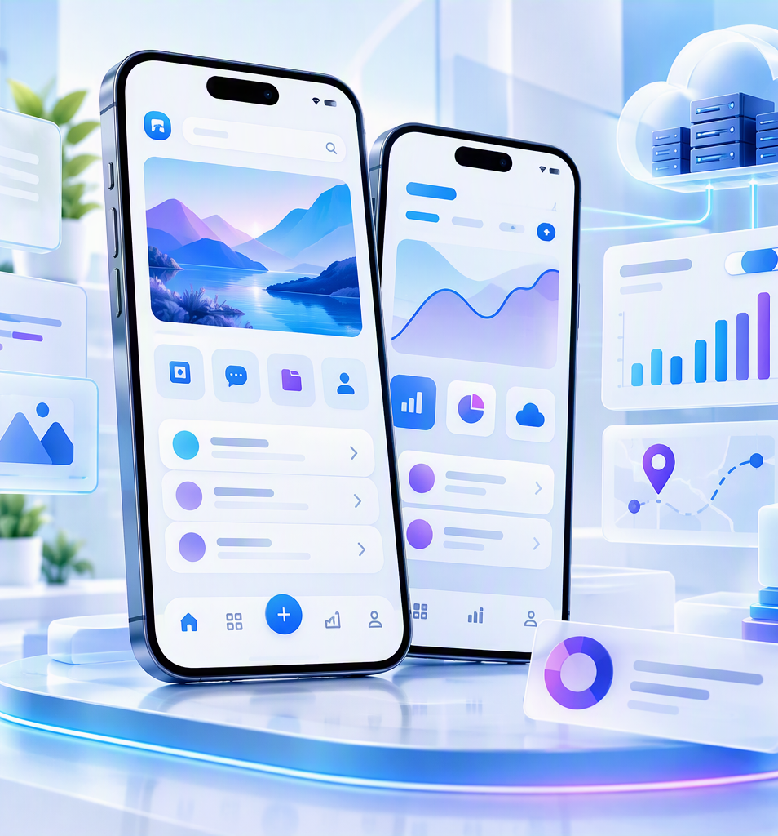
NORTHBRIDGE
TECH
02 — MOBILE DEVELOPMENT
Your product, wherever your users are.
Mobile applications designed for real-world usability and cross-platform reach.
▱
System Designing
App architecture • User flows & business logic • Scalable structure
◫
Custom Apps & SaaS
Tailored features • Business applications • Subscription products
↔
E-commerce & Cross-platform
Mobile commerce • iOS + Android strategy • Consistent experience
ONE PRODUCT • MULTIPLE PLATFORMS
05
Notes:
[Sources]
- Content adapted from the user-provided NorthBridgeTech_Services_Animated_Style_Deck.pptx.
- Visual on this slide was generated with Microsoft Copilot.
[/Sources]

Slide 6

NORTHBRIDGE
TECH
03 — DEPLOYMENT & CLOUD SERVICES
Launch with confidence. Stay online.
We help deploy, maintain and support your digital products in the cloud.
↗
Deployment
Website deployment • Application releases • Production setup
☁
Cloud Services
Cloud infrastructure • Scalable environments • Performance-focused setup
⟳
Maintenance
Updates & monitoring • Issue resolution • Ongoing technical support
DEPLOY • MONITOR • MAINTAIN
06
Notes:
[Sources]
- Content adapted from the user-provided NorthBridgeTech_Services_Animated_Style_Deck.pptx.
- Visual on this slide was generated with Microsoft Copilot.
[/Sources]

Slide 7
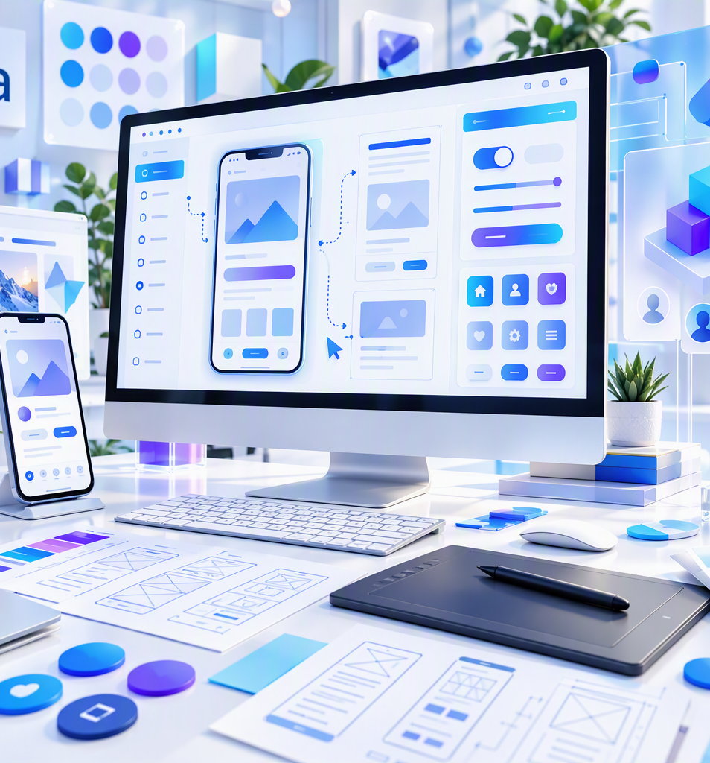
NORTHBRIDGE
TECH
04 — UI / UX DESIGN
Make every interaction feel intentional.
We turn ideas into clear, modern interfaces using Figma and relevant design tools.
◎
User Experience
User flows • Information architecture • Wireframes & journeys
✦
Interface Design
Modern UI systems • Responsive screens • Design consistency
▷
Prototype & Handoff
Figma prototypes • Interactive demonstrations • Developer-ready designs
IDEA → WIREFRAME → PROTOTYPE → UI
07
Notes:
[Sources]
- Content adapted from the user-provided NorthBridgeTech_Services_Animated_Style_Deck.pptx.
- Visual on this slide was generated with Microsoft Copilot.
[/Sources]

Slide 8

NORTHBRIDGE
TECH
05 — INTEGRATIONS
Connect your tools. Simplify your workflow.
We integrate external services so your systems can communicate seamlessly.
↔
API Integration
Connect external platforms • Data exchange • Custom API workflows
⬡
Third-party Services
Payments • Communication tools • Business platforms
⚙
Automation
Reduce repetitive work • Sync information • Streamline operations
CONNECT • SYNC • AUTOMATE
08
Notes:
[Sources]
- Content adapted from the user-provided NorthBridgeTech_Services_Animated_Style_Deck.pptx.
- Visual on this slide was generated with Microsoft Copilot.
[/Sources]

Slide 9
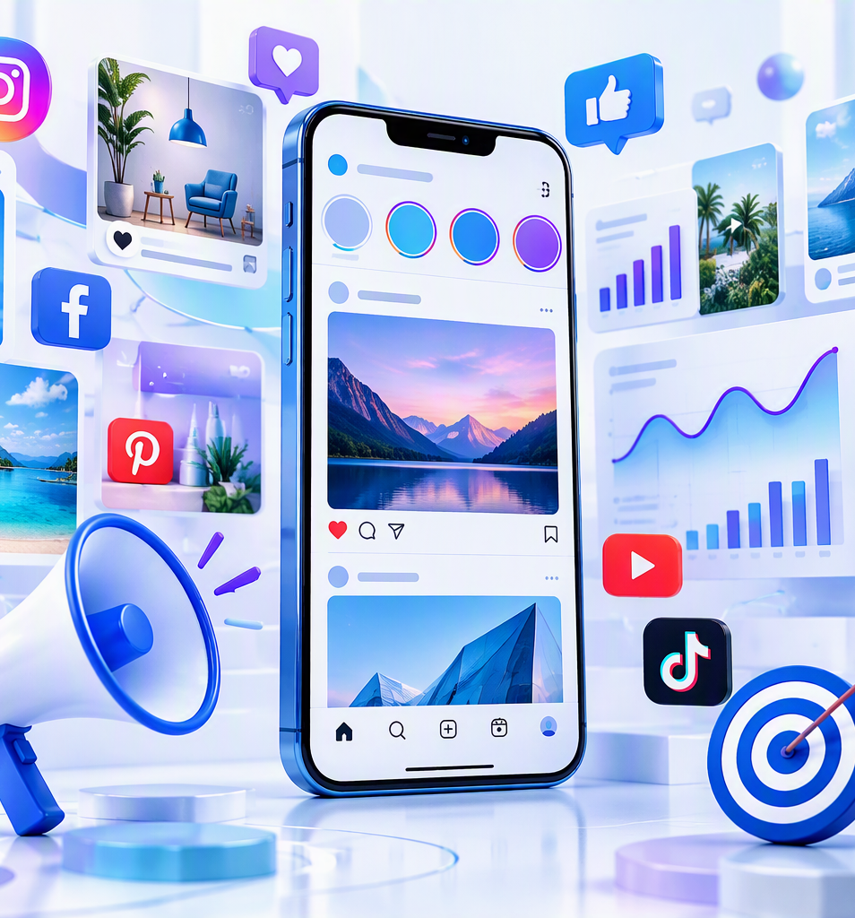
NORTHBRIDGE
TECH
06 — DIGITAL MARKETING
Turn attention into a stronger digital presence.
Creative marketing assets and digital communication designed around your brand.
▣
Instagram Profile
Profile setup & optimisation • Visual consistency • Content-ready presence
✦
Flyers & Creatives
Company flyers • Promotional designs • Social media creatives
↗
Advertising
Ad creatives • Campaign support • Audience-focused messaging
BRAND • CREATE • PROMOTE
09
Notes:
[Sources]
- Content adapted from the user-provided NorthBridgeTech_Services_Animated_Style_Deck.pptx.
- Visual on this slide was generated with Microsoft Copilot.
[/Sources]

Slide 10

NORTHBRIDGE
TECH
OUR APPROACH
From conversation to launch.
A simple process keeps the project clear, collaborative and focused.
01
02
03
04
05
DISCOVER
→
PLAN
→
DESIGN
→
BUILD
→
LAUNCH
Understand your needs
Define scope & solution
Create the experience
Develop & integrate
Deploy & support
CLEAR GOALS + SMART TECHNOLOGY + CONTINUOUS SUPPORT
10
Notes:
[Sources]
- Content adapted from the user-provided NorthBridgeTech_Services_Animated_Style_Deck.pptx.
- Visual on this slide was generated with Microsoft Copilot.
[/Sources]

Slide 11

NORTHBRIDGE
TECH
LET’S BUILD
Have an idea?
Let’s build it.
Your idea. Our technology.
Web • Mobile • Cloud • UI/UX • Integrations • Digital Marketing
northbridgetech.group
Build. Connect. Scale.
11
Notes:
[Sources]
- Content adapted from the user-provided NorthBridgeTech_Services_Animated_Style_Deck.pptx.
- Visual on this slide was generated with Microsoft Copilot.
[/Sources]

