Slide 1
Assignment-1 Discussion (Word Vectors and Analogy Test)
Adit Akarsh - 19D070003,
Akshay Iyer - 190070006,
Sumit Jain - 190050119,
Prateek Neema - 20D070061
13th Feb,2023

Slide 2
Problem Statement (1/2)
In this assignment, you will have to implement the backpropagation algorithm from scratch. After implementing backpropagation ab-initio, train CBow and Skip-gram with backpropagation. (This link might help as a quick refresher for Skip-gram and CBoW.)
The task is to compare the performance of CBoW and Skip-gram embeddings on the word analogy task.
Analogy task: Given an analogy, find a word by correctly determining its relationship with another word. For example,

Slide 3
Problem Statement (2/2)
man:woman :: king:_____
( man is to woman, what king is to ____ )
The blank should be filled with “queen”.
Input: An analogy pair with one blank. For e.g.,
Delhi:India :: Paris:_____
Output: The correct word to satisfy the analogy given in the input.
You will have to report on the validation data:
Accuracy
Compare the performance of CBoW and Skip-gram models.
Perform detailed error analysis

Slide 4
Working with Data
Pre-processing (lemmatization, spell correction, stop word removal, deduplication etc.: did you do?): We did not perform lemmatization since different versions of words occur in the analogy task, removed stop words, deduplicated the data and used spell correction.
Data Scraping to facilitate analogy: did you do? Amount of scraping?: Yes! We have a total of 108800 sentences. Added 10,297 sentences to facilitate analogy.
Vocabulary size(V): how much is it for you?:19629

Slide 5
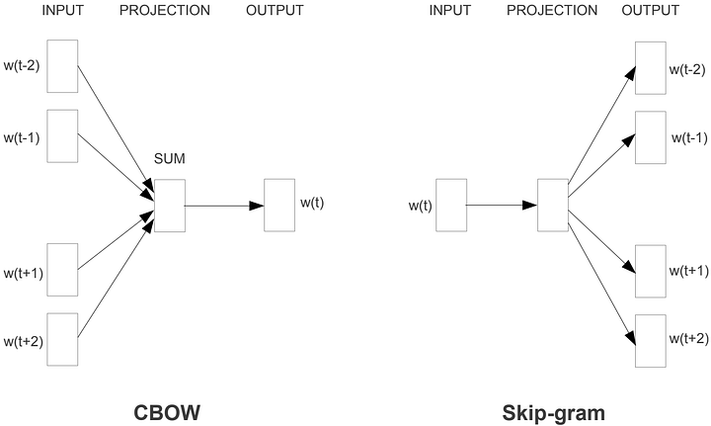
CBOW and Skipgram explained

Slide 6
Experimental Setup (give following details)
<CBOW>
Embedding dimension – 300
K – 300
no. of iterations – 10
learning rate – 0.01
<Skipgram>
Embedding dimension –300
K – 300
no. of iterations – 10
learning rate – 0.01

Slide 7
Backpropagation
<Implementation details: layers, neurons per layer>
CBOW
Input – size(1,V) i.e. mean of 4 vectors each of size(1,V)
Hidden Layer – 300 neurons
Output – size(1,V)
<ab initio implementation; will see the code>
<what is the context size> - 2 (window size = 5)

Slide 8
Results
<Give accuracy figures on Validation data already provided>
<There is only one kind of test: A:B :: C:___> fill in the 4th entity

Slide 9
Analysis
<What was right and what went wrong>
Did not implement batches earlier, very long training time
Running out of memory after implementing batching
<Compare CBOW & Skip Gram>
The CBOW model aims to predict the current word based on the context words surrounding it, whereas the skip-gram model predicts the context words based on the current word.
CBOW learns a vector representation of the target word by summing up the vectors of the context words, whereas the skip-gram model learns the vector representation of the context words by summing up the vectors of the target word.
Skip-gram model training time is slower than CBOW because it generates more training samples.

Slide 10
Progress made after eval-1
We experienced extremely long training durations so to speed it up, we shifted to Pytorch from numpy
Training time decreased from round 4 hours/epoch to 1 hour/epoch.
We also batched the input words to 200 word/context pairs per batch. Modified backpropagation equations to support batching.
Fixed bugs in backpropagating softmax derivatives.
Problem : RAM is crashing on google colab, we are still working to understand why.

Slide 11
Demo
<on notebook, show>
<remain ready; no hurry scurry during the evaluation>
<should take evaluators examples>

Slide 12
Marking (max 100)
Data pre-processing: 10 (no pre-processing 0)
Scraping: 20 (respectable size and good scraping strategy full marks)
Good implementation of BP: 20
Accuracy: >90: 20 marks; >70-90: 10 marks; >50-70: 5 marks; else 0
Analysis: 10 marks
Comparison of CBOW and Skip Gram: 10 marks
Demo: 10 marks
Topper of leader board: 5 marks bonus

