Slide 1
Assignment-Discussion POS tagging using (a) EnCo-DeCo, (b) FFNN-BP
Sumit Jain, 190050119
Akshay Iyer, 190070006
Adit Akarsh, 19D070003
Prateek Neema, 20D070061
…

Slide 2
Problem Statement: part 1
Given a sequence of words, produce the POS tag sequence
Technique to be used: Encoder-decoder (use standard word vectors); anything other than transformer
Use Universal Tag Set (12 in number); <list the tags>
ADJ, ADP, ADV, CONJ, DET, NOUN, NUM, PRT, PRON, VERB, . (punctuation) , X
5-fold cross validation

Slide 3
Problem Statement: part 2
Given a sequence of words, produce the POS tag sequence
Technique to be used: word2vec vectors, FFNN and BP (use libraries)
Use Universal Tag Set (12 in number); <list the tags>
ADJ, ADP, ADV, CONJ, DET, NOUN, NUM, PRT, PRON, VERB, . (punctuation) , X
5-fold cross validation
Compare with EnCoder-DeCoder

Slide 4
Working with Data
Preprocessing - since we are working with semantic enriched words, we do not need to lemmatize. Also lowering the string might also harm pos tagging task, nouns are efficiently discovered if they are capitalized
Vocabulary size = ~50k

Slide 5
POS Tagging
Task of assigning parts of speech to each word in the input sentence. This is a syntactic labelling task and we are using rich embeddings derived from gensim (300 dimensional) with 3 types of architectures - FFNN, Encoder only and Encoder-Decoder.

Slide 6
Experimental Setup (give details)
Platform and library used
Python Jupyter Notebook, Pytorch (Stochastic Gradient Descent with momentum), sklearn
Embedding dimension: 300
No. of epochs: 10
Learning rate: 1e-3
Momentum: 0.9
(same across all techniques to correctly compare the techniques)

Slide 7
Overall performance for FFNN
Precision 0.370
Recall 0.460
F-score (3 values)
F1-score 0.373
F0.5-score 0.367
F2-score 0.406

Slide 8
Per POS performance for FFNN
​ | Encoder-Decoder ​ |  |  | Encoder​ |  |  | Feed Forward​
Tag​ | P​ | R​ | F1​ | P​ | R​ | F1​ | P​ | R​ | F1​
VERB​ |  |  |  |  |  |  | 0.36 | 0.60​ | 0.45
NOUN​ |  |  |  |  |  |  | 0.98 | 0.99​ | 0.98​
PRON​ |  |  |  |  |  |  | 0.0 | 0.0​ | 0.0
ADJ​ |  |  |  |  |  |  | 0.0 | 0.0​ | 0.0
ADV​ |  |  |  |  |  |  | 0.0 | 0.0​ | 0.0
ADP​ |  |  |  |  |  |  | 0.26​ | 0.51​ | 0.35​
CONJ​ |  |  |  |  |  |  | 0.0 | 0.0​ | 0.0
DET​ |  |  |  |  |  |  | 0.32 | 0.57 | 0.41
NUM​ |  |  |  |  |  |  | 0.0 | 0.0​ | 0.0
PRT​ |  |  |  |  |  |  | 0.0 | 0.0​ | 0.0
X​ |  |  |  |  |  |  | 0.0 | 0.0​ | 0.0
.​ |  |  |  |  |  |  | 0.0 | 0.0​ | 0.0

Slide 9
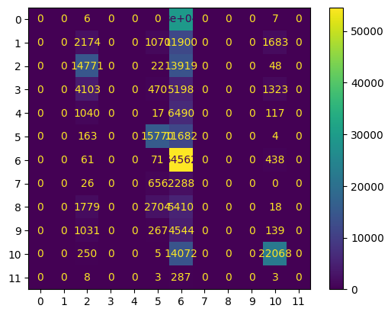
Confusion Matrix (12 X 12) (can give heat map) (Comparison between EnCo-DeCo and FFNN-BP)
Confusion Matrix for FFNN

Slide 10
Interpretation of confusion (error analysis)
Currently the models are labelling most of the words as Nouns as they are overarchingly present in huge numbers in the dataset.
FFNN is not performing well as it is limited in its context (we feed the following and previous word along with the current word to predict the pos tag

Slide 11
Inferencing/Decoding Info
We use standard word tokenizer from nltk and dont lemmatize and lower case based on previous reasons.

Slide 12
Marking Scheme
1. Demo working- 8/8 + 7/7; two problems (if not, 0)
2. Implemented EnCo-DeCo and Clarity on the approach- 5/5
3. Implemented FFNN-BP and Clarity on the approach- 5/5
4. Confusion matrix drawn and error analysed- 5/5 + 5/5 (both approaches)
5. Overall F-score > 90- 10/10, >80 & <=90- 8/10, else 6/10
6. Unknown word handling- done (5/5; else 0)

