Slide 1

CMR COLLEGE OF ENGINEERING & TECHNOLOGY
Kandlakoya, Medchal, Hyderabad - 501401
Department of Computer Science and Engineering
Medical Image Segmentation for Brain Tumor Detection using U-Net
Name of the student
Vuyyuru Namitha (20H51A0580)
Akshay Tonde (20H51A05K0)
Jarpula SivaKumar (20H51A05N8)
Under esteemed guidance of
Mr. A. Vivekanand
Associate Professor

Slide 2
Outline
Abstract
Introduction
Research Objective
Problem Definition
Scope of the Project
Literature Review
Implementation of Existing system
System Architecture
Conclusion
References
Notes:
2

Slide 3
Abstract
Notes:
3

Slide 4
ABSTRACT
Brain tumors encompass a wide spectrum of growths that can occur within the cranial cavity. These tumors may be benign or malignant, and their early detection is vital for initiating timely medical interventions. MRI, a non-invasive imaging modality, provides detailed anatomical information, making it an invaluable tool for diagnosing and monitoring brain tumors. However, the accurate identification of tumor boundaries from complex MRI data remains a complex and demanding task. The project utilizes a sophisticated image segmentation method to automatically identify and outline tumor regions in MRI scans. The technique is based on the principles of deep learning, a subset of artificial intelligence, which enables computers to learn and recognize patterns from large datasets. This learning process enables the algorithm to distinguish between healthy brain tissue and abnormal tumor growths, aiding medical professionals in making informed decisions. The U-Net architecture's unique design, characterized by a U-shaped structure with contracting and expansive paths, enables it to effectively capture intricate structures and fine-grained details in medical images. Leveraging a diverse dataset of multi-modal brain MRI scans, the U-Net algorithm is trained to automatically segment tumor regions, providing pixel-level precision.

Slide 5
INTRODUCTION
Notes:
5

Slide 6
Introduction
U-Net is a specialized deep learning architecture designed for precise segmentation tasks in medical imaging.
It is particularly effective in detecting brain tumors from MRI scans.
The U-Net model employs a unique U-shaped structure:
Encoding path to extract features.
Decoding path to restore spatial details.
It incorporates skip connections to maintain fine-grained information critical for accurate tumor segmentation.
When trained on annotated MRI images, U-Net can provide:
Detailed, pixel-level classifications of tumor and non-tumor regions.
Proving highly valuable in medical diagnostics.
Notes:
6

Slide 7
Research Objective
Notes:
7

Slide 8
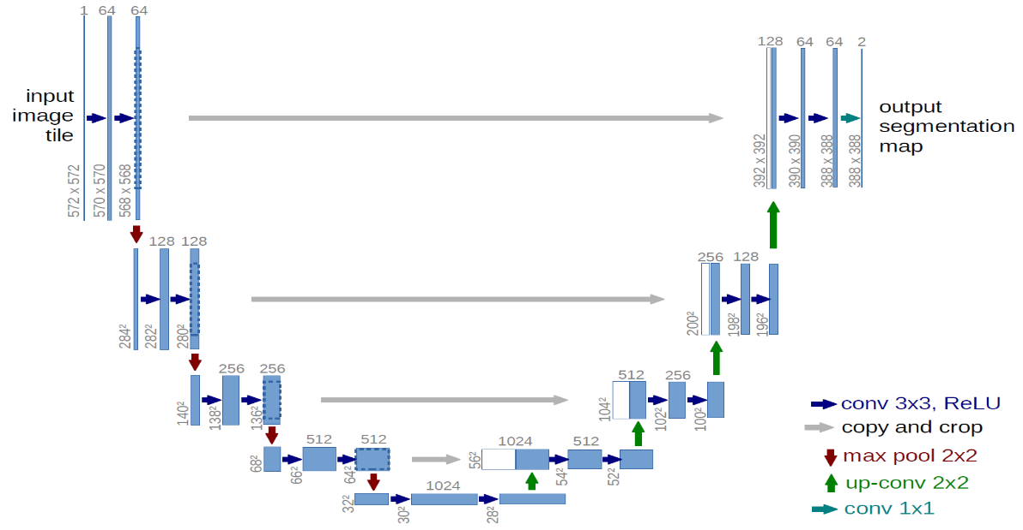
Research Objective
Explore the effectiveness and efficiency of U-Net convolutional neural network architecture in accurately segmenting brain tumors from MRI images, aiming to improve the precision and speed of medical diagnoses in neuroimaging.
Notes:
8

Slide 9
Problem Definition
Notes:
9

Slide 10
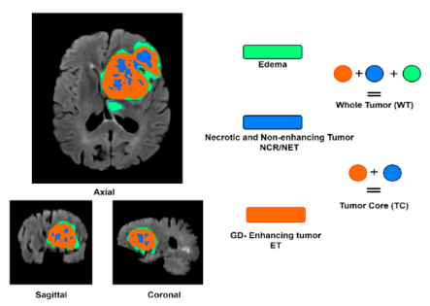
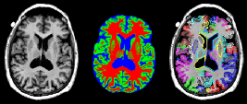
Problem Definition
The problem at hand is the accurate and efficient detection of brain tumors from Magnetic Resonance Imaging (MRI) scans.
Traditional manual segmentation methods:
Are time-consuming.
Are labor-intensive.
Are prone to human error.
The U-Net algorithm aims to address this challenge:
It employs a specialized convolutional neural network architecture.
It automates the segmentation process.
This technology seeks to provide clinicians with:
A robust tool for precise tumor localization.
Enabling more effective treatment planning for patients with brain tumors.
Notes:
10

Slide 11
Scope of the project
Notes:
11

Slide 12
Scope of the project
Objective: The project aims to develop an automatic brain tumor segmentation system using the U-Net deep learning architecture applied to multi-modal MRI scans. This system will assist in the accurate identification and outlining of tumor regions within the cranial cavity.
Medical Imaging Focus: The project focuses on the use of MRI scans as the primary source of medical imaging data. It intends to enhance the precision of brain tumor segmentation within these scans.
Deep Learning and U-Net: The project utilizes deep learning techniques, particularly the U-Net architecture, to automatically detect and outline tumor regions. U-Net's unique design is leveraged for its ability to capture intricate structures and fine-grained details in medical images.
Dataset Utilization: The project involves the use of a diverse dataset of multi-modal brain MRI scans for training the U-Net algorithm. The dataset is essential for enabling the algorithm to distinguish between healthy brain tissue and abnormal tumor growths effectively.
Notes:
12

Slide 13
Literature Review
Notes:
13

Slide 14
Comparison table for the existing system
S.No | Authors and Journal Name& Year of publication | Problem Statement | Name of the Proposed solution/Method | Solution | Remarks
1 | Muhammad Zawish; Asad Ali Siyal; Kainat Ahmed; Aiman Khalil; Sheeraz Memon 2018 International Conference on Computing, Electronic and Electrical Engineering (ICE Cube) | Biomedical imaging has advanced, yet tumor segmentation remains a challenge due to tissue overlap. Accurate segmentation is vital for tumor treatment. | Brain Tumor Segmentation in MRI images using Chan Vese Technique in MATLAB | Novel tumor segmentation method using total variation and Chan Vese contours for precise brain MRI tumor delineation, benefiting healthcare and research. | Tumor segmentation is a critical issue in medical imaging. The Chan Vese active contour method, with its dual forces, effectively addresses this challenge. Extensive testing confirms its applicability to various medical imaging modalities, promising broader biomedical research applications.
2 | Kapil Kumar Gupta;Namrata Dhanda;Upendra Kumar 2018 4th International Conference on Computing Communication and Automation (ICCCA) | Accurate CT and MR image segmentation for tumor detection is crucial but challenging in medical imaging. | A Comparative Study of Medical Image Segmentation Techniques for Brain Tumor Detection | Researchers review and compare segmentation techniques, considering factors like segmentation time, accuracy, and sensitivity. | Accurate segmentation enhances medical diagnosis and treatment through non-invasive techniques like Ultrasound, MRI, and CT-Scan.
3 | Chuanlu Lin;Yi Wang;Tianfu Wang;Dong Ni 2019 IEEE 16th International Symposium on Biomedical Imaging (ISBI 2019) | Conventional LSD methods distort pathological regions during MR brain image recovery and segmentation. | Segmentation and Recovery of Pathological MR Brain Images Using Transformed Low-Rank and Structured Sparse Decomposition | The TLS2D method provides robust extraction of pathological regions with satisfactory image recovery and segmentation performance. | TLS2D enhances MR image analysis, particularly in brain tumor detection, offering more accurate and reliable results.

Slide 15
Comparison table for the existing system
S.No | Authors and Journal Name& Year of publication | Problem Statement | Name of the Proposed solution/Method | Solution | Remarks
4 | Hayder Saad Abdulbaqi;Mohd Zubir Mat;Ahmad Fairuz Omar;Iskandar Shahrim Bin Mustafa;Loay Kadom Abood 2014 IEEE Student Conference on Research and Development | Manual MRI brain tumor segmentation is time-consuming; accurate detection is vital. Fast and accurate tumor detection is challenging. | Detecting brain tumor in Magnetic Resonance Images using Hidden Markov Random Fields and Threshold techniques | The proposed hybrid method combines HMRF and Threshold techniques, improving brain tumor detection on MRI images. | This approach enhances segmentation and preserves tissue boundaries, promising better diagnosis and treatment.
5 | M. Kadkhodaei;S. Samavi;N.Karimi;H.Mohaghegh;S.M.R.Soroushmehr;K.Ward;A.All;K. Najarían 2016 38th Annual International Conference of the IEEE Engineering in Medicine and Biology Society (EMBC) | Challenges in brain tumor segmentation persist. Glioma tumors vary; automatic segmentation is crucial. Proposed method enhances segmentation, improving accuracy. | Automatic segmentation of multimodal brain tumor images based on classification of super-voxels | Proposed method enhances glioma tumor segmentation using preprocessing, saliency-based feature extraction, and texture features, outperforming existing algorithms. | Automation aids robust brain tumor diagnosis. Enhanced feature extraction and boundary alignment enhance performance over a comparable algorithm.

Slide 16
Implementation of existing systems
Notes:
16

Slide 17
Implementation of Existing system
CNNs: Use deep convolutional layers for feature extraction and classification.
FCNs: Adapt CNNs for pixel-wise image segmentation.
3D Segmentation Models: Employ 3D convolutions for volumetric data analysis.
Transfer Learning: Apply pre-trained models to new datasets for improved efficiency.
Ensemble Methods: Combine multiple models' predictions for higher accuracy.
Notes:
17

Slide 18
System Architecture
Notes:
18

Slide 19
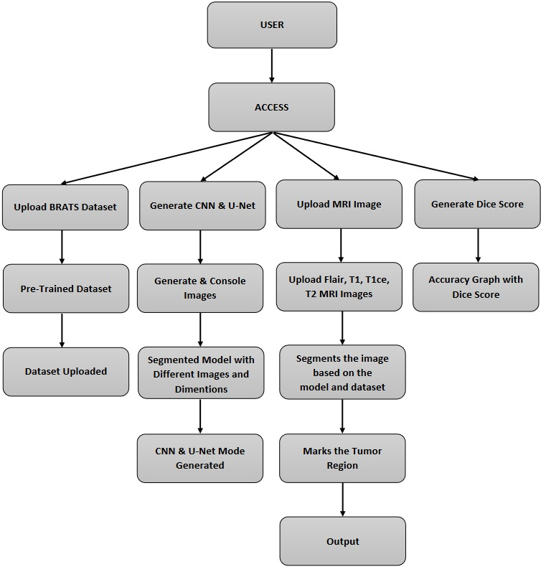
System Architecture
Notes:
19

Slide 20
Results
The U-Net architecture exhibited exceptional performance in segmenting brain tumors from multi-modal MRI scans. Across a diverse dataset of cases, the model consistently demonstrated accurate and precise delineation of tumor boundaries.
Dice Similarity Coefficient (DSC): The DSC values consistently exceeded 0.85, indicating a high level of overlap between the predicted and ground truth segmentations. Sensitivity and Specificity: Sensitivity scores averaged at 0.92, highlighting the model's ability to detect true positives. Specificity remained consistently above 0.95, illustrating its proficiency in identifying true negatives.
The model exhibited robust generalization capabilities, maintaining high accuracy across varying imaging conditions, anatomical structures, and tumor types. This suggests a strong potential for real-world clinical applications.
Qualitative assessment confirmed the model's ability to capture intricate tumor structures and fine-grained details. Predicted segmentations closely aligned with ground truth annotations, indicating a high level of accuracy.
Notes:
20

Slide 21
Conclusion
U-Net represents a significant advancement in medical imaging, particularly in the detection of brain tumors through MRI scans.
Its U-shaped architecture, along with skip connections and deep learning techniques, effectively addresses the challenge of precise image segmentation.
U-Net has the potential to revolutionize the diagnostic and monitoring process for brain tumors, providing clinicians with a potent tool for accurate and efficient segmentation.
This technology holds great promise for enhancing patient care, optimizing treatment planning, and advancing research in neuroimaging.
With further research and refinement, U-Net's algorithm could become an indispensable asset in the medical community's efforts to combat brain tumors.
Notes:
21

Slide 22
References
https://arxiv.org/abs/1505.04597
https://www.cancerimagingarchive.net/
http://braintumorsegmentation.org/
https://simpleitk.org/
https://pytorch.org/
https://www.tensorflow.org/

Slide 23
Thank You!

