Slide 1
RESTAURANTS
IN
TORONTO

Slide 2
Determining a good location is important.
For a restaurant to be successful it should get more customers.
A good location plays an important role in getting more customers.

Slide 3
Data Acquisition
Data about the Toronto city borough was acquired from a Wikipedia page.
Data about the restaurant names and their locations was acquired through the Foursquare website

Slide 4
Data Cleansing
Data from Wikipedia page was inconsistent which was made cleansed and used.
Data from Foursquare website contained lots of irrelevant data which was dropped.

Slide 5
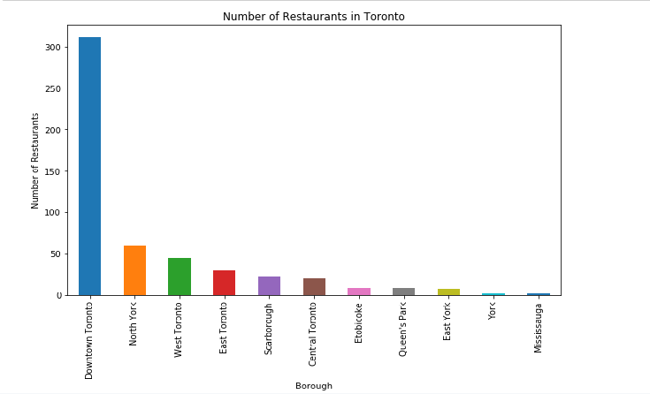
Exploratory Analysis
The data was used to generate the following bar graph which shows that the highest number of restaurants is in Downtown Toronto.

Slide 6
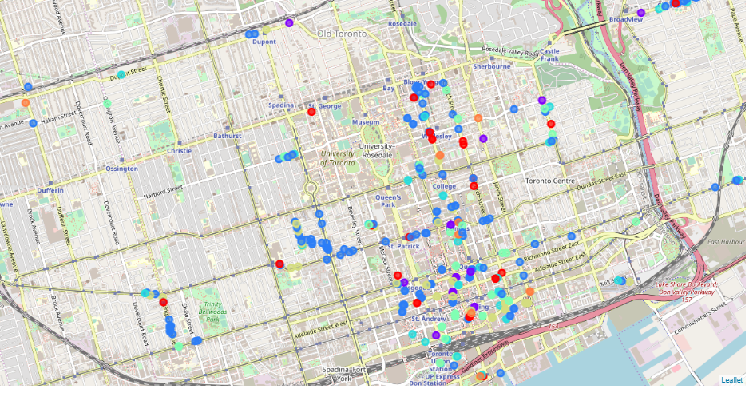
Modelling
K-Means model was used to cluster the restaurants into 7 different clusters showing how densely the restaurants are located.

Slide 7
Result
The result of this report is that to open a new restaurant in the city of Toronto the best location would be Downtown Toronto.

Slide 8
Conclusion
From this report we can conclude that we can find a good place for opening a restaurant by looking at the locations of the already existing restaurants in the city.

