Slide 1
INTRODUCTION
NAME-AKSHAY
BRANCH-CSE(AI&ML)
ROLL NO-227035
TOPIC NAME-RESTAURANT

Slide 2
INDEX
HOME
ABOUT
STORE
PAYMENT FORM

Slide 3
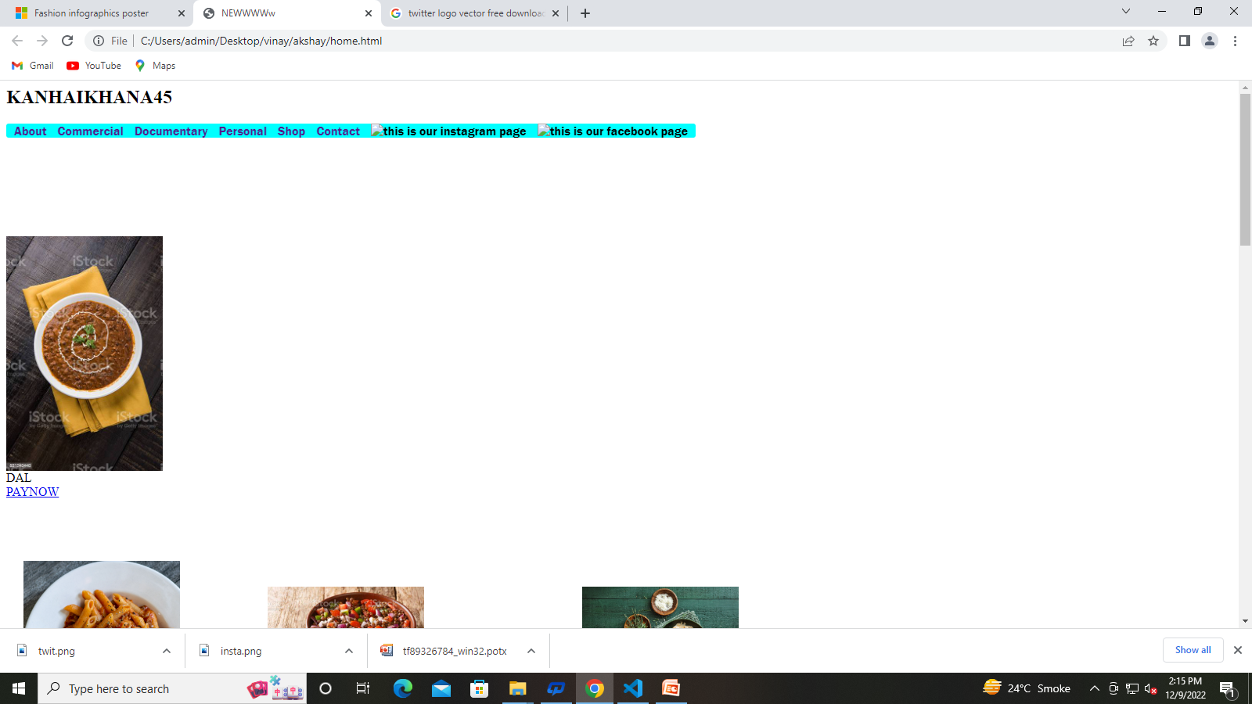

Slide 4
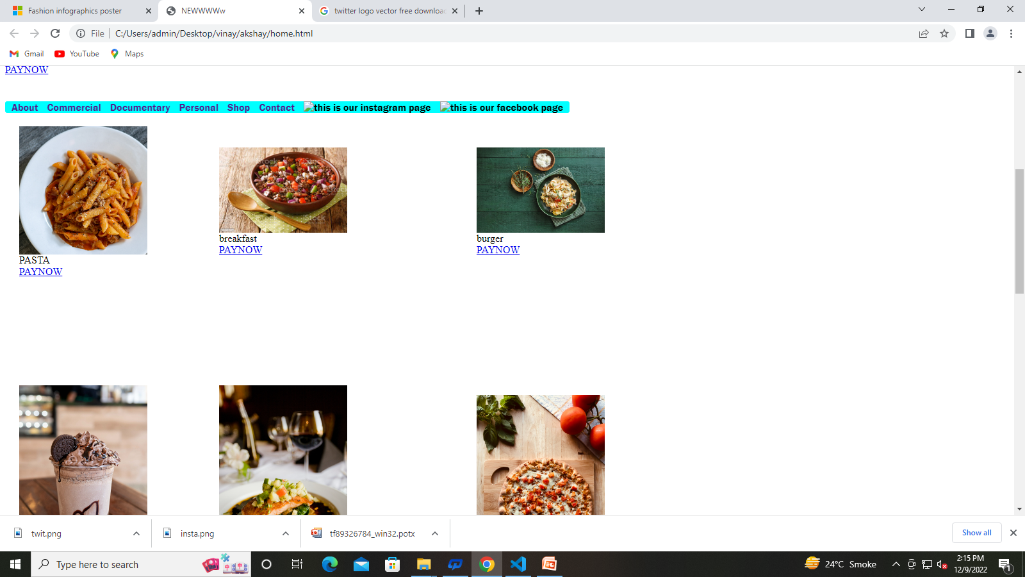

Slide 5
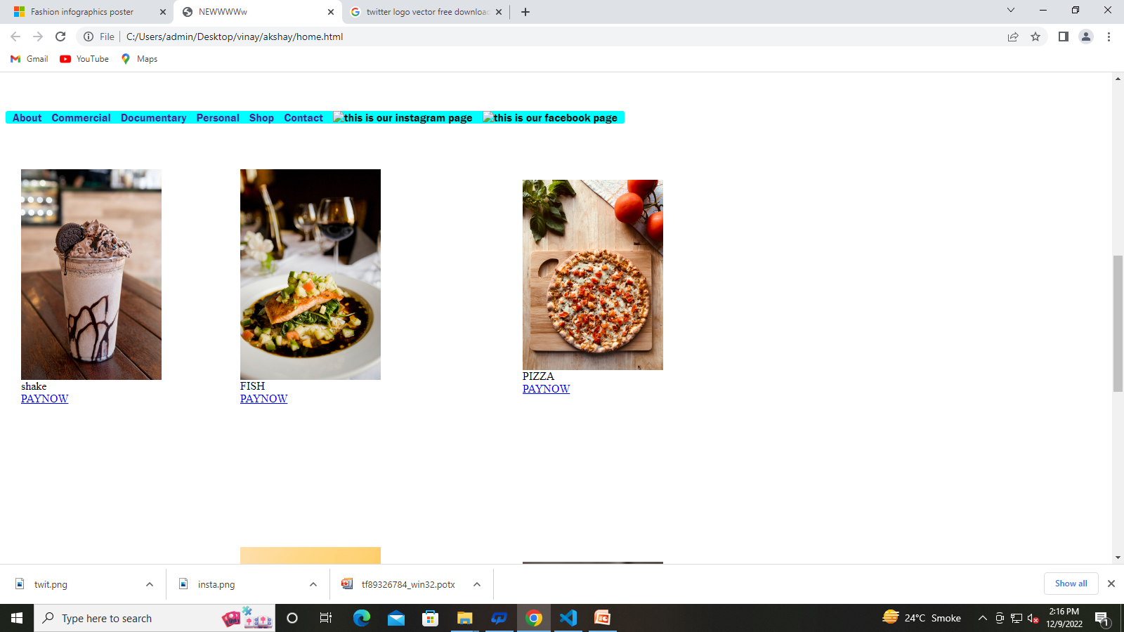

Slide 6
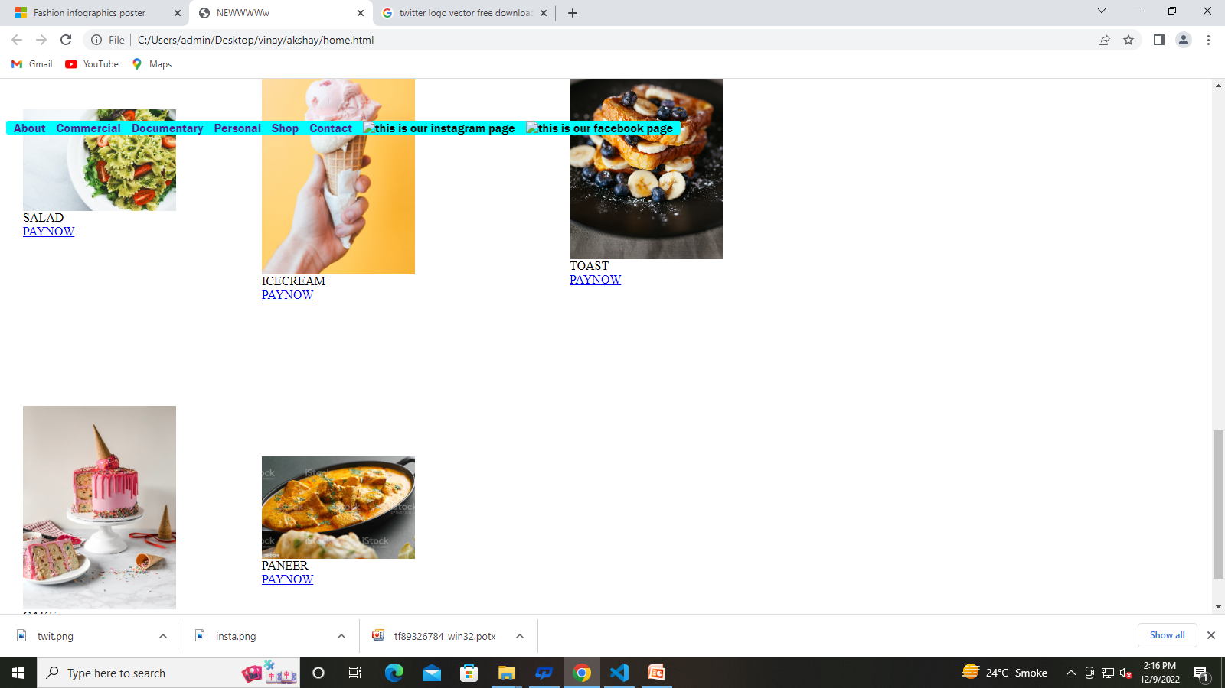

Slide 7
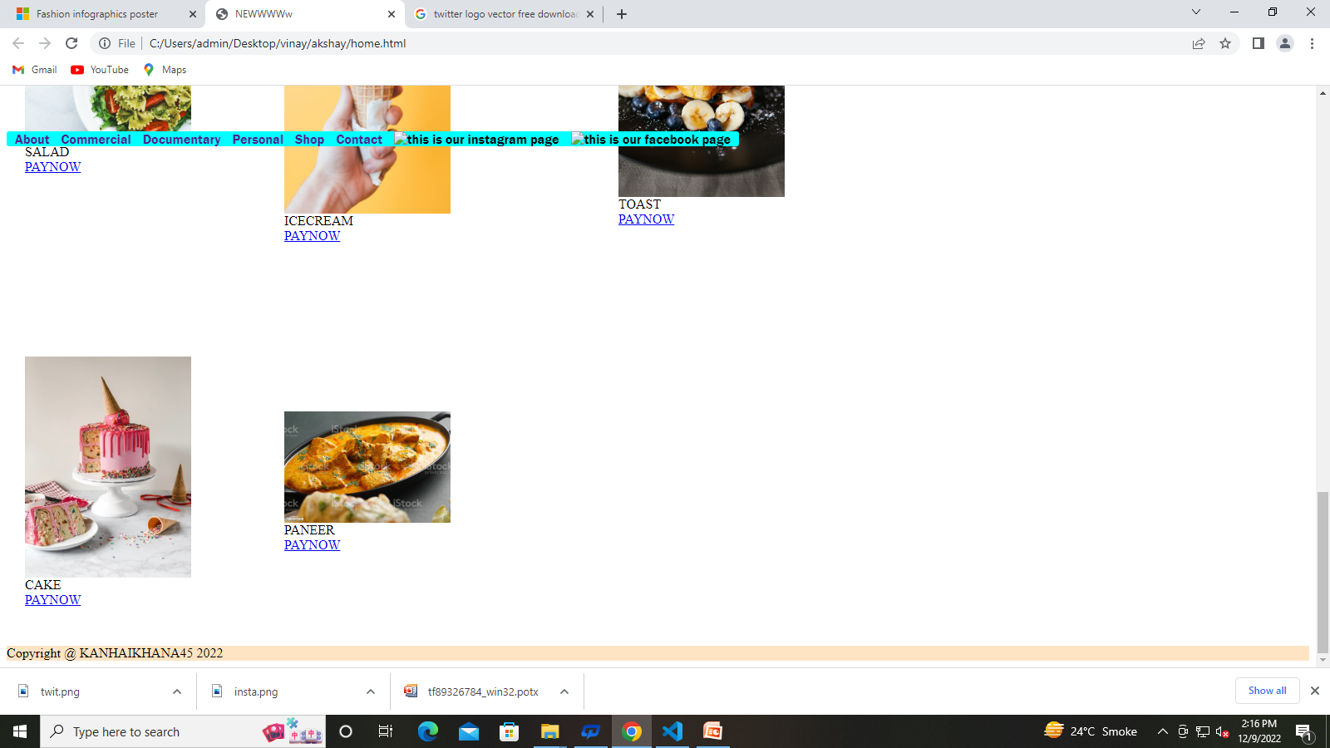

Slide 8
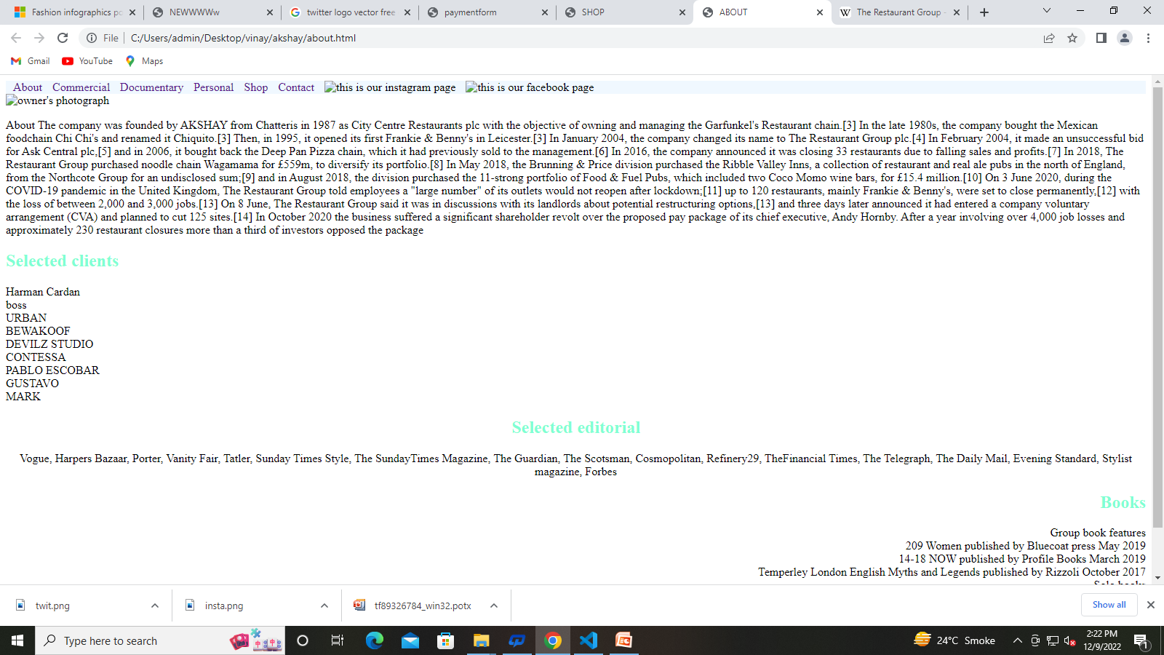

Slide 9
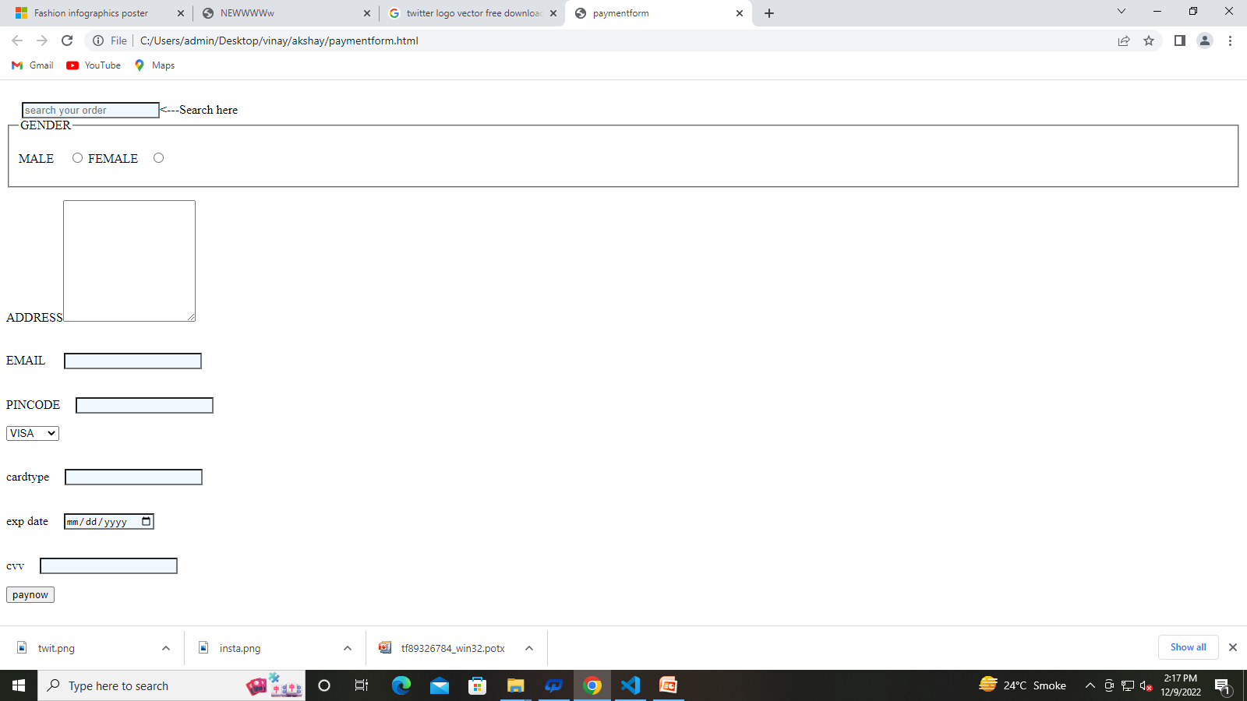

Slide 10
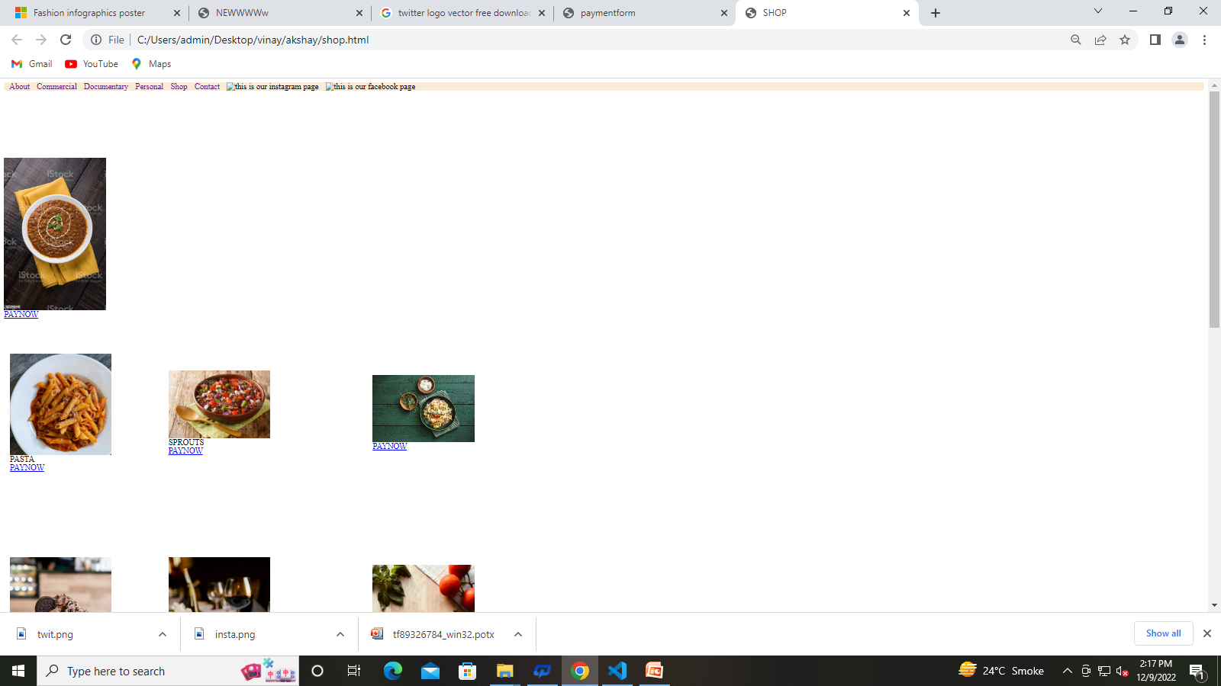

Slide 11
Acknowledgement
First of all I would like to show my heartiest gratitude to the GARVIT SIR who makes us
able to successful compilation of this WEBSITE. Then my gratitude goes to my friend
VINAY YADAV, Our honorable supervisor and lecturer in College of St.ANDREWS INSTITUE OF TECHNOLOGY& Management,
who always supported us to make this website appropriately and those
friends who gave me essential information to make this Business Plan.

Slide 12
REFERENCE
PHOTOFACTORY0707
CLASS NOTES

