Slide 1
FIL CFO Snowflake Reconciliation Framework
Design

Slide 2







Reconciliation Framework
E2E Architecture
Generic Merge transformation via Snowflake SPs UPSERT/DELETE
Oracle FDW
Oracle
GG
Stage
Snowflake FDW
Oracle Gateway to connect to the system
EC2
Connect through Snowflake Python Connector
Recon Box
Create Recon Profiles
Generate Dynamic SQL
Execute Profiles
Excel Output
Email Notification
Recon Logs
Profile Configurations in UTL_CFO schema
CloudWatch
Log Group

Slide 3









Snowflake – Low Level Architecture
Private Link (HTTPS)
extract data
Route53
HTTPS
VPC
Direct Connect
SMTP, Port 25 (Sending Emails with attachment)
extract data
FIL Mail Gateway
TLS
Logs (HTTPS)
Recon
EC2 Box
Oracle
(FDW Database)
Service Now
Tickets
Moogsoft Lambda
VPC Endpoint
Application Logs
Application Logs
Subscribe
Send Alert JSON
(HTTPS)
Moogsoft Portal
Alarm Metric
(Errors)
SNS (CMK Encrypted)
Private S3 bucket (Private Bucket Policy, encryption in transit, CMK encrypted)
CloudWatch
Logs
Notes:
Need to include more examples

Slide 4
Reconciliation Framework
A reconciliation framework will enhance various profiles to check data consistency. A profile consists different types of comparison methods. There are 4 types of profile:
Full Comparison - It compares an oracle table with a snowflake table.
Hash Comparison - It compares an oracle table with a snowflake table including an additional column comprising of concatenation of all columns to generate a SHA256 bit hashkey.
Aggregate Comparison - It compares an oracle table with a snowflake table based on row count , (sum, max and min) of number datatype columns , distinct count of each column , sum of length of varchar columns, sum of ascii value of first character of a varchar column and sum of date/timestamp datatype column.
Custom Comparison - It compares an an oracle table with a snowflake table based on custom sql queries entered by the user.
Full, Hash and Aggregate Profiles each have 4 subtypes to reconcile in different ways which include :
Full/Hash/Agg - To accept a full oracle table and snowflake table.
Full/Hash/Agg with Columns - To accept oracle table and snowflake table with the specific mentioned columns.
Full/Hash/Agg with Delta - To accept oracle table and snowflake table with the specific mentioned where clause.
Full/Hash/Agg with Columns and Delta - To accept oracle table and snowflake table with the specific mentioned columns and where clause.
Full, Hash and Custom Comparison Profiles have 2 additional required parameters : comparison key and count check.
comparison key : The user need to enter a primary key column which is present in both Source and Target tables.
count check : The user needs to enter a Y/N flag for count check parameter which validates if row count is to be taken into consideration during execution of the profile.
Profile View
FULL COMPARISON
HASH COMPARSION
AGGREGATE COMPARSION
CUSTOM COMPARSION
FULL
FULL HASH_KEY
FULL AGG
CUSTOM
FULL with COLUMNS
HASH KEY with COLUMNS
AGG with COLUMNS
FULL with DELTA
HASH KEY with DELTA
AGG with DELTA
FULL with COLUMNS & DELTA
HASH KEY with COLUMNS
& DELTA
AGG with COLUMNS
& DELTA

Slide 5
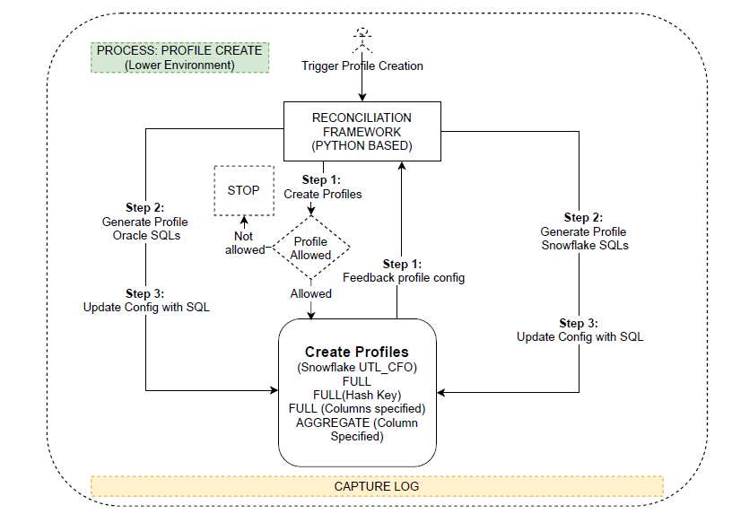
Reconciliation Framework
E2E Architecture – Create a Profile
Step 1:Once user initiates profile creation, step 1 is triggered to load RECON_PROFILE_CONFIG table. A profile is only allowed to be created if it’s marked as ‘allowed’ in table RECON_ALLOWED_PROFILE.
Step 2: Using the configuration provided, the create profile script will generate Oracle and Snowflake SQLs.
Step 3: The SQLs along with other profile detail will be updated in RECON_PROFILE_CONFIG
ASSUMPTIONS:
The ‘Create Profile’ process will run only in lower environments.
The process will generate INSERT statements for RECON_PROFILE_CONFIG which will be pushed to higher environments via Bitbucket.

Slide 6
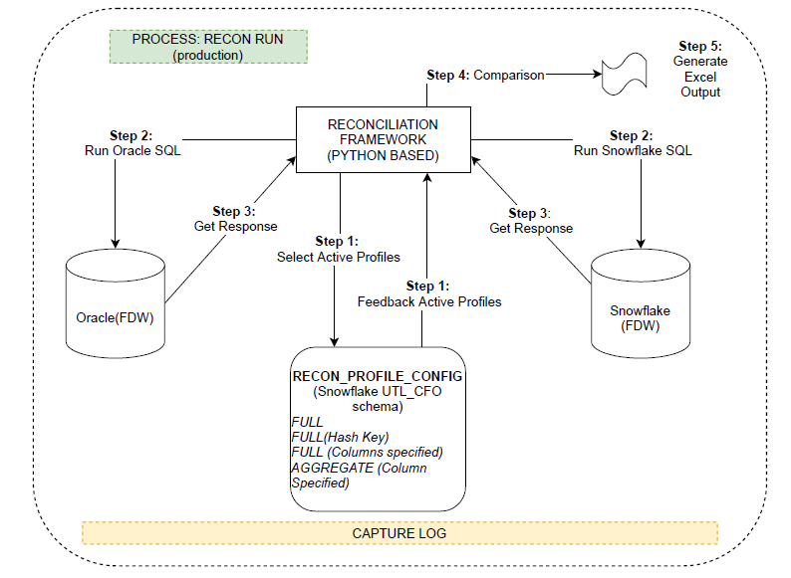
Reconciliation Framework
E2E Architecture – Execute a Profile
Step 1: The framework will trigger for a particular profile in RECON_PROFILE_CONFIG table.
Step 2: Respective profile will check if its active. In case of active profile, the respective SQLs in Oracle and Snowflake will be triggered.
Step 3: Response will be captured in the framework code and comparison will be triggered within the framework.
Step 4: Response from both Oracle and Snowflake will be compared.
Step 5: Comparison report will be generated and made available in Excel.

Slide 7
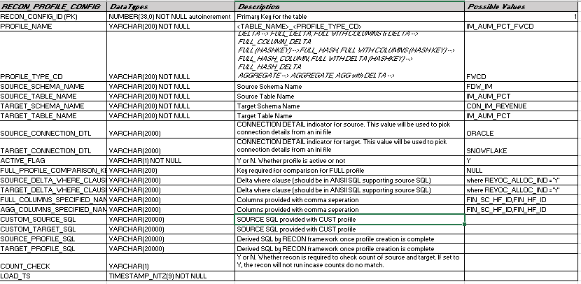
Reconciliation Framework
Audit and Config Tables – UTL_CFO
RECON_PROFILE_CONFIG
Table used to maintain active reconciliation profiles.
Profiles with Active Flag as ‘Y’ will be executed.
SOURCE_PROFILE_SQL and TARGET_PROFILE_SQL columns will contain the dynamic sql generated for the tables specified
PROFILE_TYPE_CD can have following possible values:
FULL, FULL_COLUMNS, FULL_DELTA, FULL_COLUMNS_DELTA
HASH_FULL, HASH_COLUMNS, HASH_DELTA, HASH_COLUMNS_DELTA
AGG, AGG_COLUMNS, AGG_DELTA, AGG_COLUMNS_DELTA
CUSTOM
Table Definition

Slide 8
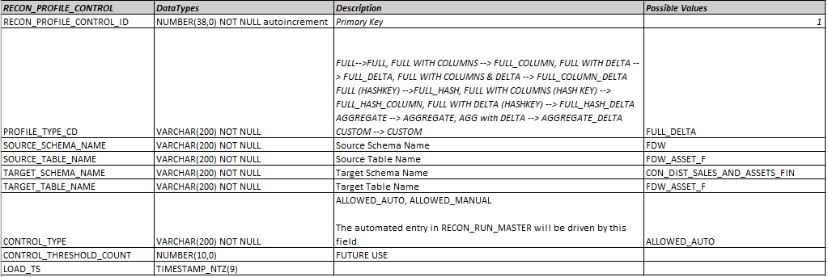
Reconciliation Framework
Audit and Config Tables – UTL_CFO
Table Definition
RECON_PROFILE_CONTROL
Table to maintain profile controls.
This will allow to control the profiles being created. For example, table FDW_ASSET_F will not be allowed the following profiles:
FULL
FULL_COLUMN
FULL_HASH
FULL_HASH_COLUMN
AGGREGATE

Slide 9
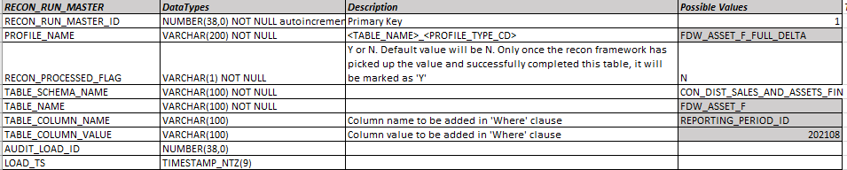
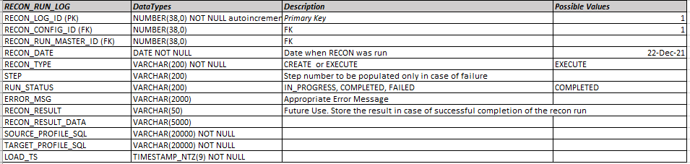
Reconciliation Framework
Audit and Config Tables – UTL_CFO
Table Definition
RECON_RUN_MASTER:
This table will be loaded post the following ingestion processes:
For regular tables: Post CONFORMED_INSERTION
For Truncate Partition: Post CONFORMED_TRUNC_PART
For Exchange Partition: Post CONFORMED_EXCH_PART
RECON_RUN_LOG
Table used to maintain recon execution run logs.
It will capture job run status at every step and post a valid response against the run.

Slide 10
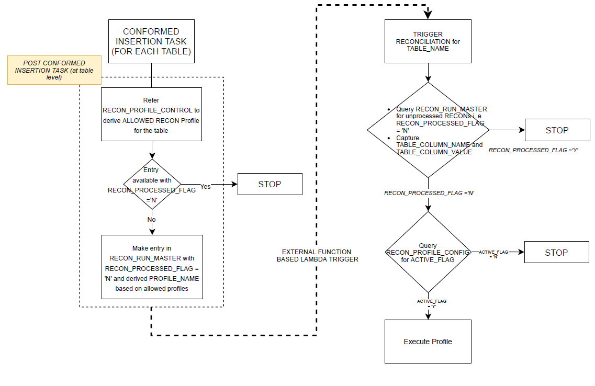
Reconciliation Framework
Run Options
Triggered via External Functions calling AWS lambda
RUN_RECON_MASTER will be loaded post the following processes for each table.
For regular tables: Post CONFORMED_INSERTION
For Truncate Partition: Post CONFORMED_TRUNC_PART
For Exchange Partition: Post CONFORMED_EXCH_PART
Once RUN_RECON_MASTER is populated a task with External Function to call AWS Lambda hosted Reconciliation Framework will be triggered
Refer RECON_PROFILE_CONTROL. Only CONTROL_TYP = ‘ALLOWED_AUTO’
Mark RECON_PROCESSED_FLAG = ‘Y’

Slide 11
Reconciliation Framework
Data Storage within the Framework
Data Storage within each run will be using the server memory. No physical files for extraction will be stored in the servers. Only reconciliation output in form of excels will be stored in S3 bucket.
We estimate up to 64GB RAM for processing close to 50 million records.
Size of EC2 instance used m4.2xlarge

Slide 12
Directory Structure
Data Storage within the Framework
Code Structures
File Lists
Error Codes
Lesson learnt
How to choose a Recon Profile
Large

Slide 13
Reconciliation Framework
Key Data Type Considerations
Certain date type considerations need to be handled within Snowflake and Oracle. This is specific to NUMBER and DATE datatypes
ORACLE
SNOWFLAKE
if source_datatype == 'DATE’ :
query = to_char(column_name,'YYYY-MM-DD’)
if source_datatype == ‘TIMESTAMP(6)’ :
query = to_char(column_name,'YYYY-MM-DD HH24:MI:SS’)
if source_datatype == ‘NUMBER’ and numeric_scale == 16 or 20:
query = trim(to_char({},'9999999999990.999999999999'))
if source_datatype in ('VARCHAR2','CHAR','NVARCHAR2','NCHAR'):
query = column_name
if target_datatype == 'DATE’ :
query = to_varchar(column_name,'YYYY-MM-DD’)
if target_datatype == ‘TIMESTAMP_NTZ’ or ‘TIMESTAMP_LTZ’ :
query =to_varchar(column_name,'YYYY-MM-DD HH24:MI:SS’)
if target_datatype == ‘NUMBER’:
query = column_name
if target_datatype == ‘TEXT’:
query = column_name

Slide 14
Reconciliation Framework
Output
Output details
Sample of Output data
S3 Storage
Cloud Details
Link to confluence Page - Error Codes and Desc
In roof this what it does (req) – what benefits it brings – what limitations it has / Known errors

Slide 15

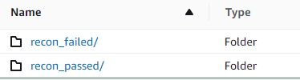
Reconciliation Framework
S3 Details
S3 (Simple Storage Service) buckets:
datalake-recon-bucket-dev
datalake-recon-bucket-sit
datalake-recon-bucket-uat

Slide 16
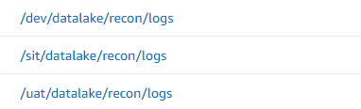
Reconciliation Framework
CloudWatch Details
CloudWatch (Monitoring Tool) Logs:
/dev/datalake/recon/logs
/sit/datalake/recon/logs
/uat/datalake/recon/logs

Slide 17
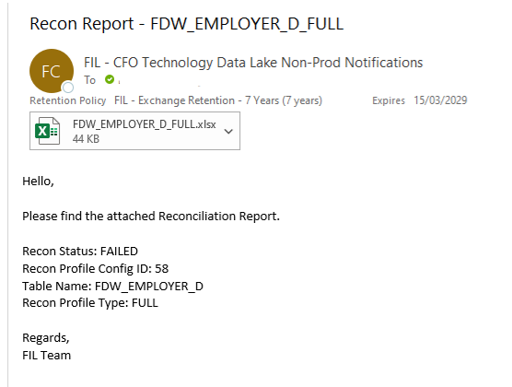
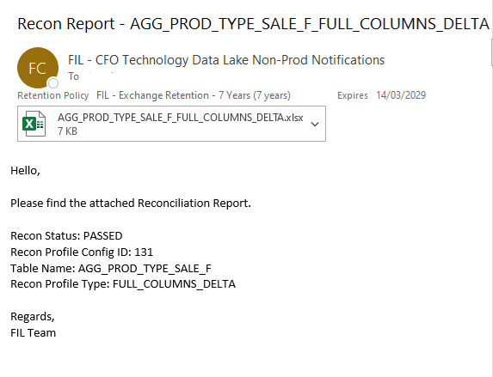
Reconciliation Framework
Sample Mail
RECON : FAILED
RECON : PASSED

Slide 18
Recon Demo

Slide 19
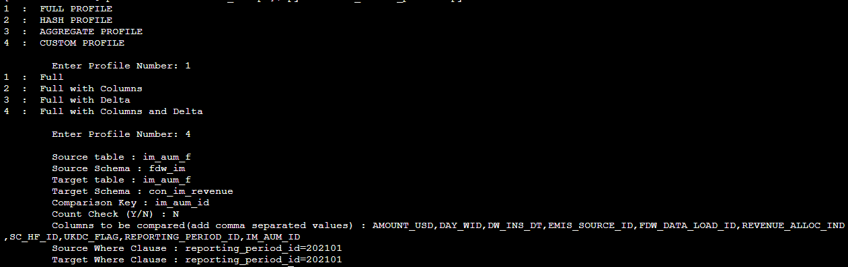
Reconciliation Framework
SOP – Create a Profile

Slide 20
Recon SOP

Slide 21
CFO Data Lake - Production Support SOP - RECON
Refer Confluence page
CFO Data Lake- Production Support SOP - RECON - Finance Management Data and Reporting space - Confluence (fid-intl.com)

Slide 22
Recon AWS Infrastructure

Slide 23
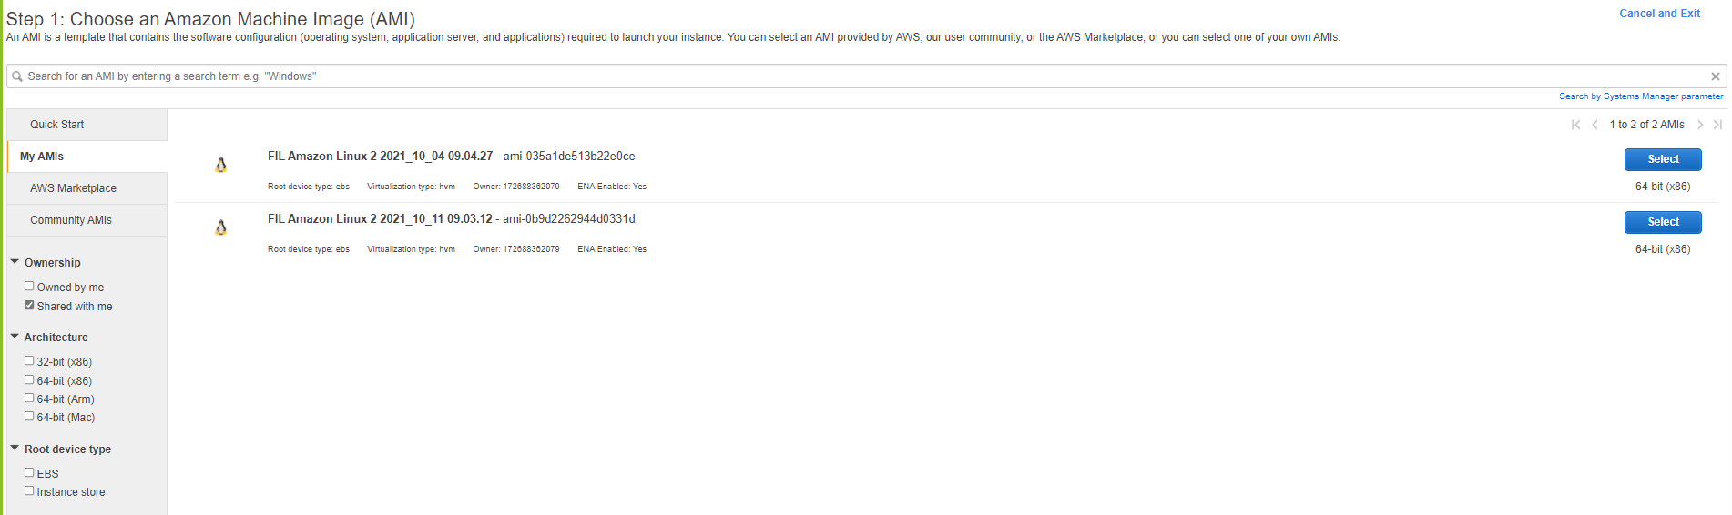
AMI Instance
Choose Shared AMI and Choose the latest one based on date and time

Slide 24
Instance Type
Choose m4.xlarge Instance Type – Instance type yet to be finalized based on the analysis of extracting the data from snowflake and oracle.
Choose existing VPS and Subnet - For HA - create more nodes
Choose Shutdown as Stop
Choose existing IAM Role or check with leads (ec2-ssm-role-dev)
Choose Hibernate behaviour only when needed

Slide 25
Userdata Script

Slide 26
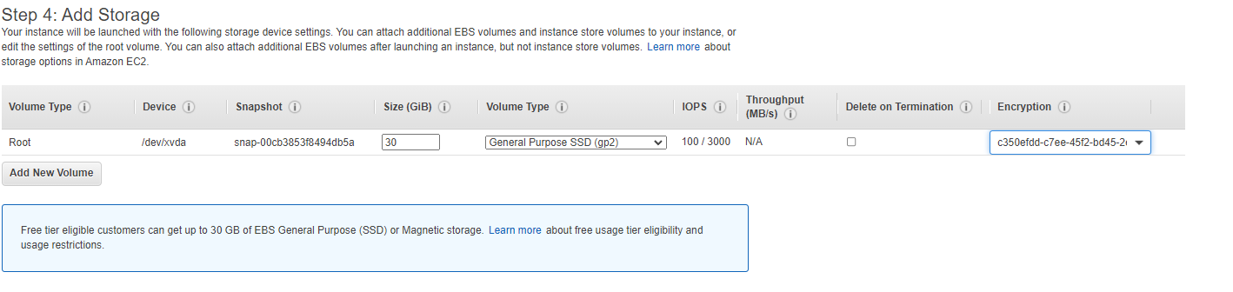
Add Storage
Add EBS Volume 30 GB GP2 if no idea and make it encrypted and disable delete on termination

Slide 27
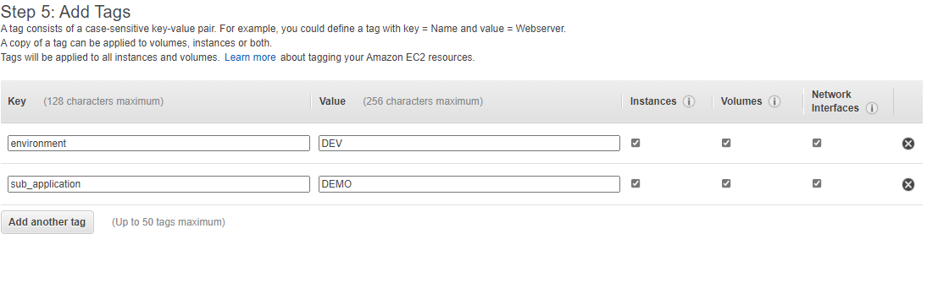
Add Basic Tags

Slide 28
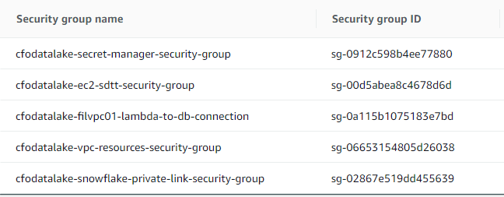
Required Security Group

Slide 29
Requirements
Python Libraries
snowflake-connector-python
cx-Oracle
pandas
configparser
rsa
Base64
Boto3
smtplib
( Note : libraries may be added as per requirements )

Slide 30
Bitbucket Installation in EC2
yum install git
Clone the bitbucket datalake repository

