Slide 1
FIL Snowflake Reconciliation Framework
Design

Slide 2








Secret Manager E2E Architecture
Private Link (HTTPS)
extract data
Route53
HTTPS
VPC
Direct Connect
extract data
TLS
Source
(FDW Database)
Fargate cluster with ECS
Secret Manager
VPC Endpoint
Notes:
Need to include more examples

Slide 3
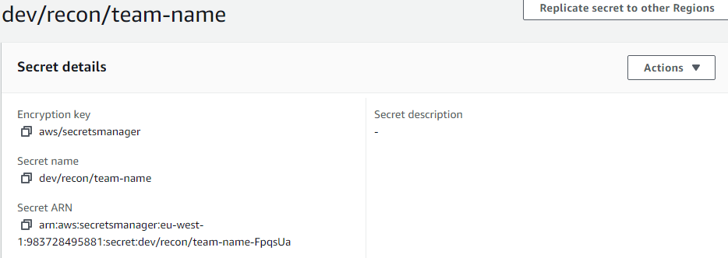
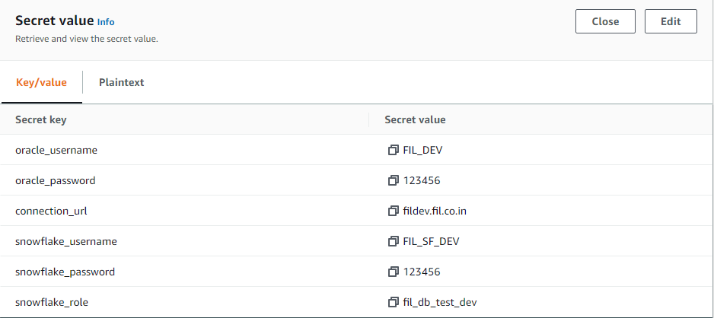
AWS Secret Manager Overview
Notes:
Need to include more examples

Slide 4

Secret Manager Low Level Architecture
Python connects to Snowflake using connection details fetched from secret manager
Private Link (HTTPS)
extract data
Route53
HTTPS
Direct Connect
extract data
Python script to extract key-value pairs as a json object from secret key using Secret ARN ID
TLS
Fargate cluster with ECS
Source
(FDW Database)
Python connects to source DB using connection details fetched from secret manager
Secret Manager
Notes:
Need to include more examples

Slide 5
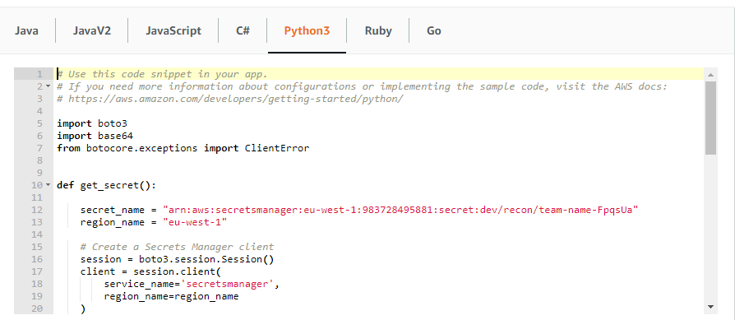
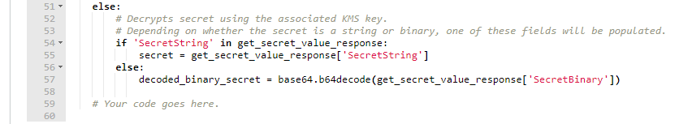
AWS Secret Manager Python Script
Notes:
Need to include more examples

