Slide 1
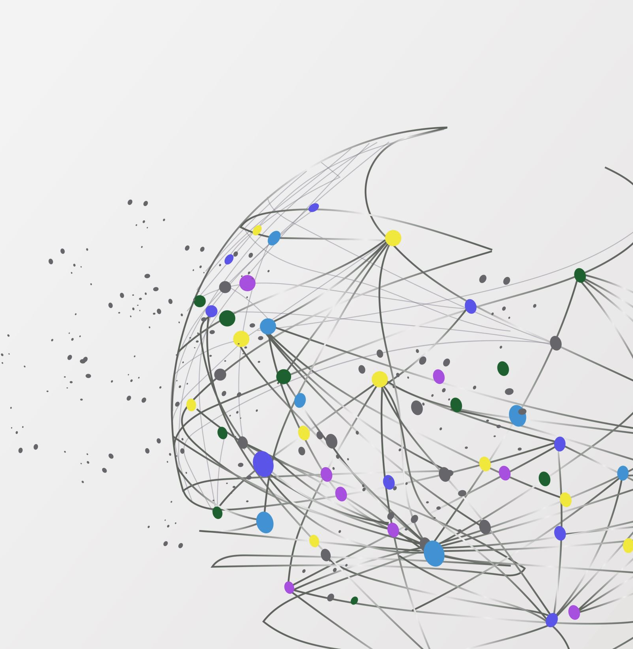
Banking ChatBOT
Student ID
100941430
100943058
100880026
100946767
100943365

Slide 2

How AI Chatbots are Transforming the Banking Industry: Exploring the Power of Chatbots
Our project aims to develop a banking chatbot that will enhance customer service and streamline banking operations.
This chatbot will be designed to assist customers with various banking inquiries, such as checking account balances, transferring funds, paying bills, and providing general information about banking products and services. We will also incorporate natural language processing (NLP) and machine learning techniques to ensure the chatbot can understand and respond to customer queries effectively.

Slide 3

Project Functionalities
Channels – The chatbot will be on a website and be integrated with Telegram
Languages – One language for now , expansion would be based on demand
Chatbot tone – Very friendly and warm
KPI metric – Feedback at the end of the conversation
Hosting – Microsoft Azure

Slide 4

Project Stages
Choose a Platform
1
Design Your Chatbot
2
Data and APIs
3
Design the Conversation Flow
4
Natural Language Processing (NLP)
5
Integration
6
Testing
7
User Experience
8
Deployment
9
Continuous Improvement
10

Slide 5
Project Stages
Choose a Platform
Microsoft Bot Framework, which offer user-friendly interfaces and good documentation.
Design Your Chatbot
Create the conversation flow for your chatbot. Define the intents (user queries) and responses (bot replies) for basic banking tasks like balance inquiries or bill payments.
Data and APIs
Ensure you have access to banking data and APIs to retrieve customer information, account details, and transaction history securely.
Design the Conversation Flow
Create a well-structured conversation flow that guides users through common banking tasks. Start with simple queries and gradually add complexity.
Natural Language Processing (NLP)
Configure the chatbot to use natural language processing (NLP) to understand user queries and provide relevant responses.
Integration
Integrate your chatbot with your banking systems and databases securely to provide real-time information.
Testing
Thoroughly test the chatbot to ensure it handles various scenarios and user inputs gracefully. Consider beta testing with actual users for feedback.
User Experience
Focus on making the bot user-friendly, with clear instructions and options for users to get help or speak to a human agent when needed.
Deployment
Deploy your chatbot to a platform of your choice. Many chatbot platforms offer integration with messaging apps like Facebook Messenger or websites.
Continuous Improvement
Based on user feedback and analytics, refine and expand your chatbot's capabilities over time.

Slide 6
Project Features
Account Balance Inquiry
Customer Support
Branch Locator and Hours
Credit Score Checker
Exchange Rate

Slide 7
Application
Frontend
Database
Backend
Telegram
HTML/CSS
JS
MySQL
Python
Microsoft Azure
LUIS (NLP)

Slide 8
Frontend functionality and technology
Telegram (integrated)
HTML/CSS
JS

Slide 9
Backend functionality
Python
Microsoft Azure
LUIS (NLP)

Slide 10
Database
Mysql
Kaggle (datasets)

Slide 11
Thank You

