Slide 1

Indian Institute Of Technology Bombay
A Presentation on
“ 3D-SCANNER”
Under the guidance of Prof. D.B. Phatak
Project Mentor:
Mr. Akshay Chipkar
Team members:
Soumya Sambit Rath
Anchal Singh Panwar
Sagar Satapathy
Animesh Srivastav

Slide 2
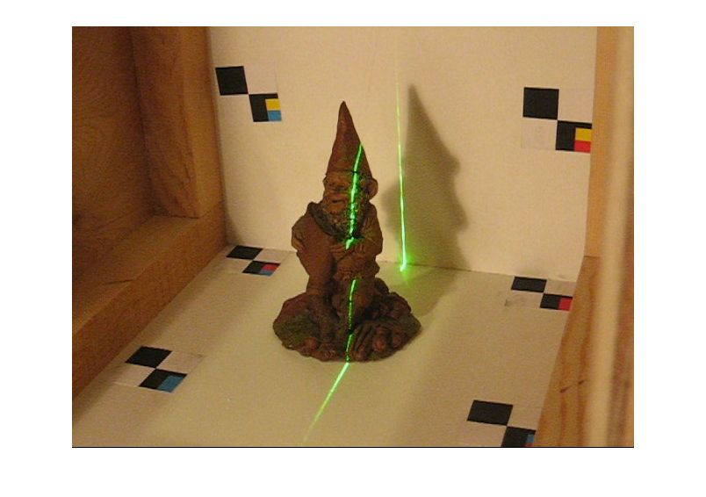
3D-SCANNER

Slide 3
Overview
Introduction
Open Source technologies Used
Main Idea
Flow chart
Hardware Components
Present scenario
Problems
Usage
Future Scope
Conclusion
What we learnt?

Slide 4
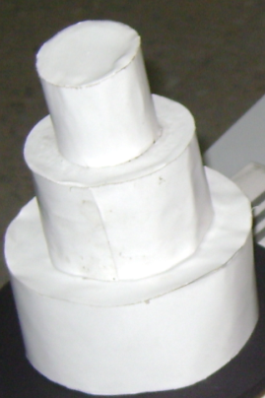
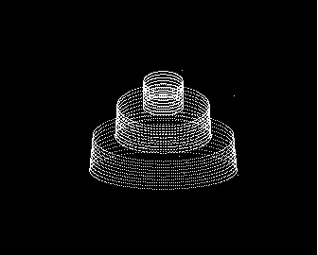
Introduction
What is 3D-Scanner?
It is a device that analyzes a real-world object or environment to collect data on its shape and possibly its appearance. The collected data can then be used to construct three dimensional models useful for a wide variety of applications.

Slide 5


Open Source Technologies Used:
Python 2.7
PyOpenGL
OpenCV 3.2.0
Numpy
Matplotlib
Pygame
Tkinter
Python Imaging Library
Pyserial

Slide 6
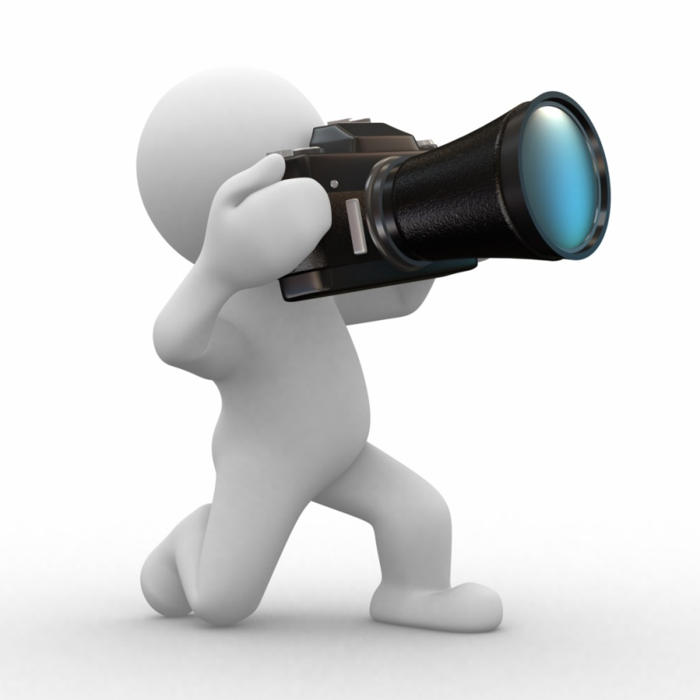
Main Idea
To obtain the outer surface of the object .
The approach which we considered is to slice the object to thin slices using a laser pointer formed into a line and aimed into the object.
This laser line will take the outer shape of the thin part of object at this moment.
A camera positioned at a known angle captures an image of the object and Captures the coordinates of one frame.
Rotate the object so that laser line covers another part of the object.
Repeat these steps until the whole object is scanned. .

Slide 7
Work flow of 3D-Scanner
Image Rendering
Extraction of coordinates of Contours
Conversion From 2D to Spherical Coordinates
Hardware Setup
Plotting 3D image using Matplotlib
Formation of 3D object file
(.ply)

Slide 8
Hardware
Components
Arduino Uno
Lasers
(Red,650nm)
Compact disk and Ply boards
Webcam
Stepper Motor

Slide 9
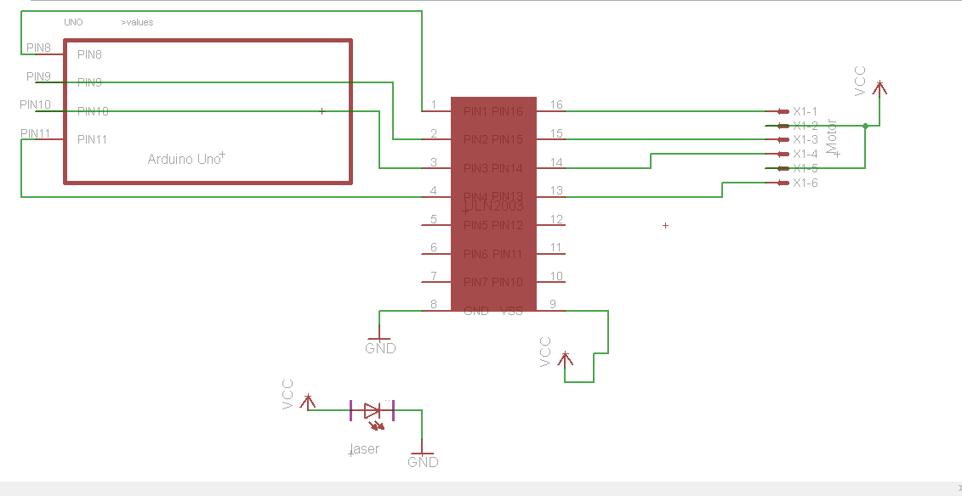
Schematic

Slide 10
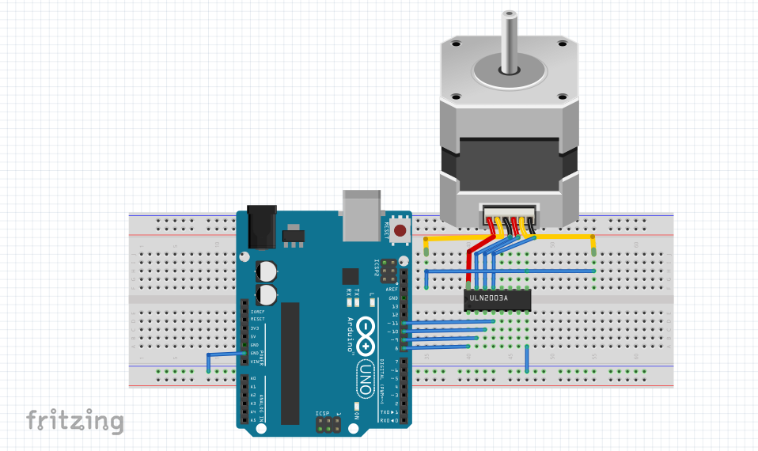
Fritzing View

Slide 11
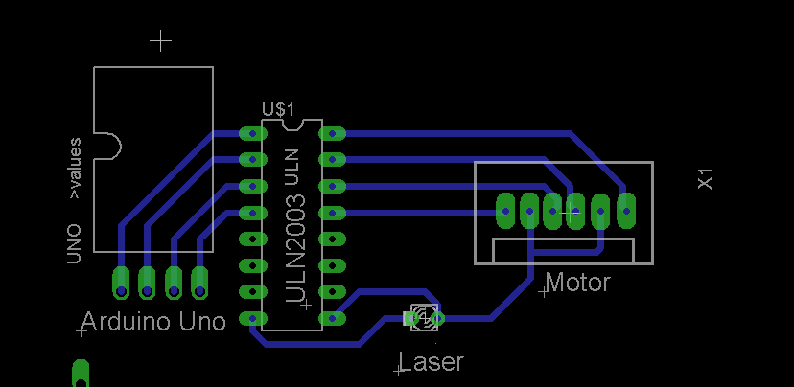
PCB Design View

Slide 12

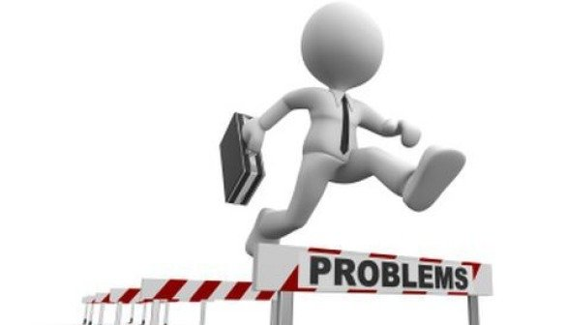
PROBLEMS
Speed: The speed of the scanning process, took about t minutes to make full scan. We managed to reduce the time by modifying the equations and quality choice
.
Noise: There was a lot of noise in the captured image due to the change in intensity of the light, we limit this problem by thresholding of image by adjusting its rgb values for detection of red contour.
Cost: Most of the industrial 3D scanner is too expensive .We tried to make it as cheap as possible by making our 3D scanner.

Slide 13
USAGE
Industrial design and manufacturing: Developing new product designs, taking the measurements of objects with complex geometry.
Healthcare: Designing customized prosthetic and orthotic devices requires real precision and paying close attention to the patient’s individual anatomy.
Science and education: The world’s leading museums also use Artec 3D scanners to digitize artifacts and create online galleries.
Art and design: The technology drives forward the movie industry and video games – many stunts and visual effects would be difficult or even impossible to bring off before the advent of 3D scanning.

Slide 14
Future Scope

Slide 15
Conclusion

Slide 16
What we Learnt
?
Python GUI (Tkinter)
OpenCV, OpenGL
Numpy
Matplotlib
Documentation Methodology
Teamwork
Time Management

Slide 17
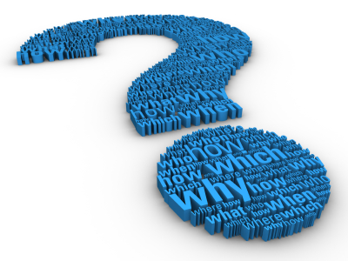
Any
Questions
?

Slide 18
Thank You

