Slide 1
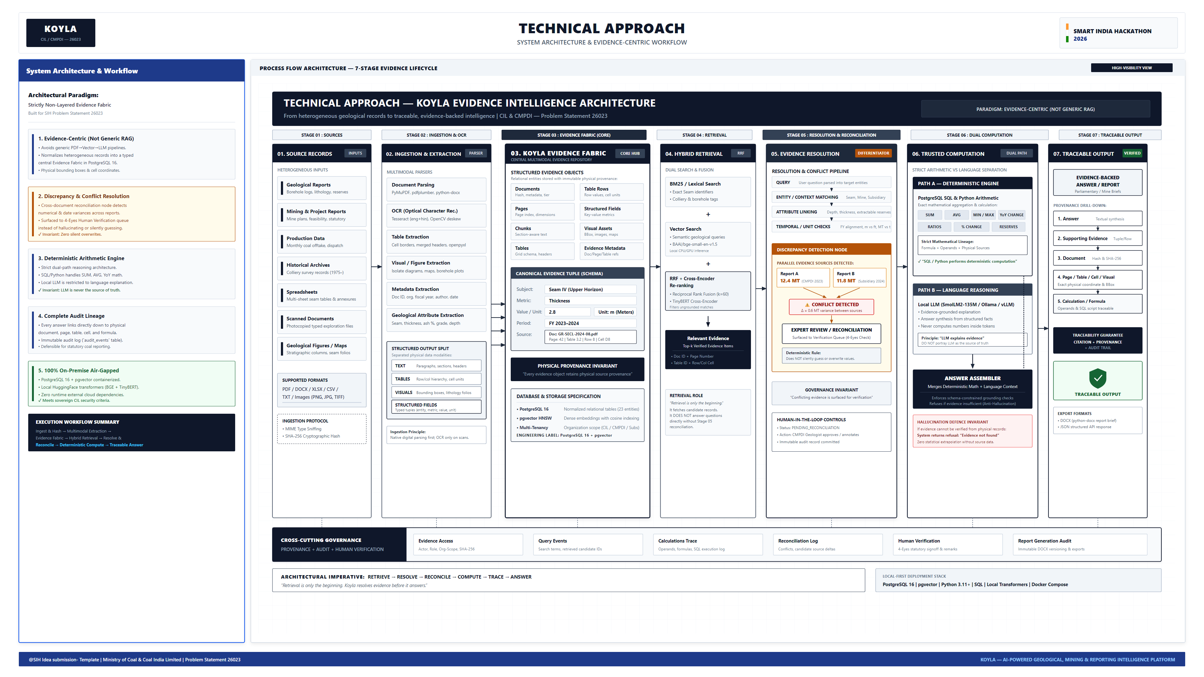

Slide 2
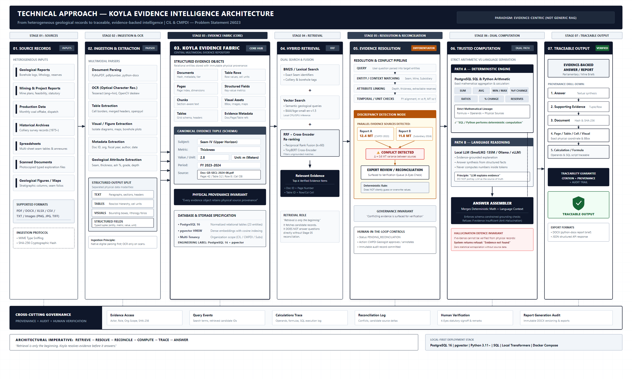
TECHNICAL APPROACH — KOYLA EVIDENCE INTELLIGENCE ARCHITECTURE
CIL / CMPDI — Problem Statement 26023 | 7-Stage Left-to-Right Evidence Flow Architecture
Title: System Architecture & Workflow
• Core Philosophy: Evidence-Centric Architecture (Not generic RAG)
• Stage 01-02: Multimodal Ingestion (PDF, Scans, Tables, Maps, Boreholes)
• Stage 03 (Core): Koyla Evidence Fabric in PostgreSQL 16 + pgvector
• Stage 04: Hybrid BM25 + Vector + Cross-Encoder Re-ranking
• Stage 05 (Diff): Discrepancy & Conflict Resolution Node with 4-Eyes Review
• Stage 06 (Math): Deterministic SQL/Python (SUM, AVG, YoY) vs Local LLM explanation
• Stage 07: Traceable Output down to Page, Table, Cell & Formula
• Governance: Immutable Audit Trail & Physical Source Provenance

Slide 3
ARCHITECTURAL JUSTIFICATION & DEFENSE — KOYLA EVIDENCE PRINCIPLES
1. Evidence Fabric vs Vector Store
• Generic RAG splits documents into arbitrary text chunks, losing tabular structure and spatial bounding boxes.
• Koyla stores 8 distinct structured evidence objects in PostgreSQL 16 (Documents, Pages, Chunks, Tables, Rows, Fields, Visuals, Metadata).
• Every single metric retains physical coordinates: Document SHA-256, page number, table ID, row index, and bounding box.
• Result: Zero lost table geometry or ambiguous seam thicknesses.
2. Discrepancy & Conflict Resolution
• Government and geological reports often disagree across publication years, exploration phases, and subsidiary filings.
• Koyla's Resolution Node detects numerical, temporal, and unit discrepancies automatically (e.g., CMPDI 12.4 MT vs Subsidiary 11.8 MT).
• Instead of randomly picking or averaging values, the system flags 'CONFLICT DETECTED'.
• Pushed to the Human Verification Queue for 4-Eyes statutory review with immutable audit logging.
3. Deterministic Arithmetic Engine
• LLMs are notorious for probabilistic token math errors in production, sum, and reserve calculations.
• Koyla enforces strict path separation: SQL & Python execute all SUM, AVG, MIN/MAX, YoY change, and reserve ratios.
• The Local LLM (SmolLM2-135M / Ollama) is used solely to generate readable linguistic explanations of the verified math.
• Complete traceability: Formula + Operands + Physical Evidence Sources recorded in the immutable audit trail.

