Slide 1

Precision Wellness · Personalized to You
Product overview

Slide 2
A lab report is data, not guidance.
A standard blood panel returns more than 100 values. Most people cannot act on a single one of them.
JIVA turns those numbers into a plan.

Slide 3
How JIVA works
1
2
3
4
Questionnaire
Panel and blood draw
Clinical engine
Vitality Map
Lifestyle, nutrition, activity, medical and family history shape everything that follows.
One draw at a partner lab covers 69 to 100+ biomarkers, chosen from a base panel plus targeted add-ons.
Physician-led analysis maps every value to 10 functional body systems and ranks what matters.
A personal report with a biological age and concrete food, supplement, exercise and yoga actions.

Slide 4
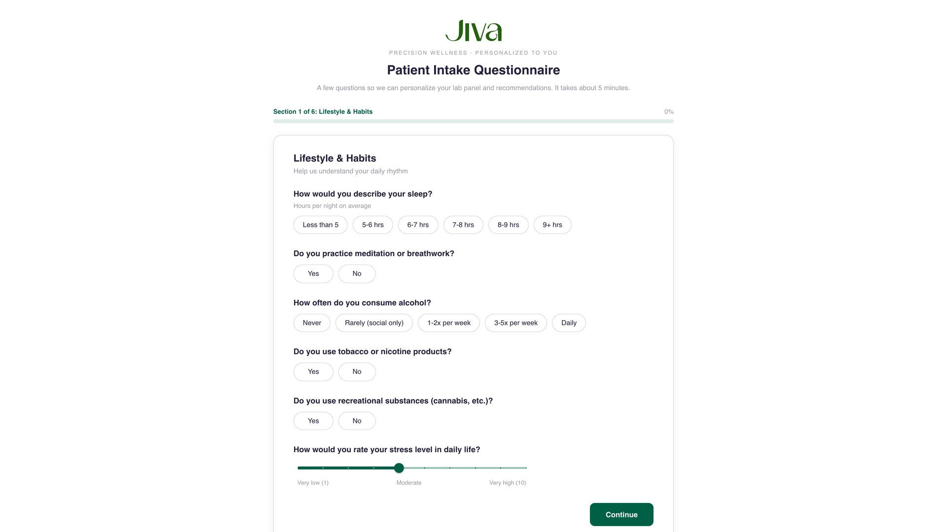
Personalization starts before the blood draw
A six-part intake covers lifestyle, nutrition, activity, medical history, family history and goals. Answers steer the panel selection and every later recommendation.

Slide 5
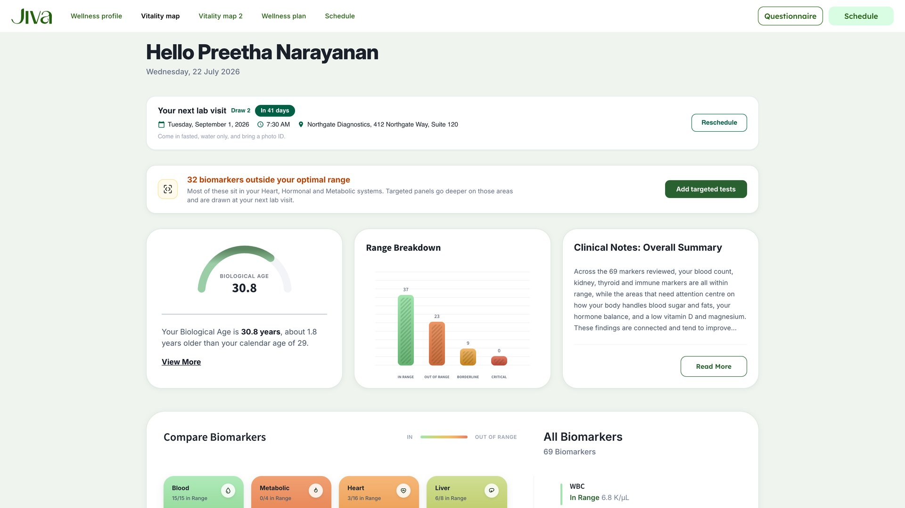
One map of your health
69 lab values become 10 color-coded body systems, a range breakdown, and a biological age of 30.8 against a calendar age of 29.

Slide 6
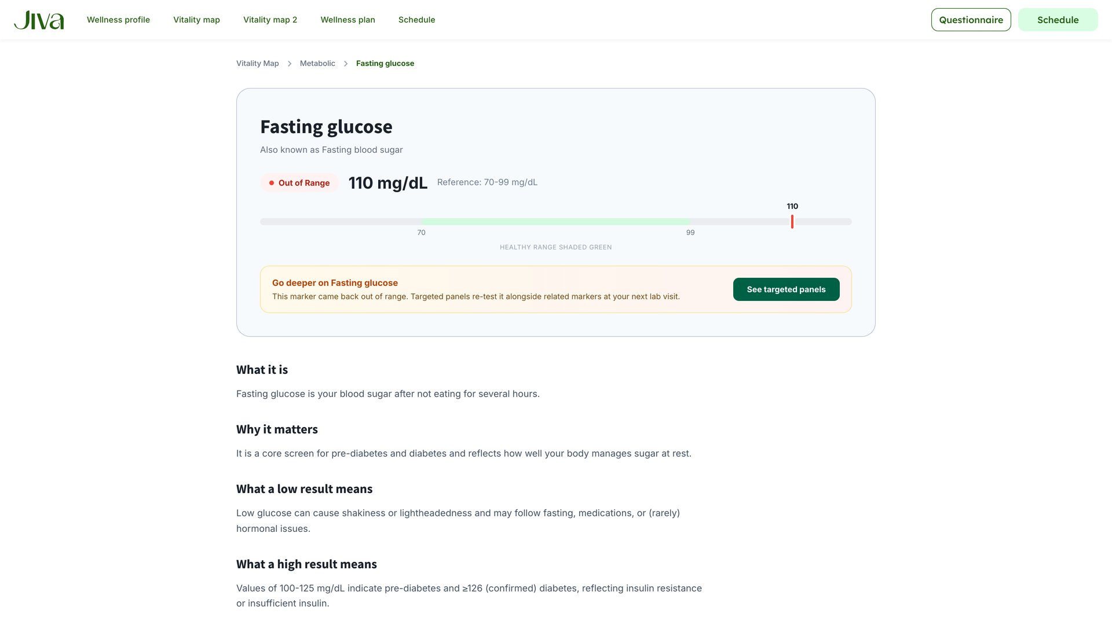
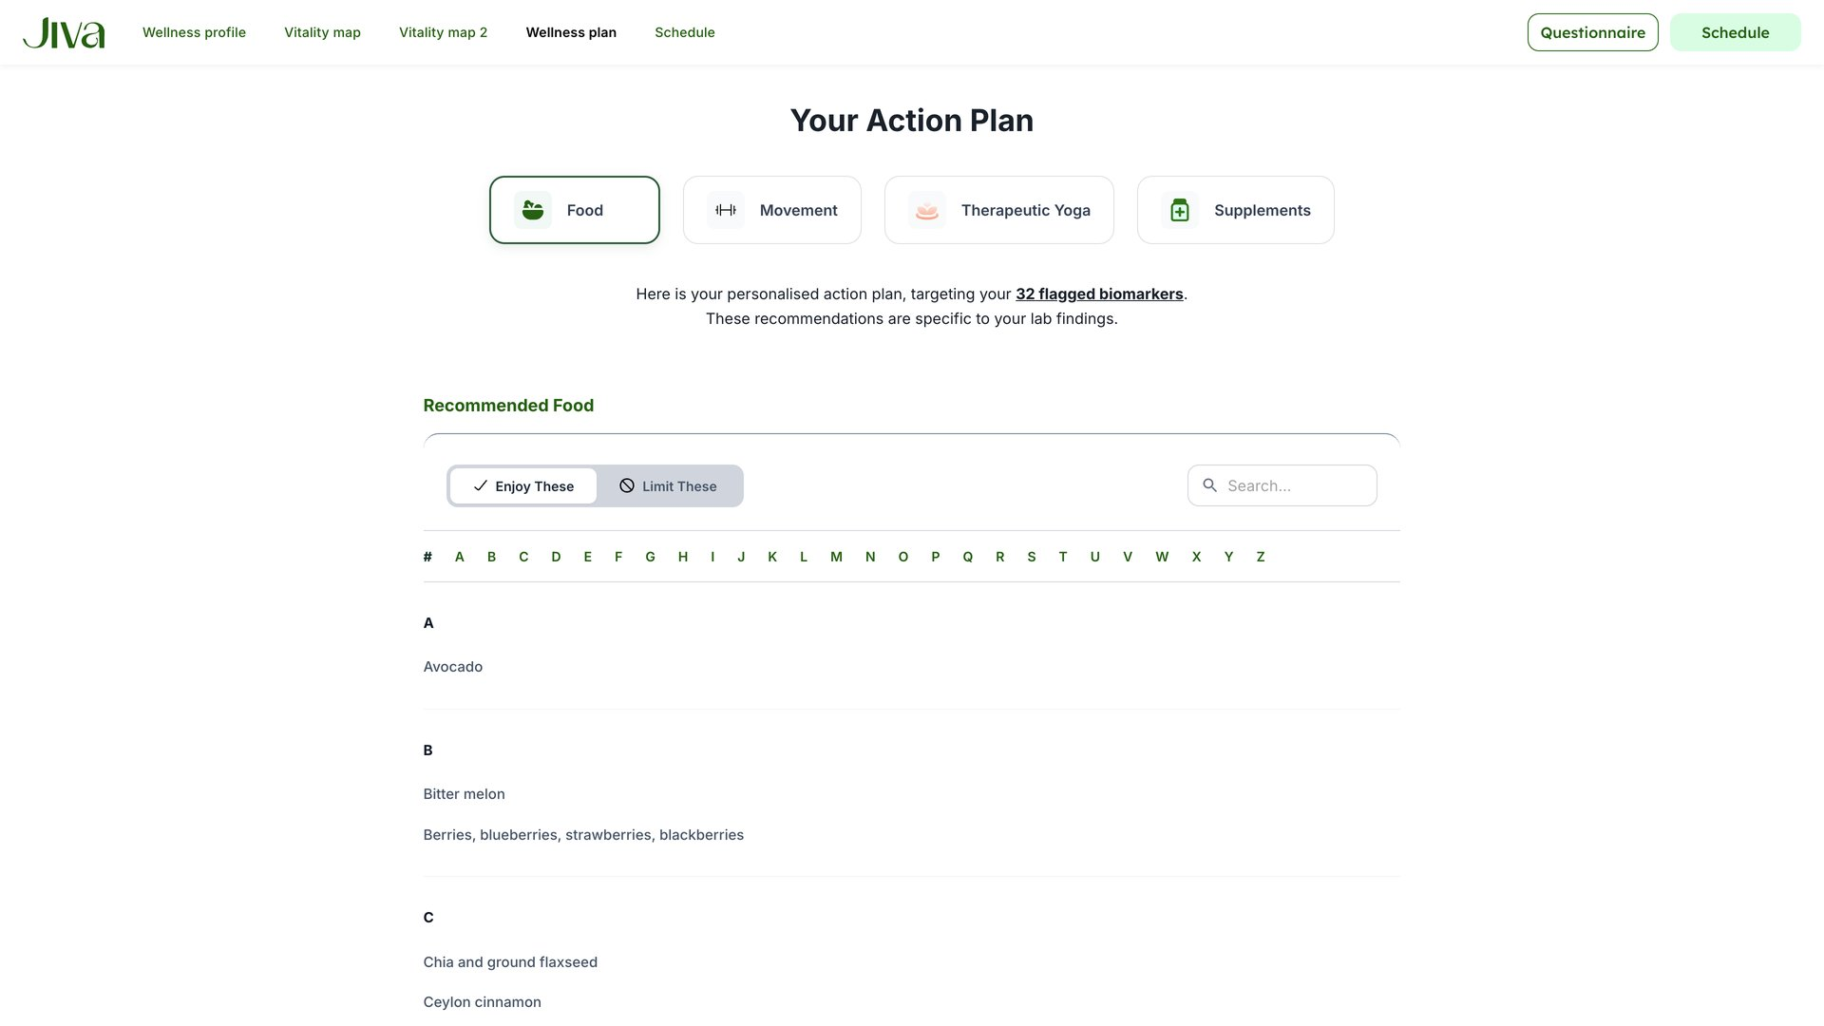
Every number explained. Every action justified.
Each biomarker sits on its reference range in plain language, and every food, supplement and exercise ties back to her specific values.

Slide 7
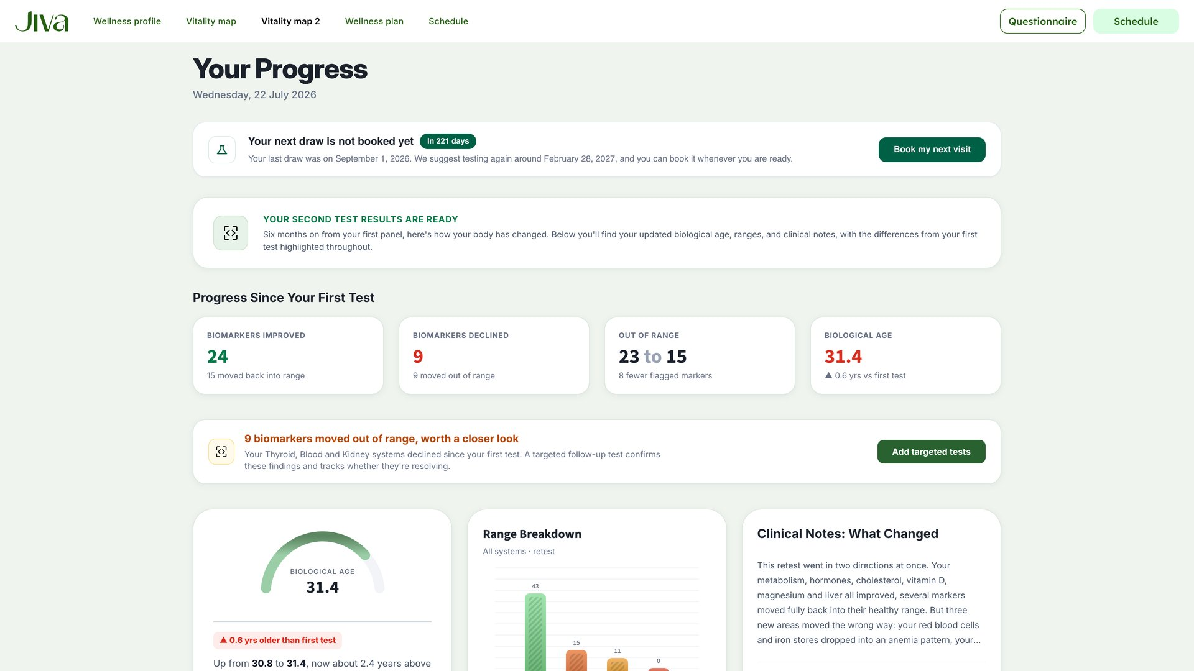
Six months later, measurably better
A follow-up draw compares every system against the baseline. Progress is visible, and the plan updates to maintenance where she has improved.

Slide 8
Why JIVA
Built for Latin America
A physician-led engine
Nicoya Blue Zone heritage
A Spanish-first experience with WhatsApp scheduling, local payment rails and locally available foods in every plan.
Recommendations anchored to your own numbers, not generic wellness advice.
Longevity science from one of only five places on earth where people demonstrably live longest.

Slide 9
See it in action
Live product demo

