Slide 1
PREDECTING RAINFALL USING CLOUD IMAGES (PRCI)
Akshay G
Dheeraj
Karthik G
Sai Ramesh G

Slide 2
Existing software
MYFREEWEATHER:
MyFreeWeather allows you to view the sky in any city in the world and track local weather.
Can track a moving storm & weather patterns via satellite & radar.
You can also view daily and detailed forecasts.

Slide 3
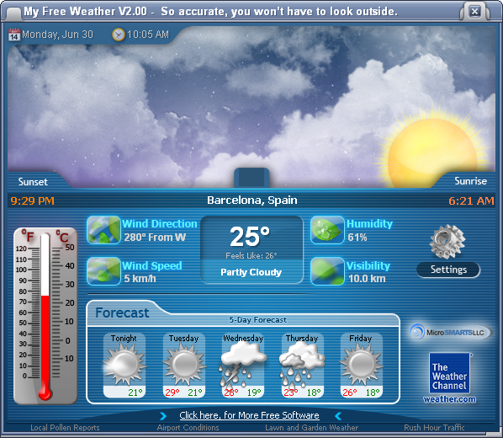
Existing software
It's a comprehensive weather tool .
Shows other information such as wind speed and direction, humidity.

Slide 4
Proposed software
PRCI works in offline mode.
PRCI is quite user friendly.
It doesn’t include any unnecessary data.
Works in real time.
No need to provide large amount of data.
Can be used by anyone without any kind of prerequisite.

Slide 5
Functions
Capturing image.
Cropping.
Retrieving standard images.
Comparison.
Display.

Slide 6
Software and hardware requirements
OpenCv, android for running platform.
Smartphone: For capturing images which will be fed to PRCI to compare with other images.

Slide 7
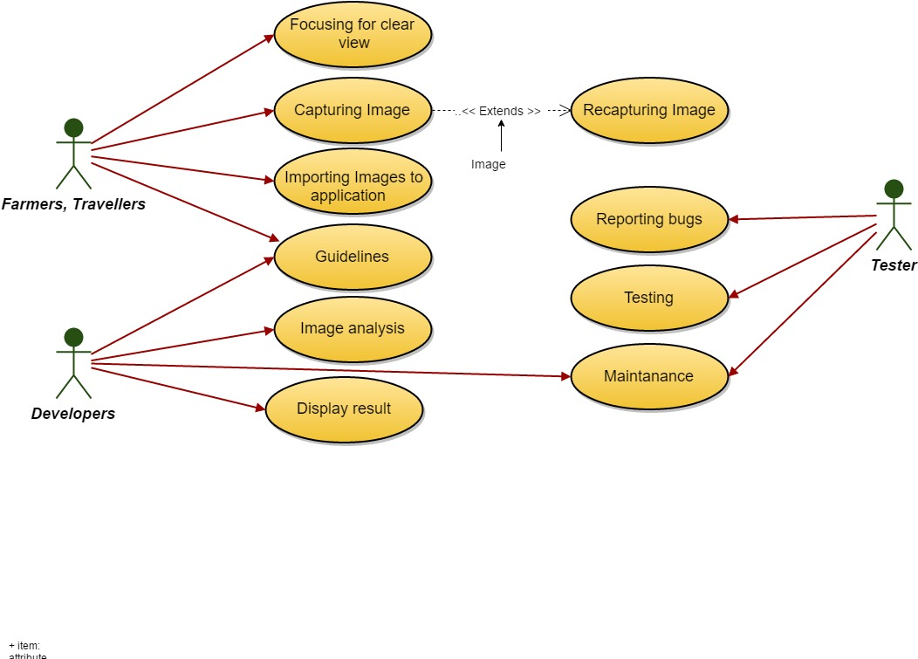
dUSECASE DIAGRAM

Slide 8
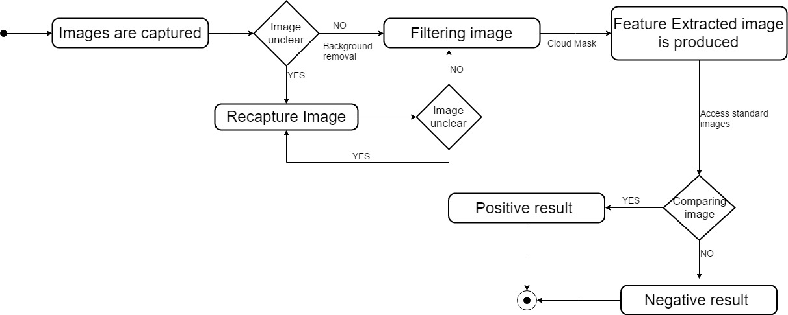
ACTIVITY DIAGRAM

Slide 9
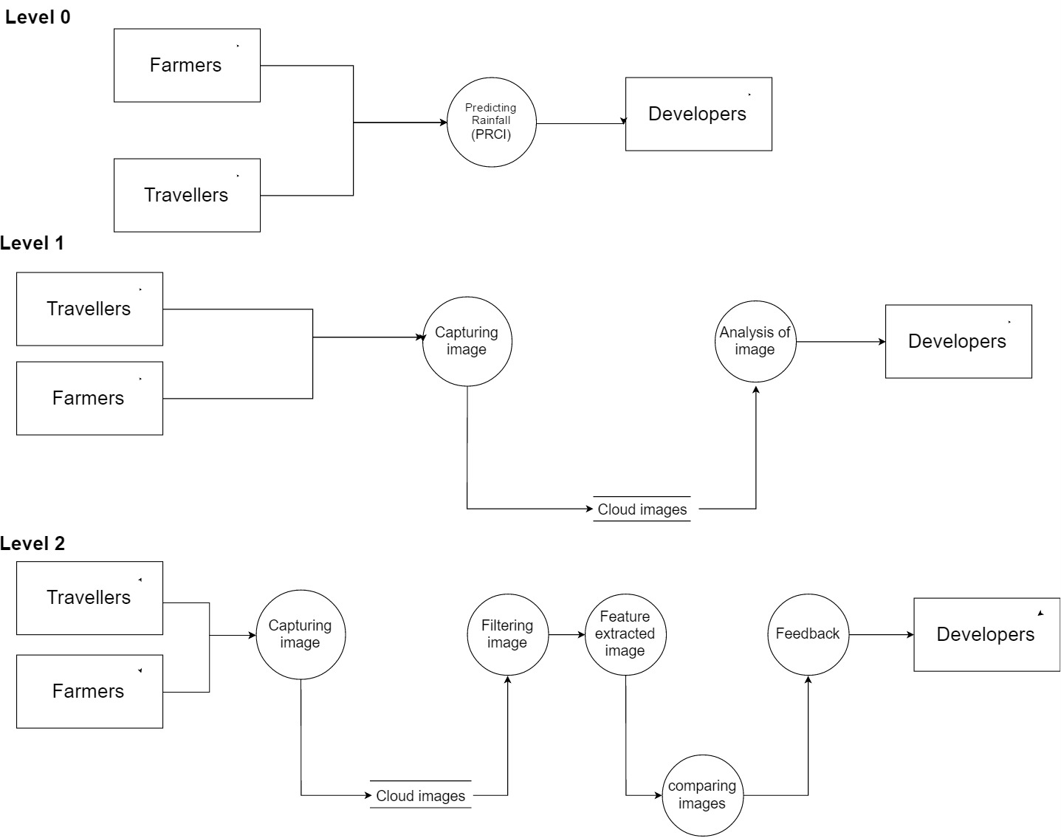
DATAFLOW DIAGRAM

Slide 10

SCREENSHOTS

Slide 11


Slide 12
OUTPUT
Texture of given input is matching with standard images hence there is chance of
it raining.

