Slide 1
Variable Valve Timing
For Variable Diesel Blends

Slide 2
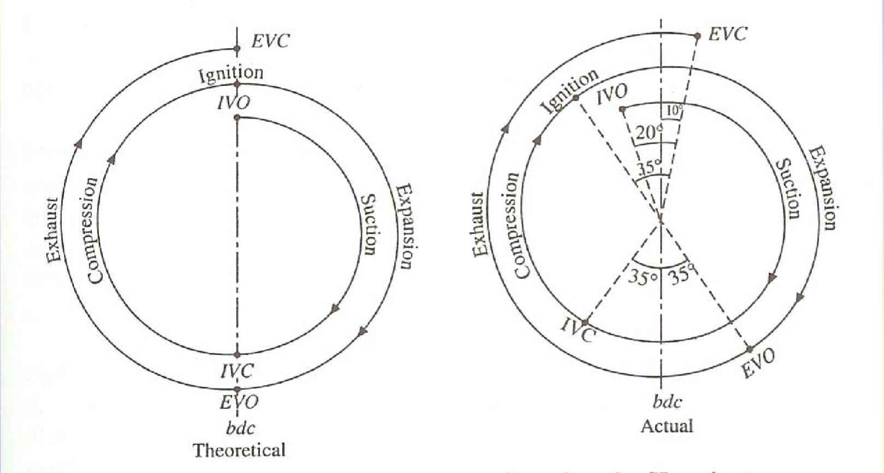

Slide 3
