Slide 1




Department of Computer Science and Engineering
JP Nagar, Kothanur, Bengaluru - 560076
LONGITUDINAL TEMPORAL DISEASE PROGRESSION
Heart Disease Modeling with Deep Learning & Gradient Boosting
Academic year 2026– 2027
Major Project Phase 3
Major Project (BCS685)
Review - 1
Presented by:
H M Akshay- 1RF23CS068
Hemanth Kumar K- 1RF23CS072
Shreya Gopalakrishna- 1RF23CS159
Venkat Baba Yemineni- 1RF23CS181
Under the Guidance of:
Mrs. Padmasree N
Assistant Professor
Dept. of CS&E
RVITM
i

Slide 2


CONTENTS
Introduction
1
Problem Statement
2
3-4
Literature Survey
5
Methodology
6–10
Project Outcomes & Results
11
References
ii

Slide 3
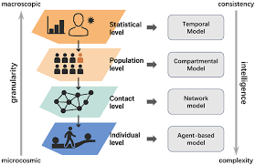
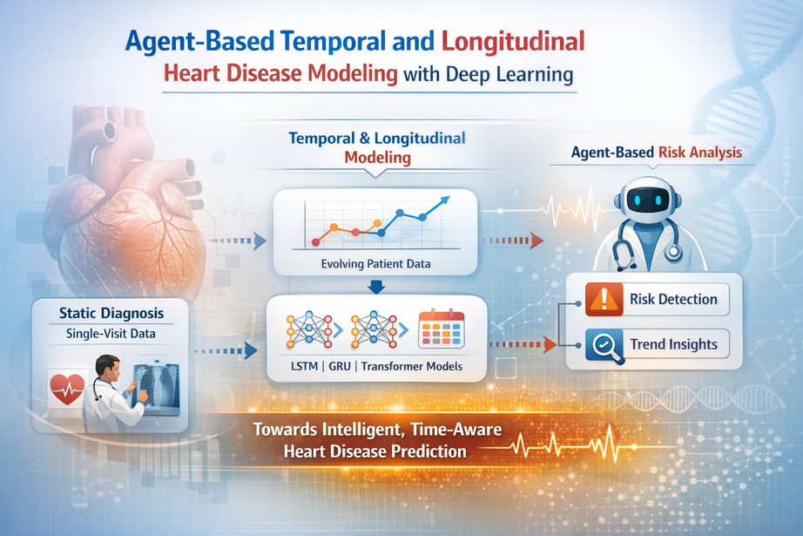
INTRODUCTION
  • Cardiovascular deterioration is a trajectory, not a single snapshot.
• We formulate progression as binary classification: worsening vs stable/improving.
• MIMIC-IV 2.1 ICU admissions are represented as sequences of 6 visits × 59 features.
• BiLSTM-attention, BiGRU, and Transformer models learn directly from visit sequences.
• Temporal feature engineering exposes trend, variability, velocity, and acceleration.
• Calibrated gradient boosting produces the strongest and most deployable model.
SEQUENCE MODELS
TEMPORAL DESCRIPTORS
CALIBRATED RISK
BiLSTM-attention
BiGRU
Transformer encoder
Trend • variability
velocity • acceleration
1,534 rich features
HistGB • LightGBM • XGBoost
soft-vote ensemble
interpretable importance
1

Slide 4
PROBLEM STATEMENT
  • Single-visit classifiers discard clinically meaningful change across admissions.
• The target class is imbalanced: only 16.9% of samples represent worsening progression.
• Sequence models can rank risk well, but the baseline shows low precision at threshold 0.5.
• A useful system must preserve recall while reducing false-positive alerts.
• It must also be CPU-friendly, calibrated, and interpretable enough for deployment.
Research question: can explicit temporal descriptors outperform heavier sequence models?
2

Slide 5
LITERATURE SURVEY
Year | Title | Author(s) | Description | Advantages | Drawbacks
2025 | Advanced Heart Disease Prediction Through Temporal Feature with SCN-Deep | Vivek Pandey, Umesh Kumar Lilhore | Hybrid deep BiLSTM model predicts heart disease from ECG signals. | Captures spatial and temporal ECG features accurately. | Relies heavily on ECG signal availability.
2024 | Application of Deep Learning for Heart Attack Prediction with XAI | Elias Dritsas, Maria Trigka | Compares multiple deep learning models for heart attack prediction with explainable AI. | High accuracy with interpretable predictions using SHAP explanations. | Limited generalization due to dataset and static inputs.
2024 | Early Detection of Heart Failure Using In-Patient Longitudinal EHR | Ignat Drozdov, Benjamin Szubert | Transformer predicts heart failure using longitudinal EHR. | Captures temporal dynamics and reveals disease subtypes. | Needs large datasets and limited interpretability.
2023 | Deep Learning-Based Heart Disease Prediction Study | Hewa Majeed Zangana, Maryam A. Sulaiman | Detects early disease prediction using longitudinal EHRs. | Early prediction with built-in temporal and feature explainability. | Requires large EHR datasets and retrospective validation.
3

Slide 6
LITERATURE SURVEY
Year | Title | Author(s) | Description | Advantages | Drawbacks
2023 | MIMIC-IV, a Freely Accessible Electronic Health Record Dataset | A. E. W. Johnson et al. | Presents the deidentified hospital and ICU dataset used for reproducible clinical ML. | Large-scale longitudinal data with detailed documentation. | Credentialed access; observational, single-center data.
2025 | Longitudinal Health Trajectories with a Transformer-Based Deep Learning | Hans Moen et al | Transformer model for longitudinal disease trajectory prediction. | Captures temporal patterns and evolving patient health trajectories. | Needs large datasets and limited interpretability.
2024 | Clustering of Disease Progression Patterns | Dulin Wang , Xiaotian Ma , Paul E. | Clusters patients using temporal deep learning on longitudinal data. | Captures temporal dynamics and reveals disease subtypes. | Complex model with limited clinical deployment readiness.
2021 | Transformer Models for Early Chronic Disease Predicti | Hewa Majeed Zangana, Maryam A. Sulaiman | Detects early disease prediction using longitudinal EHRs. | Early prediction with built-in temporal and feature explainability. | Requires large EHR datasets and retrospective validation.
4

Slide 7
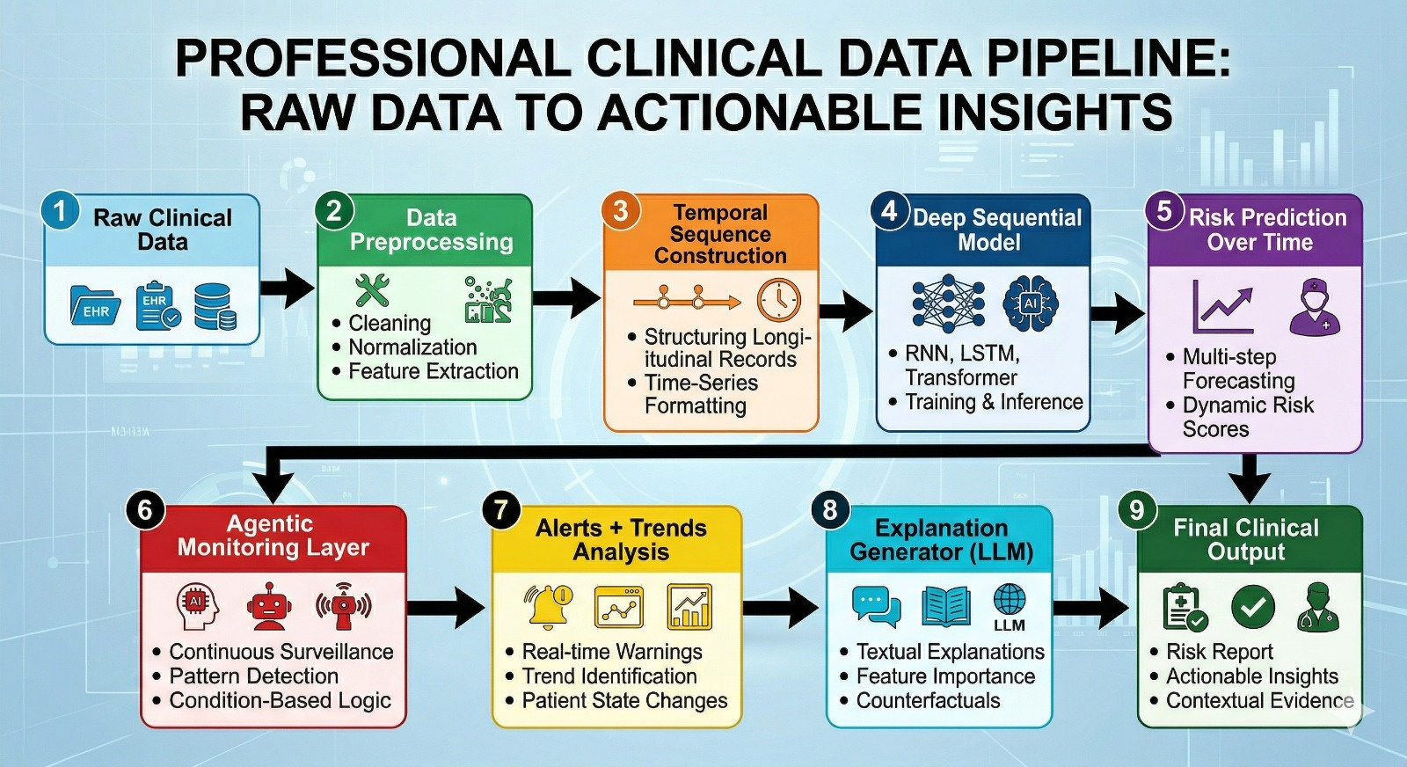
METHODOLOGY
1
MIMIC-IV 2.1
2
Preprocess
3
Sequence
4
Two model tracks
5
Validate & calibrate
Cardiac cohort
35,256 samples
Impute, scale, sanitize
70/15/15 split
6 visits × 59 features
per patient sample
BiLSTM • BiGRU • Transformer
Temporal GBM features
Isotonic calibration
F1-tuned threshold
Output: calibrated probability of worsening progression
Evaluation: Accuracy • Precision • Recall • F1 • ROC-AUC • PR-AUC
5

Slide 8
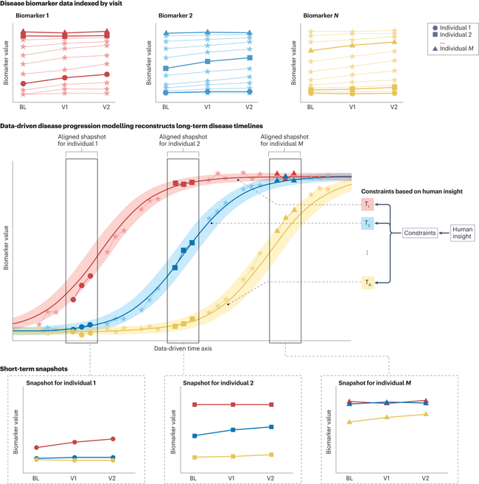
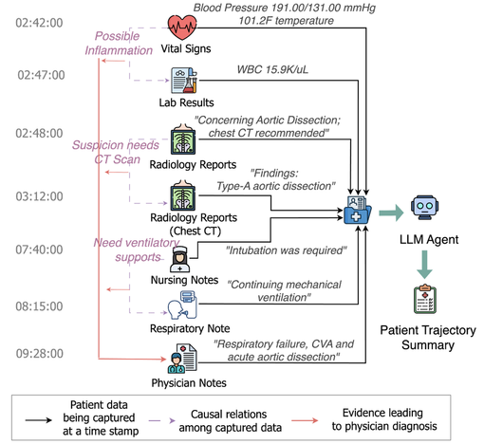
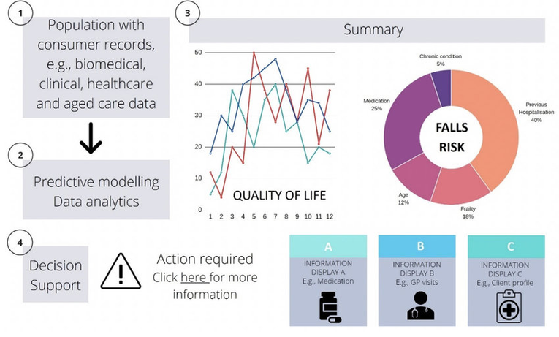
PROJECT OUTCOMES
The project now delivers a reproducible full-data pipeline and a stronger deployable model.
35,256
0.7334
0.9462
3.3 MB
total longitudinal samples
best F1 • GBM soft vote
best ROC-AUC
self-contained deployable artifact
✓ Full MIMIC-IV 2.1 cardiac progression cohort
✓ Fair baseline reproduction on identical arrays
✓ Calibrated threshold selected only on validation data
✓ Millisecond CPU inference; GPU not required
✓ Native feature importance for temporal drivers
✓ Saved metrics, predictions, and regeneration scripts
6

Slide 9
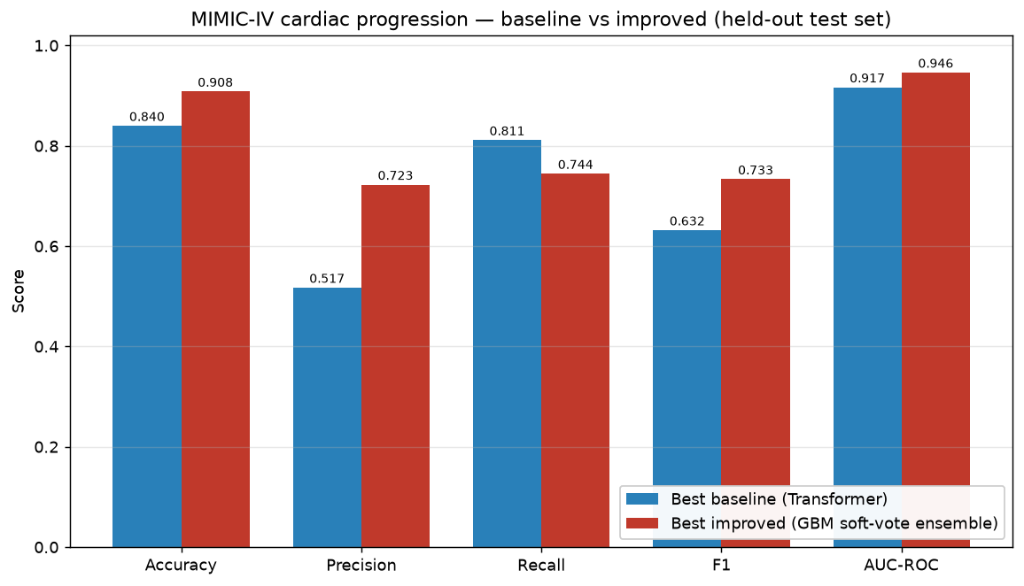
PROGRESS & RESULTS
DATASET & INPUT
BASELINE → IMPROVED
MIMIC-IV 2.1 cardiac cohort
• Train: 24,678 (4,178 worsening)
• Validation: 5,289 (896 worsening)
• Test: 5,289 (896 worsening)
• Positive class: 16.9%
Each sample: 6 visits × 59 features
Vitals • labs • cardiac markers • demographics • history • temporal gaps
7

Slide 10
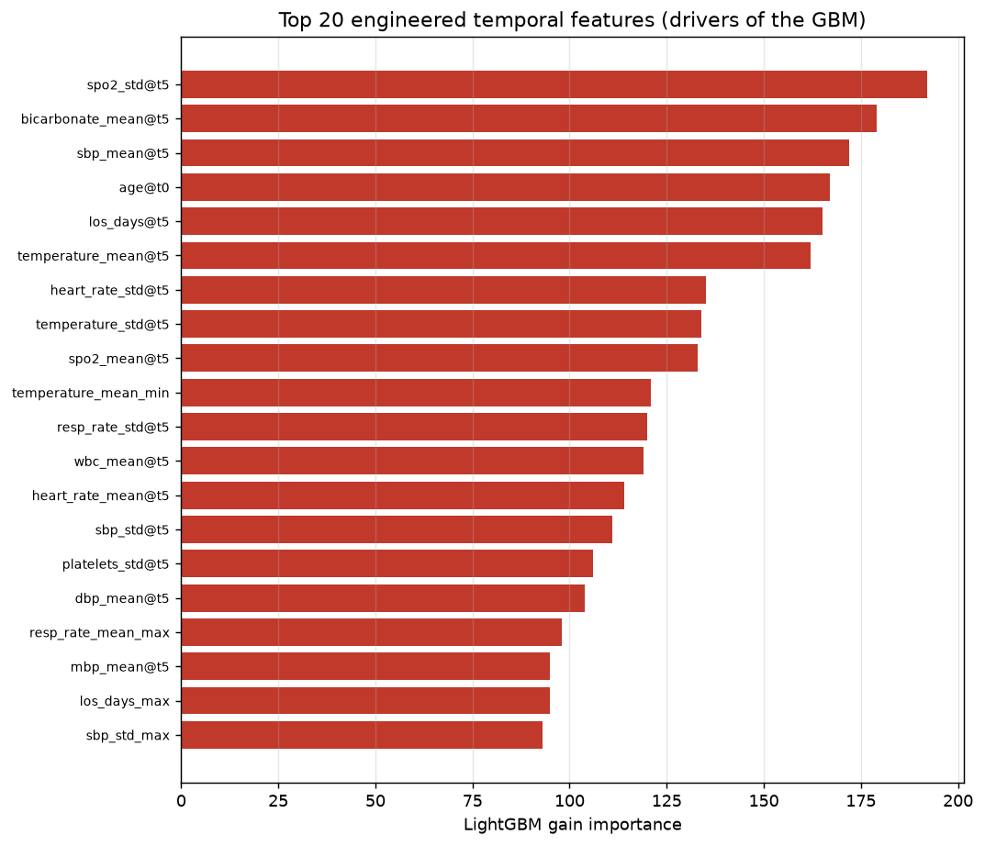
PROGRESS & RESULTS
WHY TEMPORAL GBM WINS
MOST IMPORTANT TEMPORAL SIGNALS
The sequence is short (6 timesteps), so explicit change descriptors are highly informative.
Engineered per feature:
• first / last / mean / median
• min / max / range / IQR
• delta / slope / half-split trend
• velocity / acceleration
• variability / total variation
HistGB + LightGBM + XGBoost
→ isotonic calibration → soft vote
8

Slide 11
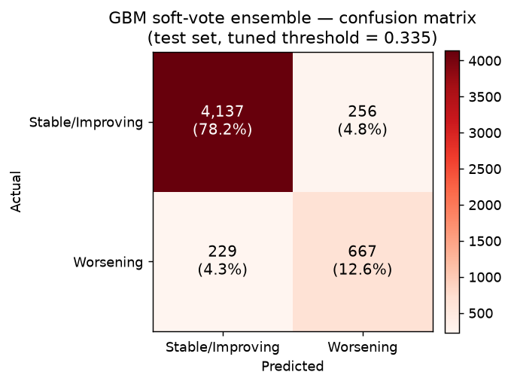
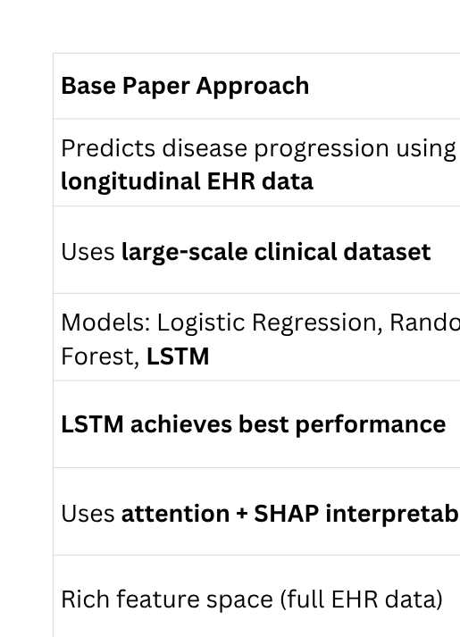
PROGRESS & RESULTS
BEST MODEL
HELD-OUT TEST SET • n = 5,289
GBM soft-vote ensemble
HistGB + LightGBM + XGBoost
Isotonic-calibrated
Validation-tuned threshold: 0.335
0.7334
0.9462
F1
ROC-AUC
0.7226
0.7444
Precision
Recall
9

Slide 12
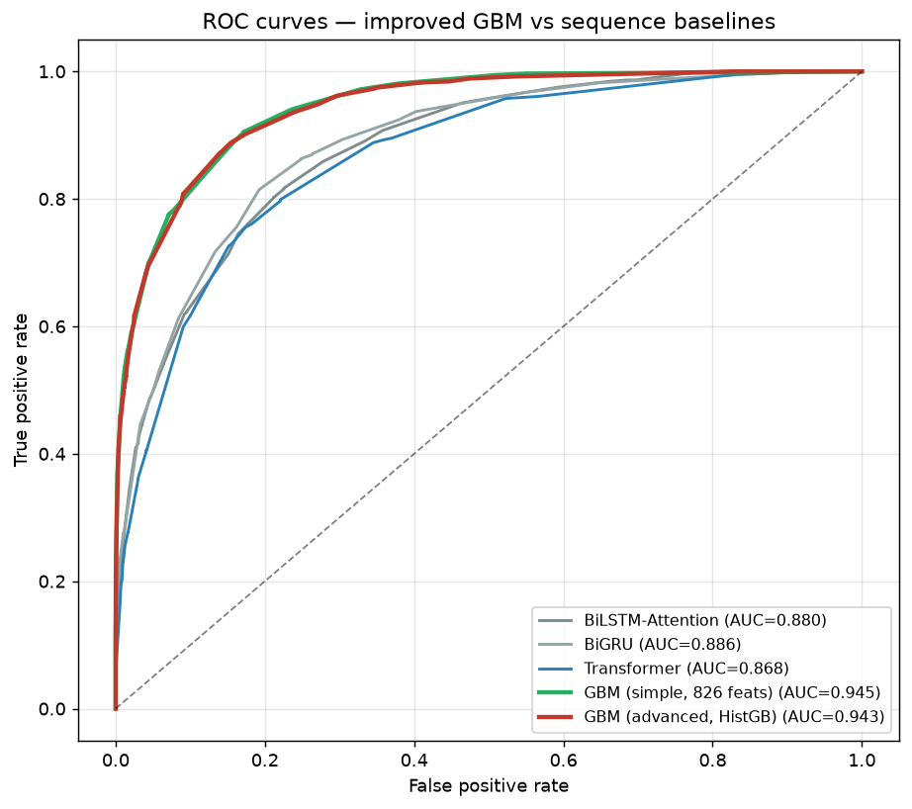
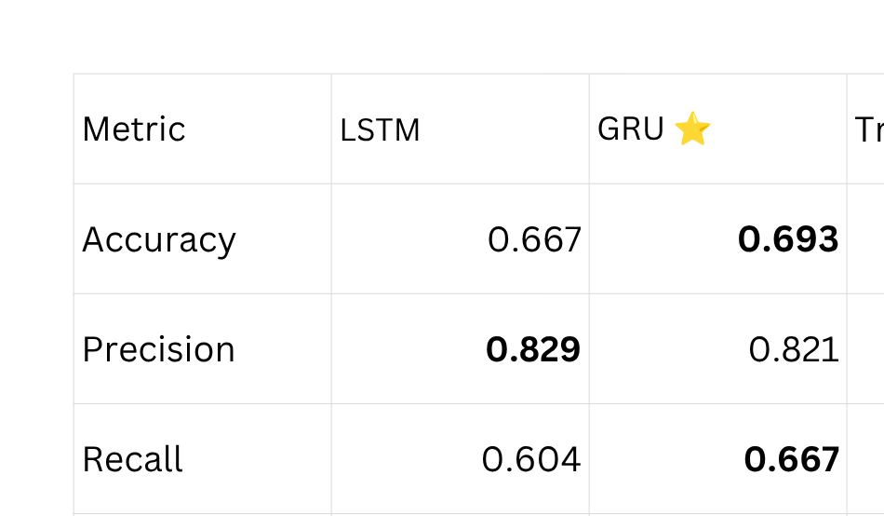
PROGRESS & RESULTS
KEY FINDINGS
ROC CURVES • BASELINES VS TEMPORAL GBM
• Best reproduced sequence baseline: Transformer
F1 0.6319 • AUC 0.9168
• GBM soft vote improves F1 by 0.1015 (+16%).
• Precision rises from 0.5174 to 0.7226 while recall remains 0.7444.
• Improved models dominate the ROC and precision-recall curves.
• Important signals are clinically plausible: SpO₂, blood-pressure and heart-rate variability, bicarbonate, and WBC.
10

Slide 13
REFERENCES
  [1] A. E. W. Johnson et al., “MIMIC-IV, a freely accessible electronic health record dataset,” Scientific Data, vol. 10, 2023. DOI: 10.1038/s41597-022-01899-x.
[2] A. E. W. Johnson et al., MIMIC-IV v2.1, PhysioNet, 2022. DOI: 10.13026/6mm1-ek67.
[3] A. Vaswani et al., “Attention Is All You Need,” Advances in Neural Information Processing Systems, 2017.
[4] T. Chen and C. Guestrin, “XGBoost: A Scalable Tree Boosting System,” Proc. ACM SIGKDD, 2016.
[5] G. Ke et al., “LightGBM: A Highly Efficient Gradient Boosting Decision Tree,” NeurIPS, 2017.
[6] Project repository: github.com/Venkat-023/Longitudinal-Temporal-Disease-Progression (commit 505e4e5, accessed 12 Aug 2026).
11

Slide 14
Thank You!

