Slide 1

Unveiling Customer Insights through CRM Analysis
Understanding Customer Behavior for Enhanced Business Strategies
- AKSHAY GUPTA
( akshayngupta.official@gmail.com )

Slide 2

Empowering Decisions with CRM Analysis
What is CRM Analysis?
Transforming CRM data into actionable insights.
Unveiling customer behavior patterns & buying habits.
Why is CRM Analysis Important?
Uncovers customer behavior for improved customer experiences.
Optimizes marketing campaigns for better targeting and ROI.
Identifies opportunities to grow customer base and retention.
Empowers proactive customer service initiatives.

Slide 3
Order Analysis - Unveiling Customer Behavior
Normal Purchase Transaction
Overall ,
Total Order Count = 19960
Total Unique Products = 4070
75% of Total Orders
have
Unique Products count <=29 per Order
75% of Total Orders
have
Quantity per Product <=11 per Order .
Overall,
Total Revenue = £ 9.7 Million
6% Products (approx.245 Products only)
are contributing
52.67% of Overall Total Revenue £ 9.7 Million .
75% of Total Orders
have
Invoice Amount <=493.46 per Order.

Slide 4

When Do Customers Buy? - Peak Order Times
Preferred Month
Preferred Weekend or NOT
Preferred Day in Week
Preferred Shopping Hour

Slide 5
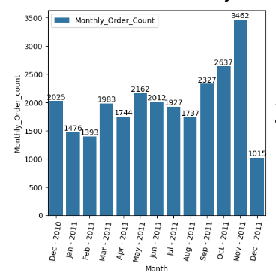
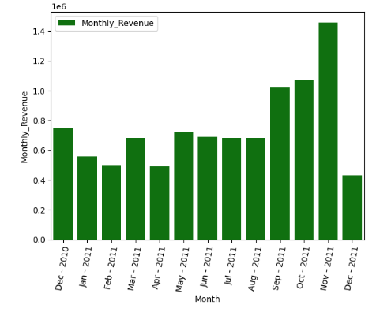
Preferred Month The month when most transactions occur
Top3 months : SEP, OCT and NOV months of Year 2011.
Avg. Monthly Order count = 1992 orders.
Avg. Monthly Customer count = 1053 customers.
Avg. Monthly Revenue = £ 0.75 Million

Slide 6
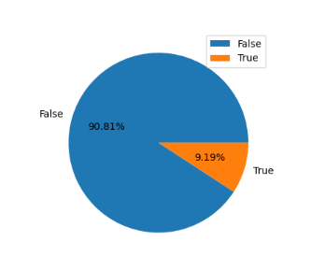
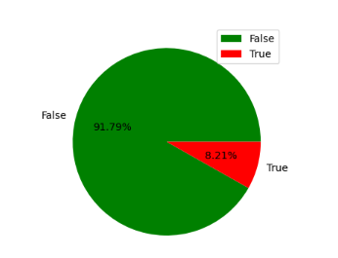
Preferred Weekend or NOT
91% orders ordered on Weekday and remaining, 9% Orders ordered on Weekend .
Since, 92% Revenue is generated on Weekday and only 8% Revenue is generated on Weekend.
Order Chart
Revenue Chart

Slide 7
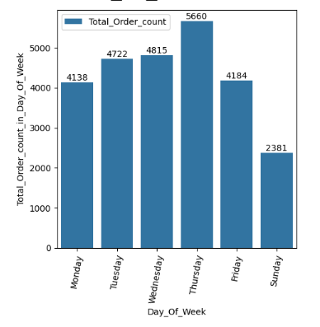
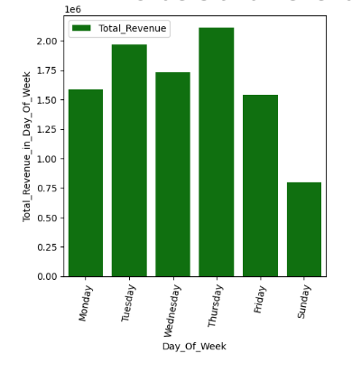
Preferred Day in Week
Overall, Customers ordered only Six days of week (except Saturday).
Even Customer ordered almost 50% on Sunday compared to other Weekday's Revenue and order count.
Top3 Day : Thursday, Tuesday and Wednesday.
Avg. of Total Order count in Day = 4316 orders.
Avg. of Total Revenue in Day = £ 1.62 Million

Slide 8
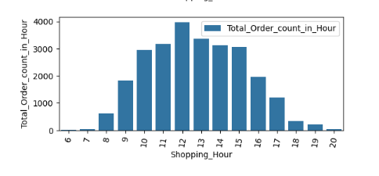
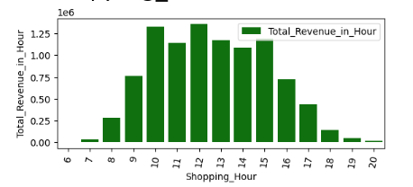
Preferred Shopping Hour
Overall, Customers ordered between 6 to 20 Hour in a Day.
Preferred Shopping hours are between 10 to 15 Hour in Day.
Avg. Total Order count in Hour = 1726 orders.
Avg. Total Revenue in Hour = £ 0.65 Million

Slide 9
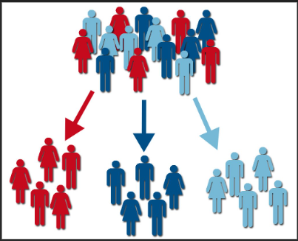
Customer RFM Segmentation Analysis and Customer Order Metrics
Metrics: Total Customer Count, AOV, Order Count
Country Wise Segmentation
RFM Segmentation

Slide 10
Metrics: Total Customer Count, AOV, Order Count
Total Customer Count = 4372 Customers
75% of Total Customers’ AOV <= £ 366.51
75% of Total Customers’ Orders count <= 5 orders

Slide 11
Country Wise Segmentation :
There are total 38 countries. There are 4372 defined customers.
Only Top6 countries ['United Kingdom', 'Netherlands', 'EIRE', 'Germany', 'France', 'Australia'] are contributing 95% to Total Revenue.
United Kingdom ( Order count = 23494, Customers = 3951, Total Revenue = £ 81.67 Million, Percentage of Total Revenue = 83.97% )
Remaining 5 countries ['Netherlands', 'EIRE', 'Germany', 'France', 'Australia'] are contributing 11% to Total Revenue.
Rest 32 countries are contributing only 5% to Total Revenue.

Slide 12
RFM Segmentation : Total 4372 defined customers
Loyal Customers → 1597 customers
( customers who shop frequently and whose last purchase has been a short while )
Potential Loyalist → 1019 customers
( customers who shop at medium frequency and have not spent a long time since their last purchase )
Customers Needing Attention --> 250 customers
( the customer class in the middle of the RF graph, and if it is not emphasized, it moves towards the risky group )
Champions → 466 customers
( customers who shop frequently and have made their last purchases in a very short time )
Hibernating --> 262 customers
( The class of customers who shop relatively often but have not shopped for a long time )
At Risk → 613 customers
( customers who shop relatively often but have not shopped for a long time )
About to Sleep --> 165 customers
( customer class who has not shopped frequently and has passed a certain amount of time since their shopping )

Slide 13

THANK YOU

