Slide 1
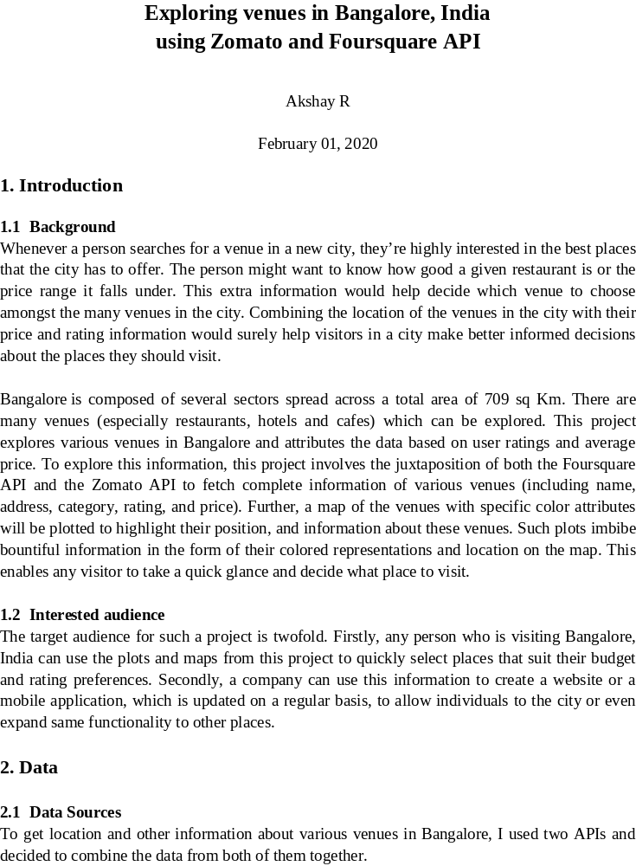

Slide 2
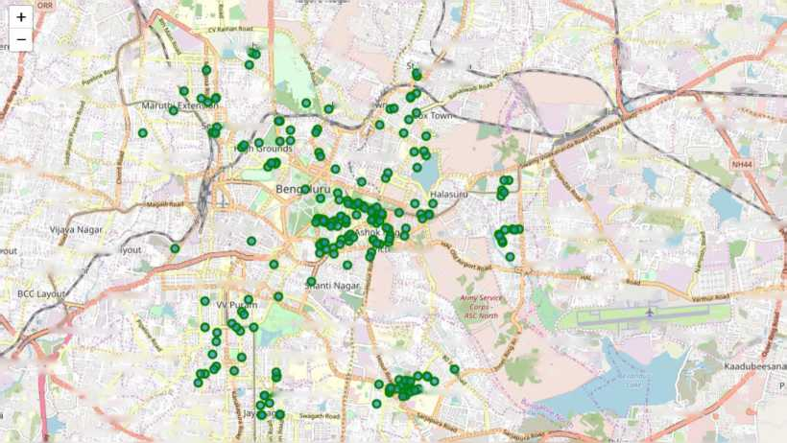
Using the Foursquare’ s explore API (which gives venues recommendations), I fetched venues up to a range of 5 kilometers from the center of Bangalore and collected their names, categories and locations (latitude and longitude).
Using the name, latitude and longitude values, I used the Zomato search API to fetch venues from its database. This API allows to find venues based on search criteria (usually the name), latitude and longitude values and more. Given that the data from the two APIs did not align completely, I had to use data cleaning to combine the two datasets properly.
From Foursquare API (https://developers.zomato.com/api), I retrieved the following for each venue:
• Name: The name of the venue.
• Category: The category type as defined by the API.
• Latitude: The latitude value of the venue.
• Longitude: The longitude value of the venue.
From Zomato API (https://developers.zomato.com/api), I retrieved the following for each venue:
• Name: The name of the venue.
• Address: The complete address of the venue.
• Rating: The ratings as provided by many users.
• Price range: The price range the venue belongs to as defined by Zomato.
• Price for two: The average cost for two people dining at the place. I later convert the same to average price per person by dividing by 2.
• Latitude: The latitude value of the venue.
• Longitude: The longitude value of the venue.
2.2 Data Cleaning
Kowdenahalli .
Sadhaj
ivanagar-^
Parachute
Regiment
Training
Cenue
PRTC
fingarajapuram
Banaswadi
Ramamurthy
Shree Vin Layoi
Nandini Layout
Subrahmanya J Nagar \
[homastowr
Nagar
iooravaninagar
Kurubara Haiti
Guttahalli
Jenson Tc
Cooke Town
Baiyyappanahal
B. Narayana'pura
Ramachandra
idripuram
Sliivajinagar
C V Raman Nagar
Mahadevapura*
Kamakshi Palya
(Jura
Govindaraj Nagara .
#hikkapete
Thippasandra
Malleshpalya
Doddanekun
^ Telecom^
>ria Layout
Jeevan Bhima Lai Bahadur Nagar Shastri Nagar
Kodihalll Vimanapura
OW KHo,,
, Murugeshpalaya
Hampi Nag«
:.'Kasturibai Nagar *
0 Kalasipalya
Austin Town
Marathah,
‘Byataranyapura
0 Wilson Garden
Neelasandra
Ejipura
^{f} Challaghatta ArtrwServiee ' Corps ASC South
HAL Airport
Yemaluru
Pantarapalya
P ORR.
Banashankari O 1st Stage
Someshwaranagar
Adugodi
•^Banashankari '3rd Stage Katriguppe Ittamadu
Thyagaraja
Nagar
Banashankari ^ 2nd Stage
layanagar East
^amangala
Bellanduru;
Figure 1: Venues retrieved from Foursquare API
2

Slide 3
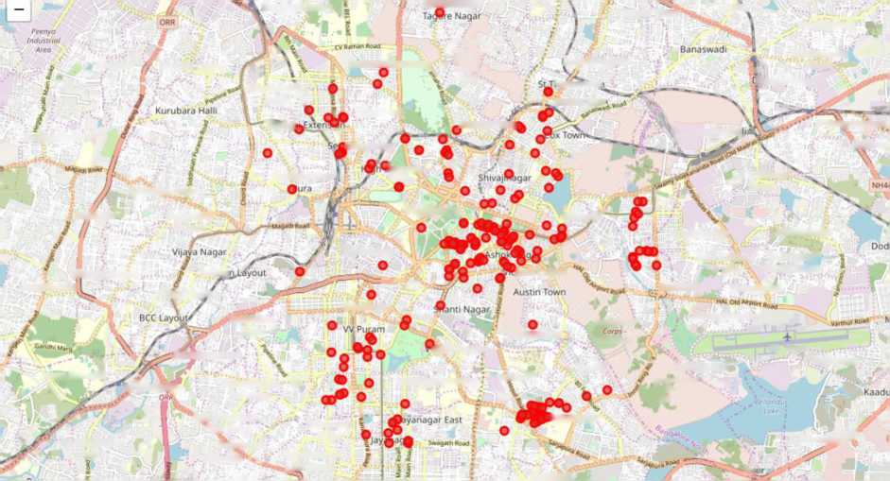
Deewanarapalya
Rabindranath
Kaiyan Nagar
Layout,
Kowdenahalli
Laggere Nandini Layout
Sadhashivanagar-^
Parachute Regiment Training Centre ■ PRTC
fingarajapuram
Ramamurthy
Nagar
looravaninagar
Subrahmartya ' Nagar \
• i imastnwf
'Marutt
Guttahalli
.Benson Tow|
Cooke Towr
BaiyyappanahaJ
B. Narayanapura
Sunkadakatte
ladripuram
(rounds
Mahade\
Kamakshi Palya
Ramachandra
CV Raman Nagar
Malagala
Govindaraj
Nagara
Bengaluru
Halasuru"
Thippasandra
Malleshpalya
Ghikkapete
Jeevan Bhima Lai Bahadur
Mallathahalli
Chandra Layout
Telecor
toria Layout
Kodihalli
\ igar
Vimanapura
Shastrl Nagar
Hampi Nagar
‘Kasturibai Nagar <f-
Kalasipalya
Ar my Sentice-ASC North
Murugeshpalaya
Byataranyapura
rilson Garden
Neelasandra
HAL Airport
rema luru
jnana Bharathi
Pahtarapalya
Banashankari O 1st Stage
Someshwaranagar
Adugodi
Ejipura
" Challaghatta ArmyService ‘ COrpi - ' v
ASC South '
Rajarajeshwari
Nagar
•^Banashankari ' 3rd Stage Katriguppe Ittamadu ■ . ,,
Thyagaraja
Nagar
Banashankari ...2nd Stage
Iramangala
Bellanduruj^^
Madiwala
i: 'I i
Figure 2: Venues retrieved from Zomato API
From figure 1 and figure 2, we can clearly see that some venues from the two APIs do not align with each other. Thus, I decided to combine them using their latitude and longitude values.
To combine the two datasets, I had to check that the latitude and longitude values of each corresponding venue match. After careful analysis, I decided to drop all corresponding venues from the two datasets that had their latitude and longitude values different by more than 0.0004 from one another. Thus, I rounded both the latitude and longitude values up to 4 decimal places. Then, I calculated the difference between the corresponding latitude and longitude values and saw if the difference was less than 0.0004 which should ideally mean that the two locations are the same. This removed many outliers from the two datasets. Once this was done, I observed that there were still some venues which were not correctly aligned.
As a final dataset, we’re left with a data set as described in figure 3.
 | categories | venue | latitude | longitude | price_range | rating | address | average_ price
0 | Hotel | Merak-JW Marriott Hotel | 12.9724 | 77.5951 | 3.0 | 0 | JW Marriott, 24/1, Vittal Mallya Road, Lavelle... | 600,0
l | Shopping Mall | Shiro | 12.9718 | 77.5959 | 4.0 | 4.4 | 2nd Floor, UB City Mall, Vittal Mallya Road, L„ | 1500,0
2 | Italian Restaurant | Toscano | 12.9719 | 77.5964 | 4.0 | 4.4 | 2nd Floor, UB City, Vittal Mallya Road, Lavell... | 1200,0
3 | French Restaurant | Cafe Noir | 12.9721 | 77.5964 | 3.0 | 4.2 | 2nd Floor, UB City, Vittal Mallya Road, Lavell... | 750,0
4 | Japanese Restaurant | Shiro | 12.9718 | 77.5959 | 4.0 | 4.4 | 2nd Floor, UB City Mall, Vittal Mallya Road, L„ | 1500,0
Figure 3: Final data aggregated from both APIs
3

Slide 4
3. Methodology and Exploratory Data Analysis
As a first step, I retrieve the venues in Bangalore from Foursquare and Zomato APIs. I extract the location data from the Foursquare API for all venues up to a distance of 5 kilometers from the center of Bangalore. Using this, I fetch the venue information including price and rating data from Zomato API.
Using data cleaning, the dataset from the two APIs will be combined based on the venue names, latitude, and longitude values. One to one matching and careful data inspection would be used to remove any remaining outliers such as multiple venues at the same location from the two datasets. The final data will include the venue name, category, address, latitude, longitude, rating, price range, and average cost per person.
Using this dataset, I begin by analyzing the top venue types that exist in Bangalore. I will then explore the venues on maps. This will allow us to better understand the location of various venues and the places where many venues co-exist and create place worth visiting. I’ll also explore the venues based on the ratings and price range of various venues. The venues will be plot using proper color coding such that a simple glance at the map would reveal the location of the venues as well as give information about them. I aim to identify places which can be recommended to visitors based on their price and rating preferences. I’ll also cluster the venues and see if we can draw meaningful information out of what kind of venues exist in Bangalore.
As a final step, I will analyze these plots and try to draw conclusions on what places can be recommended to visitors. I’ll discuss my findings and any inferences I can draw.
3.1 Categories
I begin my analysis by taking a look at the various categories of venues that exist in Bangalore. As there are many restaurants, I believe that the majority venues shall include restaurants.
4

Slide 5
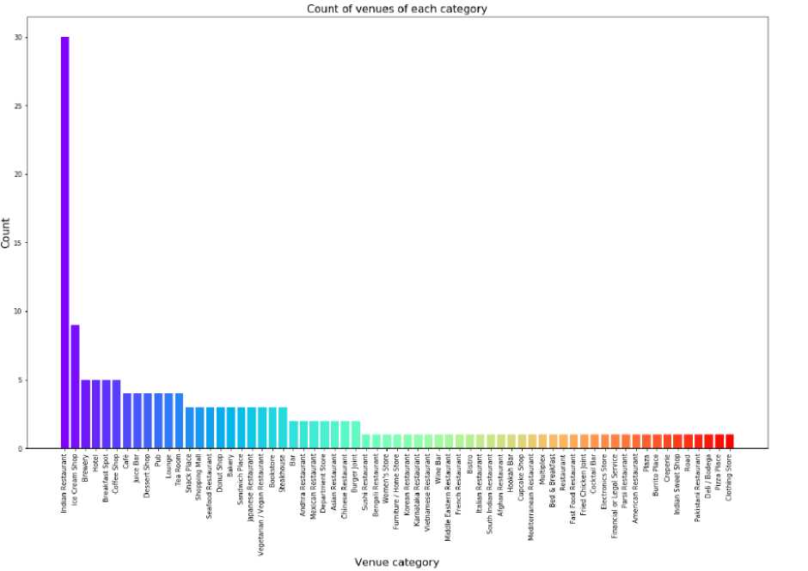
Venue category
Figure 4: Count of various types of venues in Bangalore
From figure 4, we see that the majority venues are Indian Restaurants. This is closely followed by Ice cream Shops. For someone who is visiting Bangalore and loves either Indian Restaurants or Ice cream shops, they’d surely love their stay.
3.2 Rating
Next, I’ll explore the ratings of various venues in Bangalore. I decided to plot a bar chart with x-axis as the rating from 1 to 5 and the y-axis as the count of venues with that rating. I decided to plot the bar chart to see what average rating venues get in Bangalore. This can be seen in figure 5.
While the whole range of rating of venues might stretch from 1 to 5, the average rating is spread across 4 with maximum number of venues scoring between 3 and 5.
I followed this information by plotting the venues on the map of Bangalore. The venues that were rated below 3 were marked by red and orange while the venues that were rated more than or equal to 3 were plot as green and dark green. Taking a look at figure 6 reveals the same results as the bar plot. However, it is interesting to note that many high rated venues are located near Koramagala and MG Road. VV Puram Mall has venues with rating in the complete range from low to high.
5

Slide 6
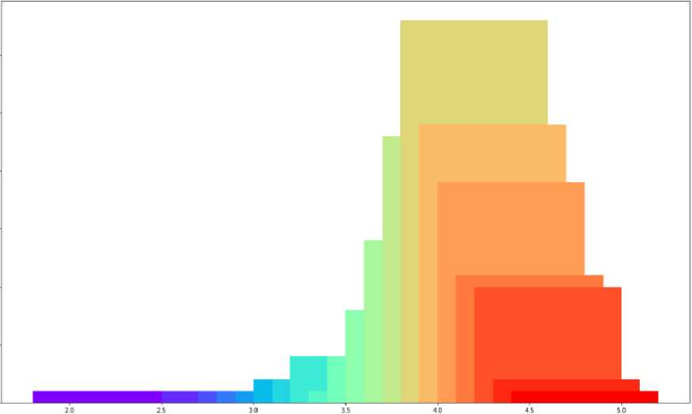
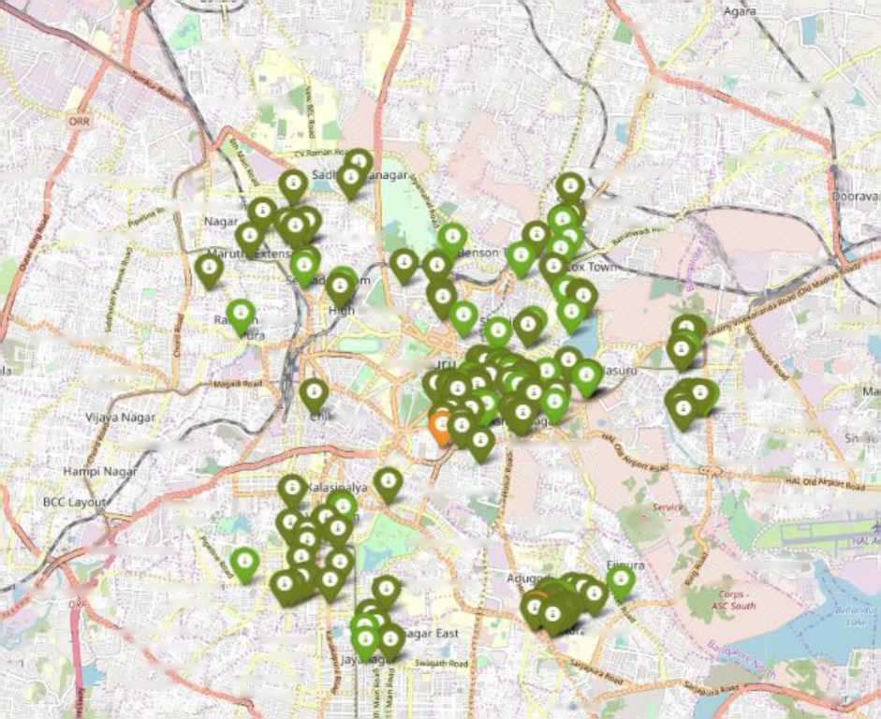
Count of venues with given rating
Rating
Figure 5: Rating and count of venues with that rating
Peenydi
Mdthikere
Sanjay Nagara Raj Mahal Vilas
Amarjyothi
Nagara
H8R Layout
Oeewanarapalya
Rabindranath Tagore Nagar
Suithanpaya
TM
Hennur
Chelekere
Post & Telegraph
Layout
Kalyan Nagar
»ggere Ar Nandini Layout
Porofhvtr
Rrg'fnwt
Training
Cttttft
- PRTt
eingarajapuram
omasrown .poke Town _.v%
Banaswadi
Kuruba^a Halli
■,A Subcahmai
Guttahalli
Baiyyappanahalli.
■an
Grounds
C V Raman
Kamakshi Palya
Bengali
Nagar
Govindaraj
Nagara
Thippa sandra
;kapete
Jervan Bhima Lai Be
layout
Tel eco ip.be yout
Victoria Layout
Naqar
• .V *'
Shanti Nagar
Austin Town
Kodihaili
Vlmanapura
Kasturlbai Nagar ’
Neelasandra
Awtiy
Murugeshpalaya
tivp<
•Byacaranyapura
Wilson Garden
asr Na/lf\ ;
Chailaghatta
^{r}Pantarapa}ya
Banashankar 1st Stage
►shwaranagar
/
Arr >/:a*r*vr
vBanashankan ' 3rd Stage Katnguppe Ittamadu . „ ■
Thyagaraja
Nagar
Banashankar i
imangala
y>r
.2nd Stage
Mud *vald
Iblu
Figure 6: Plot of venues with different ratings
6

Slide 7
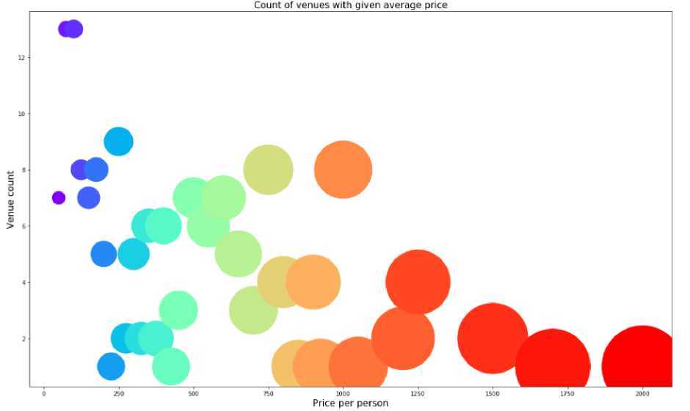
3.3 Price
Next, I explore the average prices of all venues for one person using a scatter plot along with the count of venues with that average price per person. Taking a look at figure 7, reveals that the majority venues have an average cost of Rs 200 to Rs 1000 for one person. Even though the maximum venues lie in that range, the actual range of prices is very different. There are places with average price even as high as Rs 1250+ for one person. ^{I}
Figure 7: Price per person with count of venues with that price
I also plot the venues based on their price range.
7

Slide 8
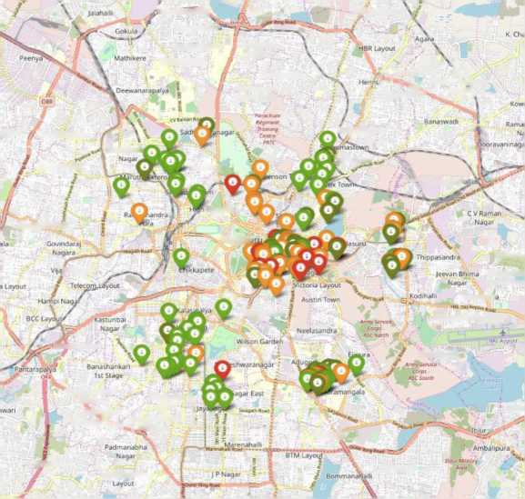
'Nat^hettyKaBj.
Bhoopasdndt
Ashiv.ilh Nagar
Sanjay Nagara Raj Mahal Vilas
Amagyothi
Nagara
, Chelekere \
r^lP|||LkJ Post 8. Telegraph „ . i.¹*⁴*'- Layout.
Kalyan Nagar ' *
Rabindranath Tagore Nagar
Sulthanpalya
aggete Nandim Layout
Subrahma?
fingarajapuram
Kurubara Haili
GuIUhalll
'ooke Town
‘Balyyappana'i
Kamakshi Palya
Grounds
fa Nagar
BengaK
Malleshp,
Vimanapur
Lai Bahadur Shastr l Nagai
Shanti Nagar
Murugeshpalaya
Jyalaianyapur .1
Challaghatu
'^gBanashankari ’’3rd Stage Katrlguppe Ittamadu^s^
Thyagaraja 5 Nagar ^
Banashartkarl !
,2nd Stage *
Betiar
AG5 Layout
Madiwaia
Kumaraswamy
HSR Layout
Figure 8 includes all the venues where high priced venues are marked by orange and red while the low priced venues are marked with green and dark green. From the plot, we observe that venues near VV Puram are primarily lower priced. The venues near MG Road has steep prices. Koramangala seems to have a mix of both high priced and low priced venues.
3.4 Clustering
Finally, I cluster all the venues based on their price range, location and more to identify similar venues and the relationship amongst them. I used KMeans clustering and decided to cluster the venues into two separate groups.
8

Slide 9
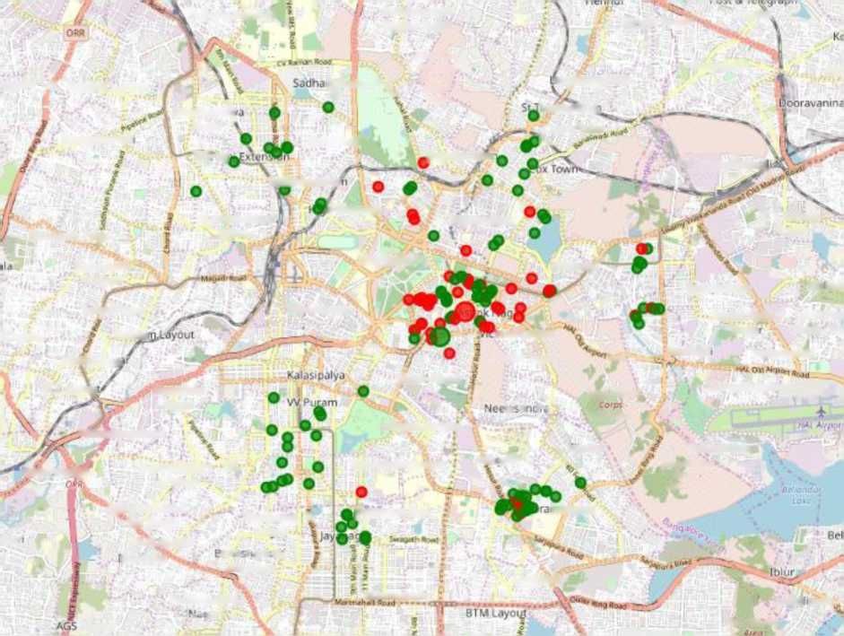
Deewanara paly a
Rabindranath Tagore Nagar
Ka'yan Nagar'
Layout
sggere p Nandini Layout
sj^/anagar.^
PaeoitKtie flrgyirnf Training,' Cmirr Pftft ■
mgarajapuram
Banaswadi
Rai
Subrahmaftj ¹ Nagar *
tiomastowj
Kurubara Hall
\1 j'Ull
Gutuhilll
^Benson Towi
Cooke Town .
IS.
SeAddripurar
' BjiyyjpPdnahjJ
Ran' achandra
h Grounds
Shivaj inagar
C V Raman Nagar
Kamakshi Palya
0ur.i
Bengaluru
Govtndaraj
Nagara
Halasuru'
Thrppasandra
Ma lesl
Vijaya Nagar
#ukkapete
Jeevan Btilma Lai Bahac
iLayout
Hampi Nag.
Telecoi
torra Layout
... Kodihall
Naga
vimanapura
Shastr i N.i
BCC Layou
Kasturibai Nagar f-
Sham* Nagar
Austin Town
NMM
Murugeshpalaya
I.I-I :• I
Army Srswf.
‘Byataranyapura
Wilson Garden
tjipuTfl
Aic Won* f
Challaghatta A'.'TJy\*rv.<e ' Ccrpi v
ASC Sot/Cfr
Panta'apaiya
Banashankari •
Someshwaranaga r
Adu iodl
I st Stage
•^anashankari
Thyagara)a %
[ayanagar East
map gala
war
3rd Stage
ittw
Katnguppe
• Ti r TV ;n i
ttamadu
JP a sidge
Madiwaia
Padmanabha
Marenahalh
Arriba pura
Layout
. • |M
Figure 9: Clusters of venues
HSR Layout
fftit * Muao/y
In figure 9, we see the two clusters:
1. The first cluster (green) is spread across the whole city and includes the majority venues. These venues have mean price range of 1.71 and rating spread around 3.57.
2. The second cluster (red) is very sparsely spread and has very limited venues. These venues have mean price range of 3.21 and rating spread around 4.03.
4. Results and Discussion
After collecting data from the Foursquare and Zomato APIs, we got a list of 237 different venues. However, not all venues from the two APIs were identical. Hence, we had to inspect their latitude and longitude values as well as their names to combine them and remove all the outliers. This resulted in a total venue count of 163.
We identified that from the total set of venues, majority of them were Indian Restaurants and Ice Cream Shops. A visitor who loves Indian Restaurants/Ice Cream Shops would surely benefit from coming to Bangalore.
While the ratings range from 1 to 5, majority venues have ratings close to 4. This means that most restaurants provide good quality food which is liked by the people of the city, thus indicating the high rating. When we plot these venues on the map, we discover that there are
9

Slide 10
clusters of venues around MG Road, Koramangala, VV Puram. These clusters also have very high ratings (more than 3).
When we take a look at the price values of each venue, we explore that many venues have prices which are in the range of Rs 200 to Rs 100 for one person. However, the variation in prices is very large, given the complete range starts from Rs 100 and goes uptil Rs 2000. On plotting the venues based on their price range on the map, we discovered that venues located near VV Puram and Malleshwaram are relatively priced lower than venues in MG Road. A mix of low price and high price exists in Koramangala.
Finally, through clusters we identified that there are many venues which are relatively lower priced but have an average rating of 3.57. On the other hand, there are few venues which are high priced and have average rating of 4.03.
1. If you’re looking for cheap places with relatively high rating, you should check VV Puram or Malleshwaram.
2. If you’re looking for the best places, with the highest rating but might also carry a high price tag, you should visit MG Road.
3. If you’re looking to explore the city and have no specific criteria to decide upon the places you want to visit, you should try Koramangala.
A company can use this information to build an online website/mobile application, to provide users with up to date information about various venues in the city based on the search criteria (name, rating and price).
5. Conclusion
The purpose of this project was to explore the places that a person visiting Bangalore could explore. The venues have been identified using Foursquare and Zomato API and have been plotted on the map. The map reveals that there are three major areas a person can visit: VV Puram, Kormangala, MG Road. Based on the visitor’s venue rating and price preferences, he/she can choose amongst the three places.
10

