Slide 1
PROPOSING FACILITY LAYOUT PLANS FOR PLASTIC BAG MAKING INDUSTRIES WORKING IN MSME SEGMENT
Submitted To
Ms. Swati Bhatt
Presented By
Akshay Dhamija
MSME → Micro small and medium enterprises

Slide 2


To Study layout plans and the factors affecting layout planning. Accordingly proposing an ideal layout plan for the plastic bag making industries in the MSME segment.
Study of various facility layout plans (Process, Product, Fixed, Hybrid)
Situations in which they are best implemented
Study of the material flow process at the Plastic bag making Industries
Proposing the best suitable Layout plan for plastic bag making industries.
Ideal working space → according to ergonomic statistics

Slide 3

A facility layout is an arrangement of everything needed for production of goods or delivery of services. A facility is an entity that facilitates the performance of any job. It may be a machine tool, a work centre, a manufacturing cell, a machine shop, a department, a warehouse, etc. (Heragu, 1997).
The layout design generally depends on the products variety and the production volumes. Four types of organization are referred to, namely fixed product layout, process layout, product layout and cellular layout (Dilworth, 1996).

Slide 4

Decrease Material Handling
Increase productivity of Workers and machines
Effective Employee communication
Increased Employee Safety
Low Risk to materials and Machines
Ease for performing Auxiliary services

Slide 5


Slide 6

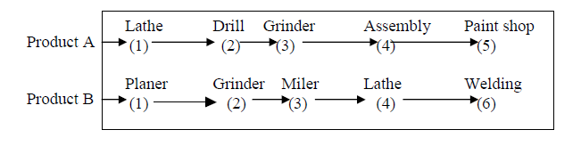

Slide 7

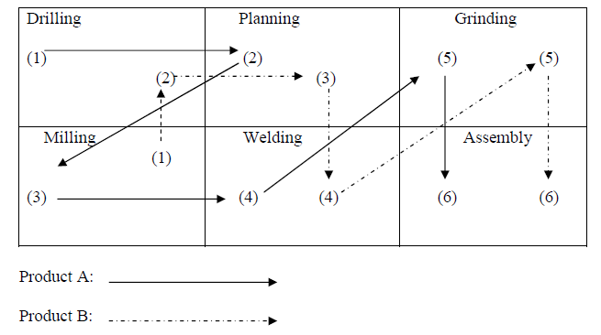

Slide 8

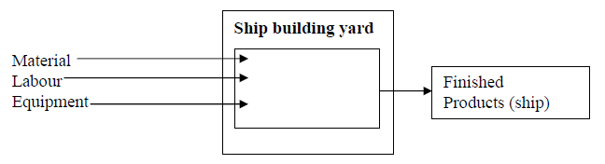

Slide 9


Slide 10
FACTORS | FIXED LAYOUT | PRODUCT LAYOUT | PROCESS LAYOUT | CELLULAR LAYOUT
Product | Made to order, Low volume | Standardized Product, Large volume, stable rate of o/p | Diversified products using common operations, Varying volumes, Varying rate of o/p | Diversified Products, Varying volumes
Process | Large scale project | Continuous and repetitive | Job or small batch | Small to medium batch
Arrangement of facilities | Facilities move where the product is being implemented | Placed along the line of product flow in a specialized sequence of task for each unit | Grouped by specialty and by function | Similar parts are grouped in part-family; one machine cell is formed which contains all facilities needed by corresponding part family

Slide 11
FACTORS | FIXED LAYOUT | PRODUCT LAYOUT | PROCESS LAYOUT | CELLULAR LAYOUT
Cost of Layout | General purpose equipment. Moderate to low. | Large investment in specialized equipment and processes. | General purpose equipment and processes. Moderate to high | Moderate to Low
Inventory | Variable inventories and frequent tie-ups because production cycle is generally long | High turnover of raw material and work in process | Low turnover of raw material and work in process, High raw material inventory | High turnover of raw material and lower work in process
Material Handling | Flow variable, often low. May require heavy duty handling equipment | Predictable, flow systemized and often automated | Flow variable, handling often duplicated. | Flow variable can be reasonably high.
Material Travel | Variable path | Fixed path | Often high | Fixed path

Slide 12

Quantity
Product
Layouts
Fixed
Position
Layouts
Mixed Layouts
Process Layouts
Number of Different Products

Slide 13


Space Shortage
Inability to make huge investments on machines and assistance equipments
Shop Based Production
Three product varieties with common processing operations
Expensive machinery
Certain amount of Technical specialization in machines

Slide 14

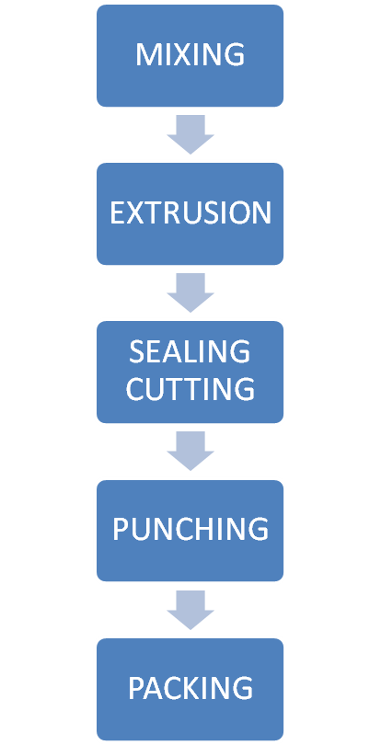
Product Category III → Rolls
Product Category II Unpunched Bags
Product Category I → Punched Bags
Product Category II → Unpunched Bags

Slide 15

Standardized Product
Large volume
stable rate of o/p
Continuous and repetitive Process
Large investment in specialized equipment and processes.
Features not suitable for Shop based production
Contradicting to MSME constraints

Slide 16
Made to order, Low volume
Facilities move where the product is being implemented
General purpose equipment.

Slide 17

Diversified Products, Varying volumes
Small to medium batch
Similar parts are grouped in part-family
one machine cell is formed which contains all facilities needed by corresponding part family
Cost of layout → Moderate to Low
Inventory → High turnover of raw material and lower work in process
Material handling → Flow variable can be reasonably high.
Movement path → Fixed path

Slide 18
Diversified products using common operations
Varying volumes
Varying rate of o/p
Job or small batch
Equipment cost Moderate to high
Features suitable for Shop based production
Inline with MSME requirements

Slide 19

Production Volume 2400Kg/24hr
RM Inventory held at any time 20tonnes
Product Category I, Punched Bags 576 Kg/day
Product Category II, Un-punched Bags 864Kg/day
Product Category III, Rolls 960 Kg/day
Capacity of 1 Extrusion Machine 20Kg/hr
Capacity of 1 Sealing Cutting Machine 15Kg/hr
Capacity of 1 Punching Machine 24Kg/hr
Packing Capacity of 1 person 12 packet of 5Kg each
Machines
Extrusion 5
Sealing cutting 4
Punching 1
Packers 1

Slide 20


Slide 21

DEPT. CODE | DEPARTMENT NAME
S1 | STOCK
S2 | MIXING
S3 | EXTRUSION
S4 | SEALING CUTTING
S5 | PUNCHING
S6 | PACKING
S7 | FG INVENTORY

Slide 22

PRODUCT GROUP | PERCENTAGE VOLUME | FLOW PATH THROUGH DEPARTMENTS
I → Punched bags | 40% | S1,S2,S3,S4,S5,S6,S7
II → Unpunched bags | 36% | S1,S2,S3,S4,S6,S7
III → Rolls | 24% | S1,S2,S3,S7

Slide 23


Slide 24
S1
100%
S1
S2
100%
S2
100%
S3
76%
40%
S4
S5
S2
S3
S3
S4
100%
76%
S7
S6
24%
36%
S4
36%
S4
S5
40%
S6
76%
S6
S7
40%
S5
40%
76%
S6
S7
S3
24%

Slide 25


Slide 26

40 cm
20 cm
70 cm
Weight → 25Kg

Slide 27

Ideal Pickup height for a sack of 25Kg weight
Minimum storage height / level = 25” = 0.635 m
Maximum storage height / level = 69.8” = 1.773 m
Height of Stack = 1.773 – 0.635
= 1.138 m
Height of department to store the stack = 1.138 + 0.1
= 1.238 m
Height above floor = 0.635 m
Height of one sack = 0.2 m
No of sacks in one stack = 1.138 / 0.2
= 5.69
≈ 5 sacks

Slide 28

No of stacks for storing 800 sacks = 800/5
= 160 stacks
= 2 * 2 * 2 * 2 * 2 * 5
= 16 * 10
i.e.
No. of rows for storing RM stock = 16
No. of columns for storing RM stock = 10
Length of Raw material warehouse = (10 * 40cm) + (70cm + 21.1”)
= 4 + 1.236
= 5.236 m
Width of Raw material warehouse = (16 * 0.7) + (0.1 * 2)
= 11.4 m
Area required for storing 800 Raw Material Sacks = 5.236 * 11.4
= 59.6904 m²

Slide 29
Area required for storing 800 Raw Material Sacks = 5.236 * 11.4
= 59.6904 m²
Width = 11.4 m
13.8 cm
Length = 5.236 m
Height = 1.138 m
10 cm
1.236 m
(70cm + 21.1”)

Slide 30

No of stacks for storing 116 sacks = 116/5
= 23.2
≈ 24 stacks
= 2 * 2 * 2 * 3
= 4 * 6
i.e.
No. of rows for storing FG Inventory = 4
No. of columns for storing FG Inventory = 6
Length of Finished Goods warehouse = (6 * 0.4) + (70cm + 21.1”)
= 2.4 + 1.236
= 3.636 m
Width of Finished Goods warehouse = (4 * 0.7) + (0.1 * 2)
= 3 m
Area required for storing 116 Finished Good Sacks = 3.636 * 3
= 10.908 m²

Slide 31
Area required for storing 116 Finished Goods Sacks = 3.636 * 3
= 10.908 m²
Width = 3 m
10 cm
Length = 3.636 m
Height = 1.238 m
10 cm
1.236 m
(70cm + 21.1”)

Slide 32

Area of mixer = (L) 2’ * (W) 4’ = 0.6096 m * 1.2192 m
= 0.7432 m²
Height of mixer = 3’ = 0.9144 m
Area of mixing tub = (L) 20” * (W) 42” = 0.508 m * 1.0668 m
= 0.5419 m²
Area of five mixing tubs = 5 * 0.5419 m²
= 2.7096 m²
Height of tub = 18” = 0.4572 m
Area for Parallel Alley = (L) 2’ * (W) (39.5” * 1.5)
= 0.6096 m * 1.50495 m
= 0.9174 m²
Area for four parallel alleys = 4 * 0.9174 = 3.6696 m²
Height of Parallel Alley = 100” = 2.5 m
Area for Perpendicular Alley = (L) (39.5” * 1.5) * (W) (4’ + (42” * 2) + ((39.5” * 1.5)*2))
= 1.505 m * 6.3627 m
= 9.5758 m²
Height of Perpendicular Alley = 100” = 2.5 m

Slide 33
0
Height = 2.5 m
Length = 2.6226 m
Width = 6.3627 m
Total Area Needed = 0.7432 + 2.7096 + 3.6696 + 9.5758
= 16.6982 m²

Slide 34

Area of one machine = (L)10’ * (W)11’ = 3.048 * 3.3528
= 10.22 m²
Area of five machines = 5 * 10.22 m²
= 51.1 m²
Height of machine = 14’ = 4.3m
Area for one parallel Alley = (L) 10’ * (W) (39.5” * 1.5)
= 3.048 * (1.0033 * 1.5)
= 4.587 m²
Area for four parallel Alleys = 4 * 4.587
= 18.35 m²
Height of Alley = 100” = 2.54 m
Area for all perpendicular Alleys
= (L) (39.5” * 2) * (W) {(11’ * 3) + (39.5” * 1.5 *2)}
= (1.0033 * 2) * {(3.3528 * 3) + (1.0033 * 1.5 * 2)}
= 26.223 m²

Slide 35
Height = 4.3 m
Length = 8.1026 m
Width = 13.0683 m
Total Area Needed = 51.1 + 18.35 + 26.223
= 95.673 m²

Slide 36

Area of one machine = (L)11’ * (W) 6’
= 3.3528 m * 1.8288 m = 6.1316 m²
Area of four machines = 4 * 6.1316 m²
= 24.5264 m²
Height of machine = 6’ = 1.8288 m
Area for one parallel Alley = (L) 11’ * (W) (39.5” * 1.5)
= 3.3528 * 1.505
= 5.046 m²
Area for four parallel Alleys = 4 * 5.046
= 20.1832 m²
Area for one perpendicular Alley
= (L) (39.5” * 2) * (W) {(11’ * 2) + (39.5” * 1.5 *2)}
= 2.0066 * (6.7056 + 3.0099)
= 19.4951 m²
Area for three perpendicular Alley (last one taken half)
= 2.5 * 19.4951 m²
= 48.7378 m²

Slide 37
Height = 93.7” = 2.38 m
Length = 11.7221 m
Width = 9.7155 m
Total Area Needed = 24.5264 + 20.1832 + 48.7378
= 93.4474 m²

Slide 38

Area of punching machine = (L)22” * (W)28” = 0.5588 * 0.7112
= 0.4 m²
Height of machine = 67” = 1.7 m
Area for parallel Alley = (L) (0.5) * (W) (0.3)
= 0.15 m²
Height of Alley = 0.7 m
Area for perpendicular Alley
= (L) (39.5” * 1.5) * (W) (18” * 2)
= 1.3761 m²
Height for perpendicular Alley = 93.7” = 2.38 m

Slide 39
Height = 93.7” = 2.38 m
Length = 2.064 m
Width = 36 m
Total Area Needed = 0.4 + 0.15 + 1.3761
= 1.9261 m²

Slide 40

Area of weighing machine cum packing table = (L)0.40 * (W) 0.90
= 0.36 m²
Height of machine = 25” + 1 m = 1.635 m
Area for parallel Alley = (L) (0.8) * (W) (0.4)
= 0.32 m²
Height of Alley = 1.4 m
Area for perpendicular Alley
= (L) (39.5” * 1.5) * (W) (18” * 2) = 1.50495 * 0.9144
= 1.3761 m²
Height for perpendicular Alley = 93.7” = 2.38 m

Slide 41
Total Area Needed = 0.36 + 0.32 + 1.3761
= 2.0561 m²
Height = 2.38 m
Length = 1.904 m
Depth 15 cm
Width = 1.3144 m

Slide 42

DEPT. CODE | DEPARTMENT NAME | DEPARTMENT AREA (L X W)
S1 | STOCK | 59.6904
S2 | MIXING | 16.6982
S3 | EXTRUSION | 95.673
S4 | SEALING CUTTING | 93.4474
S5 | PUNCHING | 1.9261
S6 | PACKING | 2.0561
S7 | FG INVENTORY | 10.908

Slide 43

S2 | MIXING
S3 | EXTRUSION
S1 | STOCK
S4 | SEALING CUTTING
S7 | FG INVENTORY
S5 | PUNCHING
S6 | PACKING
Rolls
Un-punched Bags
Punched Bags

Slide 44


Slide 45


Slide 46

DEPT. CODE | DEPARTMENT NAME
S1 | RM STOCK
S2 | MIXING
S3 | EXTRUSION
S4 | SEALING CUTTING
S5 | PUNCHING
S6 | PACKING
S7 | FG INVENTORY
S8 | CONFERNCE CUM DINING HALL
S9 | REST ROOM
S10 | OFFICE
S11 | RECREATION CENTRE

Slide 47

VALUE | CLOSENESS PRIORITY | LINE CODE | NUMERICAL WEIGHTS
A | Absolutely Important |  | 16
E | Especially Important |  | 8
I | Important |  | 4
O | Ordinary Closeness OK |  | 2
U | Unimportant |  | 0
X | Undesirable | ^^^^^^ | -80

Slide 48

CODE | REASON
1 | Movement of material
2 | Movement of personnel
3 | Ease of Supervision
4 | Common Personnel
5 | Psychology
6 | Share same space
7 | Noise
8 | Contamination
9 | Safety

Slide 49


Slide 50
 | S2 | S3 | S4 | S5 | S6 | S7 | S8 | S9 | S10 | S11
RM STOCK | A | U | U | U | U | U | X | X | O | X
 | 1 |  |  |  |  |  | 5,9 | 9 | 3 | 5,9
MIXING |  | A | U | U | U | U | X | X | U | X
 |  | 1,4 |  |  |  |  | 5,8 | 8 |  | 5,8
EXTRUSION |  |  | E | X | X | I | X | U | X | X
 |  |  | 1 | 7 | 7 | 1 | 5,7 |  | 7 | 5,7
SEALING CUTTING |  |  |  | E | E | U | X | U | U | X
 |  |  |  | 1 | 1 |  | 5 |  |  | 5
PUNCHING |  |  |  |  | A | U | X | U | U | X
 |  |  |  |  | 1,6 |  | 5 |  |  | 5
PACKING |  |  |  |  |  | A | X | U | I | X
 |  |  |  |  |  | 1 | 5 |  | 3 | 5
FG INVENTORY |  |  |  |  |  |  | X | X | I | X
 |  |  |  |  |  |  | 5,9 | 9 | 3 | 5,9
CONFERENCE CUM DINING HALL |  |  |  |  |  |  |  | I | O | I
 |  |  |  |  |  |  |  | 2,5 | 2,3 | 2,5
REST ROOM |  |  |  |  |  |  |  |  | X | U
 |  |  |  |  |  |  |  |  | 5
OFFICE |  |  |  |  |  |  |  |  |  | O
 |  |  |  |  |  |  |  |  |  | 3
RECREATION CENTRE
1 | Movement of material
2 | Movement of personnel
3 | Ease of Supervision
4 | Common Personnel
5 | Psychology
6 | Share same space
7 | Noise
8 | Contamination
9 | Safety

Slide 51


Slide 52
^^^^^^^^^^^^^^^^^^^^^^^^^^^^^^^^^^^^^^^^^^^
^^
^^
^^^^^^^^^^^
^^
STOCK
OFFICE
RECREATION CENTRE
^^^^^^^^^^^^^^
^^
MIXING
PUNCHING
PACKING
^^
^^
^^^^^^^^^^^^
^^^^^^^^
^^^^^^^^^^^^^^^^^^^^^^
^^^^^^^
^
^^^^^^^^^^^^^^^^^^^^^^^^^^^
^^^^^^^^
^^^^^^^^^^^^^^^^^^^^^
^^
^^
^^
EXTRUSION
SEALING CUTTING
^^^
FG INVENTORY
^^
^^^^^^^^
^^^^^^^
CONFERNCE CUM DINING HALL
REST ROOM
^^
^^^^^^^^^^^^^^
^^^^^^^^^^^^
^^^
^^^^^^^^^^^^^^^^^^^^^^^^^^

Slide 53


Slide 54
Height = 2.38 m
Length = 1.904 m
Width = 1.3144 m

Slide 55
Sealing Cutting Department
Punching Department
Packing Department
Height = 2.38 m
FG Inventory Department
Extrusion Department
Mixing Department
Length = 1.904 m
RM Stock Department
Width = 1.3144 m

Slide 56

The proposed facility layout plan is company specific as the layout would highly depend on the area available with the company.
The layout may also vary depending on the priorities for the management.
The layout plan suggested would also vary depending on the government rules and regulations.

Slide 57


Slide 58


