Slide 1
X APP BuSINESS PROCESS MODELING

Slide 2

Customer downloading and installing the app from Play store/App store

Slide 3


Customer signing up and configuring the App

Slide 4


Customer Successfully Subscribes the Plan

Slide 5



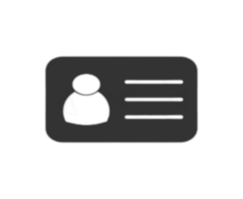

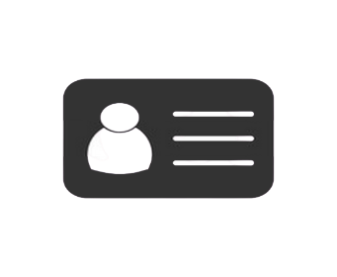
Instant notification and reflection on backend platforms on successful subscription. And cross-checking the enrollment.

Slide 6

Customer care and Support center Welcomes the subscriber

Slide 7

Concerned trainer’s work to rule

Slide 8


Respective trainers providing session to subscribers

Slide 9

In house Training for Staffs and Trainers to achieve goal

Slide 10

Business Achievement Meet

Slide 11
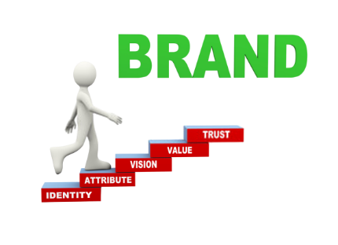

Branding & Marketing

Slide 12


Market Research

Slide 13
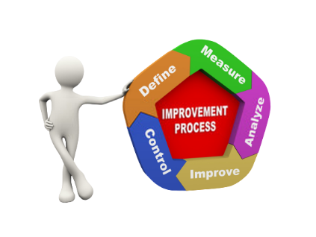

Applying 6 Sigma

Slide 14



Data storage, security and recovery

Slide 15

Board Meeting & Decision making

Slide 16
DETAILED WORKFLOW CHART

Slide 17
