Slide 1
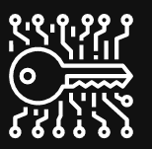
OnePass

Slide 2

Database
OnePass Database is stored on MongoDB atlas’s AWS Cloud

Slide 3
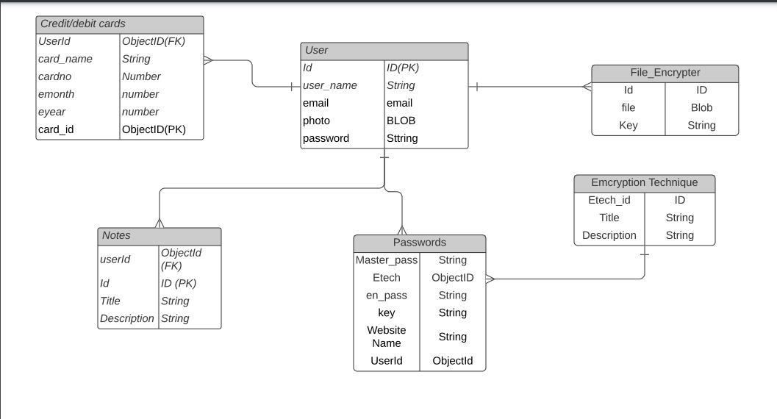
ER Diagram

Slide 4
Work Done Up till now…
Back-End
Front-End
Routing
Backend API
User Methods (login, Signin, Signout)
Schema & Database Connectivity
Notes methods( Encryption & Decryption and CRUD operations )
Local Sever (localhost Server for local hosting)
Card Methods (CRUD operations)
Created Home Page
SignIn/Signup Page
Added styling with CSS and bootstrap and font awesome.
Made web pages responsive and compatible with multiple screen sizes

Slide 5
Coming Up..
Back-End
Front-End
Password CRUD operations
File Encryption & Decryption
Backend API Testing
Backend to frontend Connectivity
Backend and Frontend API Testing
Creating smooth scroll for home page.
Connecting home page with other pages and setting up proper navigation.
Designing layout for webapp, having all the necessary options.
Connecting front-end to back-end through APIs.

Slide 6
Deployment
The deployment process will begin after the completion of development.
The complete web app will be deployed on a public cloud which will be either of AWS/Azure.
The application will wrapped in containers tested on local system and then deployed onto the cloud.
CI/CD pipeline will be created for code.
Once deployed web app can be accessed from any system without any hardware or software dependency, the user just need internet connection on the device.

