Slide 1
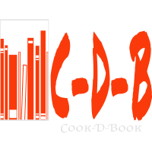
COOK-D-BOOK

Slide 2
INDEX
Introduction
Existing system
Proposed system
Requirements
Need
Scope
Benefits
Planning
User interface
Database
conclusion

Slide 3
INTRODUCTION
The project titled COOK-D-BOOK is book selling software for monitoring and controlling the transactions of buying and selling books .The project “COOK-D-BOOK” is developed in php, which mainly focuses on basic operations in a library like selling and buying second hand books, and updating new information, searching books and members and return books.
This project of “COOK-D-BOOK” of gives us the complete information about the library. We can enter the record of new books and retrieve the details of books available in the library. We can issue the books to the students and maintain their records and can also check how many books are issued and stock available in the library.
Throughout the project the focus has been on presenting information and comments in an easy and intelligible manner. The project is very useful for those who want to get books.

Slide 4
Existing system
Second hand books are not so much available in market.
Lack of consistency in buying and selling second hand books.
All the records are not well maintained.
Less chance of finding books.
Easy buyer seller communication.

Slide 5
Proposed system
The project “COOK-D-BOOK” mainly focuses on basic operation like buying and selling second hand books.
Easy search options.
Secured and consistent database.
Email verification.

Slide 6
Core components
Frontend- HTML5, CSS, javascript, bootstrapv4.6, ajax.
Backend- php, Wamp server.
Database- MySql (lite), PhpMyAdmin.
Tools- visual studio code, Netbeans.
Processor required- pentium Iv or higher.
Ram required- 128mb or higher.
Hosted in 000webhost.com.

Slide 7
NEED
For every customer and student it is not possible to purchase the book at MRP(Marked Retail Price).
So this system is very helpful for students.
They can easily find second hand books at a reasonable price and buy them.
And if they have books that are not use of them then they also can sell their books.

Slide 8
SCOPE
The scope of this project is to provide improved and optimized service, so that all manual work is converted into computerized.
It is easy to find second hand books online rather than finding at different book stores.

Slide 9
BENEFITS
Availability- the availability of software is easy and for everyone.
Correctness- the result of the function are pure and accurate.
Maintainability- after the deployment if the project if any error occurs then it can be easily maintained by software developer.
Portability- the software can be deployed at any machine.

Slide 10
PLANNING
MANAGEMENT & ORGANIZATION SECTION-
Sagar Gupta-Front end.
Akshay Turkar- backend, Database.
Rashad Ahemad- Database.
Wajahat Khan- designing.

Slide 11
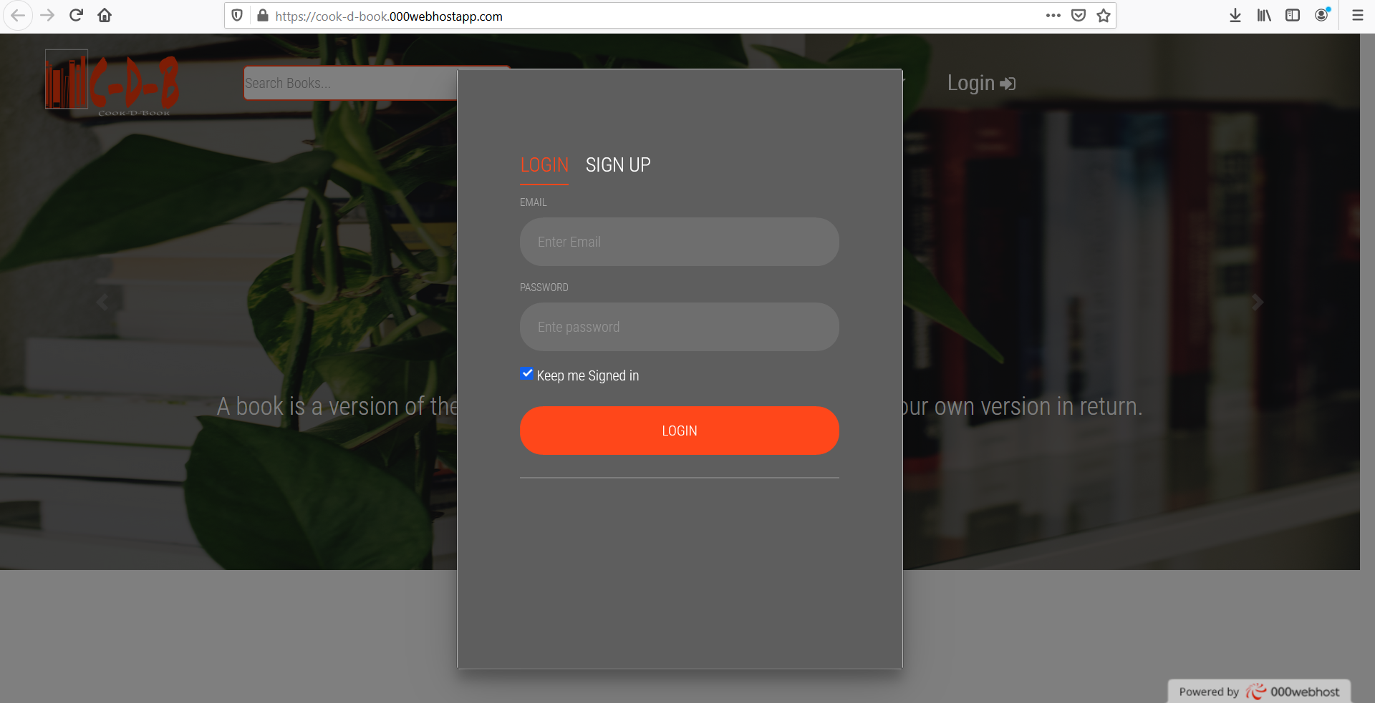
User interfaces login page-

Slide 12
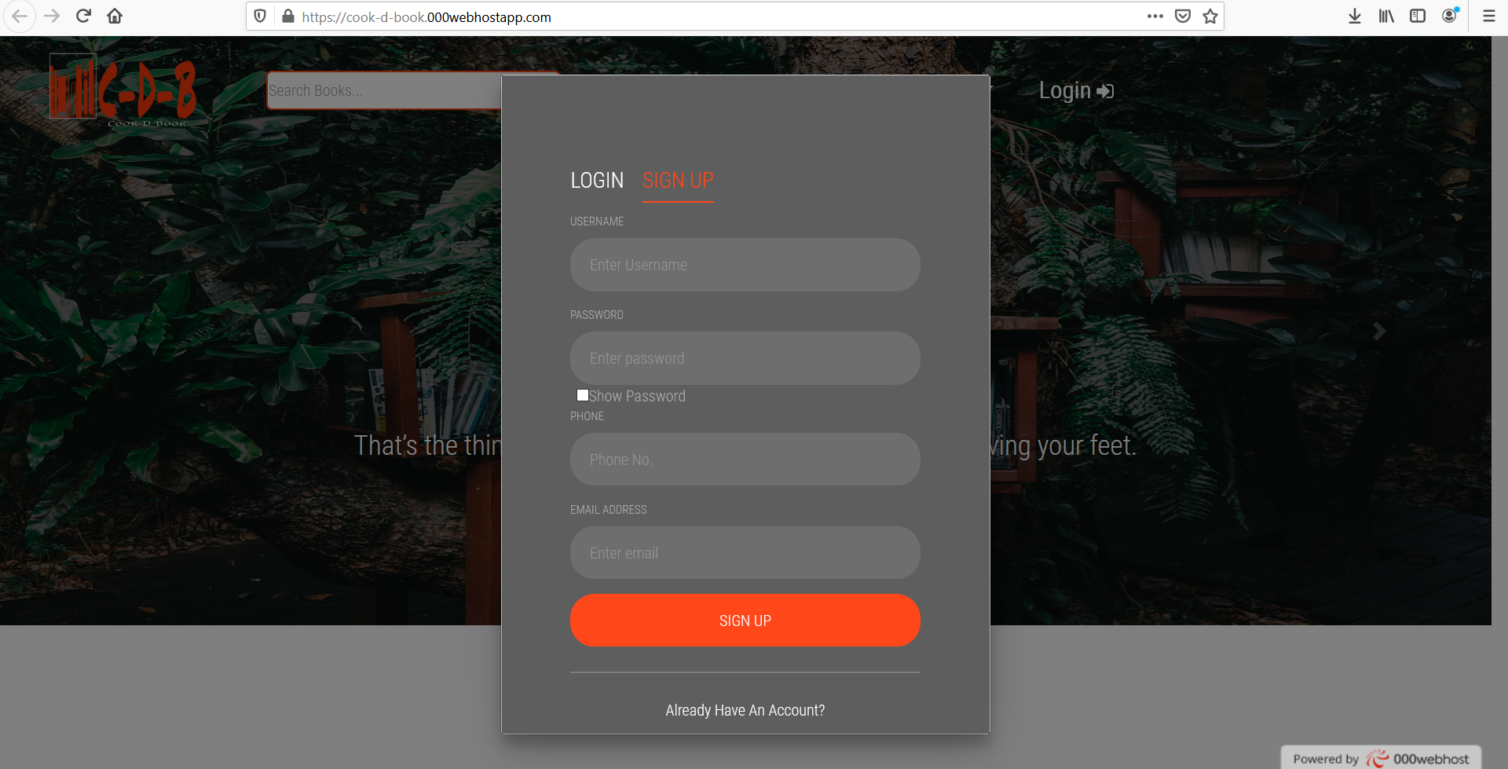
Sign up page-

Slide 13
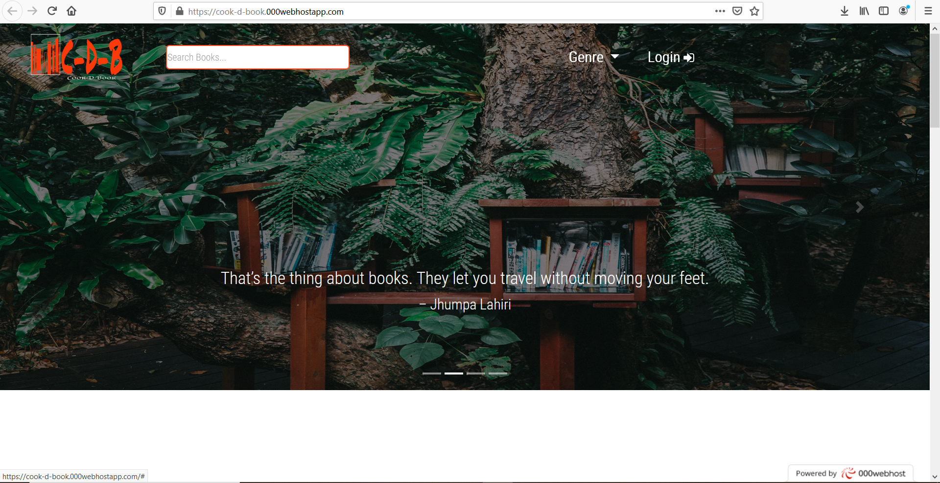
Home page-

Slide 14
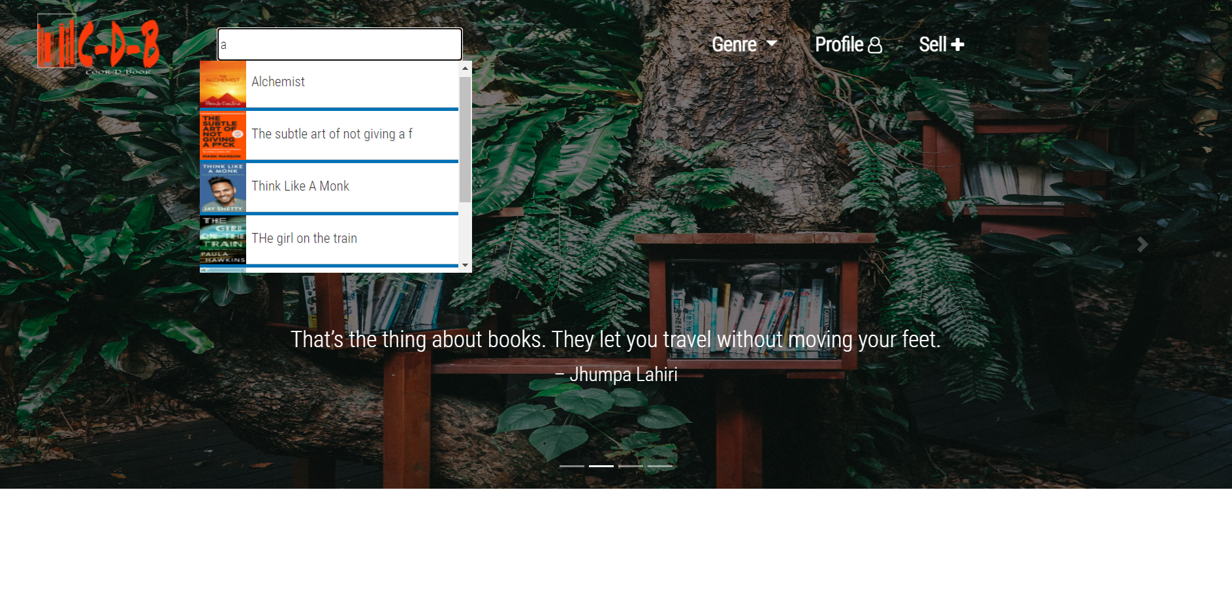
Dynamic search bar-

Slide 15
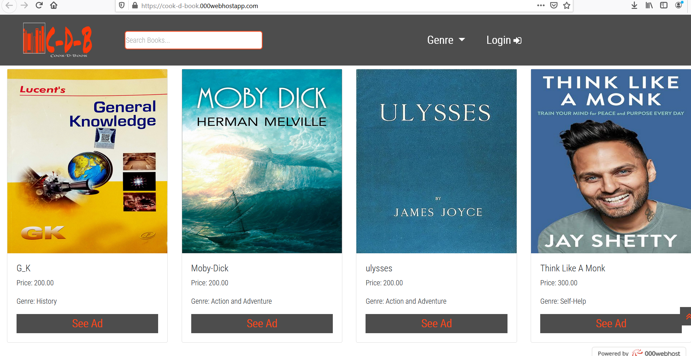
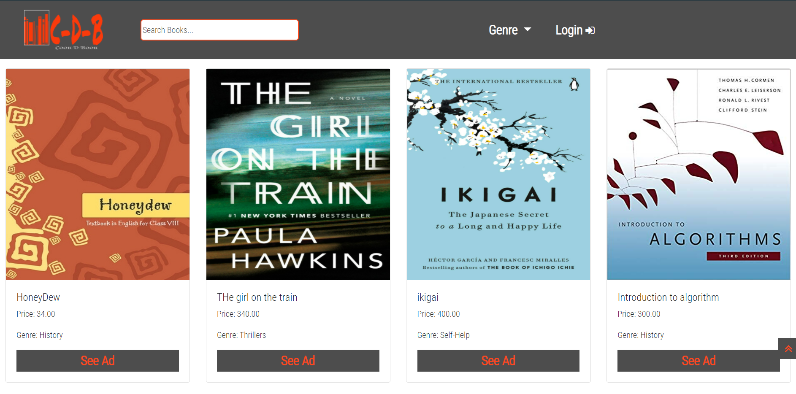
Books-

Slide 16
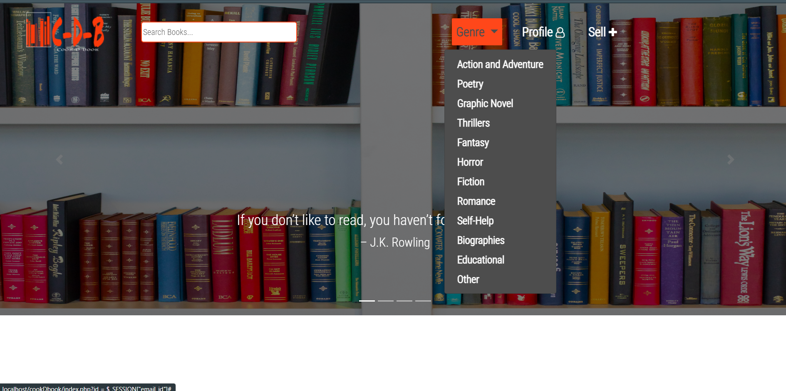
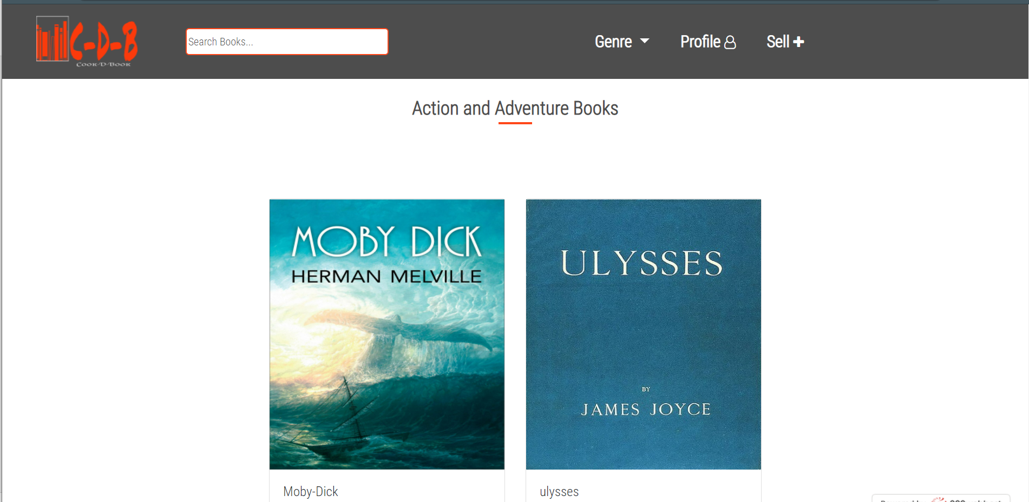
Genre-

Slide 17
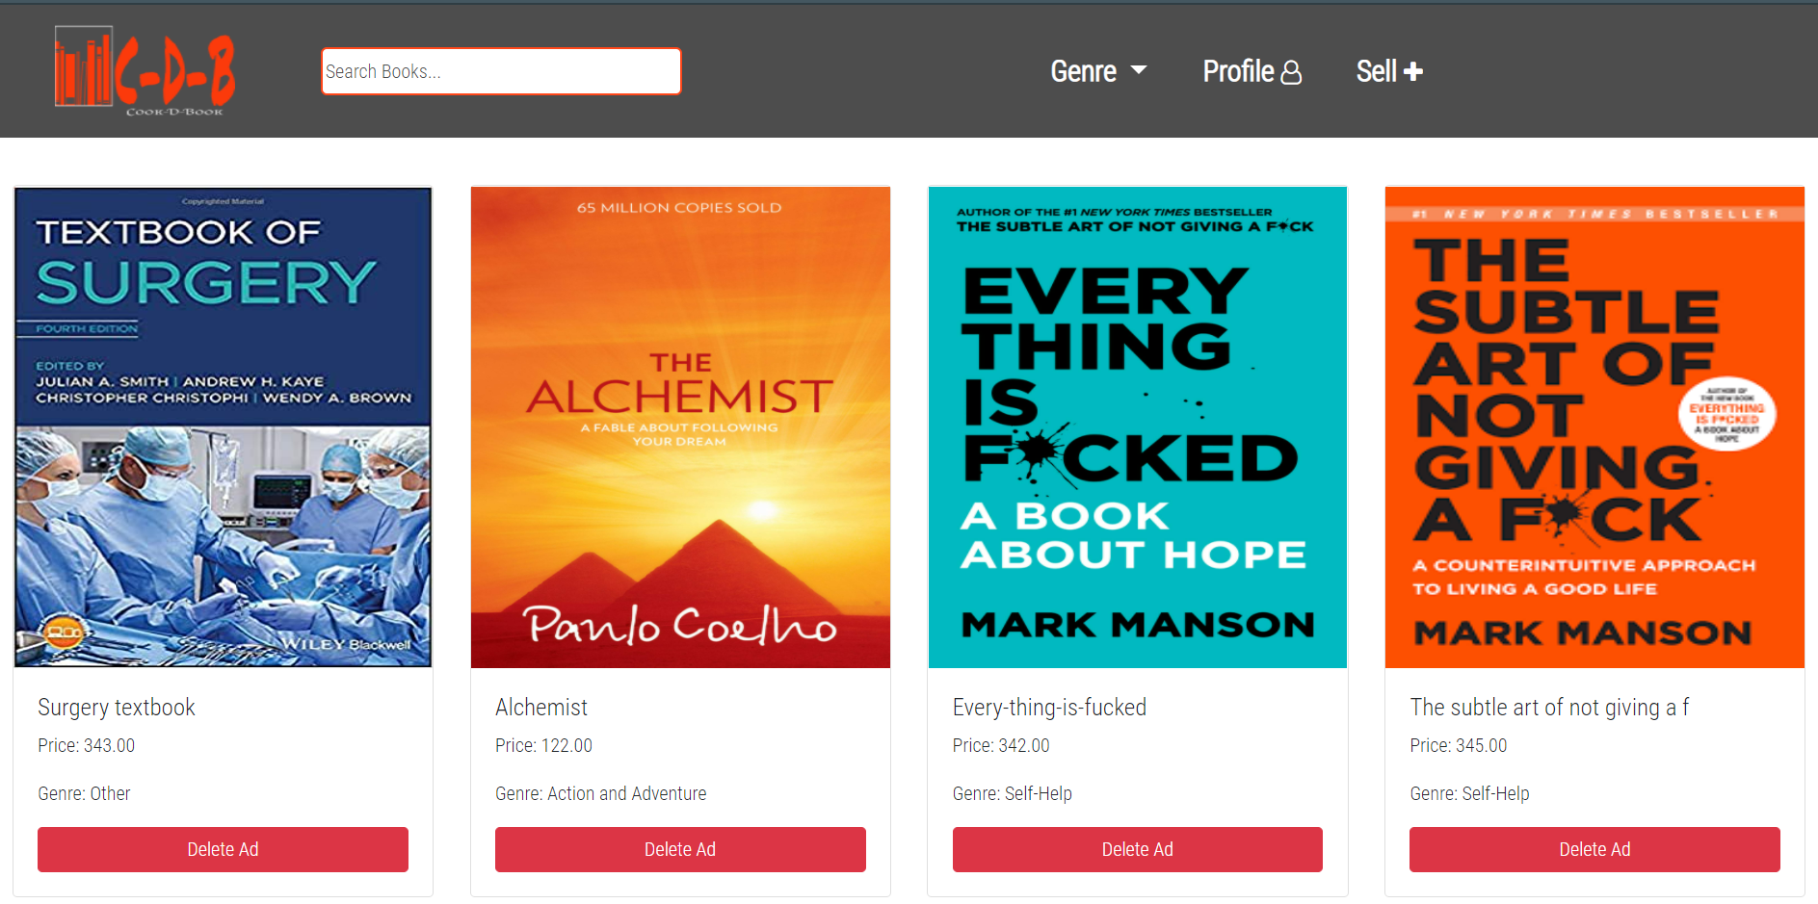
My Ads-

Slide 18
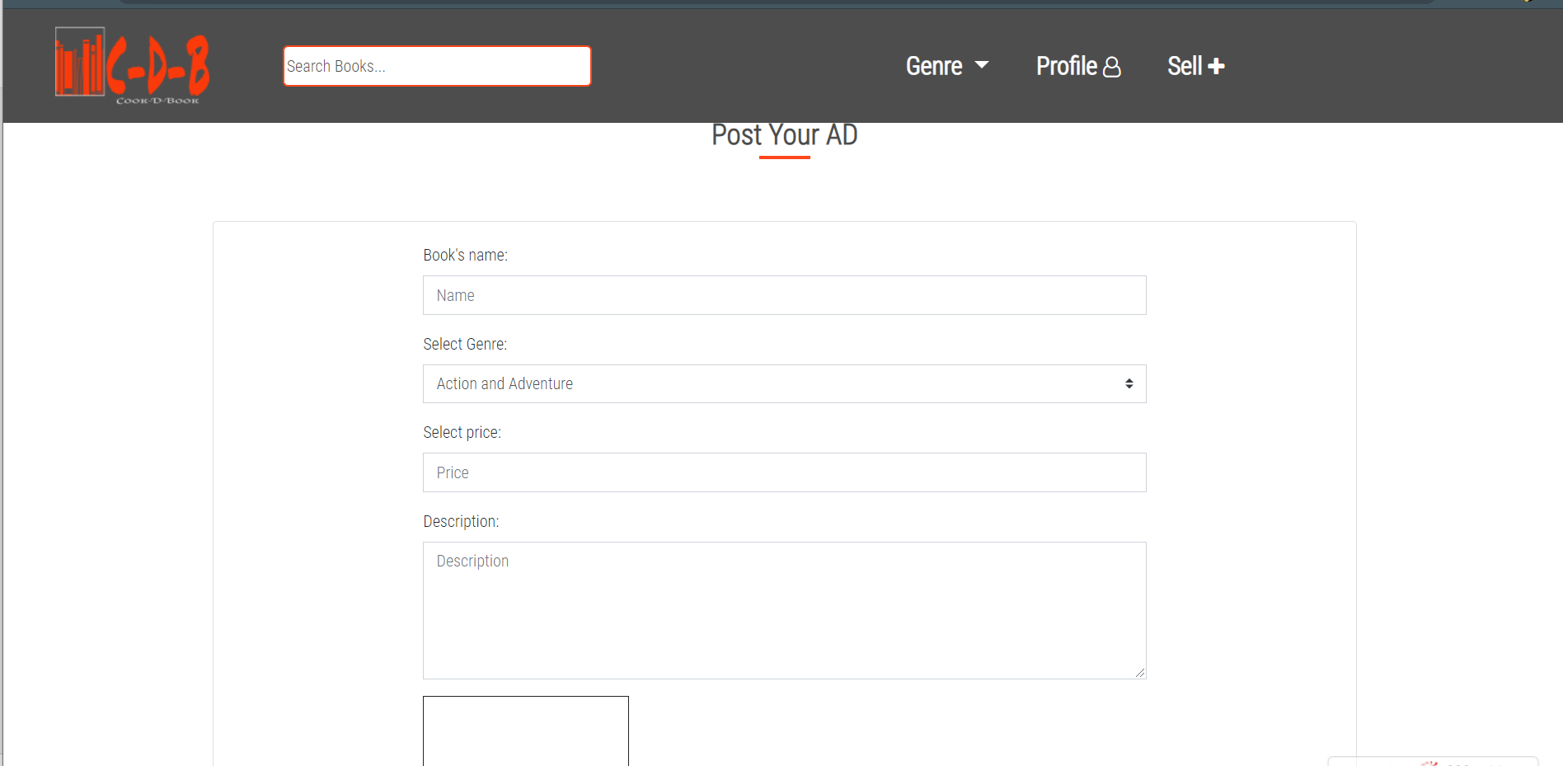
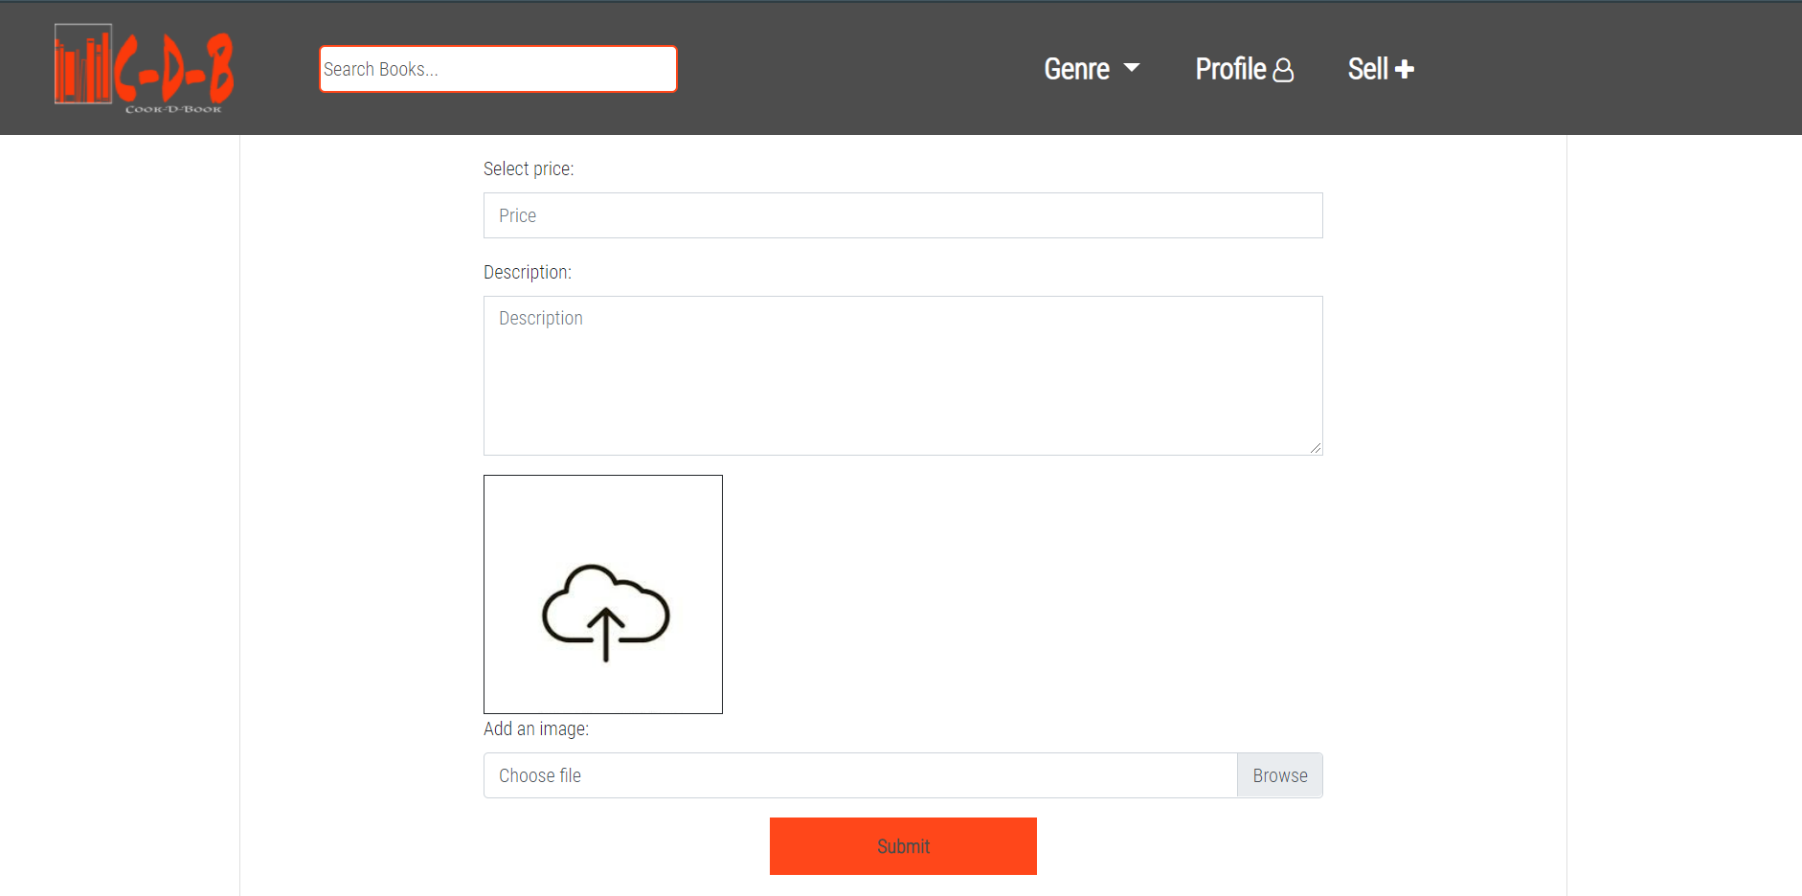
Sell-

Slide 19
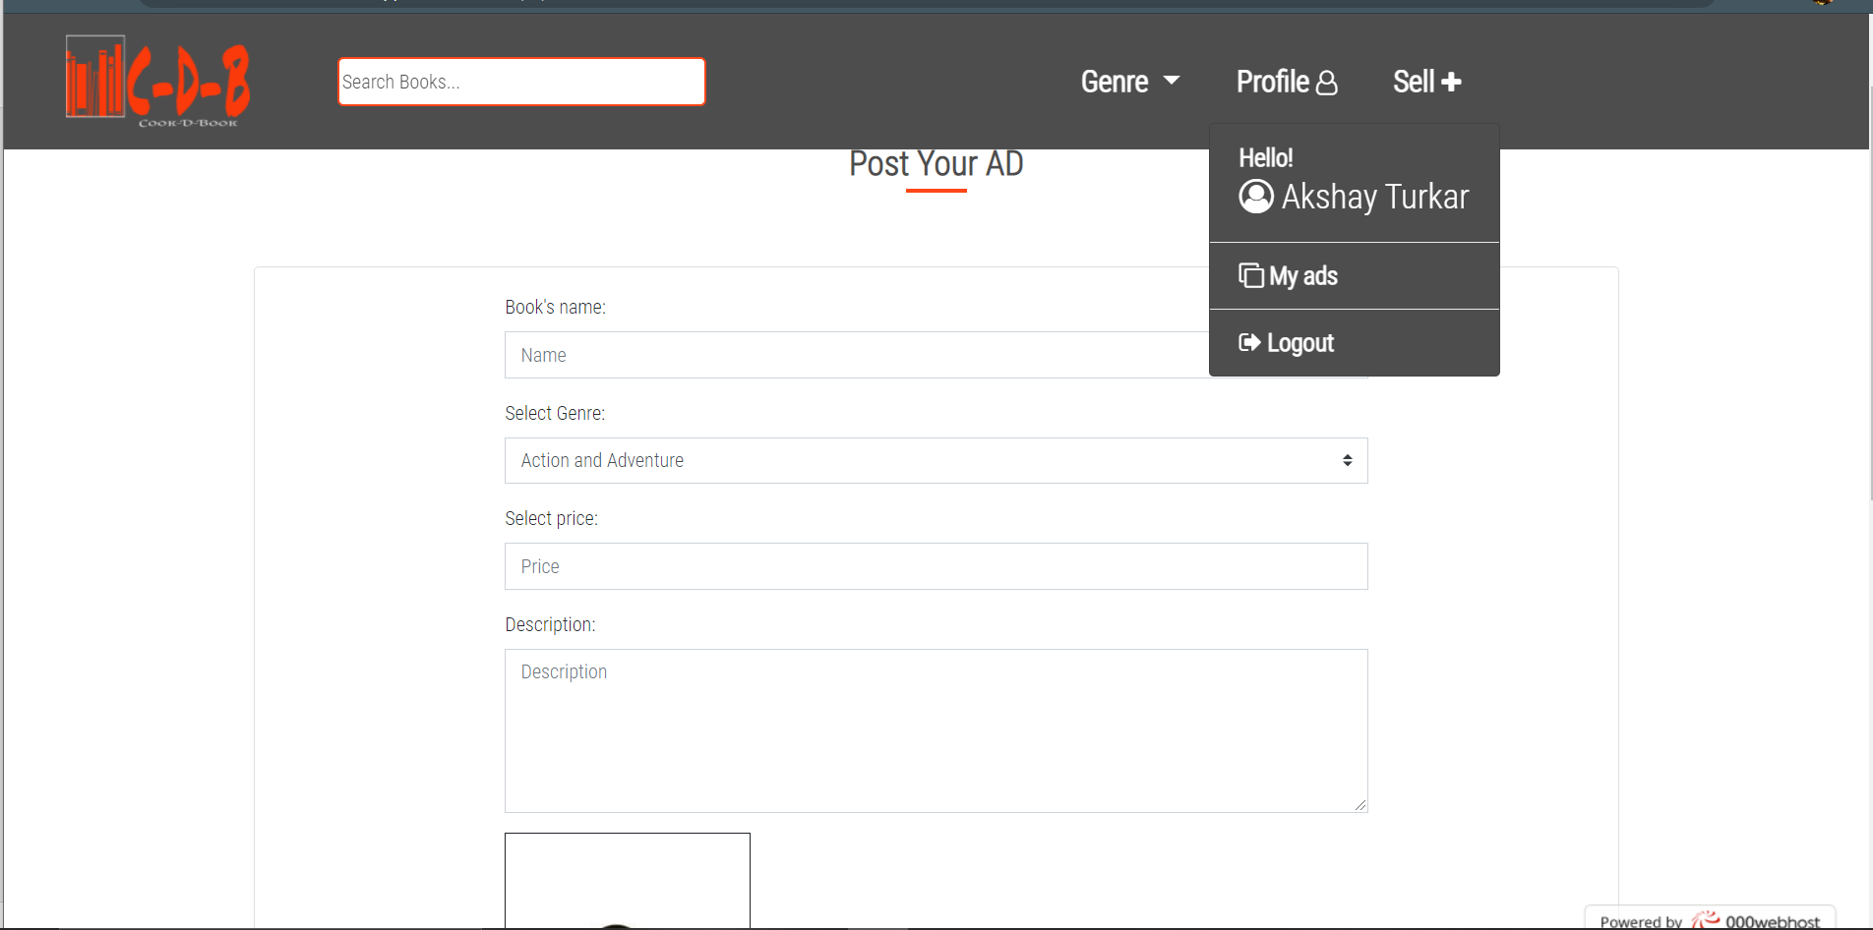
Profile-

Slide 20
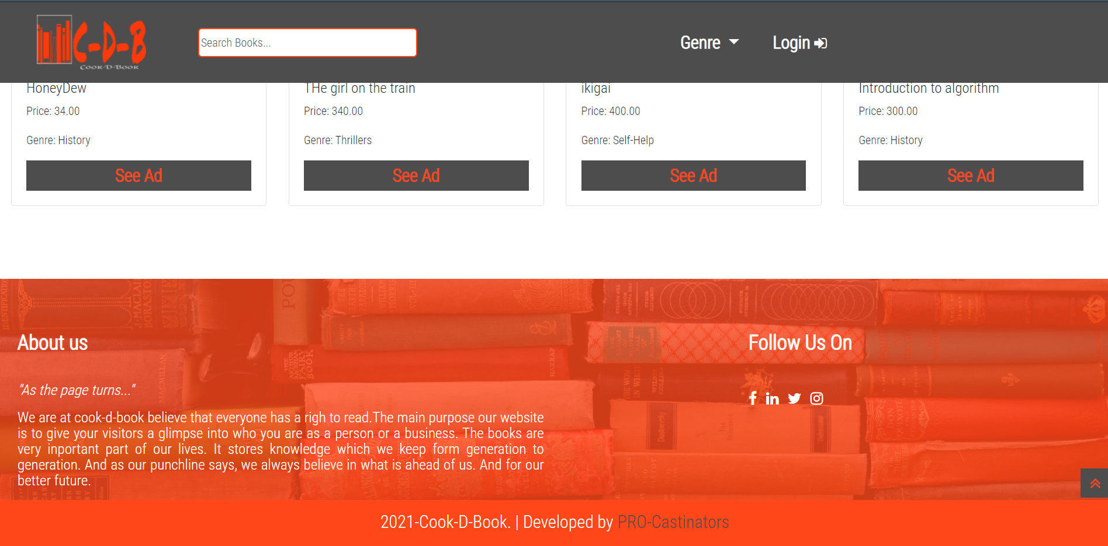
Footer-

Slide 21
Database - cookdbook
Tables – users, products

Slide 22
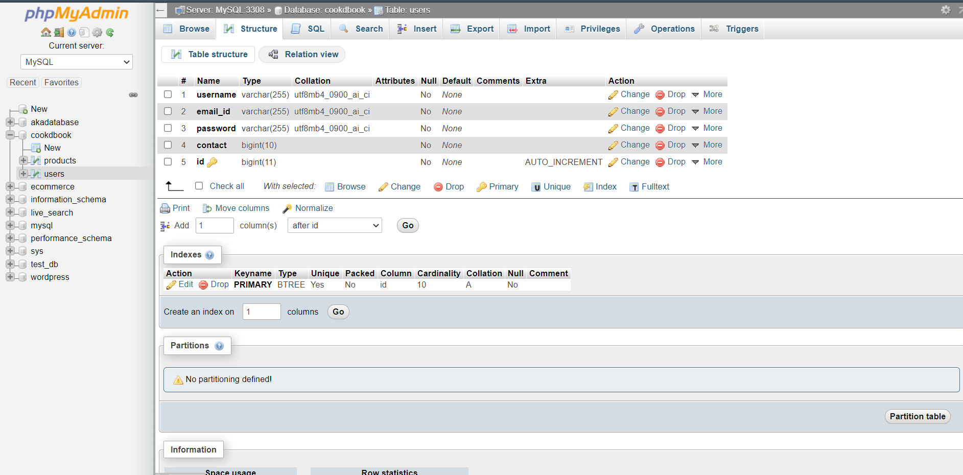
Table - user

Slide 23
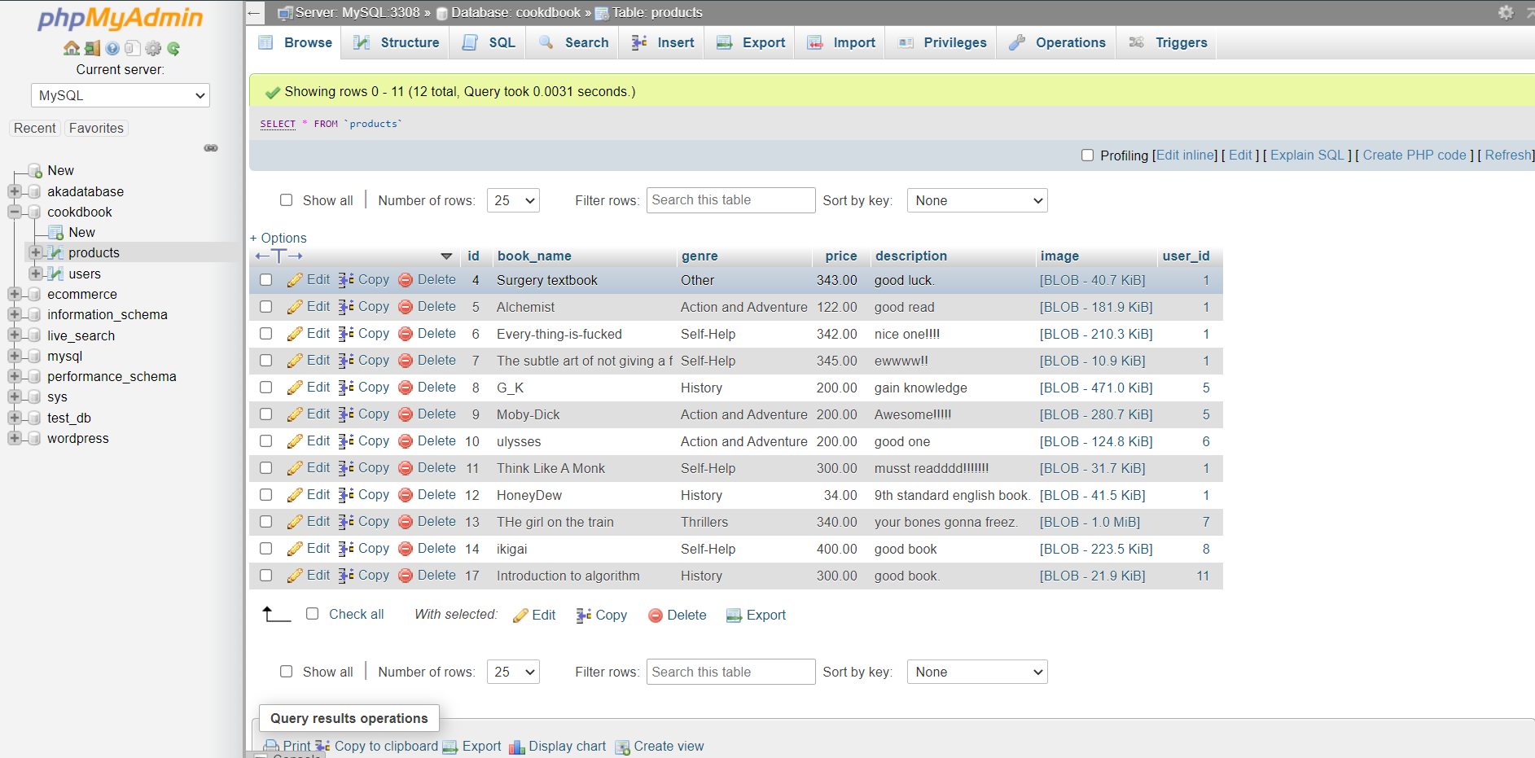
Table - products

Slide 24
CONCLUSION
After analyzing the cost benefit and working of the current system & automated system, we conclude that the automated system is the best
Computerized system is more efficient and reliable than the old system
It reduces most of the paperwork.
You can visit our website in cook-d-book.000webhostapp.com.

Slide 25
THANKYOU

