Slide 1

RNS Institute of Technology
(AICTE Approved, VTU Affiliated and NAAC ‘A’ Accredited)
Department of Information Science and Engineering
(Accredited by NBA for the Academic Years 2018-19, 2019-20 and 2020-21)
Data structures Laboratory-18CSL38
Carried out by
Akshay V Kaushik (1RN19IS019)
Staff in Charge: Dr. Prakasha S
Designation: Assistant Professor

Slide 2
Abstract
Introduction
Objective of the project
Data Structure System requirements
Project Architecture
Implementation modules
Results
Conclusion & Future Enhancements
References
Department of ISE,RNSIT

Slide 3
This is a menu-driven project which contains two game modes namely, ASK and ANSWER. We have also included features involving details of the users who play our game.
Bulls and Bears is conventionally a paper and pencil game of numbers or words.
In this project, we deal with the numerical version of the game.
Department of ISE,RNSIT

Slide 4
GAME MODES:
ASK – This game is played is played with 4 digits. All the digits must be different. The computer generates such a number. The user has to guess that number using clues called Bulls and Bears. If the matching digits are in the right position, they are “Bulls” , if in different positions, they are “Bears”. The user is given 9 chances to guess the number.
ANSWER - This game is played is played with 4 digits. All the digits must be different. The user thinks of a number and the computer has to guess it. This is done using clues called Bulls and Bears. If the matching digits are in the right position, they are “Bulls” , if in different positions, they are “Bears”. The computer is given 7 chances to guess the number.
HISTORY:
History is a feature in our menu-driven project which stores and displays the following details – Name, Game Mode, Number, Tries, Date, Time and Result . There is also an additional option to clear history.
Department of ISE,RNSIT

Slide 5
Bulls and Bears is a numerical game set to hone your mathematical deduction skills.
It can also be played to refresh your mind and for entertainment purposes.
Our History feature allows you to have a local file which stores all the details of the users who have played on your computer.
This feature can also be used to compete with other users hence making it competitive in nature.
Department of ISE,RNSIT

Slide 6
The data structures used in the development of this project are :
Arrays :
This has been used in the two game modes to store various data.
Linked Lists :
This has been used to link different instances of details in order to facilitate an organized way of writing data onto the file.
Files :
This has been used to store different instances of details locally on your computer.
Department of ISE,RNSIT

Slide 7
Hardware and Software Specifications
Processor – Intel Atom or higher
RAM – 4GB ram stick
Keyboard and Mouse
Operating System - Windows/Linux/Mac
Compiler – MinGW
Any Integrated Development Environment (IDE)
For eg – Code Blocks, Visual Studio Code etc
Department of ISE,RNSIT

Slide 8
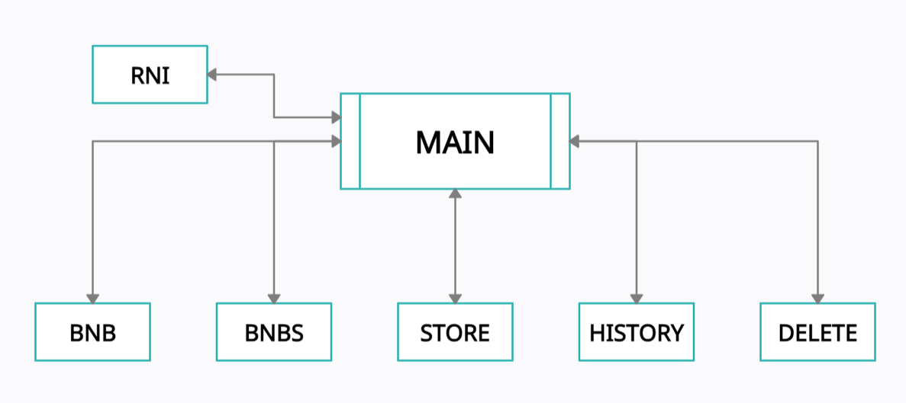
Department of ISE,RNSIT

Slide 9
void bnb() : This function is used to implement the ASK game mode.
void bnbs() : This function is used to implement the ANSWER game mode.
void store(char, char, int, int) : This function is used to create, store nodes of the linked list which contain the details of the users. The details are also written onto the file.
void delet() : This function is used to clear the entire history and also clear all the contents of the file.
void history() : This function is used to display the history from the file.
void rni(int) : This function is used to display the rules and instructions of the respective game modes.
void main() : This is the main function which implements the menu-driven program and calls all the other functions.
Department of ISE,RNSIT

Slide 10
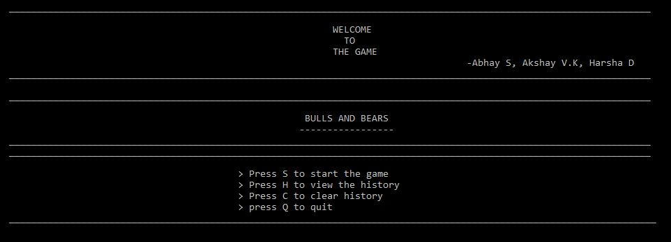
This is the home screen of the menu driven program
Department of ISE,RNSIT

Slide 11
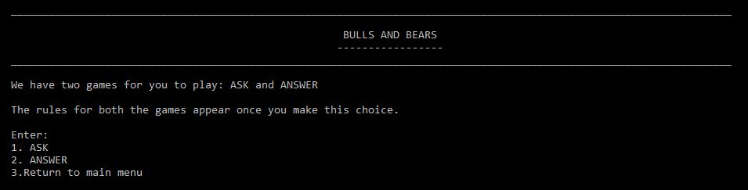
This window appears when the user chooses to start the game.
This window lets you choose the mode of the game or to return to the main menu.
Department of ISE,RNSIT

Slide 12
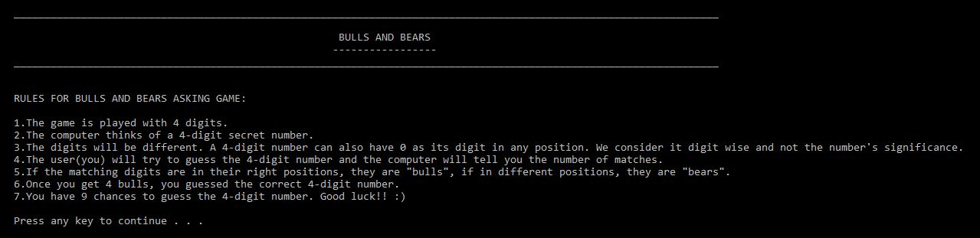
This window appears when you opt for the ASK game mode.
It displays and explains the rules and instructions of this game mode.
Department of ISE,RNSIT

Slide 13
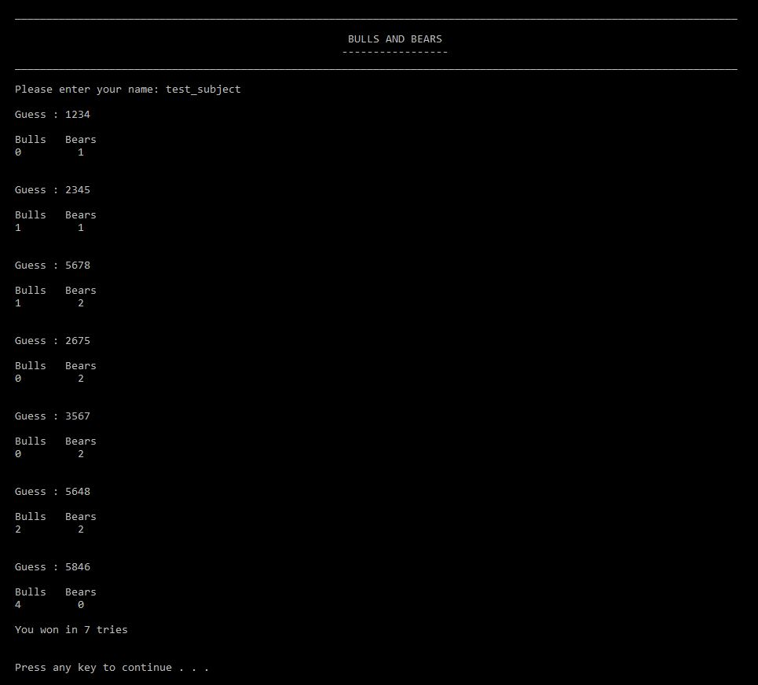
This is the ASK game where the user
types in the username and starts
guessing the computer generated
number.
Based on the validity of the entries
made, it will display appropriate
messages.
Department of ISE,RNSIT

Slide 14
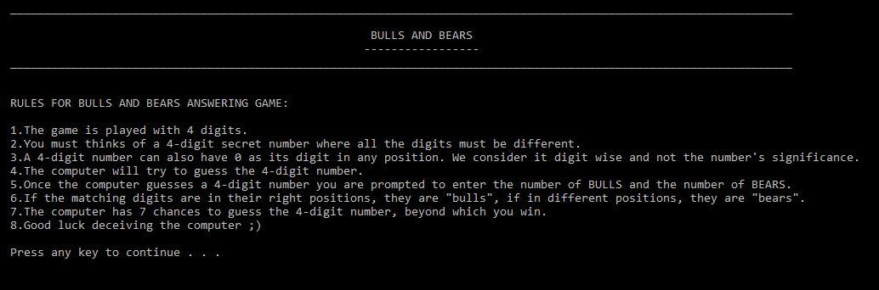
This window appears when you opt for the ANSWER game mode.
It displays and explains the rules and instructions of this game mode.
Department of ISE,RNSIT

Slide 15
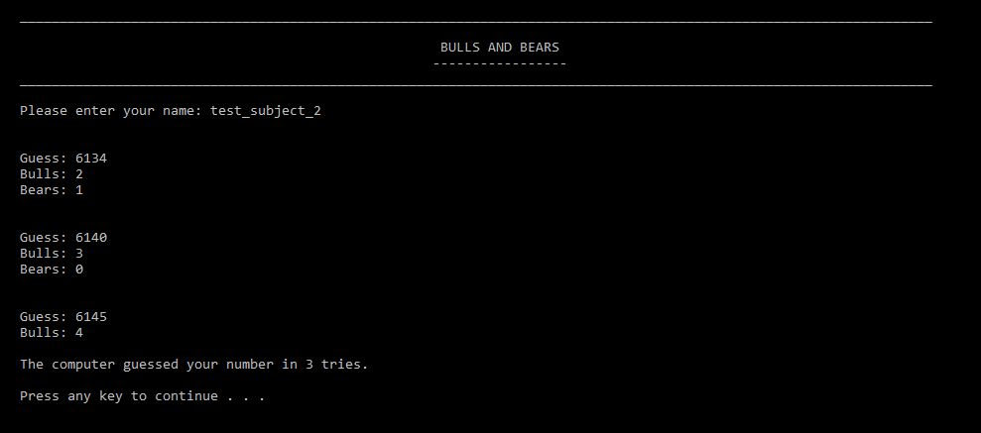
This is the ANSWER game where the user
types in the username and the computer will try and guess the user’s number. The user will provide appropriate clues in the form of BULLS and BEARS.
Based on the validity of the entries made, it will display appropriate messages.
Department of ISE,RNSIT

Slide 16
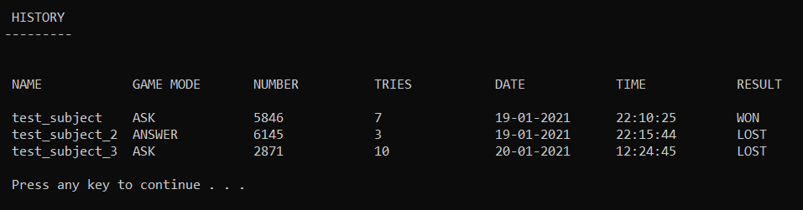
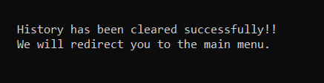
This window appears when the user chooses to view History. This contains a table of the
user’s playthrough with information as shown in the above figure.
This message is displayed when the user chooses to clear the existing History.
Department of ISE,RNSIT

Slide 17
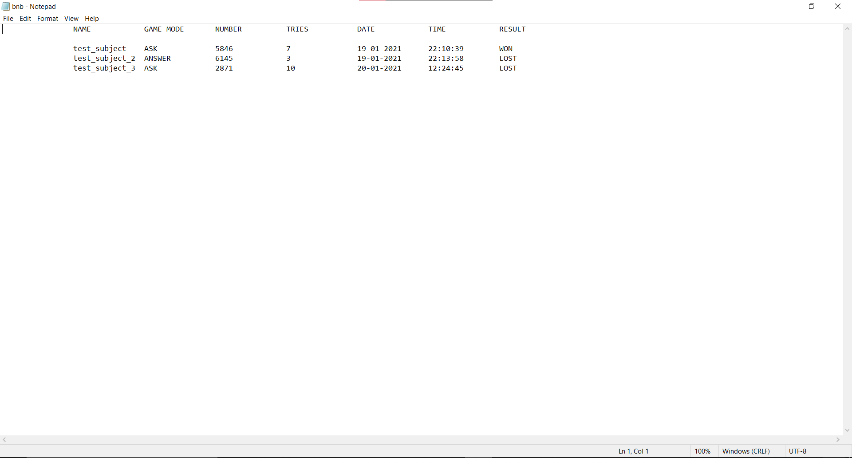
This is the file in which the contents of the History is being stored
Department of ISE,RNSIT

Slide 18
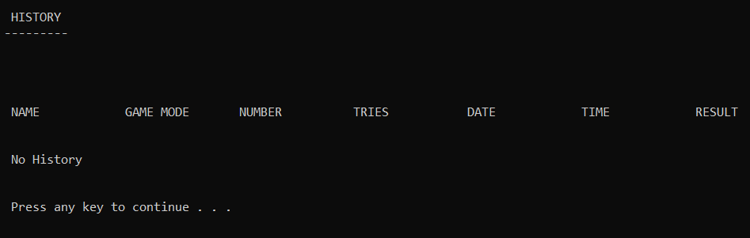


This appears when the user tries to view an empty History
This appears when the user
tries to clear an empty History.
This appears when the user decides to
quit playing our game.
Department of ISE,RNSIT

Slide 19
This menu driven project serves to improve your mathematical deduction and logical thinking efficiency by posing a challenge in the ASK game and to relax and take a breather in the ANSWER game.
The History feature allows you to compare your previous attempts or other users’ attempts and lets you try competing with them.
Since this involves permutation and combinations, one may get better, faster and more efficient in implementing these concepts in real life scenarios.
In the forthcoming future, we would also like to implement the alphabetical version of the game hence try and increase the scale and scope for improvement in your deduction skills. By doing so, one may get better and faster at solving anagrams and other word games.
We would also like to try and implement other challenges in cracking these games by involving a time factor instead of limiting the number of tries, or to make it even harder both.
We would also like suggestions or advices to improve this project and take this project further.
Department of ISE,RNSIT

Slide 20
https://www.geeksforgeeks.org/
https://www.tutorialspoint.com/
https://www.programiz.com/
https://stackoverflow.com/
Fundamentals of Data Structures in C (Textbook)
Department of ISE,RNSIT

Slide 21

Department of ISE,RNSIT

