Slide 1
Introducing C# and .NET

Slide 2
Introducing C#
C# is Microsoft’s premier language for .NET development.
C# inherits a rich programming legacy. It is directly descended from two of the world’s most successful computer languages: C and C++.
It is closely related to another: Java.

Slide 3
C as a Programming Language
C was invented by Dennis Ritchie in the 1970s
C grew out of the structured programming revolution of the 1960s.
Prior to structured programming, large programs were difficult to write because the program logic tended to degenerate into what is known as “spaghetti code,” a tangled mass of jumps, calls, and returns that is difficult to follow.
Structured languages addressed this problem by adding well-defined control statements, subroutines with local variables, and other improvements.
Through the use of structured techniques programs became better organized, more reliable, and easier to manage.

Slide 4
Problems
However, C language had its limits.
Like its inability to handle large programs.
The C language hits a barrier once a project reaches a certain size, and becomes difficult to understand and maintain.
Precisely where this limit is reached depends upon the program, the programmer, and the tools at hand.

Slide 5
C++
To solve the problems in C programming, a new way to program began to emerge.
This method is called object-oriented programming (OOP). Using OOP, a programmer could handle much larger programs.
C++ was invented by Bjarne Stroustrup beginning in 1979 .
C++ contains the entire C language.
Additions that Stroustrup made to C were designed to support object-oriented programming.

Slide 6
Internet and Java
Java is a structured, object-oriented language with a syntax and philosophy derived from C++.
Prior to the mainstreaming of the Internet, most programs were written, compiled, and targeted for a specific CPU and a specific operating system.
However, with the rise of the Internet, in which many different types of CPUs and operating systems are connected, the problem of portability re-emerged.

Slide 7
To solve the problem of portability, a new language was needed, and this new language was Java.
Java achieved portability by translating a program’s source code into an intermediate language called bytecode. This bytecode was then executed by the Java Virtual Machine (JVM). Therefore, a Java program could run in any environment for which a JVM was available.

Slide 8
Java’s use of bytecode differed radically from both C and C++, which were nearly always compiled to executable machine code.
Machine code is tied to a specific CPU and operating system. Thus, if you wanted to run a C/C++ program on a different system, it needed to be recompiled to machine code specifically for that environment.
Therefore, to create a C/C++ program that would run in a variety of environments, several different executable versions of the program would be needed.
This was impractical.

Slide 9
Here comes C#
While Java has successfully addressed many of the issues surrounding portability in the Internet environment, there are still features that it lacks.
One is cross-language interoperability, also called mixed-language programming.
This is the ability for the code produced by one language to work easily with the code produced by another.

Slide 10
It is desirable for programming software components because the most valuable component is one that can be used by the widest variety of computer languages, in the greatest number of operating environments.
Another feature lacking in Java is full integration with the Windows platform.
Since Windows is the most widely used operating system in the world, lack of direct support for Windows is a drawback to Java.
To answer these needs, Microsoft developed C#.

Slide 11
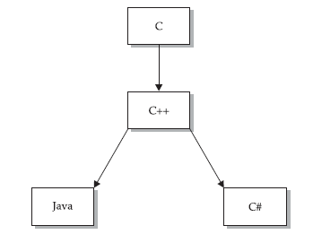
C# Family Tree

Slide 12
C# and .NET Framework
The runtime environment of C# is called .NET framework.
Both are tightly coupled because:
C# was initially designed by Microsoft to create code for the .NET Framework.
The libraries used by C# are the ones defined by the .NET Framework.

Slide 13
Introducing .NET Framework
The .NET Framework defines an environment that supports the development and execution of applications.
It defines two very important entities.
Common Language Runtime (CLR): manages the execution of your program
Class library (I/O, File I/O, Database Access, Web APIs etc.)

Slide 14
Understanding the CLR
The Common Language Runtime manages the execution of .NET code.
When you compile a C# program, the output of the compiler is not executable code.
Instead, it is a file that contains a special type of pseudocode called Microsoft Intermediate Language (MSIL).
MSIL is also known as IL or the Common Intermediate Language (CIL).
MSIL defines a set of portable instructions that are independent of any specific CPU.
It is the job of the CLR to translate the intermediate code into executable code when a program is run.

Slide 15
Microsoft Intermediate Language is turned into executable code using a JIT compiler.
“JIT” stands for “Just-In-Time.”
When a .NET program is executed, the CLR activates the JIT compiler. The JIT compiler converts MSIL into native code on demand as each part of your program is needed.
In addition to MSIL, you get metadata on the compilation of C# program.
Metadata describes the data used by your program and enables your code to interact easily with other code.
The metadata is contained in the same file as the MSIL.

Slide 16
Assemblies
.NET binaries obtained after compilation of the .CS source code, take the file extension .exe or .dll.
Specifically, .NET binaries do not contain platform-specific instructions, but rather platform-agnostic Intermediate Language (IL) and type metadata.
When a *.dll or *.exe has been created using a .NET-aware compiler, it is termed an assembly.
Assembly contains the CIL and metadata.

Slide 17
Managed Vs Unmanaged Code
Managed code is executed under the control of the Common Language Runtime.
For this, the compiler must produce an MSIL file targeted for the CLR (which C# does) and use the .NET class library (which C# does).
The benefits of managed code are many, including modern memory management, the ability to mix languages etc.

Slide 18
The Common Language Specification
If your code will be used by other programs written in different languages, then for maximum usability, it should adhere to the Common Language Specification (CLS).
The CLS describes a set of features that different .NET-compatible languages have in common.
The CLS includes a subset of the Common Type System (CTS). The CTS defines the rules concerning data types.

Slide 19
Object Oriented Programming
OOPs

Slide 20
Introducing OOPs
At the center of C# is object-oriented programming (OOP).
In the most general sense, a program can be organized in one of two ways: around its code (what is happening) or around its data (what is being affected).
In an object-oriented language, you define the data and the code that is permitted to act on that data. Thus, a data type defines precisely the operations that can be applied to that data.

Slide 21
Pillars of OOPs
Encapsulation
Inheritance
Polymorphism

Slide 22
Encapsulation
Encapsulation is a programming mechanism that binds together code and the data it manipulates, and that keeps both safe from outside interference and misuse.
When code and data are linked together in this fashion, an object is created.
C#’s basic unit of encapsulation is the class.
A class defines the form of an object.
C# uses a class specification to construct objects. Objects are instances of a class. Thus, a class is essentially a set of plans that specify how to build an object.

Slide 23
Class
Class has the following things associated with it:
Name
Data
Functions
Access Specifiers

Slide 24
Polymorphism
Allows one interface to access a general class of actions.
Real-world example:
steering wheel of an automobile. The steering wheel (the interface) is the same no matter what type of actual steering mechanism like manual steering or power steering is used.
Polymorphism helps reduce complexity by allowing the same interface to be used to specify a general class of action.
It is the compiler’s job to select the specific action (that is, method) as it applies to each situation.

Slide 25
Inheritance
Inheritance is the process by which one object can acquire the properties of another object.
Without the use of hierarchies, each object would have to explicitly define all of its characteristics.

Slide 26
Tools to build .NET Applications
As a C# programmer, you may choose among numerous tools to build .NET applications:
Notepad
Notepad++
SharpDevelop
Visual C# Express
Visual Studio
….

Slide 27
Role of the .NET Framework
You are able to build any sort of .NET program using the freely downloadable .NET Framework Software Development Kit (SDK).
This SDK provides you with numerous managed compilers, command-line utilities, sample code, and the .NET class libraries.
If you are going to be using Visual Studio or Visual C# Express, you have no need to manually download or install the .NET Framework.
However, if you are not going to be using a Microsoft IDE, be sure to install the SDK before proceeding.

Slide 28
The Developer Command Prompt
Accessible from the Start -> All Programs -> Microsoft Visual Studio -> Visual Studio Tools folder
It has been preconfigured to provide access to each of the .NET development tools.
Type the following command and press the Enter key to see a list of command-line arguments of the C# command-line compiler:
csc -?

Slide 29
Building C# Applications Using csc.exe
Write a small program using an editor like Notepad or Notepad++.
Save the file with the extension .cs.
Compile by using the command line compiler, csc.exe.
csc filename.cs
Execute the application as
Filename followed by enter

Slide 30
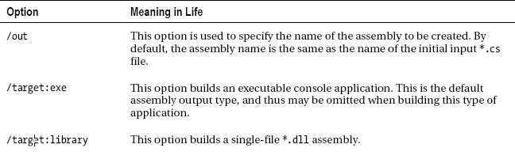
Some options used with CSC.exe

Slide 31
Examples
To compile TestApp.cs into a console application named TestApp.exe using any of the following commands:
csc /target:exe TestApp.cs
csc /t:exe TestApp.cs
csc TestApp.cs

Slide 32
Referencing External Assemblies
C# compiler understands your reference to the System.Console type because its corresponding assembly, mscorlib.dll is automatically referenced during the compilation process.
However, at times you may have to inform csc.exe which assembly contains the namespaces you are using.
This is done by using the /reference or /r flag.

Slide 33
Referencing Multiple External Assemblies
Simply list each assembly using a semicolon-delimited list.
csc /r:System.Windows.Forms.dll;System.Drawing.dll *.cs

Slide 34
Compiling Multiple Source Files
While it is perfectly permissible to have all of your .NET types defined in a single *.cs file, most projects are composed of multiple *.cs files to keep your code base a bit more flexible.
You can compile your C# files by listing each input file explicitly in the csc command.

Slide 35
Working with C# Response Files
If you were to build a complex C# application at the command prompt, you would have to specify a tedious number of input options to inform the compiler how to process your source code.
To help lessen your typing burden, the C# compiler honors the use of response files.
C# response files contain all the instructions to be used during the compilation of your current build. By convention, these files end in a *.rsp (response) extension.

Slide 36
Now, build your entire application as follows (note the use of the @ symbol):
csc @TestApp.rsp

Slide 37
Using the Visual Studio IDE
Visual Studio is Microsoft’s integrated programming environment.
It lets you edit, compile,run, and debug a C# program, all without leaving its environment.
That is why, you call it an Integrated Development Environment (IDE).

Slide 38
Anatomy of a C# Program
C# programs use the .cs file extension, and this is a convention that you should follow.
In C# it is not possible to create global functions or global points of data.
Rather, all data members and all methods must be contained within a class definition.
C# is a case-sensitive programming language.

Slide 39
The keyword, class is used to define a new class.
The class definition begins with the opening curly brace ({) and ends with the closing curly brace (}).
The elements between the two braces are members of the class.

Slide 40
The Main method
Every executable C# application (console program, Windows desktop program, or Windows service) must contain a class defining a Main() method, which is used to signify the entry point of the application.
The class that defines the Main() method is termed the application object.
static void Main() {
This line begins the Main( ) method.
A method that is modified by static can be called before an object of its class has been created.
The keyword void indicates that Main( ) does not return a value.
Main() method has a single parameter, which happens to be an array of strings (string[] args).

Slide 41
Using the System namespace
The Console class is defined within the System namespace.
Its static ReadLine() and WriteLine() methods are used to accept input and write output to the console.

Slide 42
Variations of the Main()
// int return type, array of strings as the parameter.
static int Main(string[] args)
{
// Must return a value before exiting!
return 0;
}
// No return type, no parameters.
static void Main()
{
}
// int return type, no parameters.
static int Main()
{
// Must return a value before exiting!
return 0;
}

Slide 43
Command-line Arguments
You can specify from the command prompt at the time of execution.
From the visual studio, double-click the Properties icon from Solution Explorer and select the Debug tab on the left side (separated by space).

Slide 44
Return Value from Main()
By convention, returning the value 0 indicates the program has terminated successfully, while another value (such as -1) represents an error condition .
On the Windows operating system, an application’s return value is stored within a system environment variable named %ERRORLEVEL%.

Slide 45
Exploring the C# Class
ReadLine()
WriteLine()
Write()
Beep()
BackgroundColor
ForegroundColor

Slide 46
C# Keywords
C# defines two general types of keywords: reserved and contextual.
The reserved keywords cannot be used as names for variables, classes, or methods.
They can be used only as keywords. This is why they are called reserved. The terms reserved words or reserved identifiers are also sometimes used.

Slide 47
C# defines certain contextual keywords that have a special meaning in certain contexts.
In those contexts, they act as keywords. Outside those contexts, they can be used as names for other program elements, such as variable names.

Slide 48
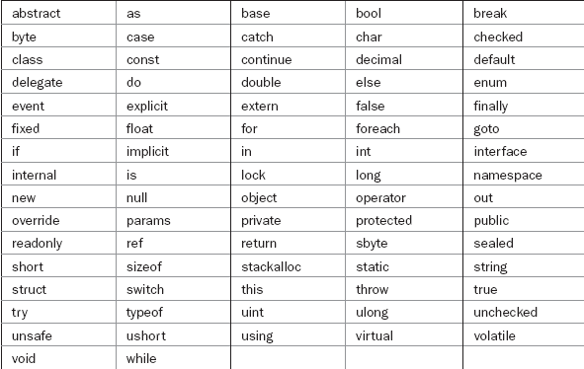
Reserved Words

Slide 49

Contextual Words

Slide 50
Identifiers
In C#, an identifier is a name assigned to a method, a variable, or any other user-defined item.
Must start with an alphabet, digits may follow.
No special characters allowed.
No space allowed (underscore can be used instead)
Reserved words cannot work as identifiers.

Slide 51
comments
Single line:
//
Multi line:
/*…….
*/

Slide 52
Significance of data types
Data types are especially important in C# because it is a strongly typed language.
This means that all operations are type-checked by the compiler for type compatibility.
Illegal operations will not be compiled. Thus, strong type-checking helps prevent errors and enhances reliability.
To enable strong type-checking, all variables, expressions, and values have a type. There is no concept of a “typeless” variable.
A value’s type determines what operations are allowed on it.
An operation allowed on one type might not be allowed on another.

Slide 53
Categories
C# contains two general categories of built-in data types: value types and reference types.
The difference between the two types is what a variable contains.
For a value type, a variable holds an actual value, such 3.1416 or 212.
For a reference type, a variable holds a reference to the value.
Value types are also called simple or primitive types because they consist of a single value.

Slide 54
ValueType are automatically allocated on the stack and, therefore, have a very predictable lifetime and are quite efficient.
On the other hand, reference types (such as System.Type, System.String, System.Array, System.Exception, and System.Delegate) are not allocated on the stack, but on the garbage-collected heap.

Slide 55
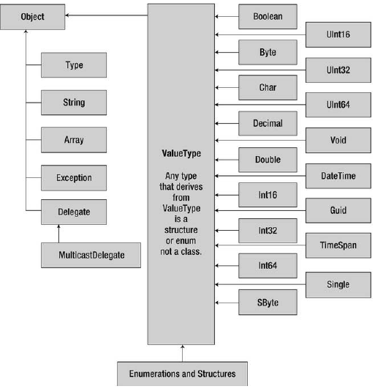
Hierarchy of C# System Types

Slide 56
System Data Types and Corresponding C# Keywords
C# defines keywords for fundamental data types.
C# data type keywords are actually shorthand notations for full-blown types in the System namespace.

Slide 57

The Inbuilt C# Datatypes

Slide 58
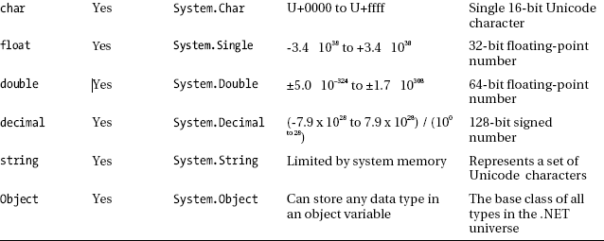

Slide 59
Note on Datatypes
By default, a floating-point number is treated as a double. To declare a float variable, use the suffix f or F to the raw numerical value (5.3F); suffix m or M to a floating-point number to declare a decimal (300.5M).
Finally, raw whole numbers default to an int data type. To set the underlying data type to a long, suffix l or L (4L).

Slide 60
Variable Declaration
What is a variable?
When you are declaring a local variable (e.g., a variable within a member scope), you do so by specifying the data type followed by the variable’s name.
Be aware that it is a compiler error to make use of a local variable before assigning an initial value.

Slide 61
ERROR
class Program
{
static void Main(string[] args)
{
GetUserData();
}
static void GetUserData()
{
int i;
Console.WriteLine(i);
}
}

Slide 62
Initializing a Variable
type var-name = value;
int count = 10; // give count an initial value of 10
char ch = 'X'; // initialize ch with the letter X
float f = 1.2F; // f is initialized with 1.2
int a, b = 8, c = 19, d; // b and c have initializations

Slide 63
Data types and the new operator
All intrinsic data types support what is known as a default constructor.
This feature allows you to create a variable using the new keyword, which automatically sets the variable to its default value.
bool variables are set to false.
Numeric data is set to 0 (or 0.0 in the case of floating-point data types).
char variables are set to a single empty character.
BigInteger variables are set to 0.
DateTime variables are set to 1/1/0001 12:00:00 AM.
Object references (including strings) are set to null.

Slide 64
In this case, it is the constructor which initializes the local variables without any need for explicit initialization.

Slide 65
The BigInteger type
The System.Numerics namespace defines a structure named BigInteger.
This type can be used when you need to represent really big numerical values, which are not constrained by a fixed upper or lower limit.
If you need to use BigInteger, your first step is to reference the System.Numerics.dll assembly into your project.

Slide 66
1. Select the Project -> Add Reference… menu option of Visual Studio.
2. Locate and select the System.Numerics.dll assembly within the list of presented libraries.
3. Press the Add button, then the Close button.

Slide 67
Thereafter, add the following using directive to the file:
using System.Numerics;
Then specify the massive value as a text literal which can be converted into a BigInteger variable via the static Parse() method.
NOTE: If you need to compile the same program from command prompt, use the following command:
csc /r:System.Numerics.dll bigIntDemo.cs

Slide 68
Strings
Strings Are Immutable.
After you assign a string object with its initial value, the character data cannot be changed.
The methods of the string type always return you a brand-new string object in a modified format.

Slide 69
System.Text.StringBuilder Type
Within the System.Text namespace lives a class named StringBuilder.
When you call members of this type, you are directly modifying the object’s internal character data (making it more efficient), not obtaining a copy of the data in a modified format.
When you create an instance of the StringBuilder, you can supply the object’s initial startup values via one of many constructors.
By default, a StringBuilder is only able to initially hold a string of 16 characters or fewer .

Slide 70
However, this default starting value can be changed via an additional constructor argument.
StringBuilder sb = new StringBuilder(“C# Programming", 256);

Slide 71
Literals
In C#, literals refer to fixed values that are represented in their human-readable form.
Integer literals are specified as numbers without fractional components. For example, 10 and –100 are integer literals.
Floating-point literals require the use of the decimal point followed by the number’s fractional component.

Slide 72
Since C# is a strongly typed language, literals, too, have a type.
First, for integer literals, the type of the literal is the smallest integer type that will hold it, beginning with int. Thus, an integer literal is either of type int, uint, long, or ulong, depending upon its value.
Second, floating-point literals are of type double.
To specify a long literal, append an l or an L.
To specify an unsigned, long integer, use ul or UL.
To specify a float literal, append an F or f to the constant.
To specify a decimal literal, follow its value with an m or M. For

Slide 73
Implicitly Typed Local Variables
C# language does provide for implicitly typing of local variables using the var keyword.
When you do so, the compiler will automatically infer the underlying data type based on the initial value used to initialize the local data point.
Implicit typing applies only to local variables in a method or property scope. It is illegal to use the var keyword to define return values, parameters, or field data of a custom type.
An implicitly declared variable is strongly typed.

Slide 74
Scope and Lifetime of Variables
A block begins with an opening curly brace and ends with a closing curly brace. A block defines a scope.
A scope determines what names are visible to other parts of your program without qualification. It also determines the lifetime of local variables.
The most important scopes in C# are those defined by a class and those defined by a method.

Slide 75
The scope defined by a method begins with its opening curly brace and ends with its closing curly brace. However, if that method has parameters, they too are included within the scope defined by the method.
Local variables declared inside a scope are not visible to code that is defined outside that scope.
Scopes can be nested.
When this occurs, the outer scope encloses the inner scope. This means that local variables declared in the outer scope will be visible to code within the inner scope. But reverse is not true.

