Slide 1
Decision Tree Pruning Methods
Validation set – withhold a subset (~1/3) of training data to use for pruning
  Note: you should randomize the order of training examples

Slide 2
Reduced-Error Pruning
Classify examples in validation set – some might be errors
For each node:
  Sum the errors over entire subtree
  Calculate error on same example if converted to a leaf with majority class label
Prune node with highest reduction in error
Repeat until error no longer reduced

Slide 3
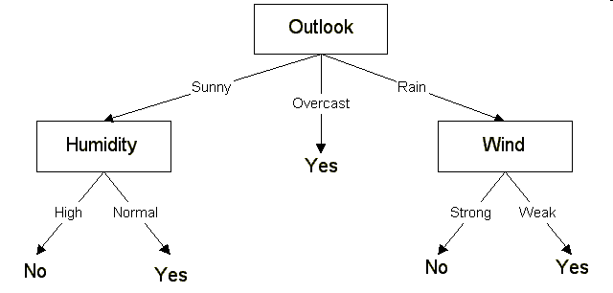
2+,3-
4+,2-
3+,2-
2-
2+,1-
2+
2+,2-
(code hint: design Node data structure to keep track of examples that pass through each node during classification)

Slide 4
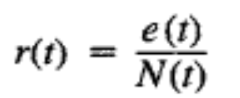
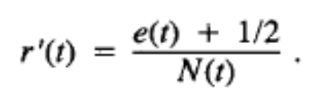
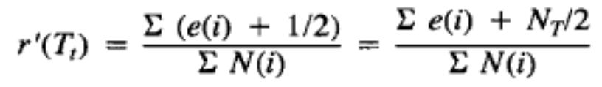
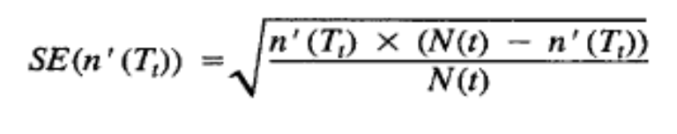
Pessimistic Pruning
Avoids needs to use validation set, can train on more examples
Use conservative estimate of true error at each node, based on training examples
“Continuity correction” to error rate at each node: add 1/2N to observed errors, for N the number of leaves in sub-tree
Prune node unless est. errors of subtree is more than 1 standard error below est. for pruned: r’_{subtree}<r’_{pruned}-SE

Slide 5
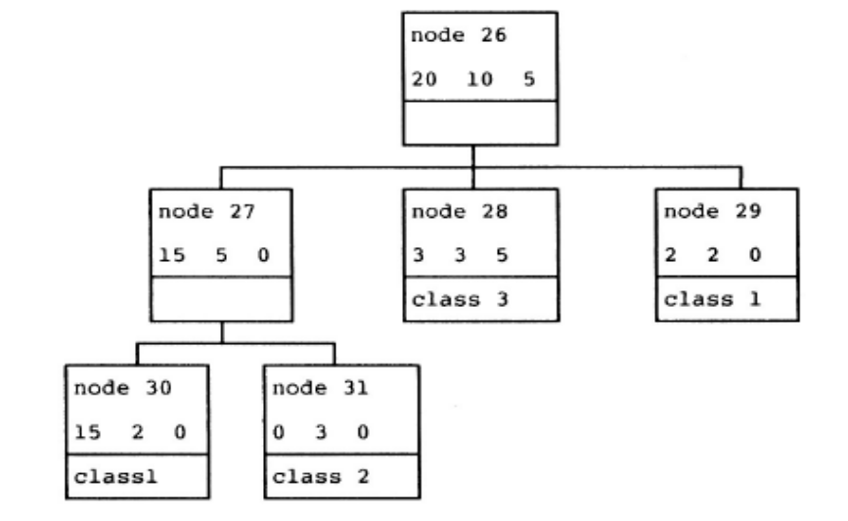
Cost-Complexity Pruning
On training examples, initial tree has no errors, but replacing subtrees with leaves increases errors
“cost-complexity” – a measure of avg. error reduced per leaf
Calculate number of errors for each node if collapsed to leaf
compare to errors in leaves, taking into account more nodes used
R(26,pruned)=15/200
R(26,subtree)=10/200
Cost-complexity is balanced when:
R(n,pr)+α=R(n,su)+αN(su)
15/200+α=10/200+4α
α=0.0083

Slide 6
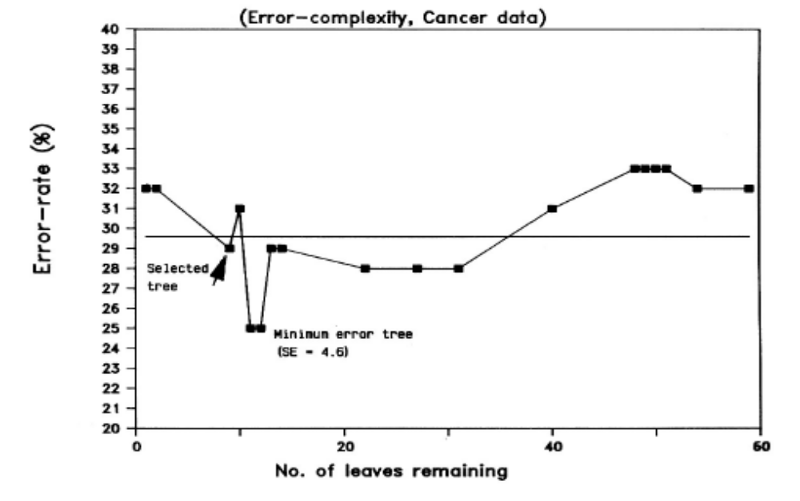
Calculate α for each node; prune node with smallest α
Repeat, creating a series of trees T₀,T₁,T₂… of decreasing size
Pick tree with min error on validation set
…or smallest tree within one standard error of minimum

Slide 7
Rule Post-Pruning
Convert tree to rules (one for each path from root to a leaf)
For each antecedent in a rule, remove it if error rate on validation set does not decrease
Sort final rule set by accuracy
Compare first rule to:
Outlook=sunny->No
Humidity=high->No
Calculate accuracy of 3 rules
based on validation set and
pick best version.
Outlook=sunny ^ humidity=high -> No
Outlook=sunny ^ humidity=normal -> Yes
Outlook=overcast -> Yes
Outlook=rain ^ wind=strong -> No
Outlook=rain ^ wind=weak -> Yes

