Slide 1

Next level Smart ( IoT )Home System
Yuvaraj.C 488CS13041
Mohd Saqib 488CS15021
Manjunath.S.G 488CS15018
Akshay Kumar.K 488CS16004
Mahesh P Patel 488CS16014
By:
Under the guidance of:
Miss Sangeetha G _{B.E,M.Tech}

Slide 2


Slide 3
INTRODUCTION
Home automation has become more and more popular in recent years.
Home automation is building automation for a home, called a smart home or smart house. A home automation system will control lighting, climate, entertainment systems, and appliances. It may also include home security such as access control and alarm systems. When connected with the Internet, home devices are an important constituent of the Internet of Things.
Home automation with full security and controlling the home light system using wireless communication as Wi-Fi.

Slide 4
EXISTING SYSTEM
Nowadays office and building automation systems are used more and more. On one hand, they provide increased comfort, results in a smarter home and is used to provide a higher & healthier standard of living.
On the other hand automation systems installed in buildings will only blindly spread light.
Hence, the lights are not really completely used for the trend.

Slide 5
Proposed System
In the era of overcrowded (data communication) world, Li-Fi is a new way of wireless communication that uses LED lights to transmit data wirelessly.
Transmission of data is one of the most important day to day activities in the fast growing world.
The future smart home or smart house will step towards smartest light ever.

Slide 6
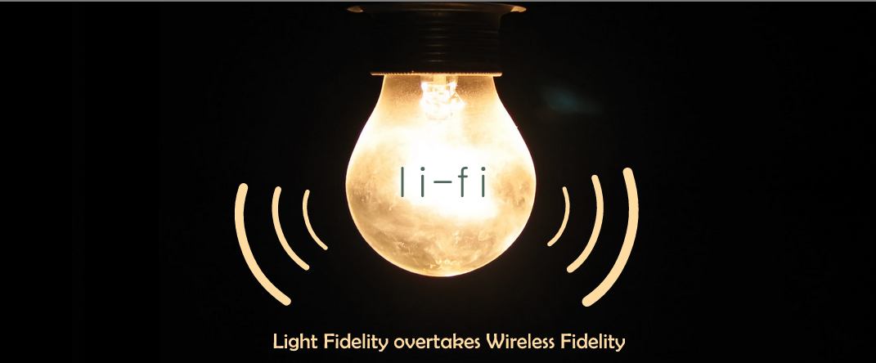

Slide 7

Light Fidelity (LiFi)
LiFi is a wireless optical networking technology that uses light-emitting diodes (LEDs) for data transmission.
LiFi is designed to use LED light bulbs similar to those currently in use in many energy-conscious homes and offices.
However, LiFi bulbs are outfitted with a chip that modulates the light imperceptibly for optical data transmission.
LiFi data is transmitted by the LED bulbs and received by photoreceptors.

Slide 8

How it Exist
Professor Harald Haas, from the University of Edinburgh in the UK, is widely recognised as the original founder of Li-Fi.
He coined the term Li-Fi and is Chair of Mobile Communications at the University of Edinburgh and co- founder of pureLiFi.
Haas promoted this technology in his 2011 TED Global talk and helped start a company to market it.

Slide 9
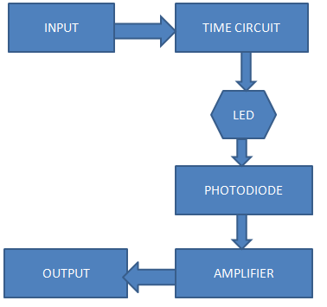
HOW IT WORKS ?
Operational procedure is very simple.
If LED is ON, digital data ‘1’ is transmitted & if LED is OFF, digital data ‘0’ is transmitted.
LEDs varies in intensity so fast that a human eye cannot detect it
A controller connected at the back side of these LEDs is used to code data.
Also called as 5G optical communication.

Slide 10
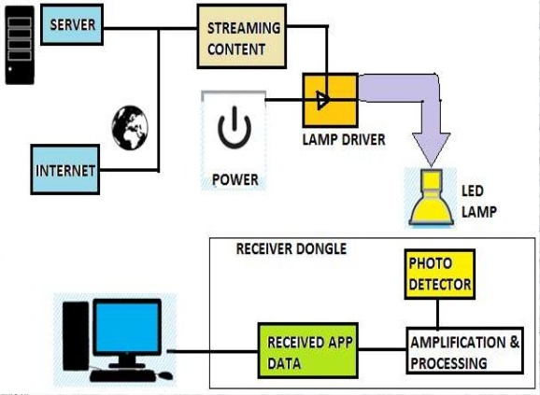
IMPLEMENTATION

Slide 11
LiFi Technology: Facts Need to Know
Li-Fi Harnesses the Power of Visible Light Instead of Radio Waves Used by Wi-F
Li-Fi Has Been Integrated into Some Smartphone Cameras
LiFi is Virtually Hack-Proof
The Inventor of LiFi started a Company Called pureLiFi and Microsoft is a Fan
Li-Fi’s spectrum is 10,000 times larger than that of radio frequencies and it has reached 224 gigabits per second during lab tests.

Slide 12
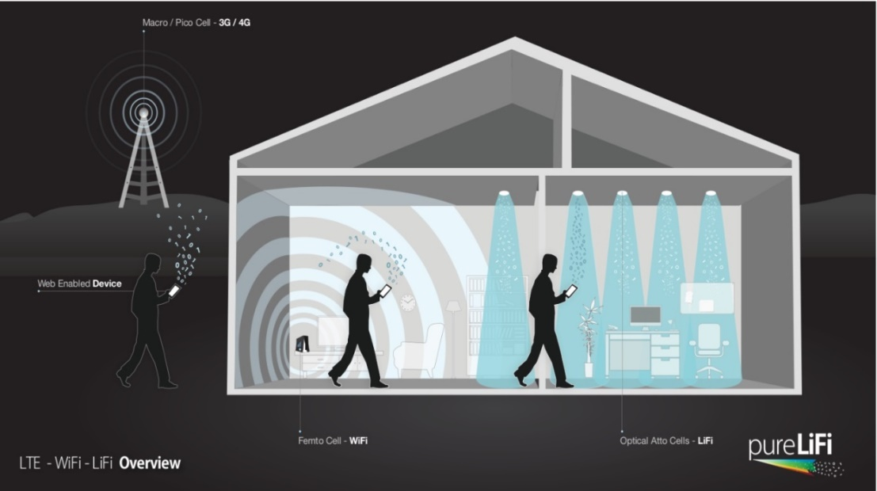
Existing wireless technology - Why do we need an alternate technology?
CAPACITY
EFFICIENCY
AVAILABILITY
SECURITY

Slide 13
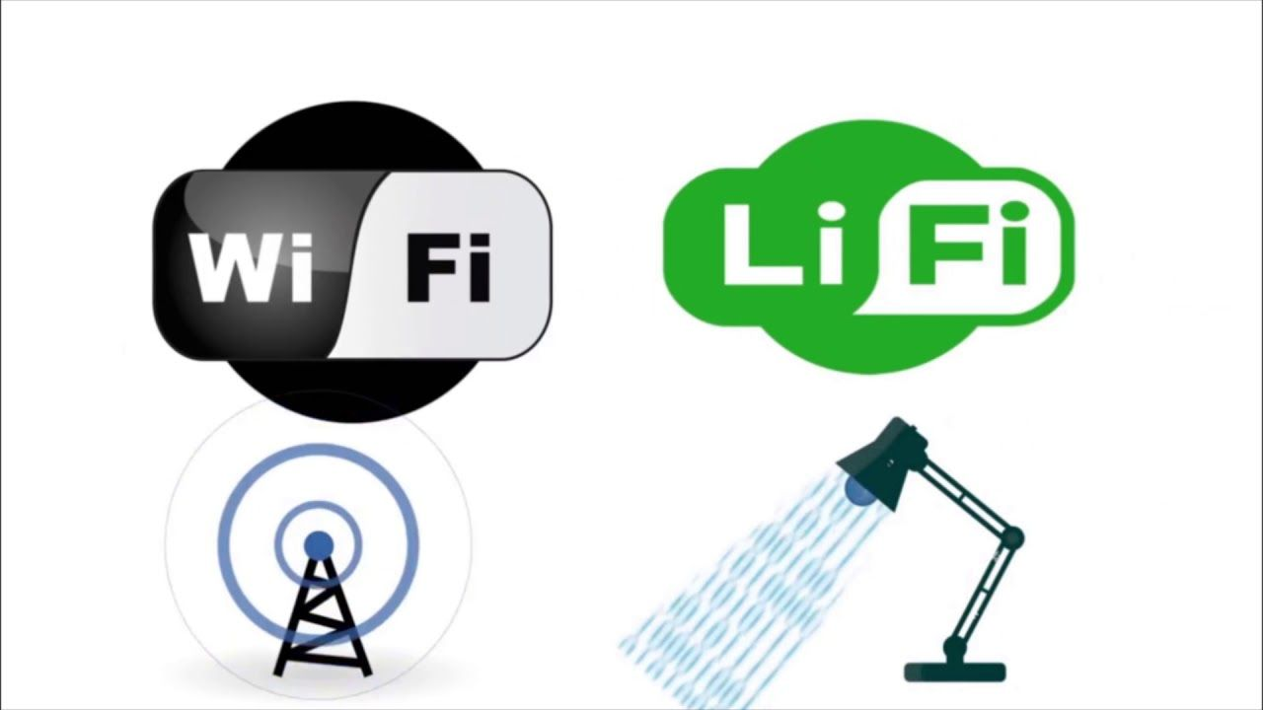
OVERCOMING WIFI ISSUES
CAPACITY
Spectrum is 10,000 times greater than that of radio frequency
EFFICIENCY
Highly efficient since LED consumes less energy
AVAILABILITY
Light waves available everywhere.
SECURITY
Cannot penetrate through walls. Hence data cannot be intercepted.

Slide 14
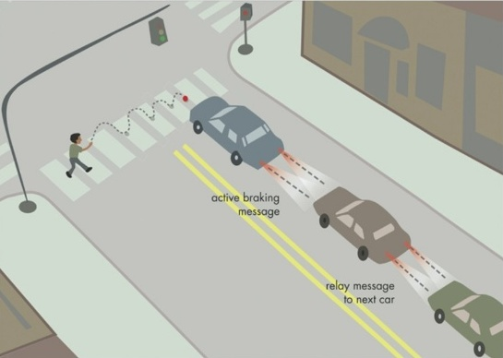


APPLICATIONS
TRAFFIC SCENARIO
AIRCRAFTS
LECTURE / SEMINAR HALLS

Slide 15


HOME AND SMALL OFFICES
In home and small offices, Li-Fi can be used to communicate with devices like
Laptops
Internet access
HD video streaming
Printer

Slide 16
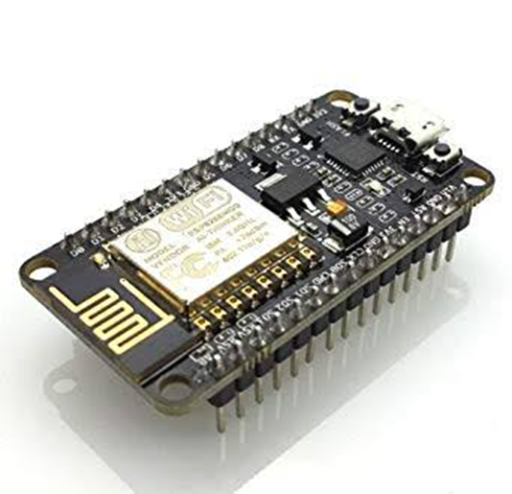


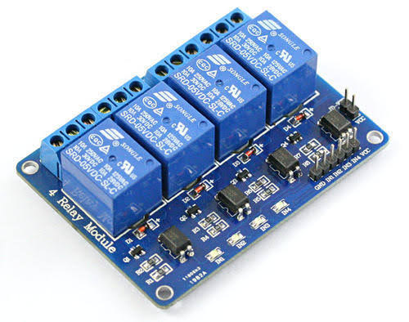

HARDWARE REQUIREMENTS SOFTWARE REQUIREMENTS
1.ESP 8266 Wi-Fi Module :
Relay Module :

Slide 17
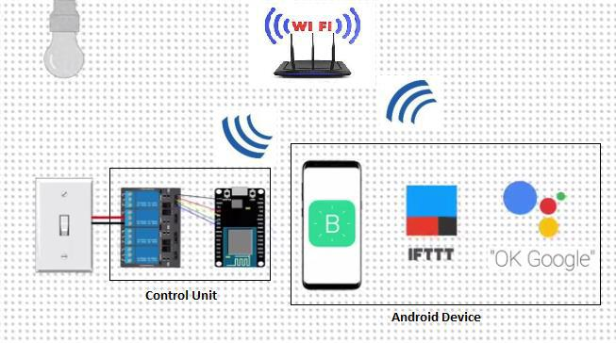
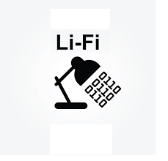
The light steps forward to transfer “THE DATA”
DESIGN

Slide 18



System proposed
Sends 0’s and 1’s
Sends 0’s and 1’s
To respective pins
Sends on and off status
Turn on light

Slide 19
Install and Configure Blynk App
MODULES:
Downloading and Setting up Arduino IDE and Blynk Libraries.
MODULES
Upload the code to NodeMCU
Hardware Assembly.
Configuring IFTTT

Slide 20
Install and Configure Blynk App.
install the Blynk App. Once the app is installed create a new account on Blynk and login using that.
After logging in, create a new project by clicking ‘New Project’. At this point Blynk will send an Auth token to your email id.
Click on the Button and give it a name. choose their Digital Pins as D4, D5 and D6 respectively.
Now, the Blynk app is all set.

Slide 21
Data Flow Diagram
Download and install
Login with Google account
New project
Select board
Create and configure buttons
D3
D4
D5
……

Slide 22
Downloading and Setting up Arduino IDE and Blynk Libraries.
Download the Arduino IDE and latest Blynk libraries from Github
Add the Blynk libraries to Arduino IDE
Download and install Arduino IDE
Data Flow Diagram
Download the latest Blynk libraries
Extract Blynk libraries
Add the libiraries to Arduino IDE
Configuration completed

Slide 23
Uploading the code to NodeMCU.
Connect the NodeMCU to your PC using a USB cable.
Now, set up the Arduino IDE by changing some settings.
Port
select ‘NodeMCU 1.0 (ESP-12E Module)’ as the board.
3) Now, in this file we only need to change 3 lines of code
“YourAuthToken”
“YourNetworkName”
“YourPassword”
4) Upload the Code

Slide 24
Data Flow Diagram
Connect the board to Pc or Laptop
Set up the Arduino IDE by changing some settings
Your Auth Token
change 3 lines of code
Your Network
Name
Your Password
Upload the Code

Slide 25
Hardware Assembly.
We’ll have to connect the NodeMCU with the Relay board
Connect
D3 pin of NodeMCU with Pin 1 of Relay.
Similarly connect D4 pin of NodeMCU with Relay pin 2,
D5 with Relay 3
D6 with Relay 4…….
Connect Ground Pin of Relay with Ground Pin of NodeMCU.
Now to power up the NodeMCU and to power up the Relay board
Connect lights

Slide 26
Data Flow Diagram
Node mcu
ESP 8266
Relay Module
D3
INI 1
D4
INI 2
D …….
INI …..

Slide 27
Configuring IFTTT.
Go to IFTTT’s website and sign up to it using your Google Account.
After Signing in create New Applet
Search for Google Assistant and select it. And then Click on Connect.
Select the card that says “Say a simple phrase” and create a trigger.
Type webhooks select it, and click connect. Webhooks will allow us to send commands to the Blynk Server.
Now, in the URL field type this URL:
https://188.166.206.43/ YourAuthTokenHere / update / DigitalPinToBeUpdateHere
Select method as PUT
Now click on ‘Create Action’ and then Finish.

Slide 28
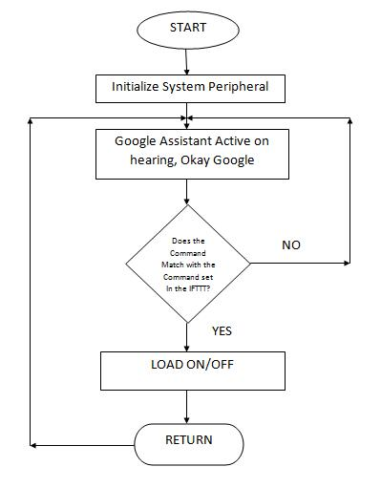
Data Flow Diagram Working:
Open IFTTT website
Sing in with same Google account
Light 1
Create the triggers on Google assistant and
web hooks
Light 2
Light ……
Voice control automation configued

Slide 29
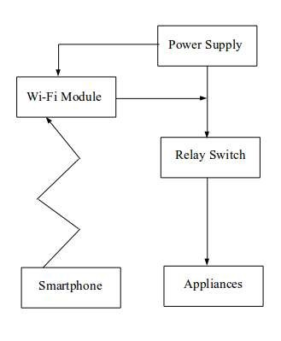
Implementation
Data flow diagram

Slide 30
Upload code
Use case diagram
Arduino IDE
Blynk application
Sends commands
Configure and
send
Voice input
ESP 8266 Wi-Fi Module
IFTTT
Works as bridge for Google assistant
and Blynk app
Output 1
Output 1
Output n
Google assistant
voice commands

Slide 31
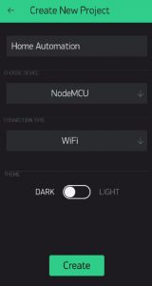
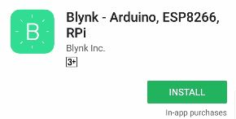

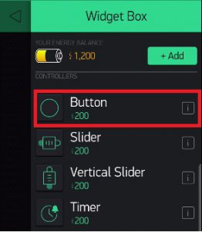
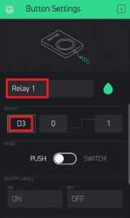
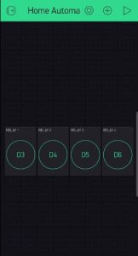
Snapshots
Install and Configure Blynk App.

Slide 32
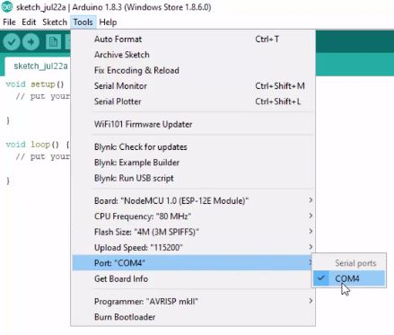
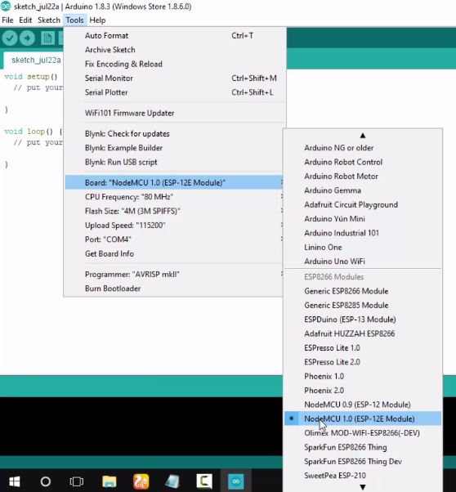
Uploading the code to NodeMCU.

Slide 33
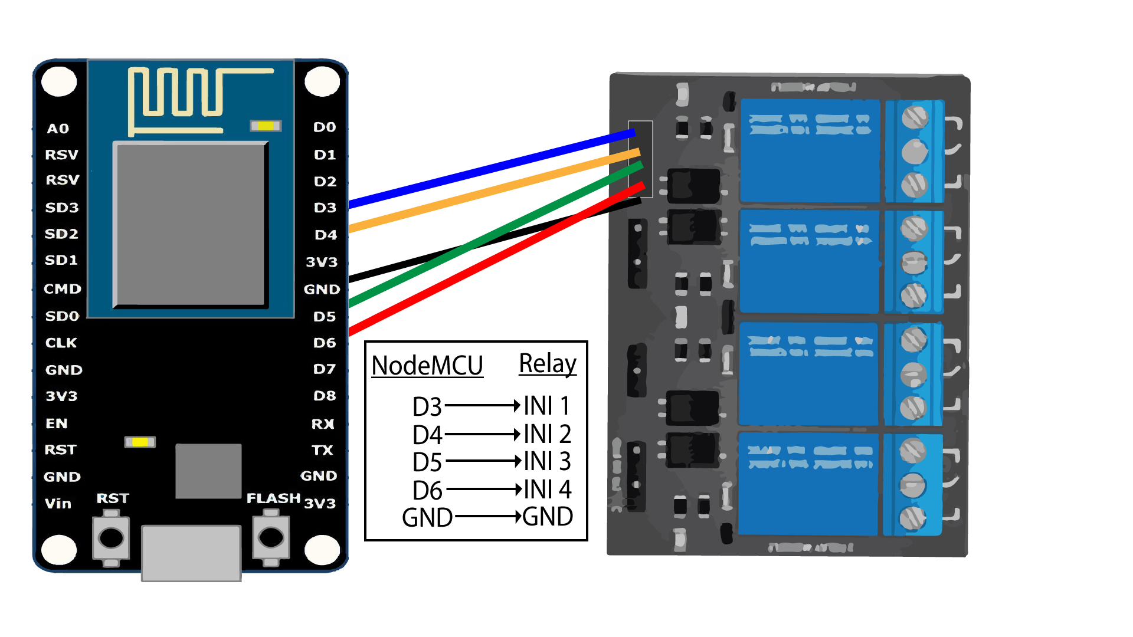
Hardware Assembly.

Slide 34
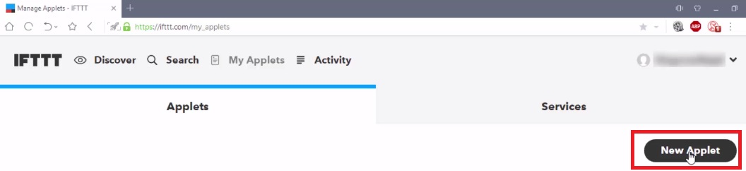
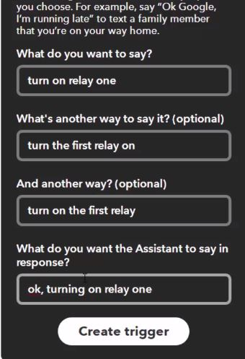
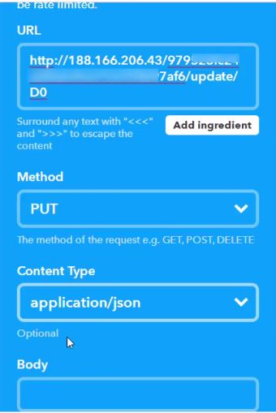
Configuring IFTTT.

Slide 35


