Slide 1
ZPAS Platform As a Service

Slide 2
What is the Need
COMPANIES SPEND A LOT OF TIME AND MONEY TO get tO A MVP STAGE for any PRODUCT IDEA
Initial FOUNDATIONAL STACK development takes a lot of time as a lot of time goes in Architecting, Developing and building the technology platform WHICH ACTS AS THE FOUNDATION FOR ADDING BUSINESS SERVICES AND LOGIC ON TOP
QUITE OFTEN THERE IS uncertainty in terms of delivery timelines along with escalation in cost of effort for the development and also for setting up the DEVOPS infrastructure COST
Along with the development and devops effort the technology platform also leads to escalation in cost for quality and certification
” To address these concerns of businesses, there is a clear need to have an acceleration platform as a service which provides a pay per use subscription based licensing model along with scale as you go model to companies who are looking for accelerated development, without compromising on the overall stability and security”

Slide 3
ZPAS
“ZPAS – ZIS Platform as a Service” provides a set of common API Endpoints & Services which enable any business to be able to build their FUNCTIONAL use cases on top of the foundational techno Functional platform

Slide 4
ZPAS – features & capabilities
COMMON FUNCTIONAL API
CUSTOMER AND ORGANIZATION ONBOARDING
LICENSING & SUBSCRIPTION Management
User Authentication, user & GROUP management, roles & access control
Document management and document security
NOTIFICATIONs & REMINDERs, NOTIFICATION & REMINDER TEMPLATES ( EMAIL/SMS/WHATSAPP)
BILLING, INVOICING & PAYMENTS
REPORTS, SEARCH & ANALYTICS
INTEGRATION FRAMEWORK & CORE ADAPTERS
NEW FEATURES THROUGH PLUGGABLE BUSINESS SERVICES
TECH CAPABILITIES
Highly scalable ( horizontally scalable) paas platform
Cloud native and cloud agnostic technology platform
HIGHLY ROBUST & RESILIENT KUBERNETES based INFRASTRUCTURE
SECURITY STANDARDS ( VAPT COMPLIANT) COMPLIANT Architecture and compliant
Open API & web 2.0 STANDARDS compliant
Extensible architecture with ability to add PLUGGABLE business services
CI / CD enabled delivery with DEVSECOPS IN PLACE
SUPPORT FOR BUSINESS RULES AND CONFIGURATIONS
c

Slide 5

ZPAS EcoSystem
Application / Feature Developer
Product Development & Deployment Process
Add new / enhance application
features
Define, Develop, Deploy Features / Services
Software Products and Solutions
PAX
Customer ( PM/DEV)
Cloud Hosted Environment
Build & Enhance Platform Capabilities / Features
Product Development & Deployment Process
Platform Developer

Slide 6
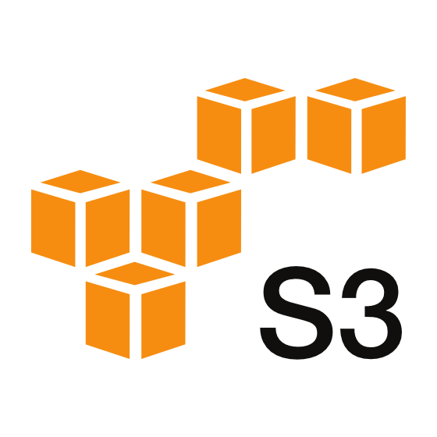







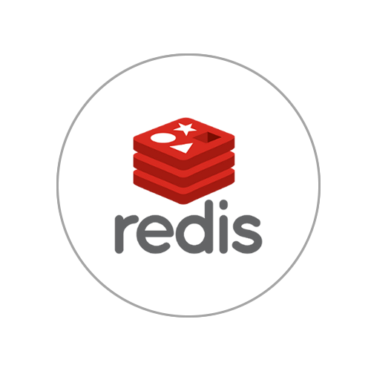

Key Tech Stack
A
P
I
G
A
T
E
W
A
Y
S
Kubernetes Cluster
Cache
Data Warehouse
Open
Search , ELK
Redis Cache
3rd Party
Integrations
( GST, Accounting etc)
Integration
Gateway
Business Services
Customer Svc
User & Groups Mgmt.
Subscription Mgmt.
Document Mgmt. Svc
Client
User
HTTPS /
REST
Notification Svc
Common
Entities
Billing & Invoicing Svc
Payment Svc
Kafka
JSON
Authentication & Authorization Service
Analytics & Reports Svc
Integration Svc
Configuration Svc
Scheduler Svc
Settings
Tax Mgmt
Organization Svc
Partner Svc
Batch Processes
KONG API
Gateway

Slide 7
Services Distribution
Common
XPNS
Tax Spanner
Customer & Org
Mgmt.
Master / Common Entities
Notifications & Reminders
Expense
Advance
Config Svc
Authentication & Authorization
User and XPNS MGMT
Reports, Dashboards, Analytics
Approval
XPNS Cards
Licensing & Subscription
Policy & Workflow Mgmt.
Tax Mgmt.
Settings & Rules
XPNS Txn
Global Search
Integration Svc
Scheduler Svc

Slide 8
Sample UseCase – ENTERPRISE CHAT
Features
Cobranded, Multi Lingual, Self Onboarded, fully digital platform
Support all categories of merchants
Digital ledger features
Merchant debit / credit sales entries
GST Invoicing
Payment Gateway Integration
Send Payment Links
Actors
Merchant ( Any one who provides products / services to a customer) – Manage Business Activity
Customer – Place & Manage Order
Delivery – Order Tracking & P2P deliveries

Slide 9
Sample Business Flow – Enterprise Chat
TBD

