Slide 1
Robot Localization and Mapping- 16833
Towards Understanding a Basic Stereo VO-SLAM Framework by building it from Scratch
By:
Akshay Badagabettu
Shubhra Aich
Sai Sravan Yarlagadda

Slide 2
Motivation
01
From initial exploratory search, we perceive that none of the SLAM implementations are essentially the same making it difficult for us to choose one.
Instead of playing around with an existing implementation, we decided to build a stereo VO SLAM system from scratch.
This allows us to get a complete understanding of the subtleties associated with building a pipeline from scratch.
Ideally we would have preferred C++, but Python was used for its ease of implementation.

Slide 3
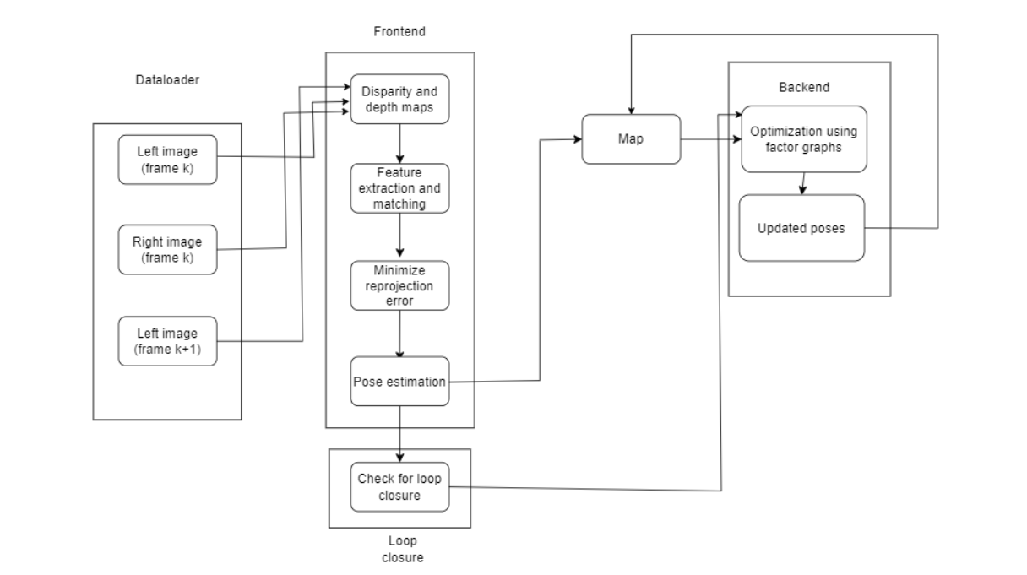
Pipeline
02

Slide 4
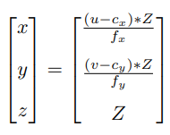
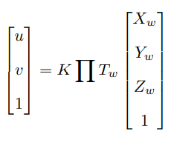

Frontend
03
Used Semi-Global Block Matching to compute the disparities. More accurate results than BM but requires a bit more compute.
Calculated depth using focal length, baseline and disparity.
Feature detection and matching was done between left frames of one frame and the next. Many algorithms exist but we decided to use SIFT or ORB as they are scale and rotation invariant.
The 3D coordinates of the key-points were then calculated (3D-2D correspondences)
We use PnP to find the extrinsic matrix that minimizes the reprojection error.
Notes:
Scale and Rotation invariant

Slide 5
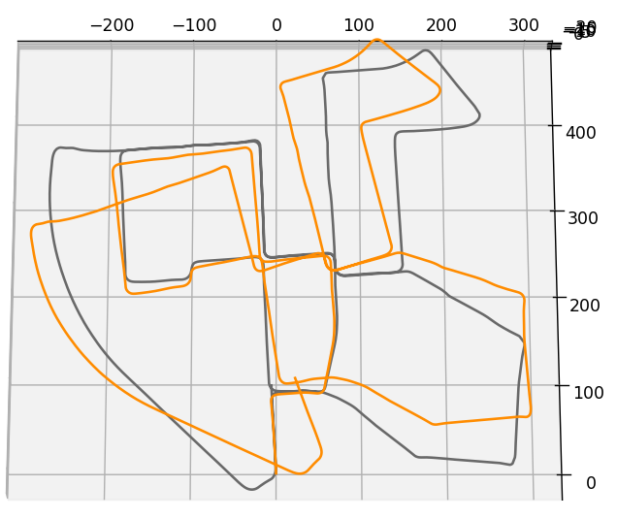
Frontend results
04
The first camera coordinate is considered the world frame. So the calculated pose is inverted and transformed to the first camera coordinate frame.
Our code is evaluated on KITTI Sequence 00.
Black - Ground truth
Orange - VO

Slide 6
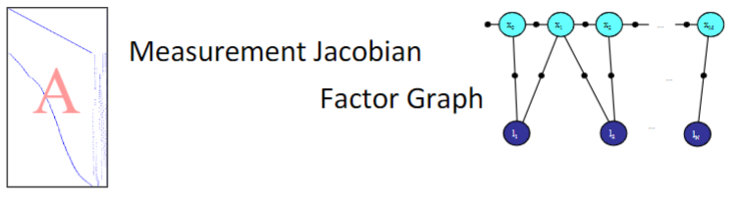
Backend
05
SLAM is a sequential estimation problem.
We can do filtering to optimize the new pose. This reduces the size of the graph but connects all the landmarks making it expensive.
Keyframe based approach works best
The measurement jacobian we are familiar with can be represented as a factor graph.
Notes:
Filtering - Relinearization is also not possible.

Slide 7
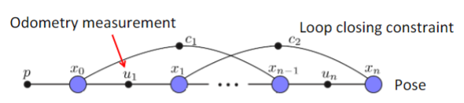

Backend contd.
05
To reduce computational time, we implemented Pose Graph Optimization.
The MAP inference for SLAM problems with Gaussian noise models is equivalent to solving a nonlinear least squares problem.
We can now linearize and solve for the state update using an initial estimate. There are multiple nonlinear optimizers such as Gauss-Newton, LM, PDL.

Slide 8
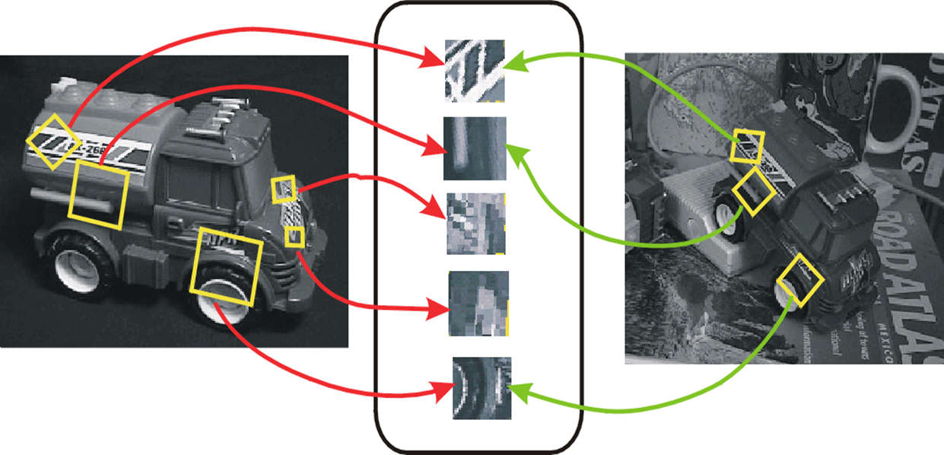
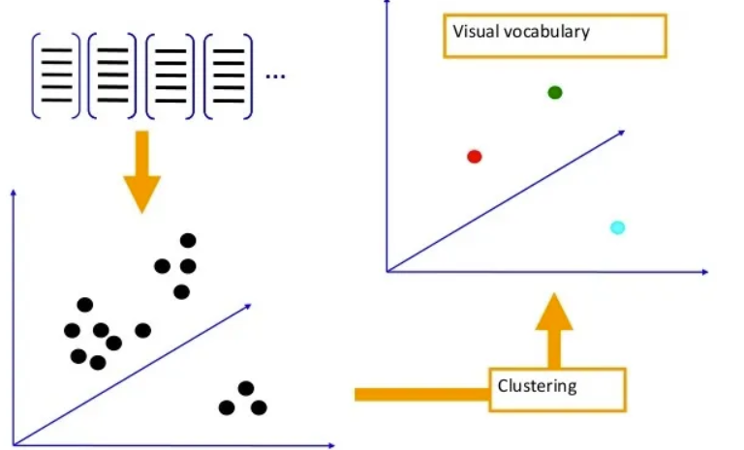
06
Loop Closure
Extract descriptors from the patches around selected key-points in the image.
After which we compute the K-means from a set of features.

Slide 9
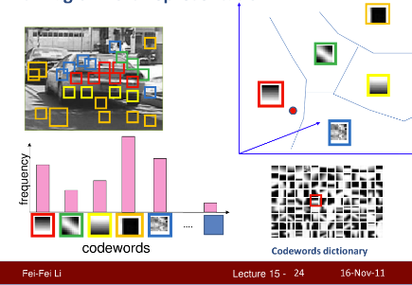
06
Loop Closure contd.
During inference, build histograms with k codewords and compute similarity.
A second check of feature detection and matching was done between the detected frames. If number of matches were greater than 200, then they become loop closure frames.
Bag of words representation

Slide 10
Backend Implementation
07
GTSAM library was used for the backend optimization implementation.
A nonlinear factor graph was initialized and a prior was added to the graph
All the poses were then looped through, and factors were added between two consecutive poses.
Initial estimates for the poses was taken as the VO pose. This ensures that the optimizer does not get stuck in a local minima.
Additional factors were added between the detected loop closure frames.
Levenberg-Marquardt and Powell’s DogLeg Optimizer were used as the nonlinear optimizers.
We initially wanted to use iSAM2 but the computational time was too high (>20min) for the very first loop closure.

Slide 11
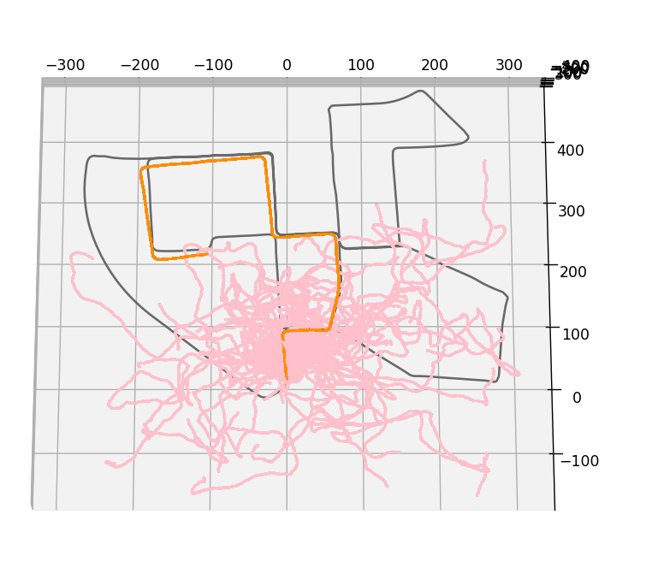
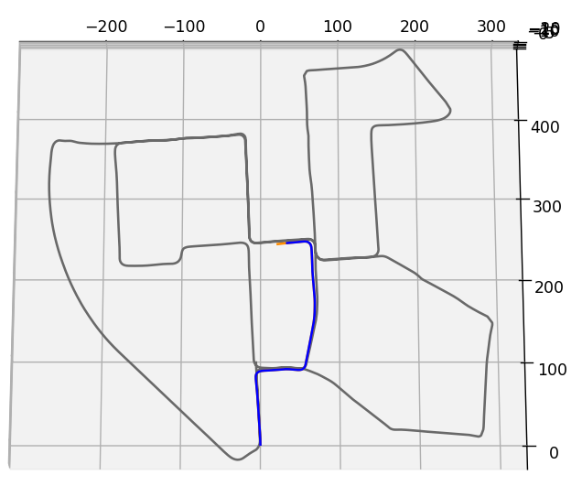
Results
08
The optimization was extremely sensitive to the noise added to the measurements
If the noise was too little, then it just follows the VO path
If the noise was too much, then we get this

Slide 12
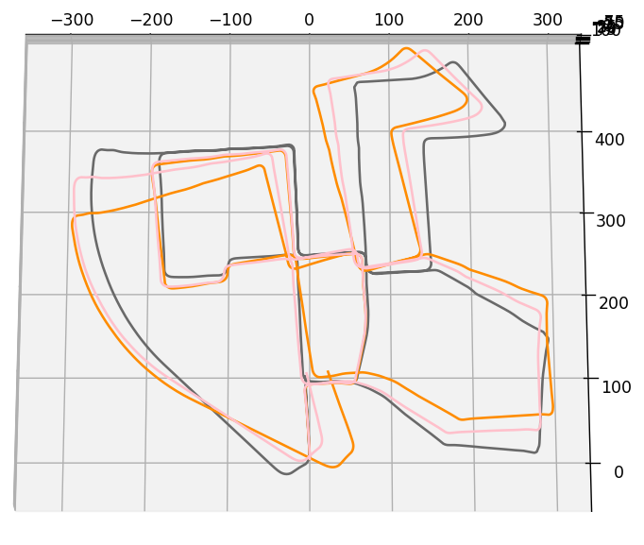
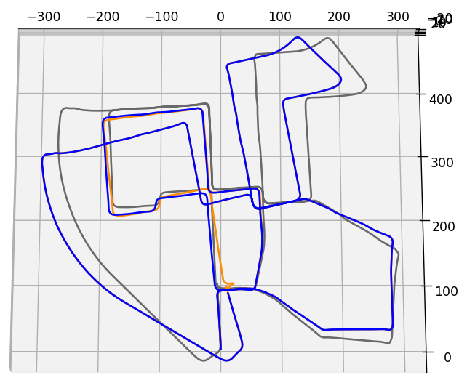
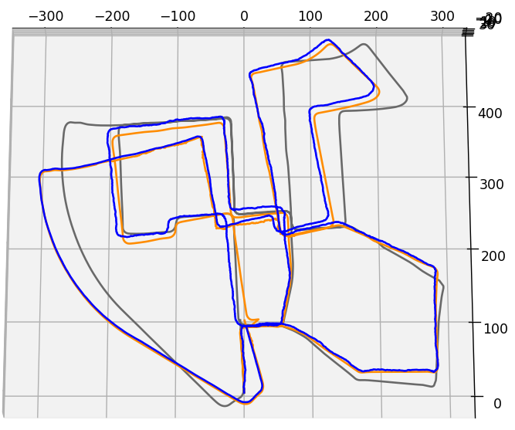
Results contd.
08
Optimization done at the end of the sequence
Optimization done at loop closure detection. No noisy measurement
Optimization done at loop closure detection. With noisy measurement

Slide 13
References
09
Lecture PPTs
Dellaert, F. and Kaess, M., 2017. Factor graphs for robot perception. Foundations and Trends® in Robotics, 6(1-2), pp.1-139.
https://github.com/borglab/gtsam/tree/develop/python
Lecture 15 - Stanford Vision Lab; Prof. Fei-Fei Li

Slide 14
THANK YOU

