Slide 1

SRM EASWARI ENGINEERING COLLEGE
Ramapuram, Chennai - 89
Smart Warehouse Management System for Real-Time Inventory, Storage and Dispatch Optimization
DEPARTMENT OF INFORMATION TECHNOLOGY
FULL STACK DEVELOPMENT – 2311CSC503R
PRESENTED BY
AKSHAY J(310624205009)
Under the guidance of
MS. SAI LAKSHMI

Slide 2
CONTENTS :
Title
Abstract
Introduction
Literature Survey
Existing System and Disadvantages
Proposed System and Advantages
System Requirements
System Architecture
References

Slide 3
ABSTRACT
Warehouses handling large volumes of goods traditionally rely on manual registers and spreadsheets to track stock. This often results in inaccurate inventory records, misplaced products, damaged goods going unnoticed, and delayed order fulfillment.
The proposed Smart Warehouse Management System is a full-stack web application developed using the MERN stack — MongoDB, Express.js, React.js, and Node.js. The system digitally manages inventory, assigns and tracks storage locations, records every stock movement, and streamlines dispatch operations.
Whenever stock is received, moved, or dispatched, the system updates inventory records in real time, ensuring warehouse staff and managers always have an accurate view of what is available, where it is stored, and what is ready to ship.

Slide 4
INTRODUCTION
Traditional warehouse operations depend on manual stock registers and physical verification, which do not scale well as the number of products (SKUs) grows.
For example, a product received today may be placed on any available shelf without being logged accurately, making it difficult to locate later or to know precisely how much stock remains.
The proposed system addresses this problem by digitally tracking every product, its assigned storage location, and every stock movement in real time.
The system provides a centralized platform where warehouse staff and managers can monitor inventory, storage locations, and dispatch status at any time.

Slide 5
LITERATURE SURVEY :
SYSTEM / PLATFORM | DESCRIPTION | ADVANTAGES | LIMITATIONS
Manual Register / Excel Tracking | Stock recorded by hand or spreadsheet | Simple, no cost, easy to start | Error-prone, no real-time sync
Barcode-based Inventory Systems | Uses barcode scanning for stock entry/exit | Faster than manual entry | Needs scanning hardware, limited analytics
RFID Warehouse Systems | Uses RFID tags to auto-track item location | Real-time location tracking | Expensive to deploy at scale
ERP Inventory Modules (SAP, Tally, etc.) | Enterprise software with inventory features | Feature-rich, integrates with accounting | Costly and complex for small warehouses

Slide 6
EXISTING SYSTEM :
Manual stock registers
Excel/spreadsheet-based tracking
Physical shelf verification
Verbal or paper-based communication between staff
Manually prepared dispatch lists
Basic barcode scanning (in some warehouses)
Staff usually update stock records manually after goods are received or dispatched, and the system generally does not reflect the exact real-time location or condition of every product.

Slide 7
DISADVANTAGES
DISADVANTAGES OF EXISTING SYSTEM
1. Inaccurate Inventory Records
Stock recorded in the system often does not match the actual quantity available on the shelf.
2. Misplaced Products
Products are stored without a fixed digital location, making them hard to find.
3. Damaged Products Go Unnoticed
Damaged stock is not flagged or removed from usable inventory in time.
4. Delayed Order Fulfillment
Lack of visibility into stock and location slows down picking and dispatch.
5. No Real-Time Stock Visibility
Managers cannot see current stock levels instantly.
6. Limited Analytics
Little to no data on fast-moving items, stock aging, or dispatch performance.

Slide 8
PROPOSED SYSTEM :
The proposed system is a MERN-based Smart Warehouse Management System that digitally manages inventory, storage locations, stock movement, and dispatch operations in real time.
The system allows warehouse staff to:
Register/login securely
Add and update product details
Assign storage locations to products
Record inward stock (goods received)
Record outward stock (goods dispatched)
Track real-time stock quantity and location
The dispatch team can:
Create and manage customer orders
Generate picking lists
Mark orders as dispatched
View order and dispatch history

Slide 9
ADVANTAGES :
Accurate Inventory
  Real-time stock counts always match actual shelf quantities.
Reduced Misplacement
  Every product has a known, trackable storage location.
Faster Order Fulfillment
  Staff instantly know quantity and location, speeding up dispatch.
Damage Tracking
  Damaged stock is flagged and excluded from sellable inventory.
Improved Visibility
  Managers can monitor stock, location, and dispatch status anytime.
Warehouse Analytics
  Insights into fast-moving items, stock aging, and dispatch trends.
Scalable Architecture
  The MERN architecture allows the system to extend to multiple warehouses.

Slide 10
SYSTEM REQUIREMENTS & SPECIFICATIONS
HARDWARE SPECIFICATIONS
SOFTWARE SPECIFICATIONS
Processor: Intel Core i5 / equivalent or above
RAM: 4 GB minimum, 8 GB recommended
Storage: 10 GB available space
Input Device: Keyboard and Mouse
Display: 1366 × 768 or above
Internet connection required
Operating System: Windows / Linux / macOS
Frontend: React.js
Backend: Node.js + Express.js
Database: MongoDB
ODM: Mongoose
Programming Language: JavaScript
Authentication: JWT + bcrypt
Real-Time Communication: Socket.IO
Development Tools: VS Code, Git, npm
Browser: Chrome / Edge / Firefox

Slide 11
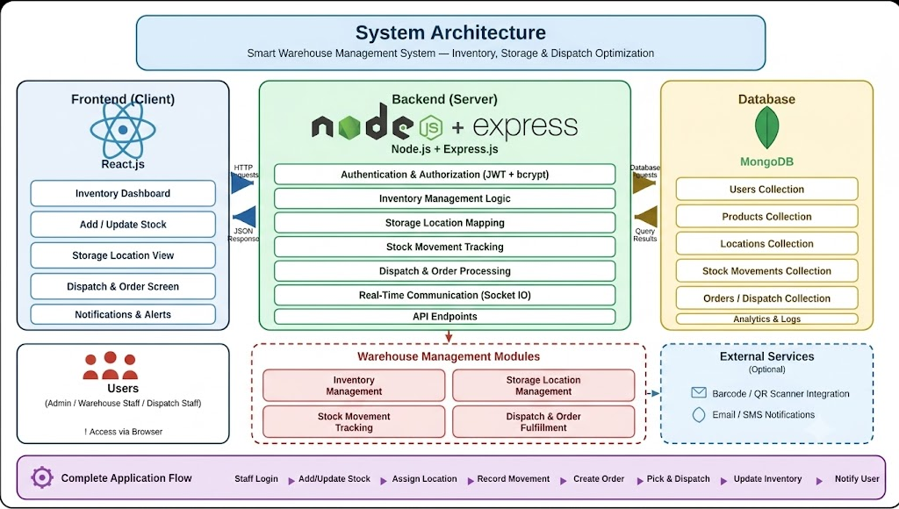
SYSTEM ARCHITECTURE :

Slide 12
REFERENCES :
Gwynne Richards, Warehouse Management: A Complete Guide to Improving Efficiency, Kogan Page.
Edward Frazelle, World-Class Warehousing and Material Handling, McGraw-Hill.
Alex Banks and Eve Porcello, Learning React, O'Reilly Media.
Ethan Brown, Web Development with Node and Express, O'Reilly Media.
Kristina Chodorow, MongoDB: The Definitive Guide, O'Reilly Media.
David Herron, Node.js Web Development, Packt Publishing.
David Flanagan, JavaScript: The Definitive Guide, O'Reilly Media.

Slide 13
THANK YOU !

