Slide 1
Pre-Trained Convolutional Neural Networks as Feature Extractors Towards Improved Malaria Parasite Detection In Thin Blood Smear Images

Slide 2
Project group id: 14
Akshay Kumar | MT19094
Gaurav Lodhi | MT19063
Ritesh Singh | MT19044
Kausal Sanadhya | MT19133

Slide 3
Introduction
Malaria is a mosquito-borne infectious disease that is caused by the Plasmodium parasites transmitted through the bite of female Anopheles mosquito.
The thick and thin blood smears are examined to detect and diagnose this disease and compute parasitemia.
Machine learning techniques like state-of-the-art Support vector machine (SVM) and Gradient Boosting combined with popular feature extraction techniques like Speeded-Up Robust Features (SURF), Oriented FAST and Rotated BRIEF (ORB) and KAZE are quite efficient to develop an efficient solution to this problem.
Although these methods are popular ,yet suffer from various problems, the results produced by these methods highly depends upon the selected feature extraction algorithm.
Therefore we have moved on to deep convolutional neural networks (CNN) due to their auto feature extraction properties.

Slide 4
Introduction
We have used Tensorflow API (Keras) to develop the baseline neural network.
Further, we have used Fast AI to implement CNN models due to its efficient deep learning models, which can be used to solve image analysis problems quickly and efficiently.
we have used pre-trained versions of the following models and further trained them on our dataset to achieve high accuracy.
Alex Net
Dense Net
Res Net
Squeeze Net
VGG_BN 11

Slide 5
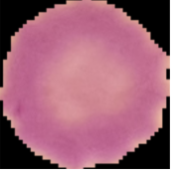
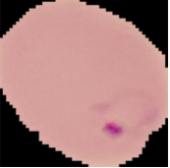
Materials And Method
Dataset Description
The dataset consists of Parasitized and the uninfected cell images each contains 13,779 images.
All the photos are in RGB format with size 139 X 142 X 3.
There are the samples of Parasitized and the uninfected cell images.
Fig 1.uninfected cell images. Fig 2.Parasitized cell images.

Slide 6
Research Paper Baseline Model
The proposed CNN has three convolutional layers and two fully connected layers.
The input to the model constitutes segmented cells of 75 × 75 × 3 pixel resolution.
The convolutional layers use 3 × 3 filters with 2 pixel strides. The first and second convolutional layers have 32 filters and the third convolutional layer has 64 filters.
Max-pooling layers with a pooling window of 2 × 2 and 2 pixel strides follow the convolutional layers.
The pooled output of the third convolutional layer is fed to the first fully-connected layer that has 64 neurons, and the second fully connected layer feeds into the Softmax classifier.
The model is trained by optimizing the multinomial logistic regression objective using stochastic gradient descent (SGD)

Slide 7
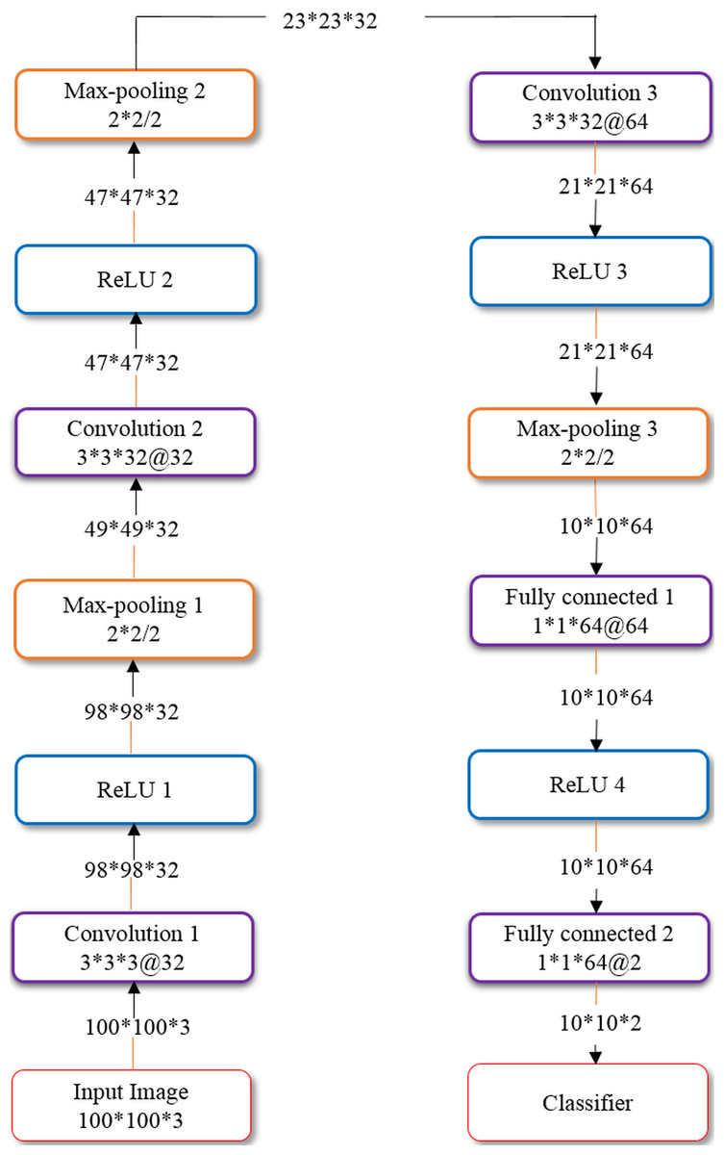
Research Paper Baseline Model
The layered architecture of the model is shown in given figure.
For the customized and pre-trained models, we empirically
determined the optimum value to be 0.9 and 1e–6 for the SGD
momentum and L2-regularization, respectively.
For the learning rate, we determined the optimum value to be
1e–5 and 1e–6 for the customized and pre-trained CNNs
Respectively.

Slide 8
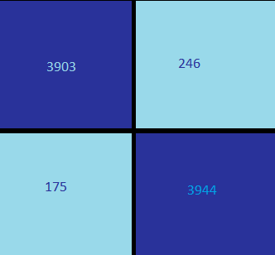
Research Paper Baseline Model
Performance evaluation:
Baseline accuracy of this model is 0.9490. Which is sufficient enough but we still have scope of enhancement in the model by using some methods like FAST AI with pre-trained neural networks.
This is the confusion matrix of generated by the baseline model.

Slide 9
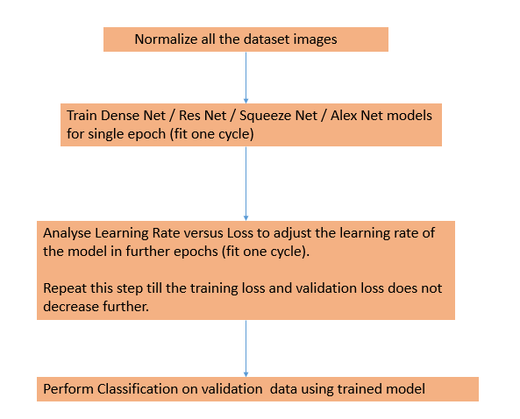
Proposed Methods
Proposed Architecture of Fast AI models:-
This is a layered architecture as shown in fig.
As an input it takes images normalized with the
same size.
The CNN model (Res Net, Dense Net, Alex Net,
and Squeeze Net) is trained for a single epoch
using fit_one_cycle() to find the model's optimal
learning rate

Slide 10
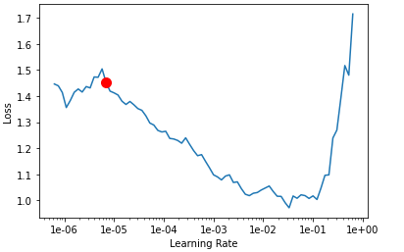
Proposed Methods
After estimating the optimal learning rate,train the model for a suitable number of epochs until training and validation loss doesn’t decrease further.As shown in fig.
Here red dot is optimal learning rate.
Perform prediction on the validation dataset.
Then we calculates all the metrics
( Accuracy, Confusion metric, Precision, F-1 score etc.)

Slide 11
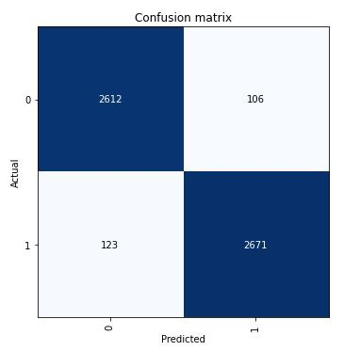
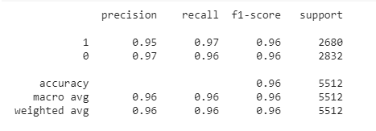
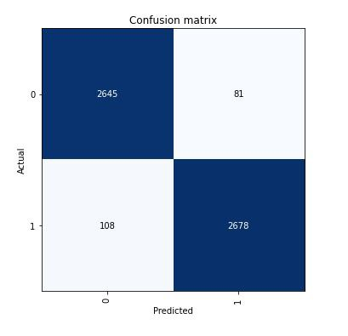
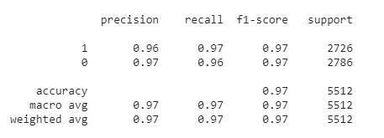
Results
Alex Net:
Dense Net:

Slide 12
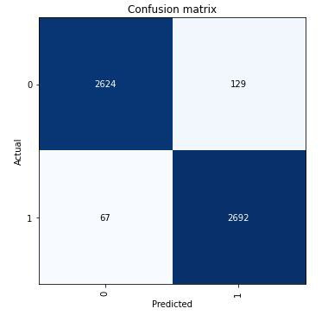
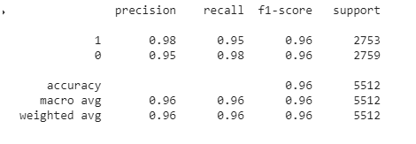
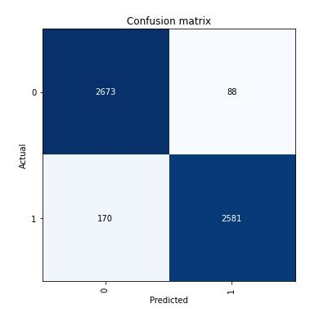
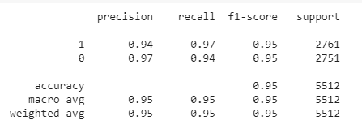
Results
III. Res Net:
IV. Squeeze Net:

Slide 13
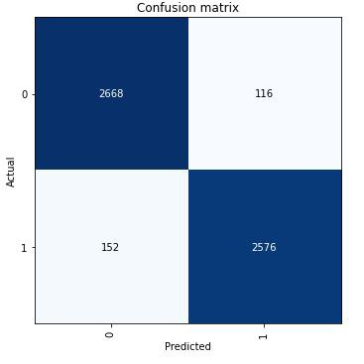
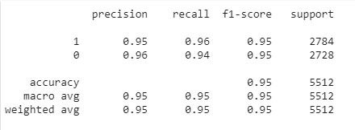
Results
V. VGG BN 11:

Slide 14
Discussion
The Dense Net 121 outperformed the other trained models in terms of overall precision, recall and F1-score metrics.
Microscopists identify a small clot inside the cellular image for an infected sample to distinguish between parasitized and uninfected samples. It is a general pattern for correctly classifying cellular samples. Moreover, this is one pattern recognized by the neural networks during their training as well. But for wrongly classified images, this pattern is not followed.
All the models implemented for these work are associated with least top-1 and top-5 error rates, which is another reason for selected these neural networks specifically.
Fast AI provides us the functionality to use pre-trained models, which can be trained on any image dataset through transfer learning.
we have divided the training images into batches of size 10-20, each which overcome the CUDA memory errors due to RAM shortage.
We observed that the FAST AI had not been used much in this field; therefore, our work counts towards this domain's contribution through our project.

Slide 15
Thank You

