Slide 1
Video Steganography
-Hiding in plain sight
Rahul Maheshwari (MT19027)
Abhishek Singh Chauhan (MT19085)
Nikunj Agarwal (MT19093)
P. Akshay Kumar (MT19094)
Piyush Jain Pradeep (MT19122)

Slide 2
Tasks performed
Separation of video into frames and audio for encryption.
Embedding of audio with information about frames which contain the encrypted concealed data.
Data is segmented into blocks and encrypted in frames using LSB encryption algorithm.
Compression is performed on the output encrypted video.
Decryption is performed to extract the original plain text information sent.
GUI (Graphical User Interface) using flask which integrates and binds all the above mentioned modules.

Slide 3
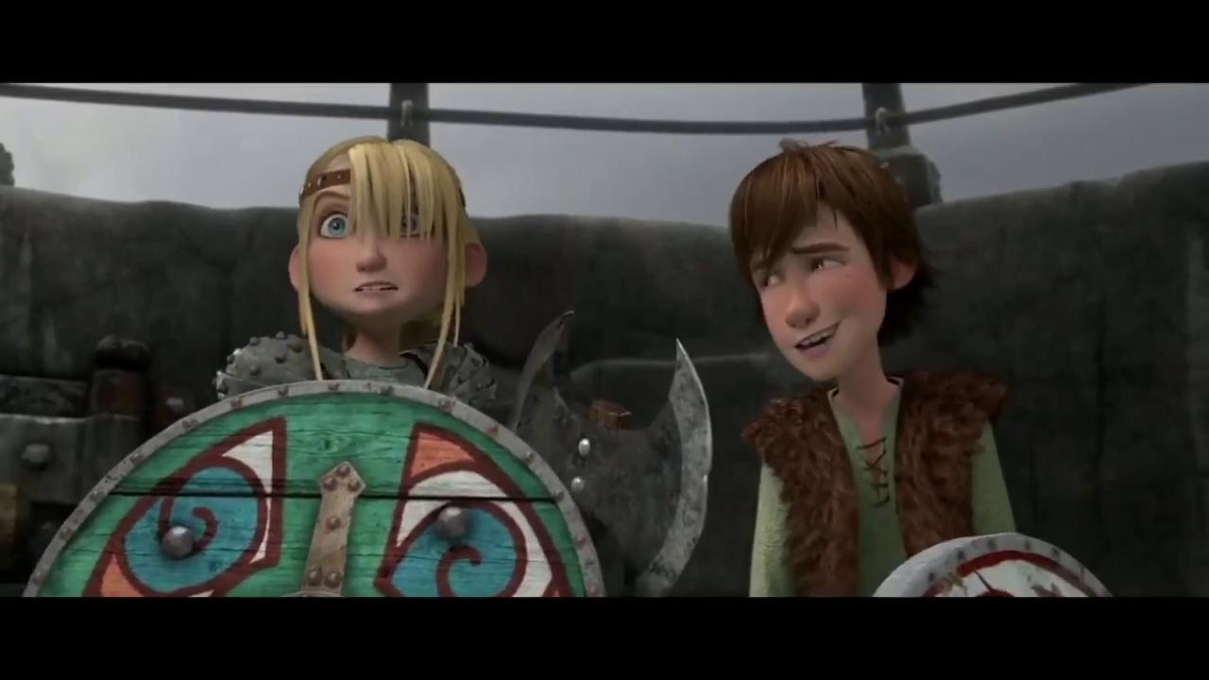
Sample video information
Video used for performing the above mentioned tasks is of length 35 secs containing a total of 842 frames.
Video is in .mp4 format

Slide 4
Audio Steganography
Audio of the video file is used to encrypt the frame number which contains the encrypted data.
Four methods for audio steganography were implemented -
Least significant bit method - In this method the data is encoded in the LSB bit of the audio data. First n frames of the audio data is used to encode n bit of data. Problem with this approach is that the attacker can easily extract the data.
Parity based technique - In this method the data is encoded by breaking the audio data into n equal size sample. And data is encoded by calculating the parity of the data. It also has the problem similar to the LSB based approach as if attacker know the size of data encoded data can be extracted by breaking the data into small samples and calculating the parity value.

Slide 5
Audio Steganography (contd…)
Random method - This method was created by us to solve the problem of the above stated methods. For this the number of frames are encoded into the first sixteen bytes of the data. And audio frames which are used for encoding are generated are using the secret key. Only problem with this approach is that the number of frame which is encoded using LSB can be extracted.
Complete random method - For this method secret key is used to select 16 audio frames which contains the number of frames. And using the frame number and secret key the frame used for encoding the final data is selected. This method works well because only the sender and receiver know the secret key.

Slide 6
Video Steganography
Video Steganography
LSB technique - Each word in the text is converted to binary form and the LSB of each byte is set to match the corresponding binary bit of the word.
Encryption:
Randomly generated corner number between 1 and 4 to decide at which corner the data will be encrypted. [1-Top left, 2-Top right, 3-Bottom left, 4-Bottom right]
The corner information and word length are encrypted using LSB technique in the first few bytes of the frame previous to the selected frame.
Each word is encrypted in the earlier randomly chosen corner using LSB technique.
The frames are then encrypted into the audio using the complete random technique mentioned in the previous slide.

Slide 7
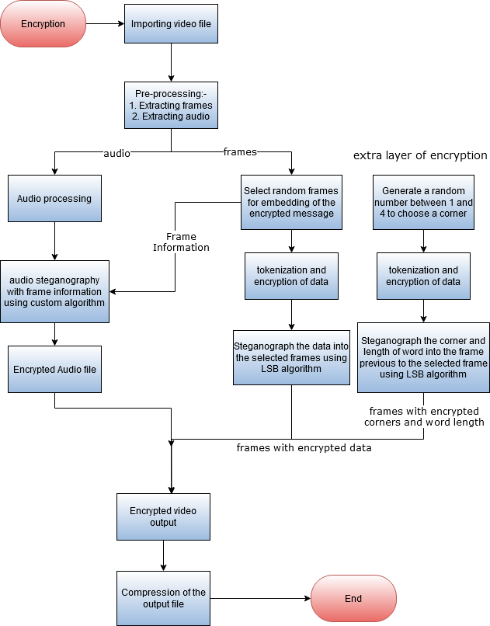
Encryption Flowchart

Slide 8
Video Steganography (contd…)
Video Steganography (contd..)
Decryption:
The frames selected for encryption are decrypted from the audio.
Firstly, the frame previous to the selected frame is used to extract the corner and word length of the word encrypted in the current frame.
Using the corner and word length information, the location of word is identified and the message is decrypted by extracting the LSB of bytes from the location.
The obtained binary is then converted to character which gives the text given as input by the user.

Slide 9
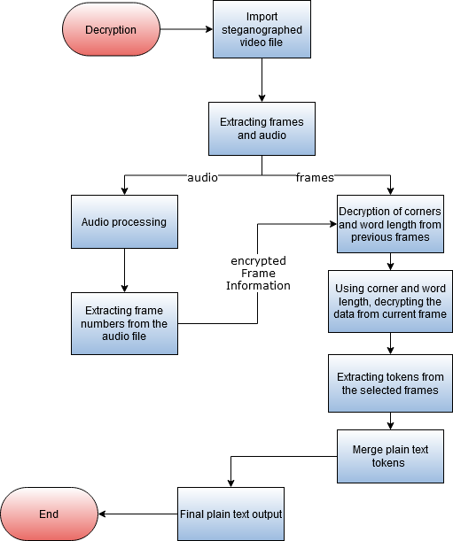
Decryption Flowchart

Slide 10
Additional Task: Compression
Compression is performed on the encrypted output video file to reduce the size in order to optimize the process and reduce the bandwidth required for sending the file to someone.
Compression involved usage of ffv1 intra frame lossless codec and conversion of output file to mkv format.
Compression reduced the size upto 3.5x-4x.

Slide 11
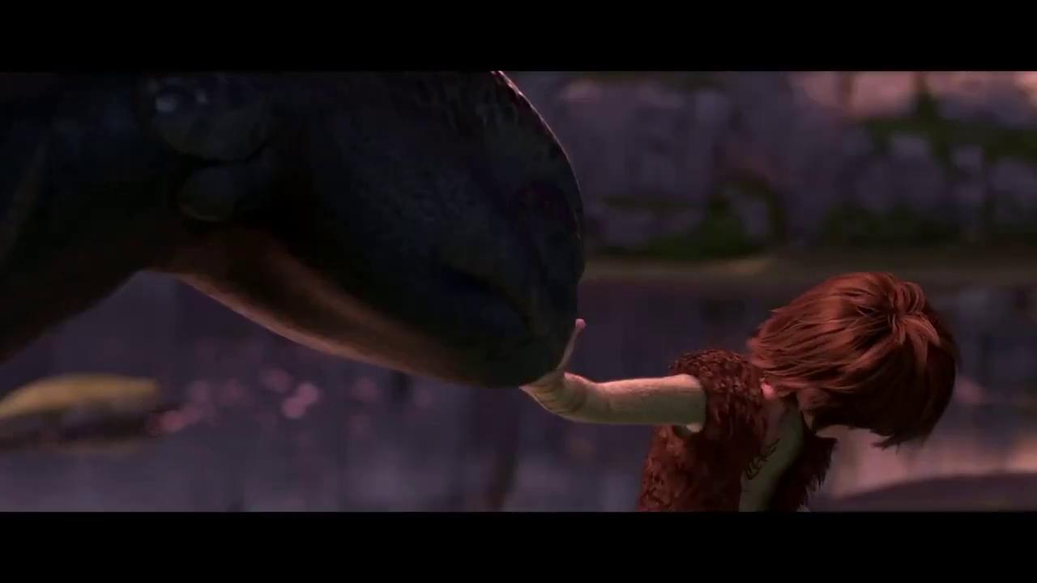
Results(Encryption Phase)
Plain text
Original Video
Encrypted Video using video steganography

Slide 12
Results(Decryption Phase)
Plain text
Encrypted Video
Decoded plain text

Slide 13
Demonstration of StegMEE!
We have created a Web Application, named StegMEE! for the demonstration of the project.

Slide 14

Thank You !

