Slide 1

YOUTUBE COMMENTS SENTIMENT ANALYSIS

Slide 2
TEAM-C14
UNDER THE GUIDANCE OF:
T.SANTHOSHA , Asst. Professor
STUDENT DETAILS:
G.DIVYA SAHUN 21R11A66A8
K.AJAY KUMAR 21R11A66B8
P.TEJASWINI 21R11A66D0

Slide 3
01
INTRODUCTION
02
PROJECT OVERVIEW
TABLE OF CONTENTS
03
IMPLEMENTATIONS GOALS
04
WORKFLOW
05
CHALLENGES
06
RESULTS AND ACHIEVEMENTS

Slide 4
1. INTRODUCTION
Youtube comments give us important clues about what viewers think and feel. Here, we are exploring how people express their sentiments towards videos through these comments using advanced technologies like Deep Learning and Natural Language Processing. Our project involves collecting comment data, cleaning and preprocessing it, and using DL models like LSTM or CNN for sentiment classification. This analysis plays a pivotal role for content creators, marketers, and viewers in understanding audience preferences
In the context of youtube, sentiment analysis can be applied to comments which were left by viewers of a video, providing some insights into how audience or users receive and respond to the content. However sentiment analysis can also help in marketing strategies where it helps to identify positive or negative responses.

Slide 5
2. PROJECT OVERVIEW
Objective:
To develop an automated system that categorizes YouTube comments into positive, negative, or neutral sentiments, helping creators understand audience feedback.
Scope
Automate Sentiment Analysis: Develop a system to automatically classify YouTube comments into sentiments without manual input.
Enhance Creator Insights: Deliver actionable insights on viewer feedback, enabling informed content decisions.
User-Friendly Interface: Create an intuitive interface for content creators to input video links, scrape comments, and view sentiment analysis results easily.
Problem Statement
YouTube's vast daily comments render manual sentiment analysis impractical. Automating this process will classify comments as positive, negative, or neutral, providing valuable insights for creators to enhance audience engagement.
Venus has a beautiful name and is the second planet from the Sun. It’s terribly hot—even hotter than Mercury—and its atmosphere is extremely poisonous. It’s the second-brightest natural object in the night sky after the Moon

Slide 6
3. PROJECT PLAN
Phase 1: Data Acquisition and Preprocessing (1-3 Weeks)
Acquire labeled sentiment dataset.
Preprocess the data (cleaning, tokenization, etc.).
Phase 2: Model Training (7-8 Weeks)
Train models using SNN, CNN, and LSTM architectures.
Perform hyperparameter tuning and validation.
Phase 3: YouTube API Integration (1-2 Weeks )
Set up and integrate YouTube API to fetch comments from videos.
Phase 4: Model Evaluation (3-4 Weeks)
Evaluate model performance using metrics like accuracy and F1-score.
Select the best-performing model based on evaluation results.
Phase 5: Interface Development (Ongoing)
Develop a user-friendly Flask interface for inputting video links.
Implement sentiment analysis results display.
Venus has a beautiful name and is the second planet from the Sun. It’s terribly hot—even hotter than Mercury—and its atmosphere is extremely poisonous. It’s the second-brightest natural object in the night sky after the Moon

Slide 7
MILESTONES AND KEY DELIVERABLES
Milestone 1: Data Acquisition and Preprocessing
Timeline: 1-3 Weeks
Key Deliverables
Acquired labeled sentiment dataset.
Completed data cleaning and preprocessing.
Generated exploratory data analysis (EDA) report.
Milestone 2: Model Development
Timeline: 7-8 Weeks
Key Deliverables
Developed and trained SNN, CNN, and LSTM models.
Evaluated model performance using accuracy metrics.
Selected the best-performing model based on evaluation results.
Milestone 3: YouTube API Integration
Timeline: 1-2 Weeks
Key Deliverables
Implemented YouTube API to fetch comments.
Successfully scraped comments from sample videos.
Ensured comments are stored for analysis.

Slide 8
Milestone 4: Model Inference
Timeline: 3-4 Weeks
Key Deliverables
Developed code for real-time sentiment analysis of scraped comments.
Generated predictions from the best-performing model.
Compiled results into a structured format for review.
Milestone 5: Interface Development and Final Evaluation
Timeline: Ongoing
Key Deliverables
User-friendly interface for content creators is being developed.
Sentiment analysis functionality is being integrated into the interface.
Final testing and evaluation of the complete system are being conducted.

Slide 9
4. IMPLEMENTATION GOALS
Implementation Achievements
Acquired the labeled sentiment dataset.
Completed preprocessing of the data.
Trained models using SNN, CNN, and LSTM.
Utilized the YouTube API to fetch comments.
Trained the model using the best-performing architecture.
Conducted model evaluation.
Success Criteria
Model Accuracy
Data Preprocessing Efficiency
Comment Fetching Capability

Slide 10
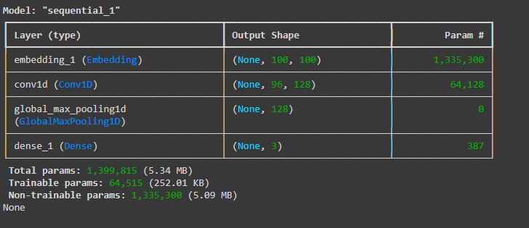
5. MODEL ARCHITECTURE
Venus has a beautiful name and is the second planet from the Sun. It’s terribly hot—even hotter than Mercury—and its atmosphere is extremely poisonous. It’s the second-brightest natural object in the night sky after the Moon

Slide 11
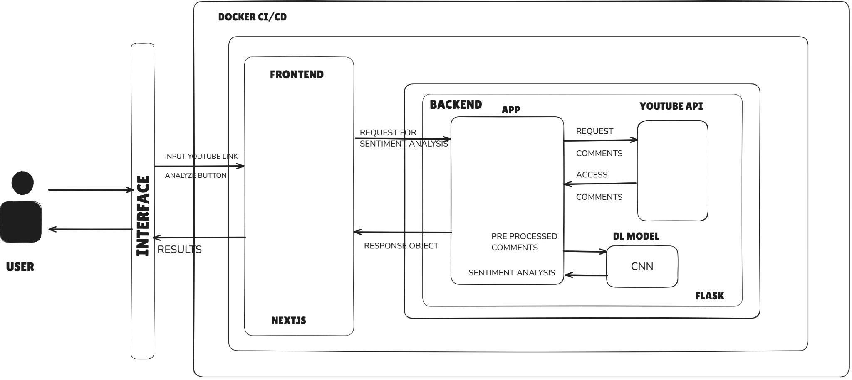
5. ARCHITECTURE DESIGN
Venus has a beautiful name and is the second planet from the Sun. It’s terribly hot—even hotter than Mercury—and its atmosphere is extremely poisonous. It’s the second-brightest natural object in the night sky after the Moon

Slide 12
6. WORKFLOW/ METHODOLOGY
The project uses an Agile approach with iterative development:
1. Data Collection & Preprocessing
2. Model Training (CNN, LSTM, Sequential)
3. Model Evaluation and Comparison
4. Web Interface Development
5. Integration of Real-Time Sentiment Analysis

Slide 13
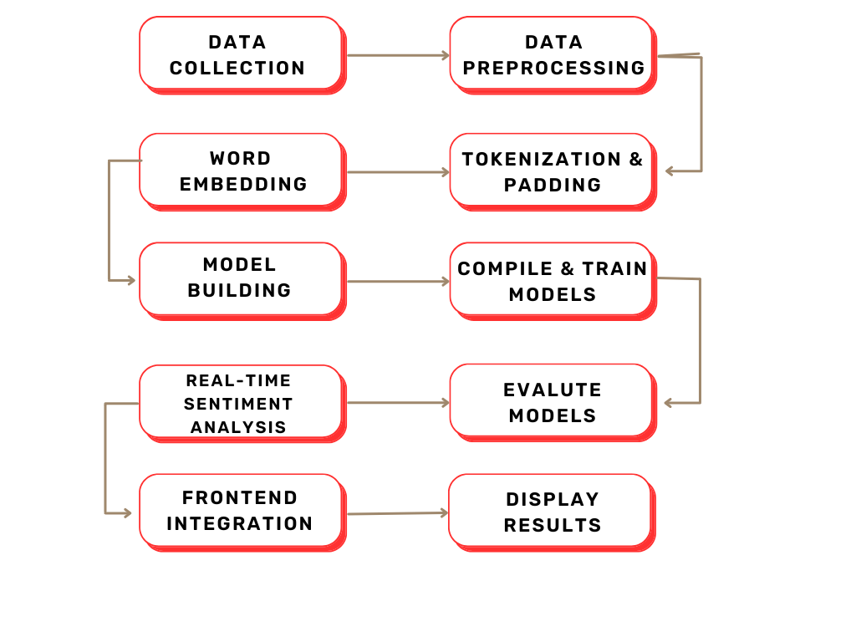
METHODOLOGY

Slide 14
7. Work Completed / Tasks Accomplished
1. Module 1: Data Preprocessing
- Collected and cleaned Kaggle airline sentiment dataset.
- Used YouTube API to scrape real-time comments.
2. Module 2: Model Development
- Implemented and trained CNN, LSTM, and Sequential models.
- Compared model accuracies.
3. Module 3: Web Interface
- Developed a web interface for users to input YouTube video links and view sentiment results.

Slide 15
8. TECHNICAL CHALLENGES FACED
Imbalanced Dataset:
- The dataset required oversampling to balance sentiment classes.
Model Accuracy Variations:
- CNN performed better than Sequential in real-time scenarios.
Real-time API Limitations:
- Handling large numbers of comments without hitting API limits.
Venus has a beautiful name and is the second planet from the Sun. It’s terribly hot—even hotter than Mercury—and its atmosphere is extremely poisonous. It’s the second-brightest natural object in the night sky after the Moon

Slide 16
9. SOLUTIONS TO CHALLENGES
Class Imbalanced:
-Applied oversampling techniques to ensure balanced training.
Model Optimization:
- Tuned hyperparameters and used GloVe embeddings to improve accuracy.
API Limitations:
- Added pagination to fetch a higher number of comments.
Venus has a beautiful name and is the second planet from the Sun. It’s terribly hot—even hotter than Mercury—and its atmosphere is extremely poisonous. It’s the second-brightest natural object in the night sky after the Moon

Slide 17
10. KEY ACHIEVEMENTS
Model Accuracy:
Achieved an accuracy of 92% with the CNN model.
Web Interface:
Currently completing the implementation of a web interface for real-time sentiment analysis.
Real-Time Processing:
Finalizing the handling of real-time YouTube comments, with a focus on minimizing prediction time.
Venus has a beautiful name and is the second planet from the Sun. It’s terribly hot—even hotter than Mercury—and its atmosphere is extremely poisonous. It’s the second-brightest natural object in the night sky after the Moon

Slide 18
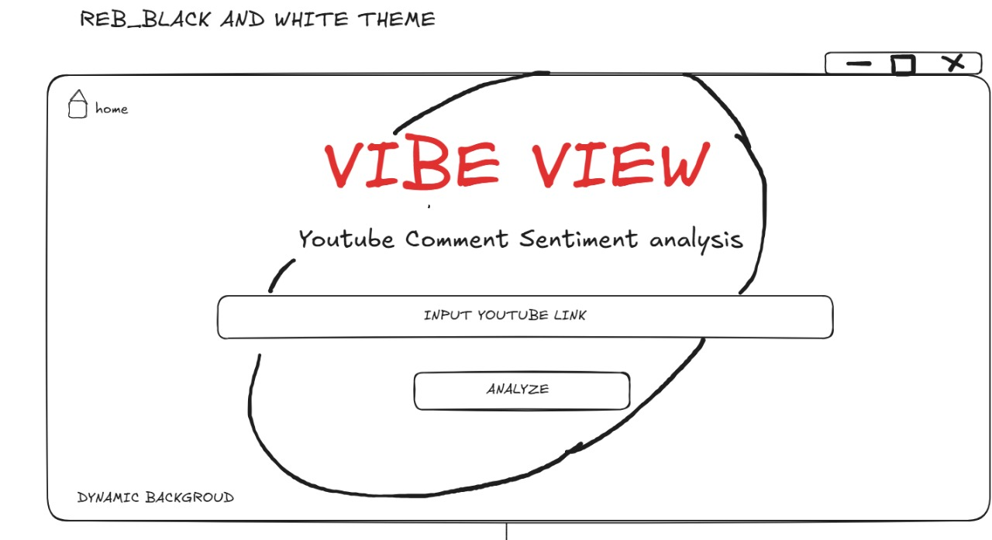
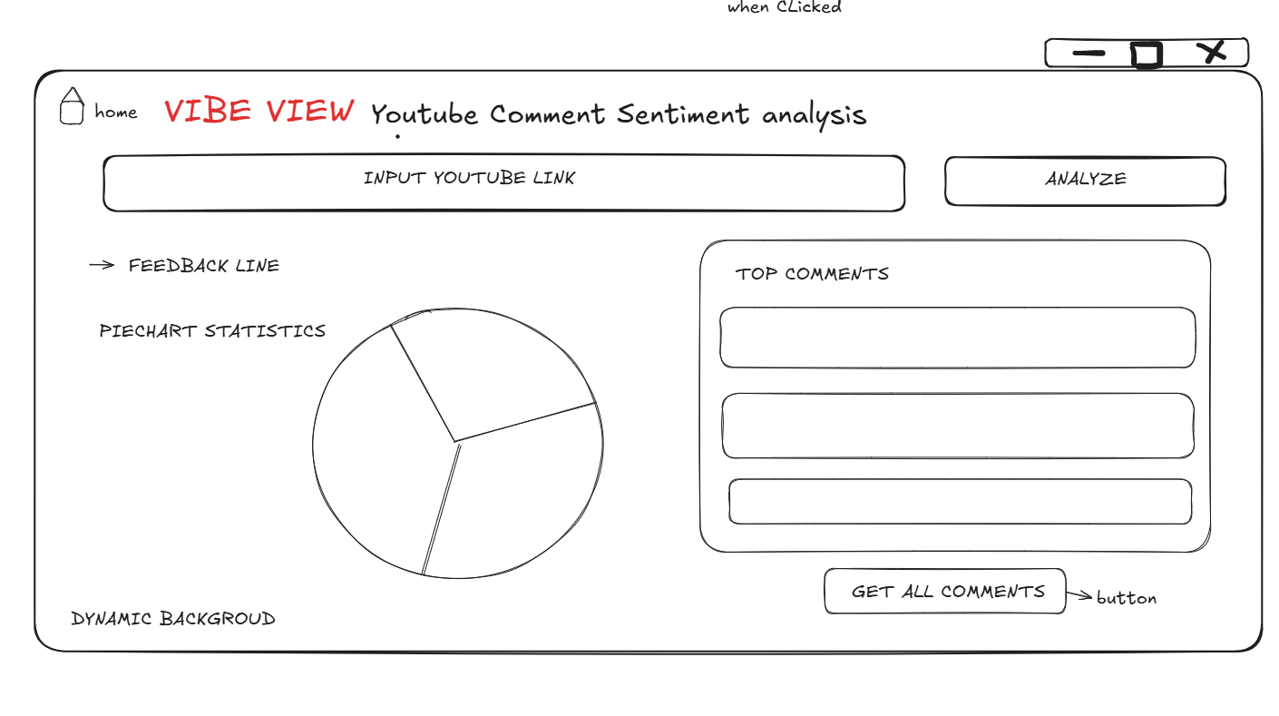
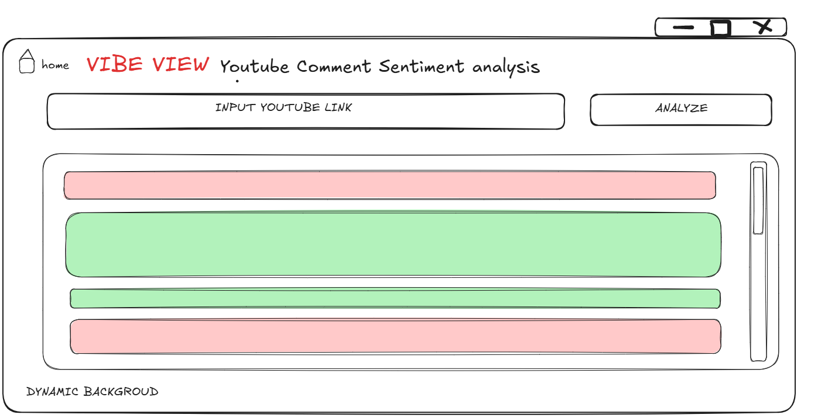

Slide 19
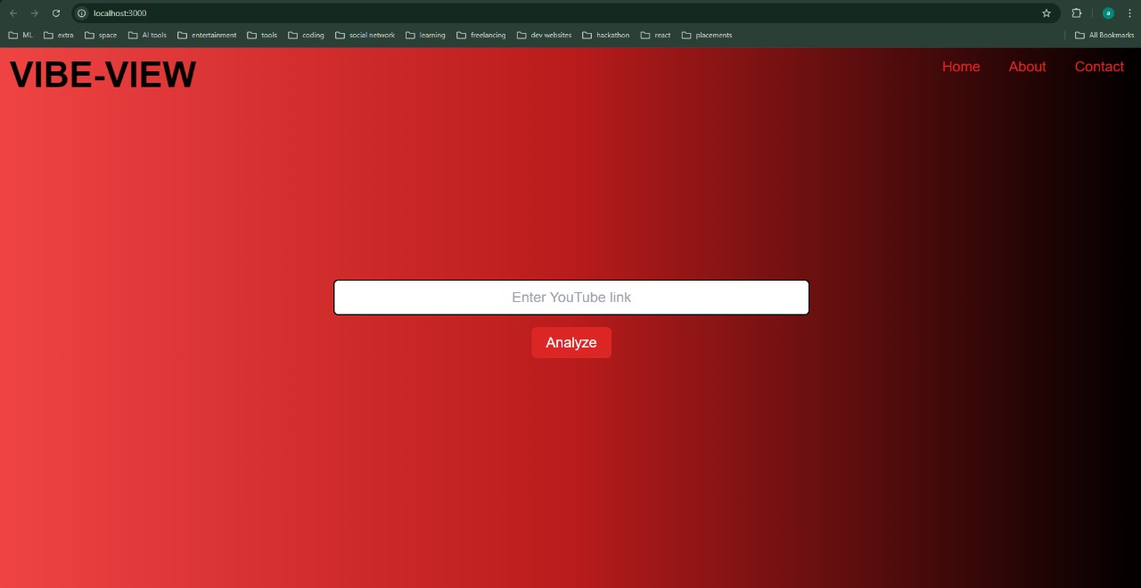
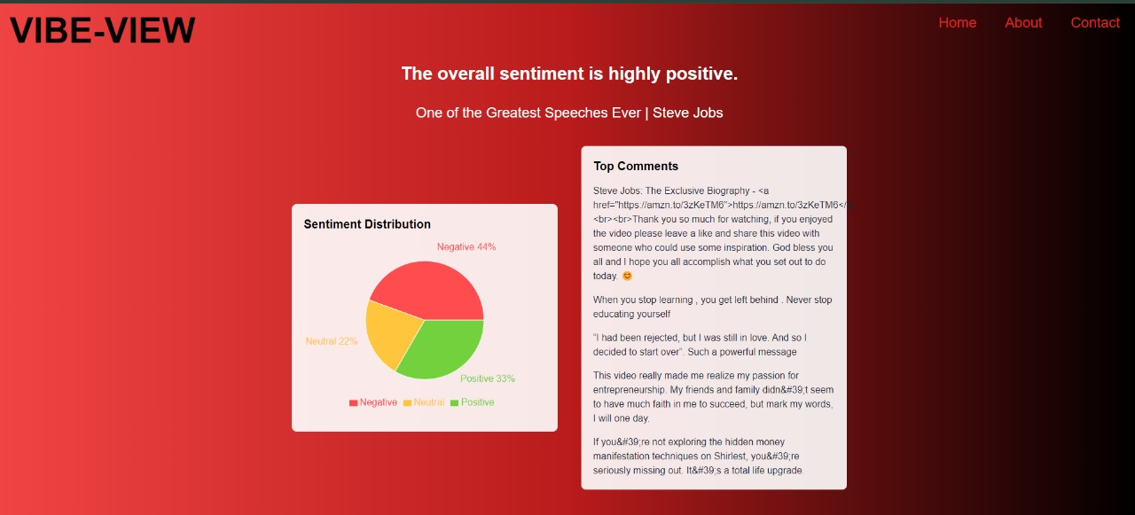
11. DEMO

Slide 20
EVALUATION METRICS
ACCURACY
FORMULA:
accuracy = model.evaluate(X_test, y_test)[1]
RESULTS:
SNN Model Accuracy: 0.7441438436508179
CNN Model Accuracy: 0.9211912155151367
LSTM Model Accuracy: 0.3361176550388336
Venus has a beautiful name and is the second planet from the Sun. It’s terribly hot—even hotter than Mercury—and its atmosphere is extremely poisonous. It’s the second-brightest natural object in the night sky after the Moon

Slide 21
EVALUATION METRICS
LOSS
FORMULA:
loss = model.evaluate(X_test, y_test, verbose=0)[0]
RESULTS:
SNN Model Loss: 0.6266180872917175
CNN Model Loss: 0.2655746340751648
LSTM Model Loss: 1.098703384399414
Venus has a beautiful name and is the second planet from the Sun. It’s terribly hot—even hotter than Mercury—and its atmosphere is extremely poisonous. It’s the second-brightest natural object in the night sky after the Moon

Slide 22
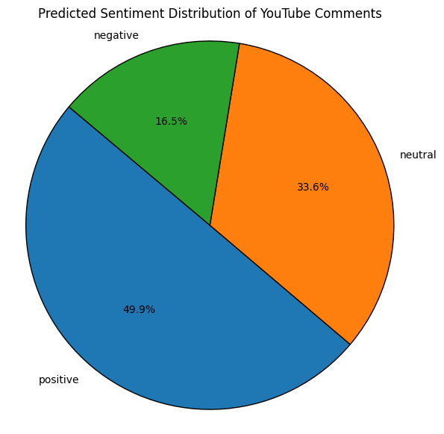
MODEL OUTCOMES
Venus has a beautiful name and is the second planet from the Sun. It’s terribly hot—even hotter than Mercury—and its atmosphere is extremely poisonous. It’s the second-brightest natural object in the night sky after the Moon

Slide 23
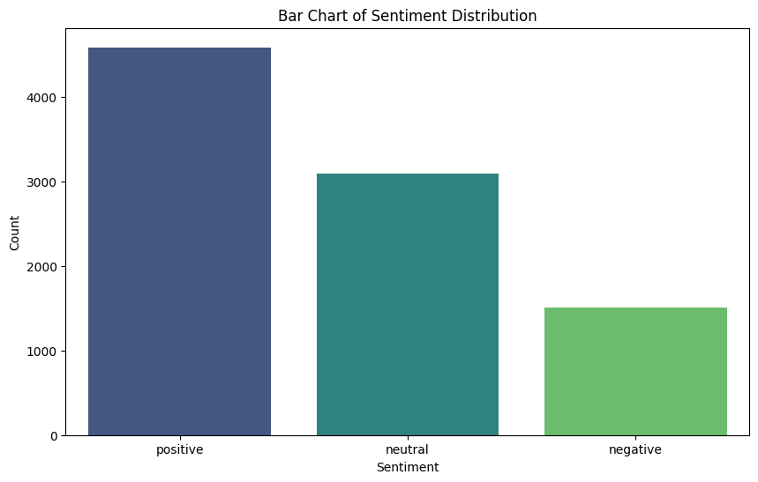
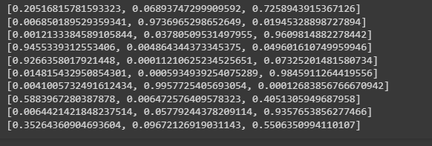
PROBABILITIES
[NEGATIVE,NEUTRAL,POSITIVE]
Venus has a beautiful name and is the second planet from the Sun. It’s terribly hot—even hotter than Mercury—and its atmosphere is extremely poisonous. It’s the second-brightest natural object in the night sky after the Moon

Slide 24

FUTURE WORK
MULTILINGUAL
SUPPORT
SPAM AND BOT DETECTION
ENHANCED
VISUALISATION
NOISE
REDUCTION

Slide 25
CONCLUSION
This project leverages NLP and Deep Learning to automate the sentiment analysis of large-scale video comments, providing valuable insights for content creators, marketers, and researchers. By classifying comments into positive, neutral, and negative sentiments using CNN and LSTM models, it achieves high accuracy in predictions, showcasing AI's capability to process real-world data at scale. The project also highlights the potential for AI-driven content moderation and feedback analysis, improving efficiency.
The ReactJS-based interface bridges technical complexity with usability, allowing users to easily analyze audience reactions and make data-driven decisions. This system not only saves time but also enhances decision-making by offering actionable insights, ultimately helping to optimize engagement strategies and content performance. Metadata
Venus has a beautiful name and is the second planet from the Sun. It’s terribly hot—even hotter than Mercury—and its atmosphere is extremely poisonous. It’s the second-brightest natural object in the night sky after the Moon

Slide 26

THANK YOU

