Slide 1

Project:
Exploring Entomological knowledge using GBIF dataset
By Akshay Ghatage
Guided by Asst. Prof. B. S. Pujari

Slide 2
Spatial data Analysis
Spatial is relating to the position, area, shape and size of things
Spatial data are data that are connected to a place in the Earth
Spatial data are data/information about the location and shape of, and relationship among, geographic features usually stored as coordinates and topology
Analysis is the process of inferring meaning from data
Analysis in GIS can also be carried out by measurements, statistical computations, fitting models to data values other operation
Spatial analysis is the process by which we turn raw data into useful information
In a narrow sense, spatial analysis has been described as a method for analysing spatial data, while in broad sense, it includes revealing and clarifying processes, structures, etc., of spatial phenomena that occur on the Earth’s surface.

Slide 3
Data Visualization
Data visualization is the visual presentation of data or information
The goal of data visualization is to communicate data or information clearly and effectively to readers. Typically, data is visualized in the form of chart, infographic, diagram or map.
Data visualization can be used for:
- Making data engaging and easily digestible
- Recognizing trends and outliers within a set of data
- Telling a story found within a data
- Reinforcing an argument or opinion
- Highlighting the important parts of a set of data

Slide 4
GBIF Dataset:
Global Biodiversity Information Facility
GBIF enables free and open access to biodiversity data online
Access to biodiversity data for GIS analysis and environmental monitoring
Madagascar is one of the world’s most important biodiversity hotspots
We considered a GBIF dataset of 24 orders of insects: Coleoptera, Diptera, Hemiptera, Hymenoptera, Lepidoptera, Neuroptera, Odonata, Orthoptera and Trichoptera, etc.
This GBIF dataset includes 231,604 records referred to 24 insect orders
there are 7383 localities present in the Madagascar which are having these 2,31,604
records.

Slide 5
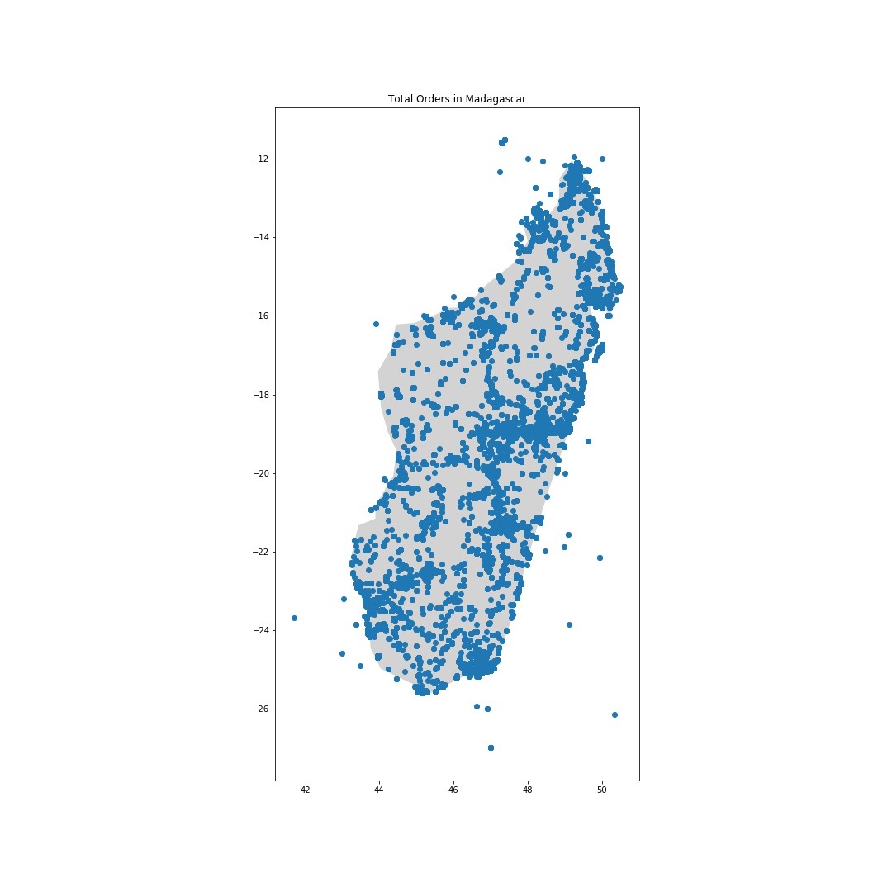
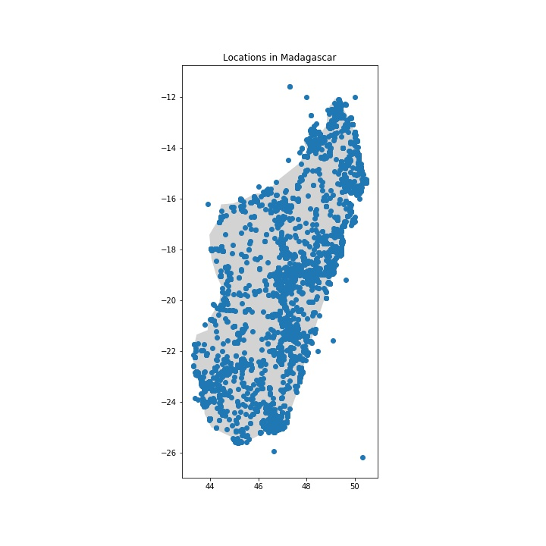
Fig. 1 is representing the total orders 231,604 in Madagascar and Fig. 2 is representing the 7383 localities in Madagascar where we found these records.
Fig. 1 Fig.2

Slide 6
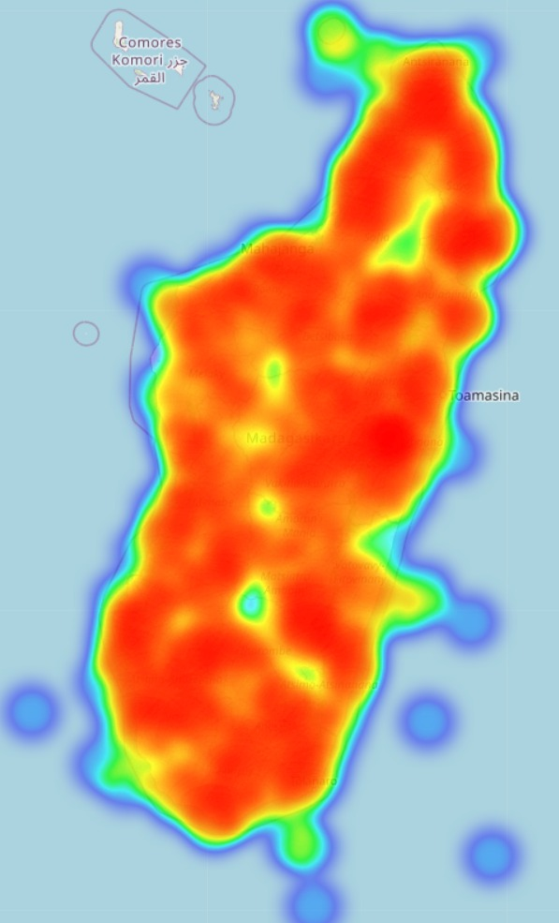
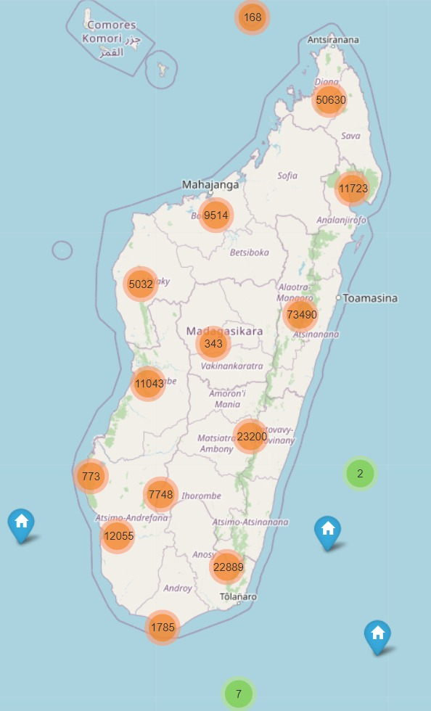
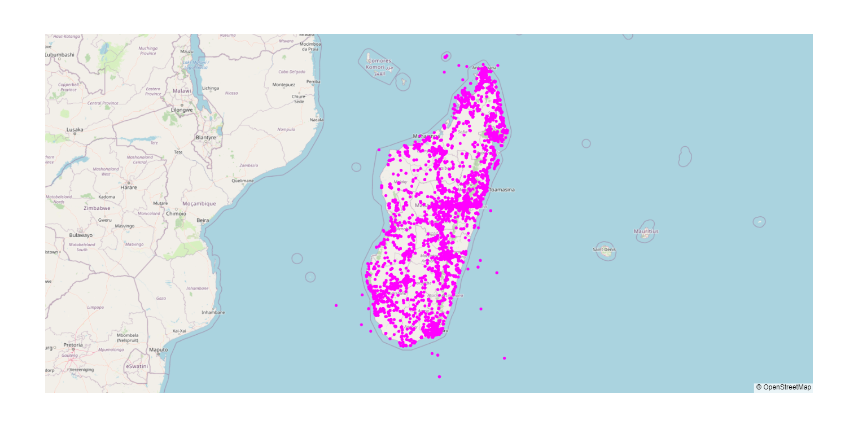
Results
1. Heat map, marker cluster and scatter map of all records
Below heat map and marker cluster are plotted on the base map of Madagascar. These maps are used to see the distribution of all orders of insects in Madagascar.
Third map is representing the total records of all orders of insects(231,604).

Slide 7
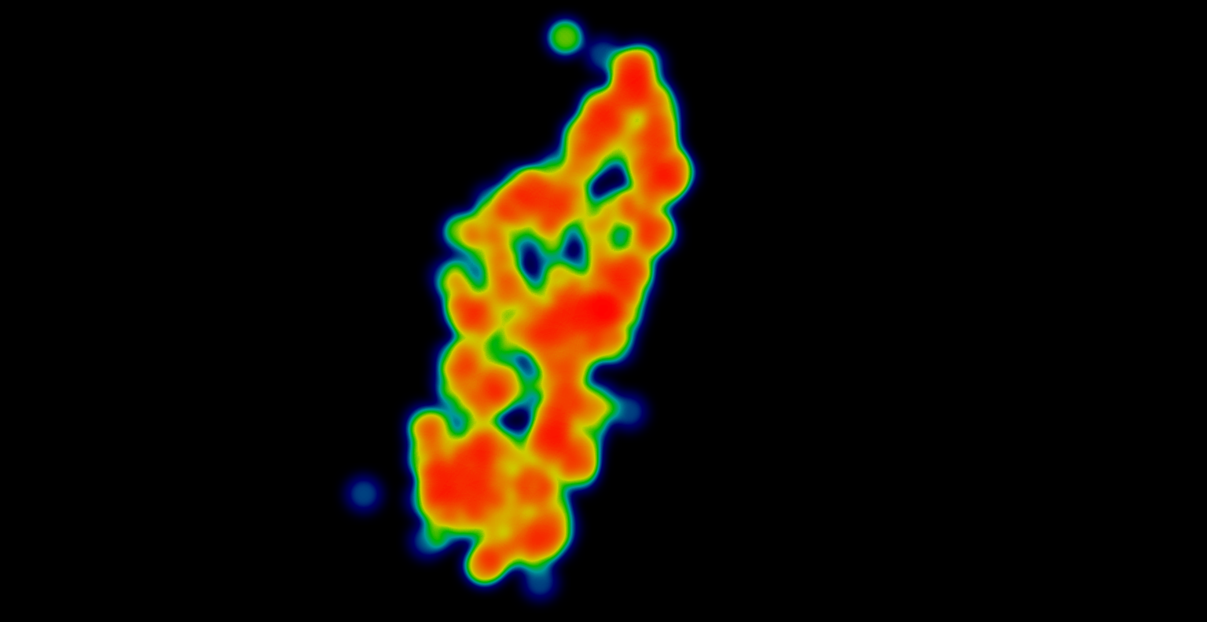
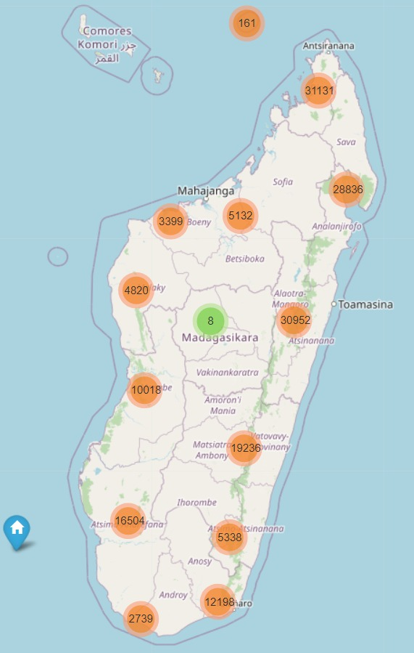
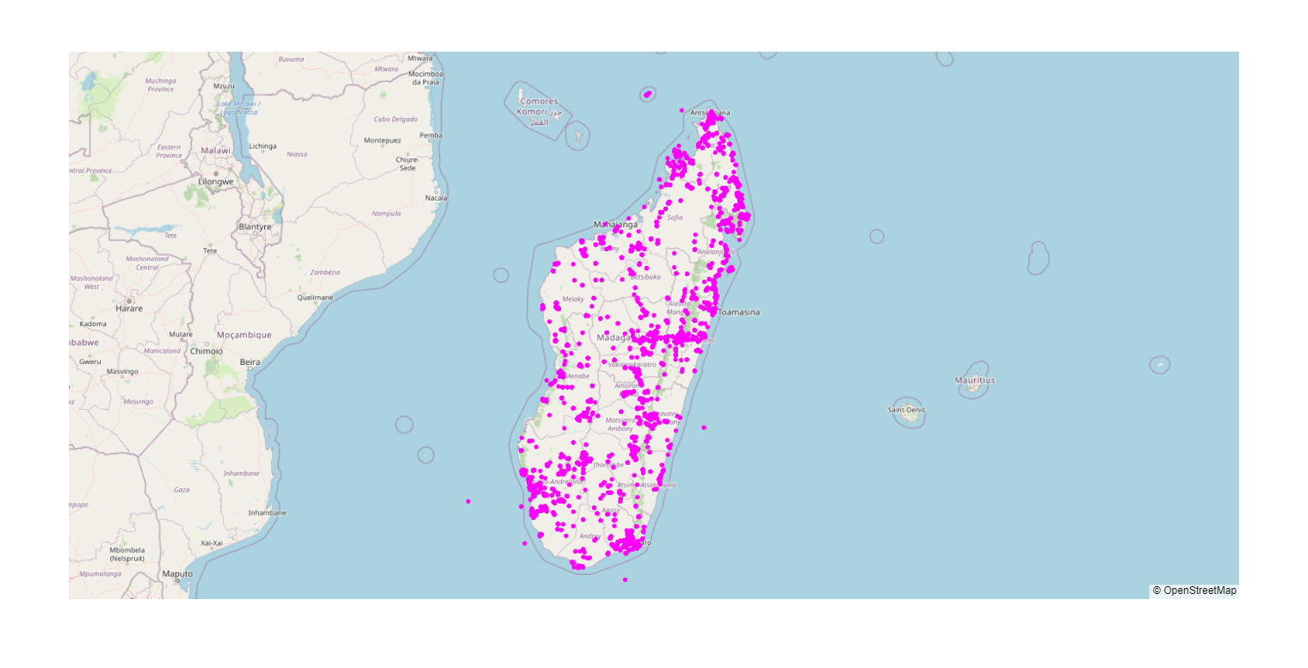
2. Heat map, marker cluster and scatter map of Hymenoptera
Hymenoptera is one of the order of insects which is having most records(170,473) in Madagascar as compared to other records.
According to the below maps, records of this order of insects are present in almost all localities of Madagascar.

Slide 8
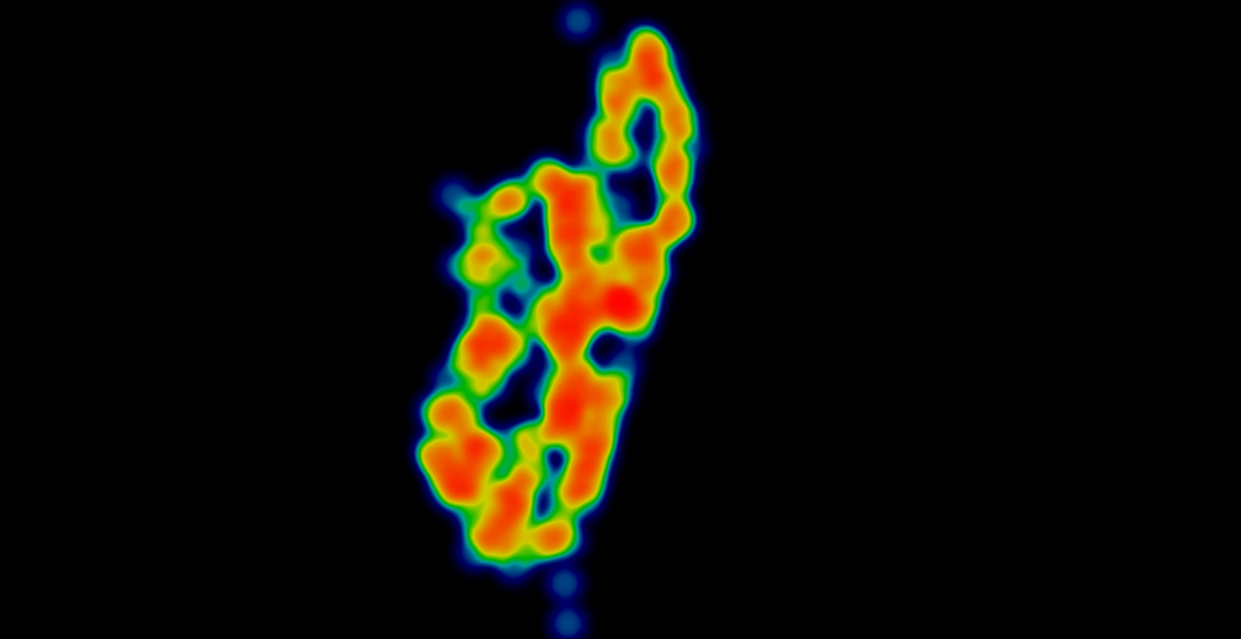
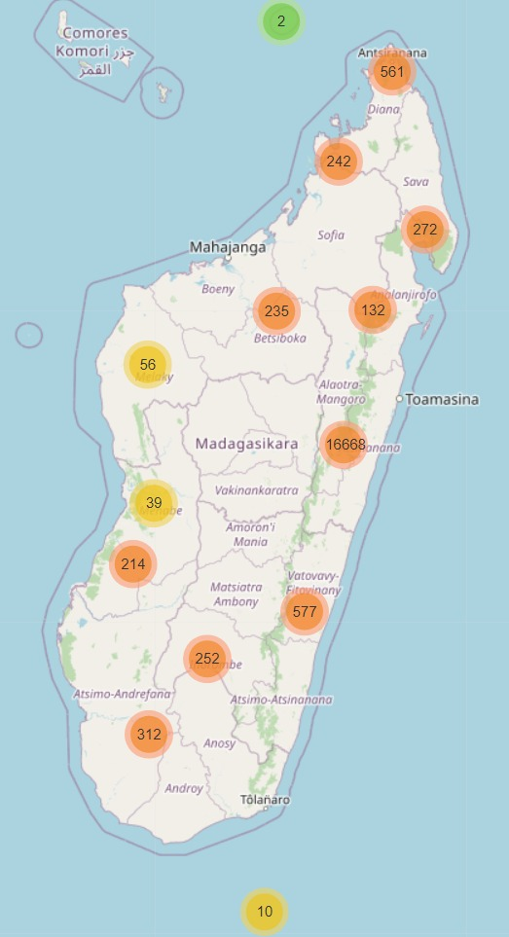
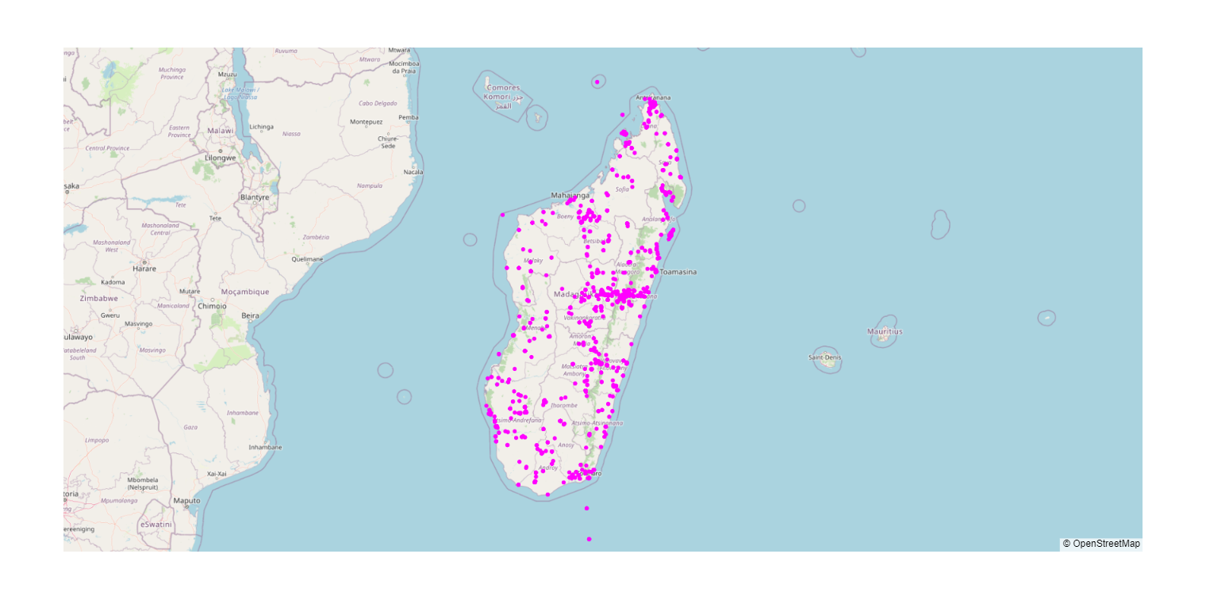
3. Heat map, marker cluster and scatter map of Diptera
The order Diptera is having total 19,527 records.
In the heat map, we will see that small areas of Madagascar are not having the records of order Diptera.
The distribution of Diptera records are shown in other two maps.

Slide 9
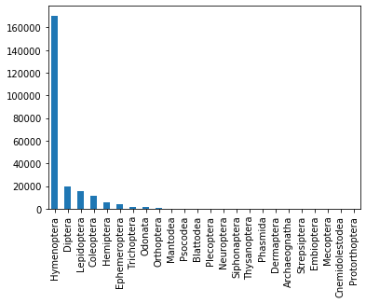
Here I mentioned about two orders of insects viz., Hymenoptera and Diptera. These two orders are having large number of records.
Similarly, I also plotted the heatmaps, marker clusters and scatter maps of remaining orders.
These 24 orders of insects are Lepidoptera(15080), Coleoptera(11177), Odonata(1184), Hemiptera(5237), Hymenoptera(170473), Orthoptera(826), Diptera(19572), Neuroptera(67), Cnemidolestodea(1), Psocodea(191), Blattodea(179), Thysanoptera(45), Dermaptera(29), Mantodea(202), Phasmida(40), Trichoptera(1597), Ephemeroptera(4316), Plecoptera(127), Strepsiptera(2), Siphonaptera(54), Embioptera(2), Archaeognatha(2), Mecoptera(1), Protorthoptera(1).
All maps are plotted based on records of these orders.

Slide 10
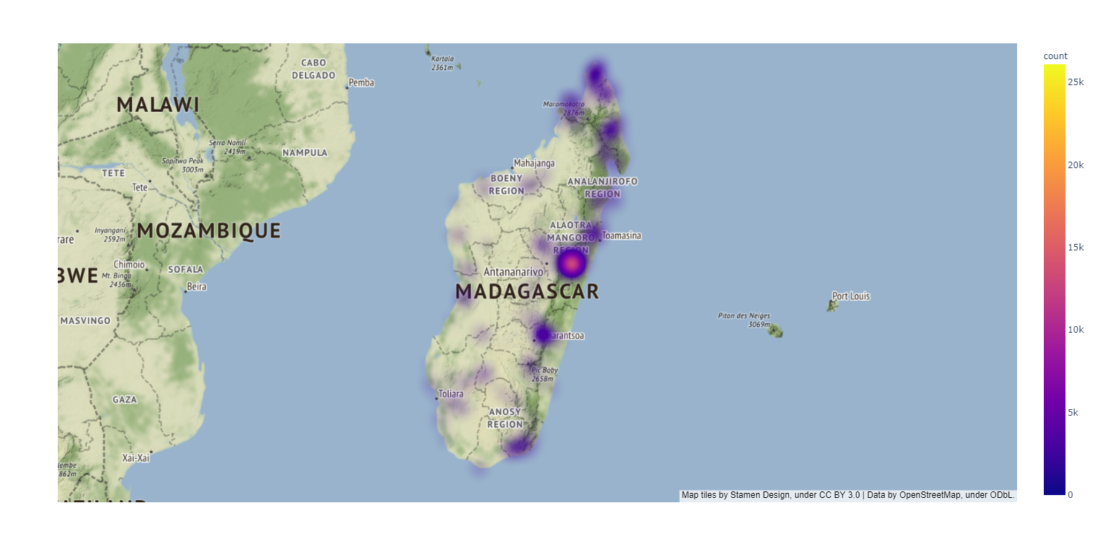
4. Density map of localities containing all records
The above map is representing the density of all records of all orders in different localities of Madagascar.
When we see this map, we found that maximum number of records of all orders are occurred in the Eastern Madagascar.

Slide 11
Conclusion and future work
When we got above results in the geographical format, we definitely made one observation that Eastern Madagascar is playing very important role in the biodiversity of Madagascar. The most of the records of the different type of orders of insects are present in the Eastern Madagascar.
To conserve these species there are protected areas in the Madagascar. But we need to increase those areas. When we see our results, we got know that where these species mostly occurs. So, on the basis of this knowledge, we will definitely help to increase protected areas. The localities which are having these records of all orders are mostly in the Eastern Madagascar.
When we think about future work regarding this project, GBIF organization is playing very important role in this. By using GBIF datasets, we explore different continent's different species on the basis of their occurrences and also we will get different geographical results on the basis of their occurrences. That means this will help us to conserve different species in different continents.

Slide 12
Thank You

