Slide 1
⚡
9-BLOCKER D2 / F3 · AUTONOMOUS GRID AGENT
Renewable Energy
Orchestrator
An Autonomous AI Agent for India's 500 GW Renewable Future
Real-time dispatch of solar, wind, batteries, grid, and demand — every 15 minutes.

Slide 2
01 · PROBLEM
India's Renewable Grid Needs an Intelligent Operator
500 GW
₹1.2L Cr+
15 min
6+
Renewable target
by 2030
Lost annually to
curtailment + diesel
Decision window
for operators
Competing objectives
to balance
Why today's approach fails
⚡ Our Solution
▸ Solar and wind are intermittent — forecasts are uncertain; static dispatch rules break under volatility.
▸ Operators must balance cost, carbon, reliability, battery health, curtailment, and profit — humans cannot optimize 20+ variables every 15 minutes.
▸ Batteries are under-utilized as arbitrage + reserve assets; expensive diesel peakers fire up when stored solar could have been used.
▸ Demand response and grid export are rarely coordinated in real time.
An autonomous AI agent that:
• reads telemetry and forecasts every 15 minutes,
• reasons about anomalies and uncertainty,
• calls a numerical LP optimizer as a tool,
• validates the plan and re-plans if needed,
• dispatches batteries, grid, curtailment, and DR,
• accepts natural-language operator commands.
Result: 71% cost cut, 153 t CO₂/day avoided, zero critical outages.
Renewable Energy Orchestrator · ET × Accenture AI Hackathon — Agentic Edition · Problem 4
2 / 10

Slide 3
02 · PROPOSED SOLUTION
A Genuinely Agentic Loop: Observe → Reason → Optimize → Validate → Act
👁️
🧠
⚙️
✓
⚡
→
→
→
→
OBSERVE
REASON
OPTIMIZE
VALIDATE
ACT
Telemetry from 11 assets
+ 5-horizon forecasts
+ alerts
Diagnose anomalies;
choose 6 objective weights
+ battery reserve
Calls LP solver (PuLP/CBC)
— ~20 variables, <50 ms
— as a tool
Check critical load,
SOC bounds, price
sanity; replan on fail
Dispatch kW flows;
stream to dashboard;
log to audit trail
What makes this agentic (not an LP with an LLM wrapper)
▸ The agent chooses objective weights + reserve dynamically per tick; the LP is a called tool, not the brain.
▸ Closed-loop reflection: validation failures trigger an automatic replan with higher reliability weight.
▸ Forecast confidence modulates risk posture (low confidence → higher battery reserve).
▸ Natural-language commands from operators blend with (not override) the agent's reasoning.
▸ Structured telemetry + textual alerts (D2); continuous multi-timestep simulation under varying conditions (F3).
▸ Hard safety layer (SOC 10–95% bounds, power-balance equality, ₹50/kWh critical penalty) can never be overridden.
Renewable Energy Orchestrator · ET × Accenture AI Hackathon — Agentic Edition · Problem 4
3 / 10

Slide 4
03 · ARCHITECTURE
Four-Layered System with an Immutable Safety Layer
🧑‍💻 OPERATOR DASHBOARD
React 19 · Recharts · WebSocket streaming (sub-50 ms)
Glass UI with live topology, dispatch chart, NL commands, audit trail
⇅
🧠 AGENT BRAIN
Observe → Reason → Optimize → Validate → Act
Rule-based expert (default, offline) · LLM-adaptive when API key present
⇅
⚙️ LP OPTIMIZER (TOOL)
PuLP / CBC MILP · ~20 variables · <50 ms per tick
Power balance · SOC evolution · charge/discharge exclusivity · DR caps · line derates
⇅
🌍 SIMULATION WORLD
5 solar (93 MW) · 3 wind (75 MW) · 2 BESS (40 MW / 160 MWh)
Grid interconnection (TOU tariffs) · 3 industrial loads · 5 forecast horizons with confidence
🛡 SAFETY LAYER (cannot be overridden)
Battery SOC 10–95% hard bounds in LP · Power-balance equality · ₹50/kWh critical-load penalty · Greedy fallback when LP is infeasible · Human pause/override any time
Renewable Energy Orchestrator · ET × Accenture AI Hackathon — Agentic Edition · Problem 4
4 / 10

Slide 5
04 · AI MODELS & TECHNOLOGIES
Stack Overview
AI & Optimization
Platform & Engineering
▸ LLM-Adaptive Reasoning
▸ Backend
OpenAI-compatible client (Claude / GPT / Gemini) for situation diagnosis, anomaly detection, and dynamic weight selection per tick. Works when an API key is set.
FastAPI + async WebSockets for sub-50 ms tick broadcast. Structured REST API + WS push. Background tick loop with safety try/except.
▸ Rule-Based Expert Brain (Default)
▸ Frontend
Zero-dependency deterministic engine — delivers identical agentic loop and KPIs without external APIs. Critical for DISCOMs with data-sovereignty constraints.
React 19 + Vite + Recharts. 16:9 glass-mission-control dashboard with animated power-flow topology, live charts, decision audit, and natural-language command bar.
▸ Multi-Objective LP Solver
▸ Reliability Engineering
PuLP + CBC as a called tool. ~20 variables, <50 ms per tick. Objectives: cost, carbon, reliability, battery life, curtailment, profit export. Closed-loop replan on validation failure.
Hard safety constraints in LP (not in prompt). Greedy fallback dispatch when LP is infeasible. End-to-end QA: 78/78 checks across 8 phases (health, WS, 4 scenarios, 10 events, 6 NL commands).
▸ Uncertainty Handling
▸ Deployment
5 forecast horizons (15m–4h) with confidence values. Low confidence → elevated battery reserve; anomaly triggers (faults, storms, price spikes) automatically shift weights.
One command: ./run.sh auto-installs deps, builds frontend, starts server. No external API keys required. Ships with a demo simulation representing India's NCR solar/wind mix.
Renewable Energy Orchestrator · ET × Accenture AI Hackathon — Agentic Edition · Problem 4
5 / 10

Slide 6
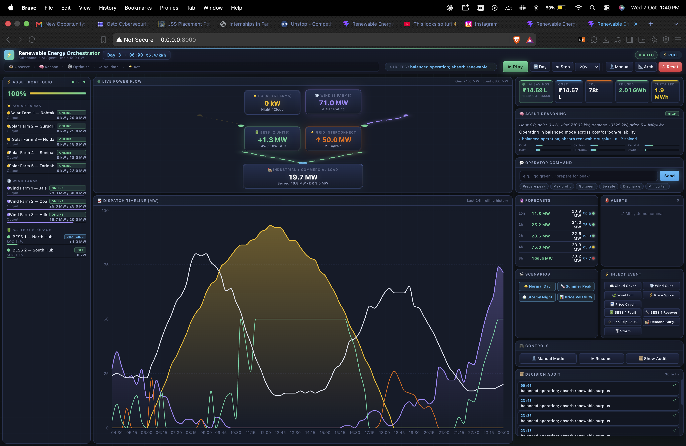
05 · PRODUCT DEMO
Live Mission-Control Dashboard
◂ Left: Asset portfolio (solar/wind/BESS live outputs) · Center: Live power flow + 24h dispatch timeline · Right: AI savings, reasoning, NL commands, forecasts, controls, audit ▸
Renewable Energy Orchestrator · ET × Accenture AI Hackathon — Agentic Edition · Problem 4
6 / 10

Slide 7
06 · BUSINESS IMPACT
Measured Results vs. Dumb-Grid Baseline (24h Simulated Day)
71%
153 t
487 MWh
0 MWh
Operating Cost
Reduced
CO₂ Emissions
Avoided
Curtailment
Reduced
Unmet Critical
Load
₹13.7 L saved per day
on a ~100 MW portfolio
≈ taking 33 cars off
the road per day
Renewable energy that
would have been wasted
100% reliability across
all stress scenarios
Stress-tested across 4 scenarios — zero critical outages every run
☀️ Normal Day
🌡️ Summer Peak
⛈️ Stormy Night
📊 Price Volatility
Balanced renewable day
Demand surge + price spike
Wind gusts + line trip
Extreme price swings
✓ 60% cost saved · 0 unmet load
✓ 62% cost saved · diesel avoided
✓ Replan triggered · 0 outage
✓ 78% cost saved via battery arbitrage
Renewable Energy Orchestrator · ET × Accenture AI Hackathon — Agentic Edition · Problem 4
7 / 10

Slide 8
07 · SCALABILITY
From One Industrial Site to National Grid
🎯 TODAY
🚀 NEAR-TERM
🌏 LONG-TERM
Portfolio Scale
DISCOM Zone
National 500 GW Vision
▸
≈ 100 MW pilot: 5 solar + 3 wind + 2 BESS + 3 industrial loads.
▸
Swap LP for MILP with unit commitment, economic dispatch, and transmission constraints.
▸
Multi-zone coordination across state DISCOMs with frequency/stability signals.
▸
LP solves in <50 ms → 15-minute tick is plenty of headroom.
▸
Integrate IMD weather APIs, IEX price feeds, SCADA telemetry.
▸
Plug in EV fleets, green-hydrogen electrolyzers as flexible loads.
▸
Per-tick statelessness enables horizontal scaling across portfolios.
▸
Hierarchical: one agent per zone + coordinating supervisor agent.
▸
Carbon-credit & REC arbitrage as explicit objectives; autonomous market bidding.
Renewable Energy Orchestrator · ET × Accenture AI Hackathon — Agentic Edition · Problem 4
8 / 10

Slide 9
08 · FUTURE ROADMAP
Go-To-Market Plan
0–30 Days
30–90 Days
6–12 Months
PILOT DEPLOYMENT
DISCOM MVP
MARKET LAUNCH
▸
Deploy at one captive industrial site (5–10 MW RE + BESS) in Delhi-NCR.
▸
Scale to one DISCOM zone (1–2 GW) with a zonal coordinator agent.
▸
Multi-zone coordination for state-level DISCOMs with transmission constraints.
▸
Integrate with site SCADA and inverter Modbus/REST APIs.
▸
Integrate IMD weather, IEX day-ahead prices, and short-term forecasts.
▸
Onboard EV fleets and green-hydrogen electrolyzers as flexible loads.
▸
A/B test agent vs human operator on cost, curtailment, and carbon KPIs.
▸
Confidence-aware forecasting model trained on historical SCADA.
▸
Carbon-credit / REC arbitrage; autonomous participation in power exchanges.
▸
Refine UX with operator feedback.
▸
Operator console with anomaly alerting and SLA tracking.
▸
Productized SaaS with tenant isolation and audit reporting.
Renewable Energy Orchestrator · ET × Accenture AI Hackathon — Agentic Edition · Problem 4
9 / 10

Slide 10
⚡
Let Agents Orchestrate the Renewable Transition.
71% cost cut · 153 t CO₂ avoided per day · zero critical outages · works fully offline
Thank you.
ET × Accenture AI Hackathon — Agentic Edition · Problem 4: Renewable Energy Grid Orchestration

