Slide 1
PROJECT
Name | Shikar Shetty Rakesh Kumar Akshay Chatra
Registration Numbers | 231059016 | 231059028 | 231059030
Branch | Cyber Security
Project Title | Botnet Traffic Analyzer

Slide 2
CONTENTS
Introduction
Literature Review
Objective
Methodology
Operational Flow
Functional Requirements
Results
References

Slide 3
1.Introduction
A Botnet Traffic Analyzer is a software tool or system designed to monitor and analyze network traffic for signs of botnet activity.
A Botnet Traffic Analyzer is like a detective for our computer network.
It looks at the data traveling between devices and spots anything unusual or suspicious that could signal a botnet helps the adminisator to notify the potential threats on the network.

Slide 4
2.Literature Review
Sl.No | Paper Name | Author | Learning
1. | Research based on Scrapy Crawling of Recruitment Information , 2021. | Lin Guande | Paper Provides Scrapy crawling of recruitment information involves using the Scrapy framework, a powerful web crawling and web scraping tool in Python, to extract data from various online sources
2. | Effectiveness of Wireshark Tool for Detecting Attacks and Vulnerabilities in Network Traffic, 2020. | Nawal A. L Mabsali(B), Hothefa Jassim, and Joseph Mani | Wireshark provides powerful filtering and search capabilities that allow you to focus on specific types of traffic, protocols, IP addresses, port numbers, packet contents, and other criteria of interest.
3. | A Survey of Botnet Technology and Defenses, 2018. | Michael Bailey, Evan Cooke, Farnam Jahanian, Yunjing Xu | Paper describes the communication protocols used by botnets to communicate between bots and command and control servers, such as IRC, HTTP, HTTPS, and custom protocols.

Slide 5
3.Objective
To develop a tool that can effectively detect and analyze botnet traffic within a computer network.
This tool aims to identify patterns, potential threats associated with botnet communication, enabling administrators to take proactive measures to mitigate threats and protect network integrity.
To provide users with a user-friendly interface for generating detailed reports on botnet activity, facilitating informed decision-making and effective response strategies against botnet attacks.

Slide 6

4. Methodology
Application is designed to captures network packets, detects potential DoS attacks, and provides a basic user interface for monitoring the detected attacks.
BotnetTrafficAnalyzer Class is responsible for capturing network packets using Scapy, detecting potential denial-of-service (DoS) attacks based on the number of packets from a particular source IP address, and updating the user interface accordingly.

Slide 7
4. Methodology
Pcap file contains recorded network traffic, which could be obtained from various sources, including live network monitoring or packet capture tools like Wireshark.
Once the packets are captured, the program iterates through each packet to extract relevant information such as source IP address, destination IP address, protocol, and timestamp. It checks if the packet contains an IP layer, ensuring that it deals only with IP traffic.
After analyzing the packets and assigning vulnerability ratings, the program generates an HTML report to present the findings in a structured format. The HTML report includes a table with columns for source IP, destination IP, protocol, timestamp, and vulnerability rating. The report is styled using CSS to enhance readability and visual appeal.
The program sets up a simple HTTP server using Python's http.server module to serve the generated HTML report. It listens on a specified port for incoming HTTP requests and serves the HTML content on the browser.

Slide 8
5.Operational Flow
HTML Report
Generation
WireShark
Pcap File
Python Script
Web Server Setup

Slide 9
6.Functional Requirements
Python
WireShark
HTML and CSS
Python libraries:
pyshark, http.server , socketserver, os, base64

Slide 10
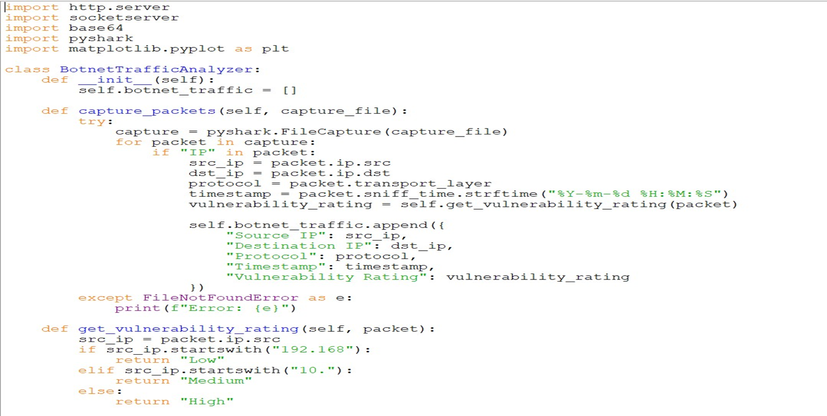
7. Work Done

Slide 11
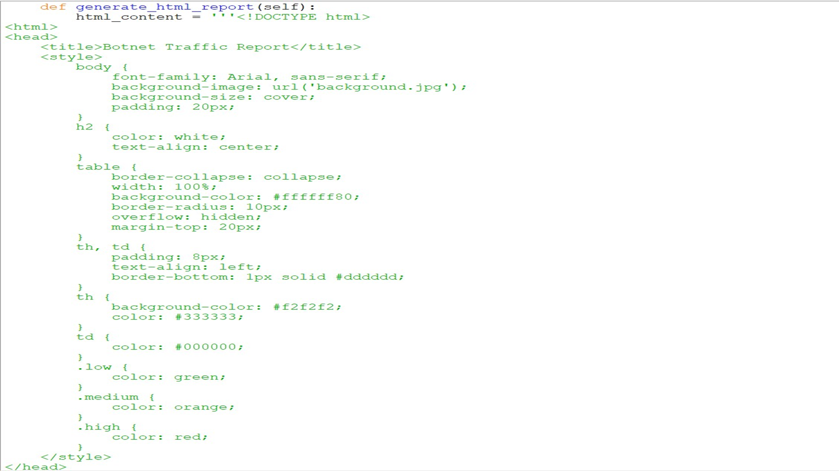
7. Work Done

Slide 12
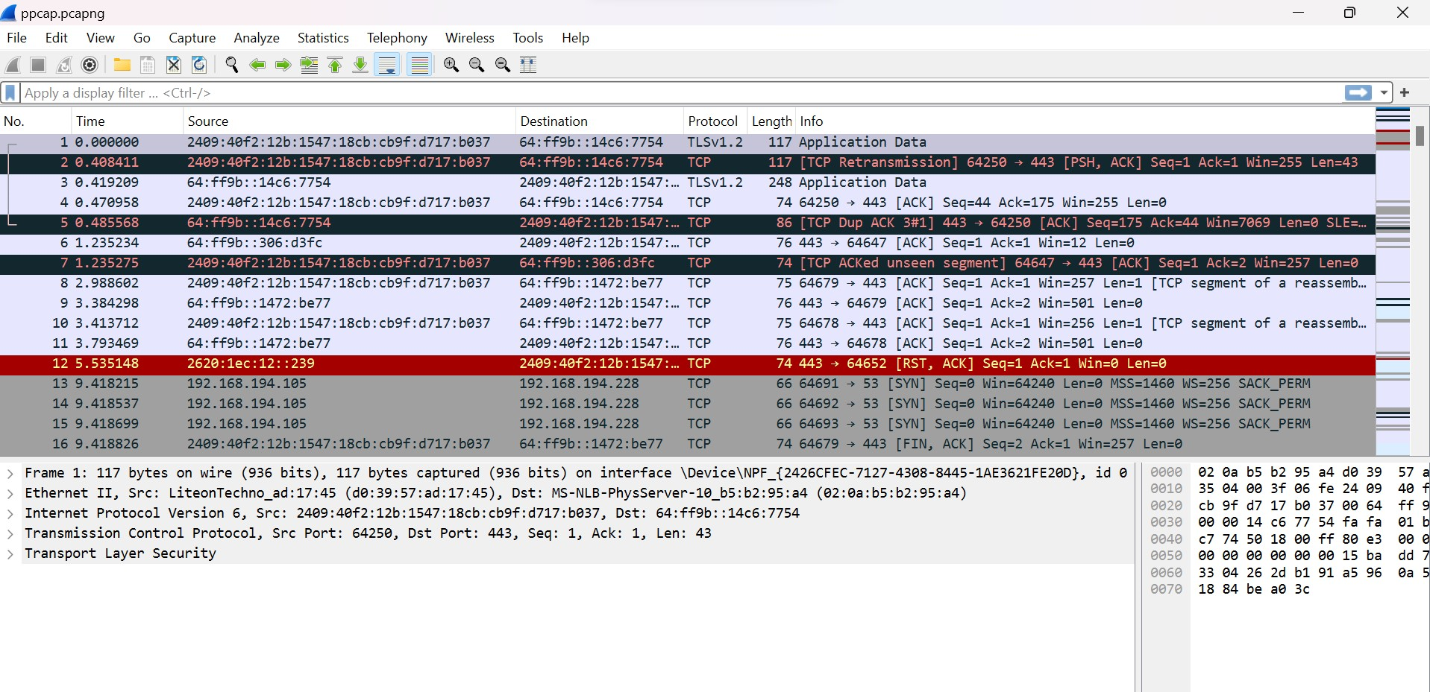
7. Work Done

Slide 13
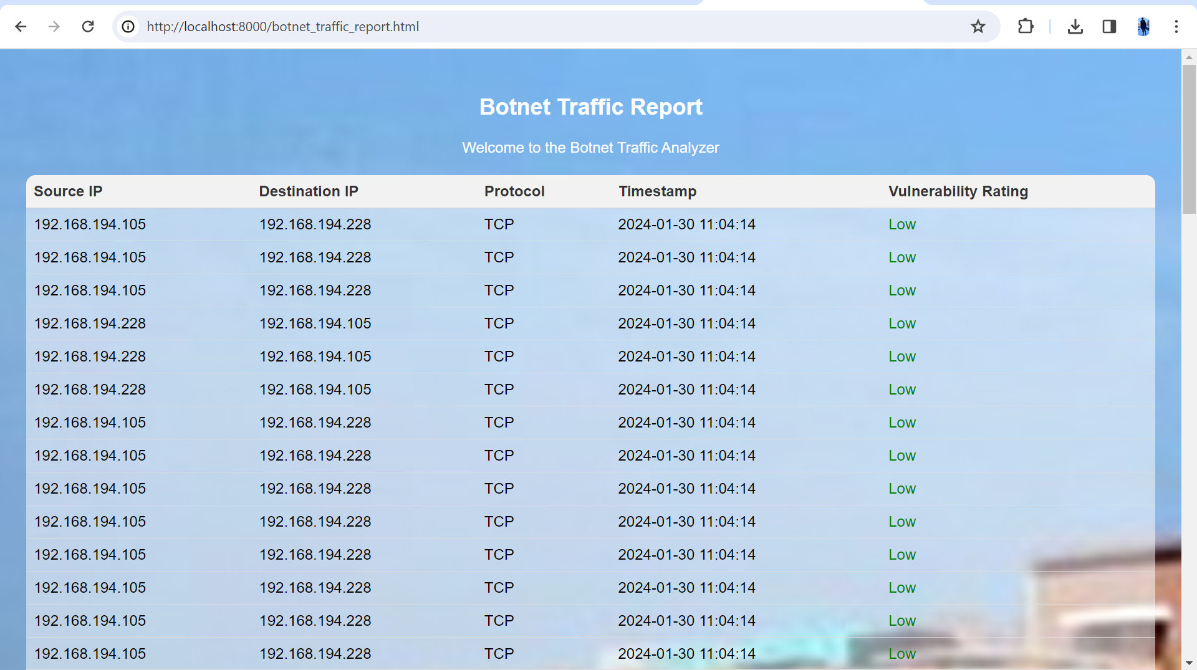
7. Work Done

Slide 14
8. Reference
REFERENCES
Lin Guande, Research based on Scrapy Crawling of Recruitment Information [J]. Computer Knowledge and Technology. 2020,(35):54-55.
Effectiveness of Wireshark Tool for Detecting Attacks and Vulnerabilities in Network Traffic, Nawal A. L. Mabsali(B), Hothefa Jassim, and Joseph Mani Modern College of Business and Science, Muscat, Sultanate of Oman.
Pan Qiaozhi, Zhang Lei. Discussion on Python-based Web Crawler Technology under Big Data Environment [J]. Network Security Technology and Application. 2018.
A Survey of Botnet Technology and Defenses, Michael Bailey, Evan Cooke, Farnam Jahanian, Yunjing Xu University of Michigan,2016.

Slide 15
THANK YOU

