Slide 1
IST 707
Week 4

Slide 2
Reminders & Announcement
1. HW 1 was due on Thursday 02/01 at Midnight. The automatic grace period ends on Thursday 02/08 Midnight.
2. HW 2 is due before class Tuesday 02/05, with an automatic extension ending on Tuesday 02/12 (prior to class).
3. You should have read chapters 4 & 5 from the textbook prior to class; and step through (and execute) the notebooks from your fork of: https://github.com/IST407-707/707-lecture-master.
For next week you should read chapters 6 & 7 from the textbook prior to class.
4. I've shared my solutions (which are incomplete, but at minimum has everything I demonste in class) for you at: https://github.com/IST407-707/mcsweeney-exercises/tree/main, which should be public.
5. On request I'll be moving my office from Friday to Wednesday 10:00 to 11:30am on discord.

Slide 3
Class Layout
Administrata (0-5)
Review (regression, regularization, svms) (45-60)
Quiz (20 - 30)
In class Exercises (2x at 15 minutes)
Last 10 minutes: Brainstorming for your group projects. By week 7 you need your groups data and plan. This will come sooner than you think.

Slide 4
Regression

Slide 5
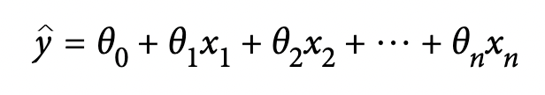


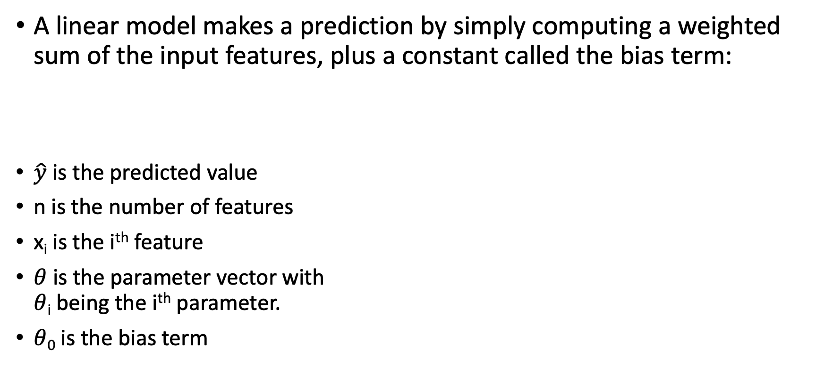
Linear Regression
A linear model makes a prediction by simply computing a weighted sum of the input features, plus a constant called the bias term:
$\hat{y}$ is the predicted value
n is the number of features
x_{i} is the i^{th} feature
$θ$ is the parameter vector with $θ$_{i} being the i^{th} parameter.
$θ$₀ is the bias term
Can also be written in vector form where:
is the dot product operation.

Slide 6
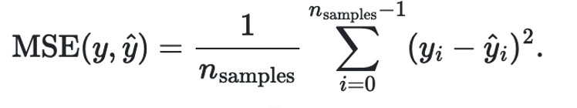
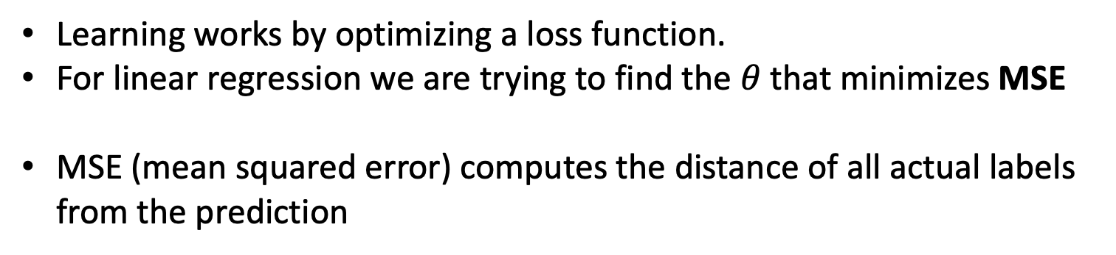
Mean Squared Error
Learning works by optimizing a loss function.
For linear regression we are trying to find the $θ$ that minimizes MSE
MSE (mean squared error) computes the distance of all actual labels from the prediction
Notes:
`mean_squared_error` is one of many of the metrics provided by Scikit-learn. You can find an overview of additional metrics on the [Model Evaluation](https://scikit-learn.org/stable/modules/model_evaluation.html) page.

Slide 7
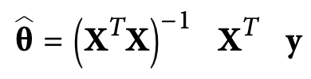
The Normal Equation
There exists a closed form solution (mathematical equation) that gives the result directly:
X is the training matrix: 1 row per record, 1 column per feature.
X^{T} is the transpose of a matrix
X^{T} X is a matrix multiplication
(X)⁻¹ is an inverse matrix operation
y is the vector of labels
X^{T} y is a matrix-vector multiplication

Slide 8
Runtime
The normal equation computes: X^{T} X, which is an (n+1) x (n+1) operation. Where n is the number of features.
Inverting a matrix is O(n^{2.4}) to O(n³)

Slide 9
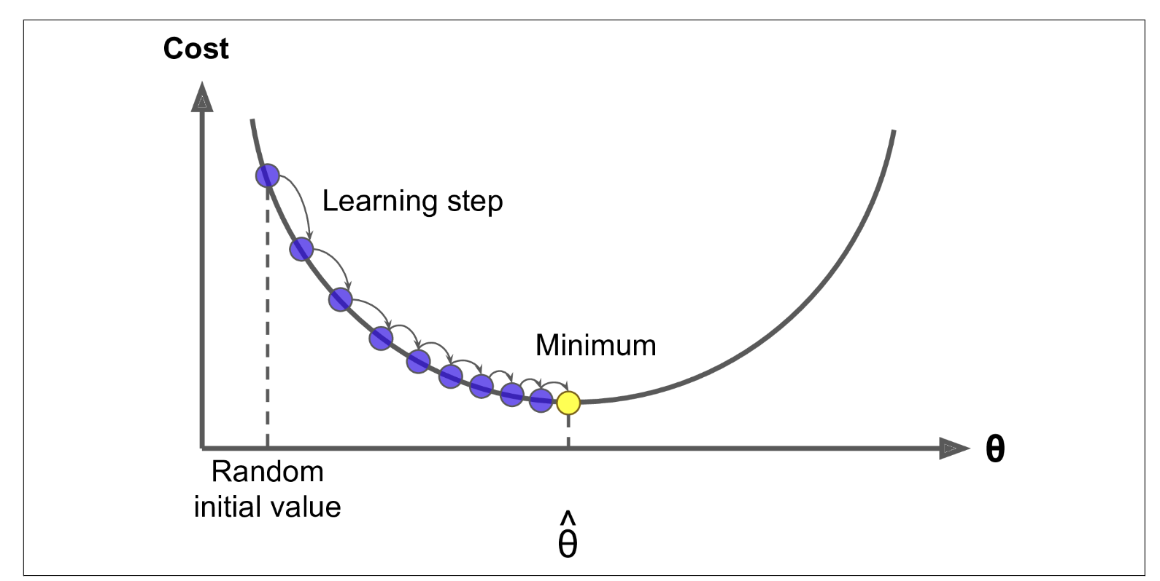

Gradient Descent
Gradient descent is a generic optimization algorithm capable of finding optimal solutions to a wide range of problems.
Compute the gradient of the cost function with regard to each model parameter $θ$_{I}
Calculate how much the cost function will change if I change $θ$_{i} by a little bit.

Slide 10
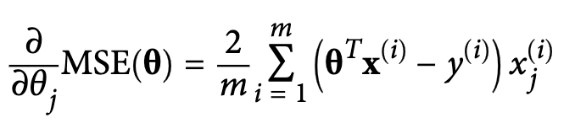
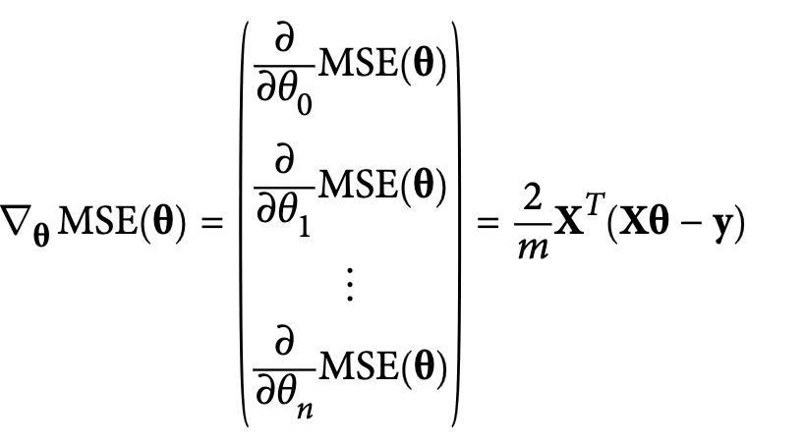

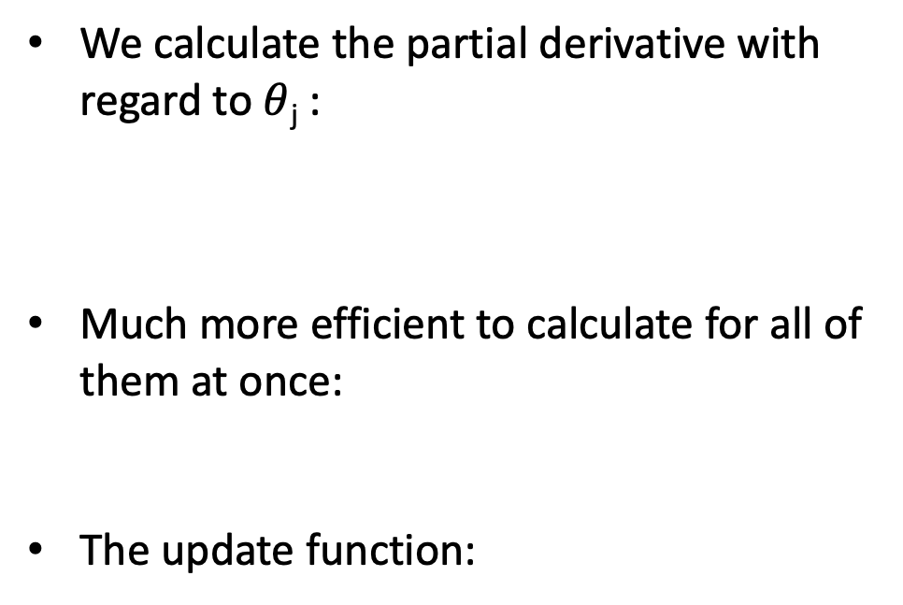
Gradient Descent
We calculate the partial derivative with regard to $θ$_{j} :
Much more efficient to calculate for all of them at once:
The update function:
Note that we are calculating over all features and samples!!
Notes:
Remember that X

Slide 11
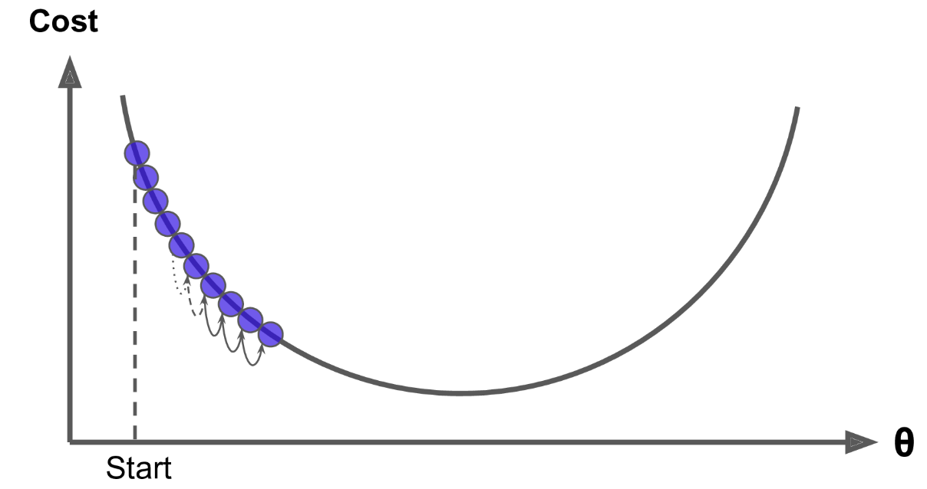
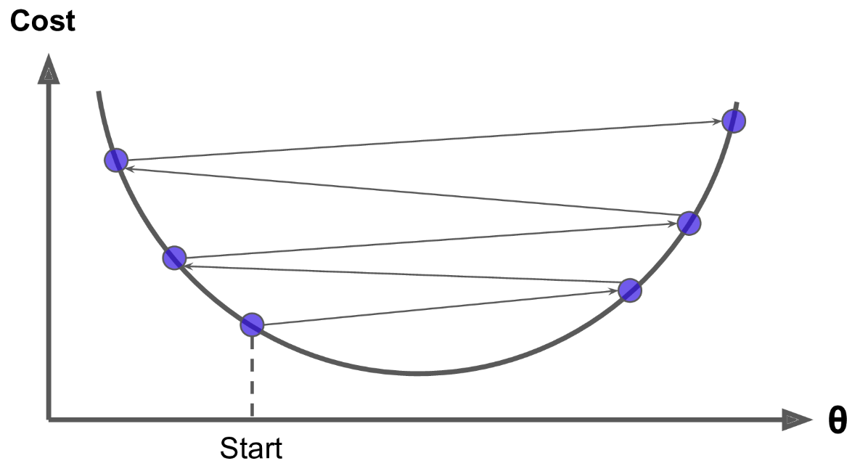
Step function
Choosing a learning rate (step size) that is too small will mean that the algorithm converges too slowly!
Choosing a learning rate (step size) that is too large will lead towards oscillation, and the algorithm may never converge.

Slide 12
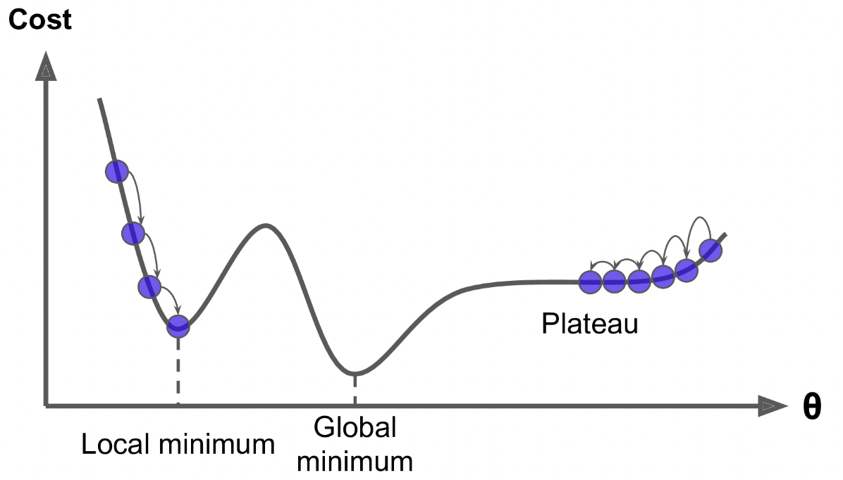
Local Optima vs Global Optima
A local minimum is a minimum that is the smallest in some small neighborhood.
A global minimum is a minimum that is smallest across the entire function.

Slide 13
Convex Problem Space
A convex function is one that if you pick any two points on the curve the line segment joining them is never below the curve.
Basically this means there are no local optima, just one global optima.
It is also a continuous function with a slope that never changes abruptly.
MSE as a cost function for linear regression happens to be convex!

Slide 14
Stochastic Gradient Descent
Previously we used all training records to compute the gradient. This is time consuming.
SGD picks 1 random instance at every step and computes the gradients using only that record.
Can train on huge number of records (larger than memory).
But will take more epochs to converge, as loss may go up for a single update.
Randomness can be good for escaping a local minimum (if using a different cost function or algorithm.
Training samples must be IID (independent & identically distributed):
Be sure to randomize the set of training examples.

Slide 15
Simulated Annealing
Gradually reduce the learning rate.
The steps start out large, which helps make quick progress towards global optima.
But get’s smaller so we can converge as we get closer to the global optima.
Annealing is a process of allowing metal to cool slowly.
The rate of the learning function slowing down is called the learning schedule.

Slide 16
Convergence Criteria
When the cost function is convex and its slope does not change abruptly, Batch Gradient Descent with a fixed learning rate will eventually converge to the optimal solution, but you may have to wait a while: it can take O(1/ϵ) iterations to reach the optimum within a range of ϵ depending on the shape of the cost function.
If you divide the tolerance by 10 to have a more precise solution, then the algorithm may have to run about 10 times longer.
Just wait until the loss falls below some threshold.

Slide 17
Mini-Batch Gradient Descent
Standard (Batch or Full) Gradient Descent uses the full training set.
Stochastic gradient descent computes on a single instance.
Mini-batch descent grabs random handfuls and uses them to compute the gradients (handfuls = mini-batches).
Why?
We can compute many gradients at once using the matrix update method (which GPUs are great at).
So we get a performance boost with GPUs.

Slide 18
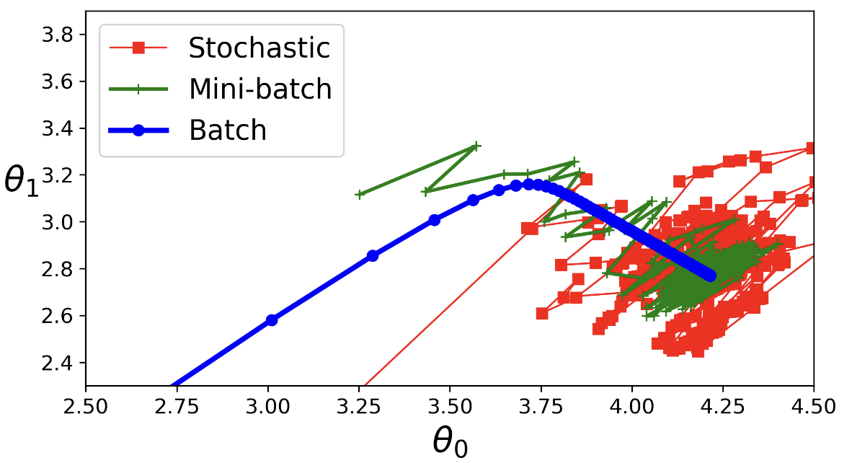
Comparing Descents

Slide 19
Polynomial Regression
What if your data is not a straight line?
Add powers of each feature as a new feature.
For features a, b, we would with degree=2, we add: a², b², ab
Transforms an array of n features into an array:
(n + d)! / d!n!

Slide 20
Bias/Variance Tradeoff
A model’s generalization error can be expressed as the sum of three very different errors:
Bias: Due to wrong assumptions. Such as assuming that the data is linear when it is quadratic. Likely to underfit the training data.
Variance: Due to the model’s excessive sensitivity to small variations in the training data. A model with many degrees of freedom is likely to have high variance. Likely to overfit the training data.
Irreducible error: Due to the noisiness of the data itself. The only way to reduce this part of the error is to clean up the data (e.g., fix the data sources).
Increasing a model’s complexity will typically increase its variance and reduce its bias.
Conversely, reducing a model’s complexity increases its bias and reduces its variance.
This is why it is called a tradeoff!

Slide 21
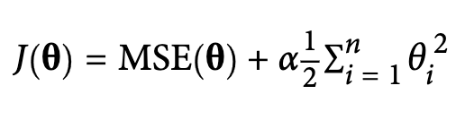
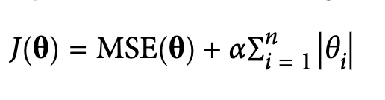
Regularization
https://scikit-learn.org/stable/modules/generated/sklearn.linear_model.Lasso.html https://scikit-learn.org/stable/modules/generated/sklearn.linear_model.Ridge.html
Regularization is a method that aims to reduce overfitting of models.
Ridge regression (aka L2) aids a regularization term to the cost function which forces the algorithm to keeps weights small:
Lasso regression (aka L1) is just like ridge but uses the L1 norm:
Lasso tends to eliminate weights of the least important features (sets them to 0). Helps reduce model size.

Slide 22
Early Stopping
Just stop training your model earlier than convergence.
Examine you learning curve to see when validation error starts to go back up.

Slide 23
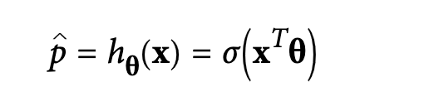
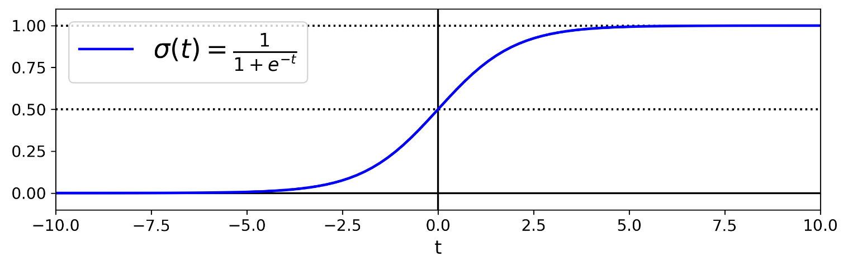
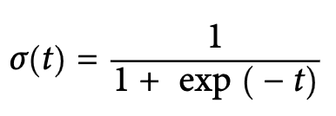
Logistic Regression
Used to estimate the probability of an instance belonging to a certain class.
Use a threshold to decide actual class.
Sigma is a sigmoid function

Slide 24
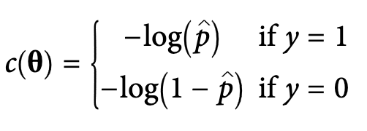
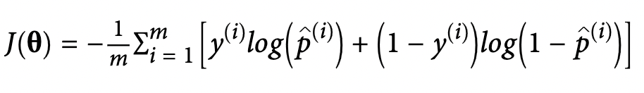
Cost Function
– log(t) grows very large when t approaches 0:
Will be large if the model estimates a probability close to 0 for a positive instance
Will also be very large if the model estimates a probability close to 1 for a negative instance.
– log(t) is close to 0 when t is close to 1:
Will be close to 0 if the estimated probability is close to 0 for a negative instance
Will be close to 0 if t=1 for a positive instance
* For a single training instance
Overall training instance we just take the average

Slide 25
Logistic Regression Properties
There is no closed form to calculate.
But cost function is convex!
Can still use L1 or L2 regularization

Slide 26
Softmax Regression
Logistic regression can be generalized for multiple classes

Slide 27
Support Vector Machines

Slide 28
Linear Separators
Binary classification can be viewed as the task of separating classes in feature space:
w^{T}x + b = 0
w^{T}x + b > 0
w^{T}x + b < 0
f(x) = sign(w^{T}x + b)

Slide 29
Linear Separators
Which of the linear separators is optimal?

Slide 30
Classification Margin
Distance from example x_{i} to the separator is
Examples closest to the hyperplane are support vectors.
Margin ρ of the separator is the distance between support vectors.
ρ
r

Slide 31
Maximum Margin Classification
Maximizing the margin is good according to intuition and theory.
Implies that only support vectors matter; other training examples are ignorable.
Hard Margin SVM: Assumes that the data is perfectly separable and tries to find a hyperplane with no violations (i.e., all points are on the correct side of the margin).

Slide 32
Soft Margin Classification
What if the training set is not linearly separable?
Slack variables ξ_{i} can be added to allow misclassification of difficult or noisy examples, resulting margin called soft.
ξ_{i}
ξ_{i}

Slide 33
Linear SVMs: Overview
The classifier is a separating hyperplane.
Most “important” training points are support vectors; they define the hyperplane.
Scaling is critical, as at its heart SVM is a distance based solution

Slide 34
SVM in Sklearn
https://scikit-learn.org/stable/modules/generated/sklearn.svm.SVC.html
https://scikit-learn.org/stable/modules/generated/sklearn.svm.LinearSVC.html#sklearn.svm.LinearSVC
https://scikit-learn.org/stable/modules/svm.html#svm-classification
https://scikit-learn.org/stable/modules/generated/sklearn.svm.NuSVC.html#sklearn.svm.NuSVC
There are three implementations:
SVC
NuSVC
LinearSVC (slightly faster)
These area all (slightly) different implementations of Support Vector Machines.
They can perform classification or regression
All follow the fit, predict API.

Slide 35
Non-linear SVMs
Datasets that are linearly separable with some noise work out great.
But what are we going to do if the dataset is just too hard?
How about… mapping data to a higher-dimensional space:
x
0
0
x
x²
0
x

Slide 36
Non-linear SVMs: Feature spaces
General idea: the original feature space can always be mapped to some higher-dimensional feature space where the training set is separable:
Φ: x → φ(x)

Slide 37
The Kernel Trick
Low degree polynomials may not separate out our features.
High degree polynomials add too many features. What to do?
The Kernel Trick
A kernel is a function that takes two inputs and returns a scalar output
It essentially computes a measure of similarity between the inputs.
The kernel provides a shortcut: It computes the results of the high-dimensional operations without explicitly visiting the high-dimensional space
Instead of separating the classes in the original space, a kernel transforms the data into a higher-dimensional space.
In this new space, the data becomes linearly separable, allowing SVM to find a decision boundary.

Slide 38
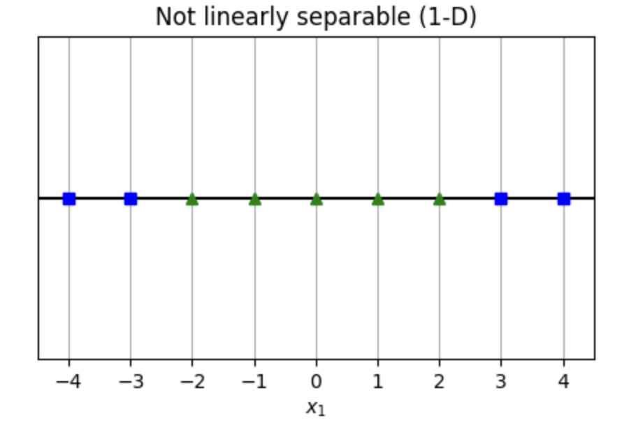
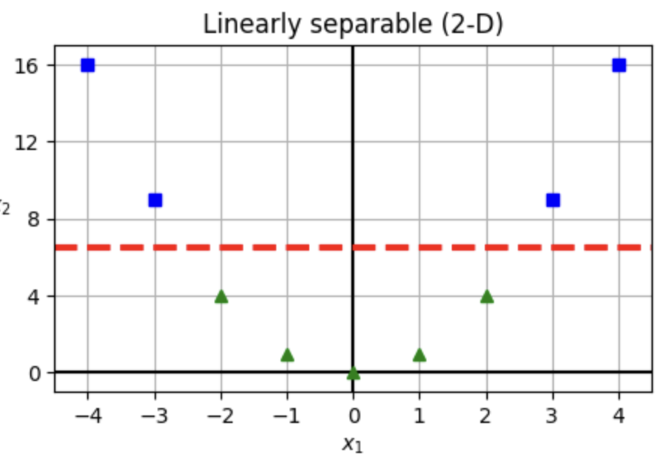

Simple example

Slide 39







Transformation

Slide 40
Common Kernel methods
Linear
Polynomial
Radial Basis Function (RBF) or Gaussian Kernel
Sigmoid Kernel

Slide 41

Linear Kernel
The simplest form, equivalent to not applying any transformation.
Use if the dataset is linearly separable or nearly linearly separable.
It's less computationally expensive than other kernels.
Always worth trying as a first step, as it can be surprising how often linear methods can be effective.
If computational resources are limited, or if you have a very large dataset, the linear kernel might be a good choice due to its efficiency.

Slide 42

Polynomial kernel
Applies a polynomial transformation to the data.
If there's a reason to believe that the data could be separated not just by a line, but by some polynomial function.
Increasing the degree of the polynomial increases the risk of overfitting.
Cross-validation is crucial to find the right degree (d in equation).

Slide 43

Radial Basis Function (RBF) or Gaussian Kernel
One of the most popular kernels, it can map data into an infinite-dimensional space.
Useful for non-linear problems.
When there's no prior knowledge about the data, the RBF kernel is a good default choice.
Has an additional hyperparameter (gamma) to tune.
If gamma is set too high, the decision boundary might be too strict and can overfit.
If set too low, it might be too flexible and can underfit.
Requires proper scaling of input features.

Slide 44

Sigmoid Kernel
Similar to the neural network activation function.
Historically used in neural networks.
Less common in SVMs but can be useful for some types of data.
Like the polynomial kernel, the sigmoid kernel is not always positive semi-definite, which can cause convergence issues.
Alpha and C are constants

Slide 45
General Guidelines
Feature Scaling: Kernels, especially the RBF, are sensitive to feature scaling. It's essential to normalize or standardize data before applying SVM with a kernel.
Cross-Validation: Given that there are hyperparameters associated with most kernels (like the degree of the polynomial or the gamma of the RBF), using cross-validation to tune these hyperparameters is crucial.
Visual Inspection: For lower-dimensional data, visualizing the data can give insights into whether the data is linearly separable or if there might be some non-linear patterns.
Start Simple: It's often a good strategy to start with the linear kernel. If it's inadequate in terms of performance, then move to more complex kernels like the RBF.
Overfitting: More complex kernels can capture intricate patterns in the data, but they can also overfit. If a non-linear kernel gives very high accuracy on training data but performs poorly on test data, it might be overfitting.
Computational Resources: Training an SVM with a complex kernel on a large dataset can be computationally intensive. Consider the available resources and the size of the dataset when choosing a kernel.

