Slide 1
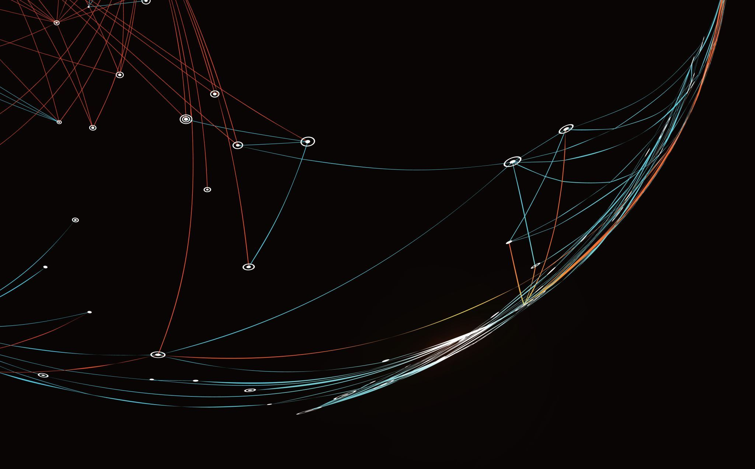
PHISHING DETECTION USING MACHINE LEARNING
Atharva marathe - 21BCE1558
Akshay Thakur- 21BCE1512
Anirudh soma - 21BCE5537
Ayush Tripathi- 21BCE1148

Slide 2
Abstract
1. Develop machine learning-based software to detect phishing and harmful online links, addressing accuracy issues and adaptability by comparing Logistic Regression, SVM, Decision Trees, and Neural Networks.
2. Combat deceptive techniques targeting user passwords and sensitive data through robust algorithms.
3. Create a browser plugin, potentially a Chrome extension, as the ultimate goal to enhance online security against evolving phishing threats.
4. Overcome limitations of current detection methods by leveraging advanced categorization algorithms.
5. Utilize machine learning to construct a reliable solution, emphasizing the importance of accuracy and adaptability in combating phishing attacks.

Slide 3
Introduction
1. Addressing pervasive threat of phishing with machine learning for web security, aiming for adaptive solutions due to dynamic nature.
2. Testing three machine learning algorithms on comprehensive dataset to develop user-friendly software identifying new attack patterns.
3. Creation of web browser plugin for widespread distribution, targeting end-users to enhance security against phishing attacks.
4. Comprehensive project report covers review of previous work, proposed approach, dataset insights, machine learning explanations, Chrome plugin implementation, and conclusive results.
5. Emphasis on accuracy, segregation, and recall through graphical presentation in project report, comparing effectiveness of machine learning algorithms.

Slide 4
Literature Review
S.No | Title of the Paper | Name of the Author | Year of Publication | Name of Journal | Technique used | Advantages | Drawbacks
1 | Fuzzy Rough Set Feature Selection to Enhance Phishing Attack Detection | Mahdieh Zabihimayvan and Derek Doran | 2019, June | IEEE Security & Privacy ( Volume: 10, Issue: 3, https://ieeexplore.ieee.org/document/8858884 | Fuzzy Rough Set (FRS) Theory: Normal feature selection typically involves selecting a subset of features from a dataset based on relevance whereas considers the uncertainty and imprecision inherent in real-world data Benchmark Datasets: Three benchmarked datasets are used to evaluate the effectiveness of the FRS feature selection approach. | 1) Handling Uncertainty and vagueness 2) Capturing Complex Relationships 3) Adaptability to Different Data Types | Limited Dataset Diversity: The study may have relied on a limited number of datasets 2. Assumed Feature Importance: the assumption of feature importance may not fully capture the dynamic nature of phishing attacks. 3. Lack of Real-world Validation

Slide 5
S.No | Title of the Paper | Name of the Author | Year of Publication | Name of Journal | Technique used | Advantages | Drawbacks
2 | Phishing Website Classification and Detection Using Machine Learning | Jitendra Kumar, Balaji Rajendra, A. Santhanavijayan | 2020, June | 2020 International Conference on Computer Communication and Informatics (ICCCI -2020) https://ieeexplore.ieee.org/document/9104161 | 1) Feature Engineering: The researchers extract various features from website URLs, including lexical structure-based features, etc 2) Classification Algorithms: they learn the features to distinguish between phishing and benign URLs. 3) Evaluation Metrics:The performance of the classifiers is evaluated using metrics such as precision, recall, F1-score, accuracy | 1) utilization of ML techniques: increases accuracy of detecting phishing URLs 2) Comprehensive Analysis: explores various aspects including lexical analysis, host-based features, etc 3) Comparative Study: employing different classifiers and evaluating their performance using various metrics, gives strengths and weaknesses of each approach | Dataset Limitations:The study may have relied on a limited number of datasets 2. Feature Engineering Complexity:the assumption of feature importance may not fully capture the dynamic nature of phishing attacks. 3. Content-Based Analysis:

Slide 6
S.No | Title of the Paper | Name of the Author | Year of Publication | Name of Journal | Techniques used | Advantages | Drawbacks
3 | Detecting and Classifying Phishing Websites by Machine Learning | Zichen Fan | 2021 | (2021, July 1). IEEE Conference Publication IEEE Xplore. https://ieeexplore.ieee.org/document/9712124 | The study utilizes original data from PhishTank and employs Support Vector Machines (SVM) and Bayesian methods, to detect and classify phishing websites. Introduces a depth detection system for phishing web pages. Various characteristics and methods, including blacklist, visual similarity, and text classification, are investigated. Ensemble learning and feature selection are integrated to improve detection accuracy. | Effective in high-dimensional spaces - Suitable for binary classification tasks Incorporates diverse characteristics for comprehensive phishing detection - Addresses visual and textual aspects Combines multiple models for improved performance - Robust against overfitting and noise in data | Not suitable for large datasets due to high training time - Requires careful selection of hyperparameters May require significant computational resources for image processing - Integration complexity with existing systems Requires careful tuning and selection of constituent models

Slide 7
S.No | Title of the Paper | Name of the Author | Year of Publication | Name of Journal | Techniques used | Advantages | Drawbacks
4 | The Emergence Threat of Phishing Attack and The Detection Techniques Using Machine Learning Models | Sadia Parvin Ripa; Fahmida Islam; Mohammad Arifuzzaman | 2021 | (2021, July 8). IEEE Conference Publication | IEEE Xplore. https://ieeexplore.ieee.org/abstract/document/9528204 | Ensemble learning algorithm (XGBoost) utilizing gradient boosting for high predictive accuracy. Probabilistic classifier based on Bayes' theorem, suitable for text classification tasks. Lexical Features: Capture structural and compositional characteristics of URLs for phishing detection. Host-based Features: Offer insights into domain-related attributes, aiding in identifying suspicious URLs. URL Reputation Services: Leverage databases and real-time analysis to assess URL reputation | Simple, effective, and High predictive accuracy Robust against overfitting and noise in data Capture structural and compositional characteristics of URLs, aiding phishing detection. Real-time analysis | May require fine-tuning of hyperparameters to optimize performance Can become computationally expensive with large datasets May overlook semantic aspects of URLs, limiting detection effectiveness Reliance on external services may introduce latency and dependency issues

Slide 8
S.No | Title of the Paper | Name of the Author | Year of Publication | Name of Journal | Techniques used | Advantages | Drawbacks
5 | Real-Time Phishing Attack Detection through Advanced Machine Learning Techniques | Hemant Sharma, Praveen Sharma,Rakesh Singh | 2023 | (2023, December 8). IEEE Conference Publication | IEEE Xplore. https://ieeexplore.ieee.org/document/10456013 | URL Analysis: extracting features from URLs, such as domain reputation, length, presence of certain keywords, and similarity to known phishing domains. Content Analysis: extracting features from the content of web pages or messages, such as textual patterns, language characteristics, and embedded scripts. Behavior Analysis: Features derived from behavior analysis may include click patterns, session duration, frequency of interactions, and deviations from typical behavior | Combines multiple models for improved performance Effective in high-dimensional spaces Learns intricate patterns in data By extracting a diverse set of features, the model can capture various aspects of phishing attempts, improving its ability to generalize and detect new and evolving threats. | Complexity in managing multiple models Manual feature selection may be time-consuming and subjective Requires large amounts of data and computational resources The effectiveness of feature engineering heavily depends on the quality and representativeness of the dataset

Slide 9
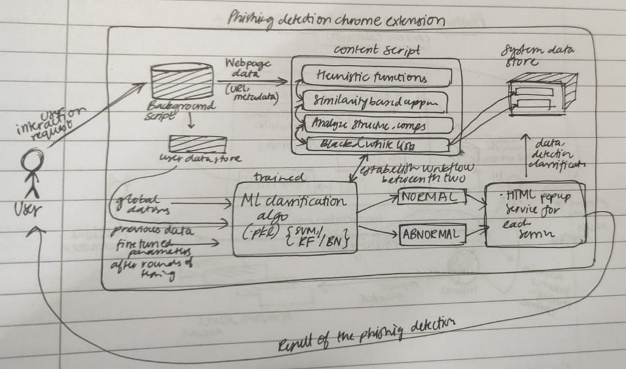
Architecture
User Interaction: Users engage with the system through their browser, browsing websites and interacting with content.
Content Script: JavaScript program injected into web pages, monitoring user activities and extracting data for analysis.
Phishing Detection: Identifies potential phishing attempts by analyzing web requests and page content using various techniques.
Detection Module: Core component analyzing data using rule-based heuristics, URL analysis and machine learning algorithms.
Feature Extraction: Preprocesses data by extracting relevant characteristics from web requests and page content.
Real-Time Detection and User Alerts: Continuously monitors user activity for prompt phishing detection, generating alerts to advise caution or action when potential threats are identified.

Slide 10
Pseudocode:
function isLongURL(){
var url = window.location.href;
if(url.length<54){
console.log("NP");
return -1;
}
else if(url.length>=54 && url.length<=75){
console.log("Maybe");
return 0;
}
else{
console.log("P");
return 1;
}
}
function isTinyURL(){
var url = window.location.href;
if(url.length>20){
console.log("NP");
return -1;
}
else{
console.log("P");
return 1;
}
}
function isAlphaNumericURL(){
var search ="@";
var url = window.location.href;
if(url.match(search)==null){
console.log("NP");
return -1;
}
else{
console.log("P");
return 1;
}
}
function isRedirectingURL(){
var reg1 = /^http:/
var reg2 = /^https:/
var srch ="//";
var url = window.location.href;
if(url.search(srch)==5 &&
reg1.exec(url)!=null &&
(url.substring(7)).match(srch)==null){
console.log("NP");
return -1;
}
else if(url.search(srch)==6 &&
reg2.exec(url)!=null &&
(url.substring(8)).match(srch)==null){
console.log("NP");
return -1;
}
else{
console.log("P");
return 1; } }

Slide 11
Pseudocode:
function isHypenURL(){
var reg = /[a-zA-Z]\//;
var srch ="-";
var url = window.location.href;
if(((url.substring(0,url.search(reg)+1)). match(srch))==null){
console.log("NP");
return -1;
}
else{
console.log("P");
return 1;
}
}
function isMultiDomainURL(){
var reg = /[a-zA-Z]\//;
var srch ="-";
var url = window.location.href;
if((url.substring(0,url.search(reg)
+1)).split('.').length < 5){
console.log("NP");
return -1;
}
else{
console.log("P");
return 1;
}
}
function isIllegalHttpsURL(){
var srch1 ="//";
var srch2 = "https";
var url = window.location.href;
if(((url.substring(url.search(srch1)))
.match(srch2))==null){
console.log("NP");
return -1;
}
else{
console.log("P");
return 1;
}
}
function isFaviconDomainUnidentical(){
var reg = /[a-zA-Z]\//;
var url = window.location.href;
if(document.querySelectorAll
("link[rel*='shortcut icon']").length>0){
var faviconurl = document.querySelectorAll
("link[rel*='shortcut icon']")[0].href;
if((url.substring(0,url.search(reg)+1))
==(faviconurl.substring(0,faviconurl.
search(reg)+1))){
console.log("NP");
return -1;
}
else{
console.log("P");
return 1; } }
else{
console.log("NP");
return -1; } }

Slide 12
Pseudocode:
function isImgFromDifferentDomain(){
var totalCount = document.querySelectorAll("img").length
var identicalCount = getIdenticalDomainCount("img");
if(((totalCount-identicalCount)/totalCount)<0.22){
console.log("NP");
return -1;
}
else if((((totalCount-identicalCount)/totalCount)>=0.22) && (((totalCount-identicalCount)/totalCount)<=0.61)){
console.log("Maybe");
return 0;
}
else{
console.log("P");
return 1;
} }
function isAnchorFromDifferentDomain(){
var totalCount = document.querySelectorAll("a").length
var identicalCount = getIdenticalDomainCount("a");
if(((totalCount-identicalCount)/totalCount)<0.31){
console.log("NP");
return -1;
} else if((((totalCount-identicalCount)/totalCount)>=0.31) && (((totalCount-identicalCount)/totalCount)<=0.67)){
console.log("Maybe");
return 0;
}
else{
console.log("P");
return 1; } }
function isScLnkFromDifferentDomain(){
var totalCount = document.querySelectorAll("script").length + document.querySelectorAll("link").length
var identicalCount = getIdenticalDomainCount("script") + getIdenticalDomainCount("link");
if(((totalCount-identicalCount)/totalCount)<0.17){
console.log("NP");
return -1;
}
else if((((totalCount-identicalCount)/totalCount)>=0.17) && (((totalCount-identicalCount)/totalCount)<=0.81)){
console.log("Maybe");
return 0;
}
else{
console.log("P");
return 1; } }
function isFormActionInvalid(){
var totalCount = document.querySelectorAll("form").length
var identicalCount = getIdenticalDomainCount("form");
if(document.querySelectorAll('form[action]').length<=0){
console.log("NP");
return -1; }
else if(identicalCount!=totalCount){
console.log("Maybe");
return 0; }
else if(document.querySelectorAll('form[action*=""]').length>0){
console.log("P");
return 1; }
else{
console.log("NP");
return -1; } }

Slide 13
Pseudocode:
function isMailToAvailable(){ if(document.querySelectorAll('a[href^=mailto]').length<=0){
console.log("NP");
return -1;
}
else{
console.log("P");
return 1;
}
}
function isStatusBarTampered(){
if((document.querySelectorAll
("a[onmouseover*='window.status']").length<=0) || (document.querySelectorAll("a[onclick*='location.href']").length<=0)){
console.log("NP");
return -1;
}
else{
console.log("P");
return 1; } }
function isIframePresent(){ if(document.querySelectorAll('iframe').length<=0){
console.log("NP");
return -1;
}
else{
console.log("P");
return 1;
}
}
It creates an array `testdata` by calling these functions and passing the results into the array.

Slide 14
Explanation:
Functions to check various characteristics of URL:
- `isLongURL`: Checks if the URL length is between 54 and 75 characters.
- `isTinyURL`: Checks if the URL length is less than 20 characters.
- `isAlphaNumericURL`: Checks if the URL contains an "@" symbol.
- `isRedirectingURL`: Checks if the URL starts with "http://" or "https://" and does not contain "//" after the first 5 or 6 characters, respectively.
- `isHypenURL`: Checks if the URL contains a hyphen after a letter followed by a "/".
- `isMultiDomainURL`: Checks if the URL has more than 4 subdomains.
- `isFaviconDomainUnidentical`: Checks if the domain of the page and the favicon domain are different.
- `isIllegalHttpsURL`: Checks if the URL starts with "https://" but does not contain "https" after "//".
- `isImgFromDifferentDomain`: Checks if the ratio of images from different domains is within a certain range.
- `isAnchorFromDifferentDomain`: Checks if the ratio of anchor tags from different domains is within a certain range.
- `isScLnkFromDifferentDomain`: Checks if the ratio of script and link tags from different domains is within a certain range.
- `isFormActionInvalid`: Checks if the form action is empty or if there are forms with different action domains.
- `isMailToAvailable`: Checks if there are any "mailto" links.
- `isStatusBarTampered`: Checks if there are any anchor tags with "onmouseover" or "onclick" events.
- `isIframePresent`: Checks if there are any iframes in the document.

Slide 15
Pseudocode:
testdata=[isIPInURL(),isLongURL(),isTinyURL(),isAlphaNumericURL(),isRedirectingURL(),isHypenURL(),isMultiDomainURL(),isFaviconDomainUniden tical(),isIllegalHttpsURL(),isImgFromDifferentDomain(),isAnchorFromDifferentDomain(),isScLnkFromDifferentDomain(),isFormActionIn valid(),isMailToAvailable(),isStatusBarTampered(),isIframePresent()];
function predict(data, weight) {
var f = 0;
weight = [3.33346292e-01, -1.11200396e-01, -7.77821806e-01, 1.11058590e-01, 3.89430647e-01,
1.99992062e+00, 4.44366975e-01, -2.77951957e-01, -6.00531647e-05, 3.33200243e-01, 2.66644002e+00,
6.66735991e-01, 5.55496098e-01, 5.57022408e-02, 2.22225591e-01, -1.66678858e-01];
Explanation:
- `isIPInURL()`: Weighted by `3.33346292e-01`
- `isLongURL()`: Weighted by `-1.11200396e-01`
- `isTinyURL()`: Weighted by `-7.77821806e-01`
- `isAlphaNumericURL()`: Weighted by `1.11058590e-01`
- `isRedirectingURL()`: Weighted by `3.89430647e-01`
- `isHypenURL()`: Weighted by `1.99992062e+00`
- `isMultiDomainURL()`: Weighted by `4.44366975e-01`
- `isFaviconDomainUnidentical()`: Weighted by `-2.77951957e-01`
- `isIllegalHttpsURL()`: Weighted by `-6.00531647e-05`
- `isImgFromDifferentDomain()`: Weighted by `3.33200243e-01`
- `isAnchorFromDifferentDomain()`: Weighted by `2.66644002e+00`
- `isScLnkFromDifferentDomain()`: Weighted by `6.66735991e-01`
- `isFormActionInvalid()`: Weighted by `5.55496098e-01`
- `isMailToAvailable()`: Weighted by `5.57022408e-02`
- `isStatusBarTampered()`: Weighted by `2.22225591e-01`
- `isIframePresent()`: Weighted by `-1.66678858e-01`

Slide 16
Pseudocode:
function predict(data, weight) {
var f = 0;
for (var j = 0; j < data.length; j++) {
f += data[j] * weight[j];
}
return f > 0 ? 1 : -1;
}
Explanation:
f = 0.
The function then iterates through each element of the data array.
For each element, it multiplies the value of the element in data with the corresponding weight in the weight array and adds it to f.
After iterating through all elements, f represents the dot product of data and weight.

Slide 17
Pseudocode:
prediction = predict(testdata);
if (prediction === 1) {
console.log("Warning: Phishing detected!!");
sendMessageToBackground(1);
} else if (prediction === -1) {
console.log("No phishing detected");
sendMessageToBackground(-1); // Sending message for no phishing detected
}
Explanation:
Finally, it uses the `predict` function to predict whether the website is phishing based on the `testdata`.
If `prediction` is 1 "Warning: Phishing detected!!"
If `prediction` is -1 "No phishing detected

Slide 18
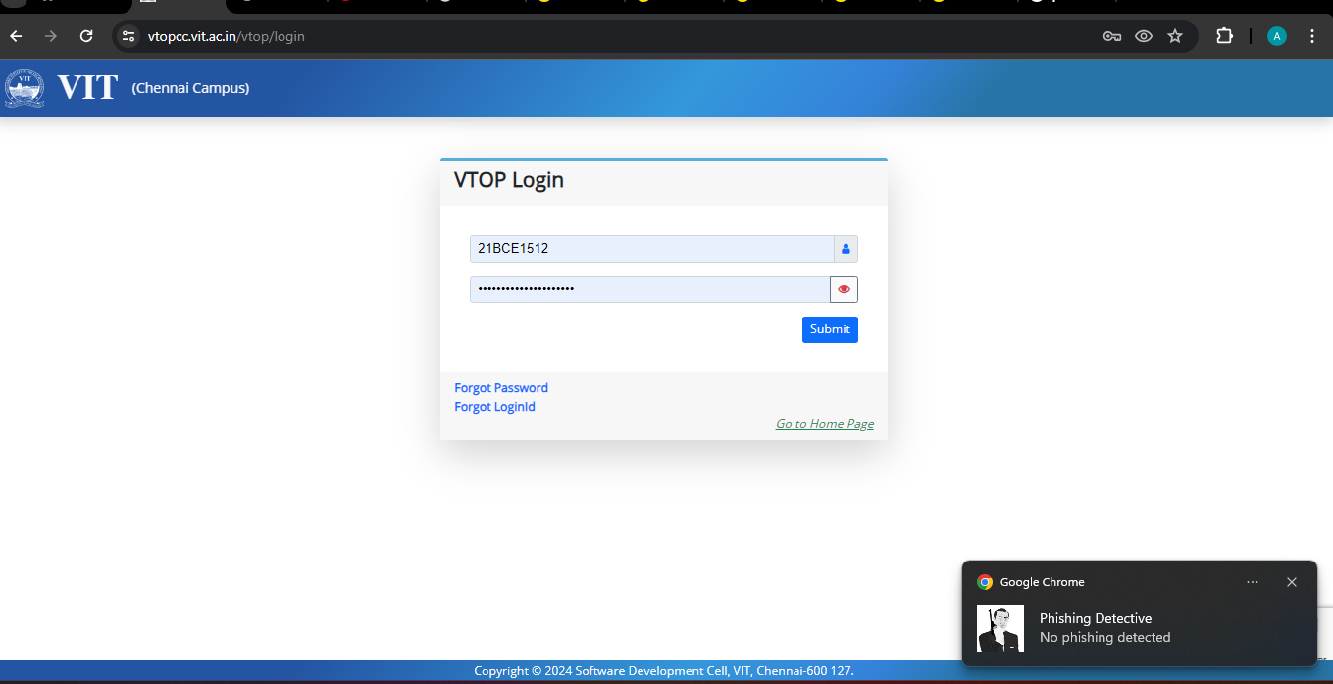
Snapshots (No phishing detected!)

Slide 19
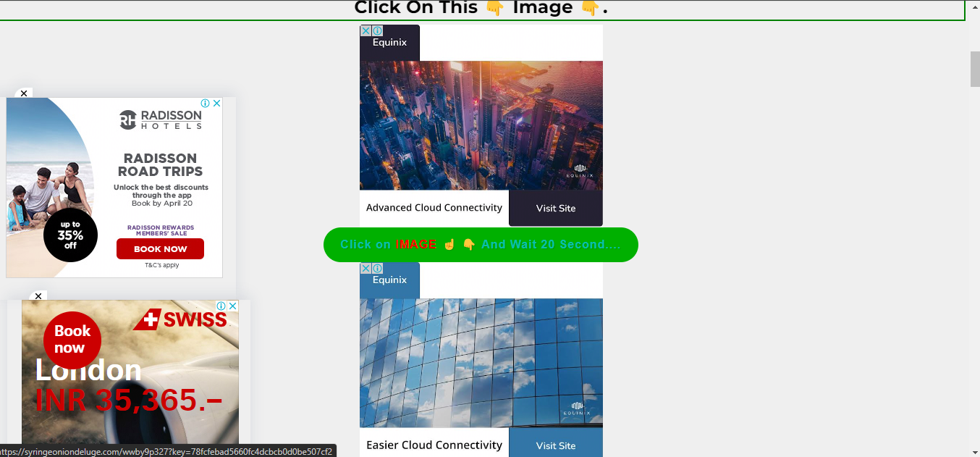
Snapshots (Pshishing detected!)

Slide 20
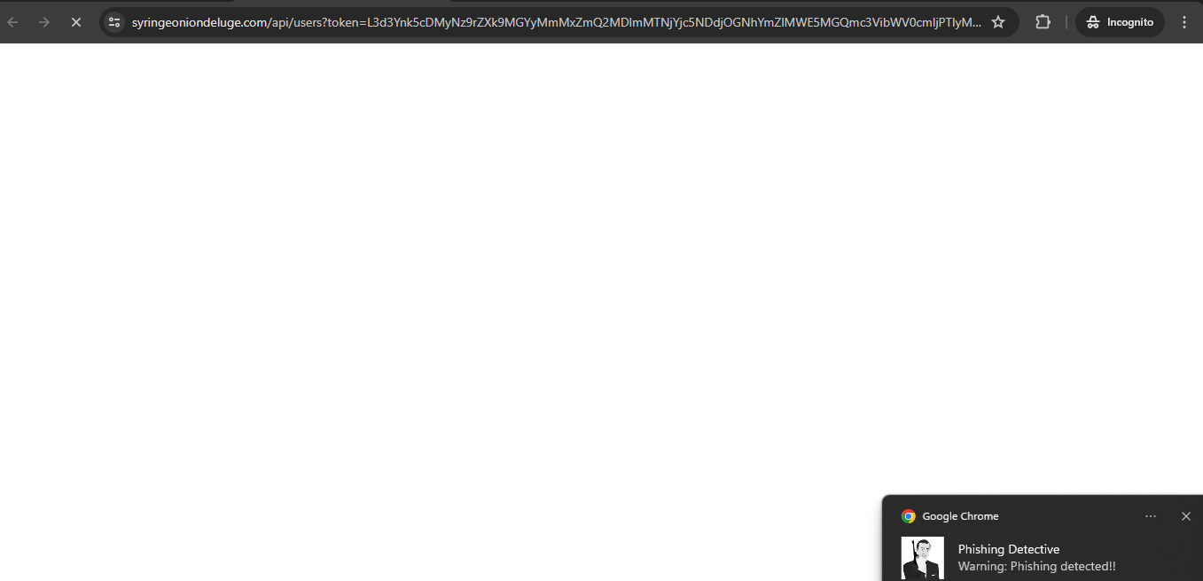
Snapshots

Slide 21
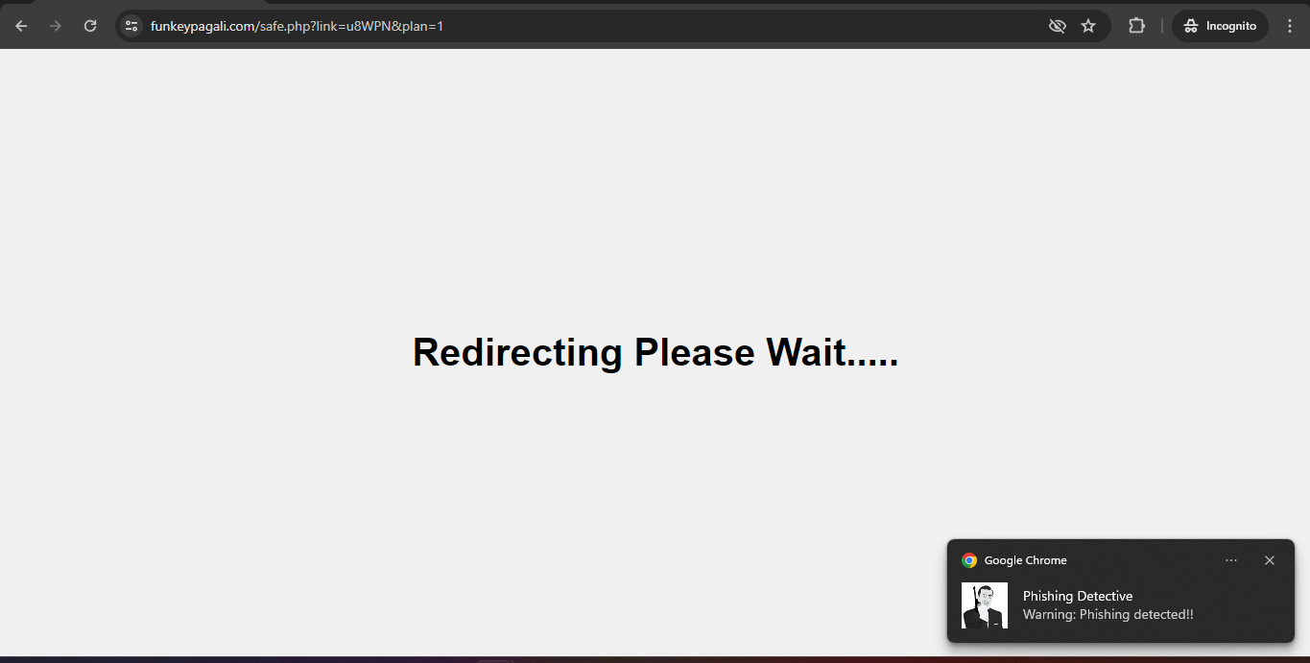
Snapshots

Slide 22
Conclusion
1. Phishing Threat: Phishing represents a significant threat to internet security and safety, highlighting the critical need for effective detection methods.
2. Machine Learning Techniques: The study involved testing three machine learning techniques on the 'Phishing Websites Dataset' to identify the most effective approach for detection.
3. Chrome Plugin Development: A Chrome plugin was developed based on the selected algorithm to provide an accessible tool for end users to detect phishing websites easily.
4. Future Improvements: Future efforts aim to enhance the phishing detection system by developing it into a scalable web service with online learning capabilities. This will enable the system to adapt to evolving phishing attack patterns and improve model accuracy over time.

Slide 23
Reference
IEEE
https://ieeexplore.ieee.org/document/

