Slide 1
TIME TABLE SCHEDULER

Slide 2

Scheduling of a time table has been a challenging task for any organization, specially for universities having a large number of students and faculties, working in multiple shifts, taking care of the availability of the classrooms .
With so many factors in stake it takes a lot of brainstorming for the person assigned to design this schedule and it also sometimes leads to ambiguous results with a clear state of dissatisfaction amongst the faculties and students .

Slide 3
TIME TABLING AS A NP-COMPLETE PROBLEM
NON DETERMINISTIC POLYNOMIAL TIME COMPLETE PROBLEM
Any solution to the problem can be verified
Very quickly.
If the problem can be solved quickly then do every problem in NP.
When search space is very large and no algorithm exists in polynomial time, such problem is classified as NP-HARD.
Genetic algorithm have been the most prominently used in genetically near optimal solution to time table problems , hence it’s usage in implementation of the project

Slide 4
SOLUTION
The aim of this product is the generation of course schedules while demonstrating the possibility of building these schedules automatically through the use of computers in such a way that they are optimal and complete with little or no redundancy through the development of a viable lecture timetabling software.

Slide 5
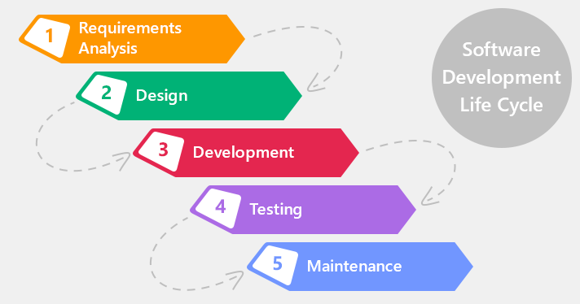
WATERFALL MODEL

Slide 6
TOOLS USED
Sublime Text Editor
Modern Requirements
Draw.io

Slide 7

REQUIREMENT GATHERING

Slide 8
Inception—ask a set of questions that establish …
Identify the stakeholders (people concerned with design of time-table teachers, students, etc..)
Asking basic requirements questions.
Elicitation—elicit requirements from all stakeholders.
Collaborative Requirements Gathering.
Quality Function Deployment.
Why difficult? Problems faced.
Elaboration—create an analysis model that identiﬁes data, function and behavioral requirements.
Analyzing phase.
Elements of Analysis Model(Scenario based, Class based, etc..)

Slide 9
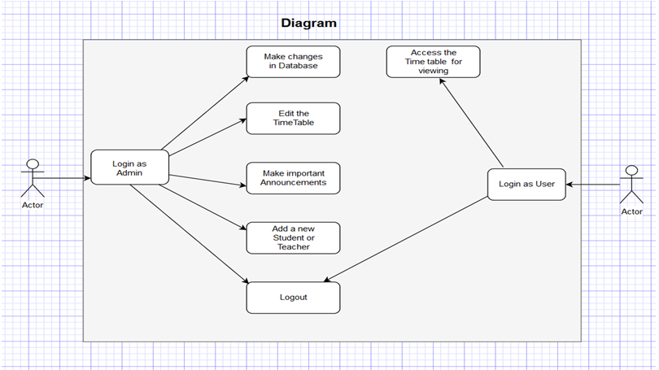
USE CASE

Slide 10
Negotiation—agree on a deliverable system that is realistic for developers and customers.
Identifying the key stakeholders.
Try to accommodate their requirements.
Negotiate.
Specification—final work product of Requirement Engineering. Final work product can be specified in any one of the following:
A written document
A collection of user scenarios
A prototype, algorithm

Slide 11
Validation—a review mechanism that looks for
Errors in content
Inconsistencies encountered.
Conflicting Requirements.
Requirement Management—Manage changing requirements.
Difficult to change(Waterfall Model)
Notes:
<number>

Slide 12
DESIGN AND ARCHITECTURE
Design is an iterative process through which requirements are translated into blueprint for constructing the software.
The Architecture of the system is a comprehensive framework that describes its form and structure its components and how they fit together.
Architecture Style Used:
Call and Return Architecture

Slide 13



BIG CONCEPT
The brain behind this product

Slide 14
GENETIC ALGORITHM
Search algorithm based on the mechanism of natural selection and natural genetic.
Based on the “survival of the fittest” concept.
Stimulates the process of evaluation

Slide 15

WHY GENETIC ALGORITHM ?
BECAUSE IT CONVERGES TO THE GLOBAL POINTS ALWAYS

Slide 16
OUTLINE OF GENETIC ALGORITHM
START
FITNESS
NEW POPULATION
SELECTION
CROSSOVER
MUTATION
ACCEPTING
REPLACE
TEST
LOOP

Slide 17
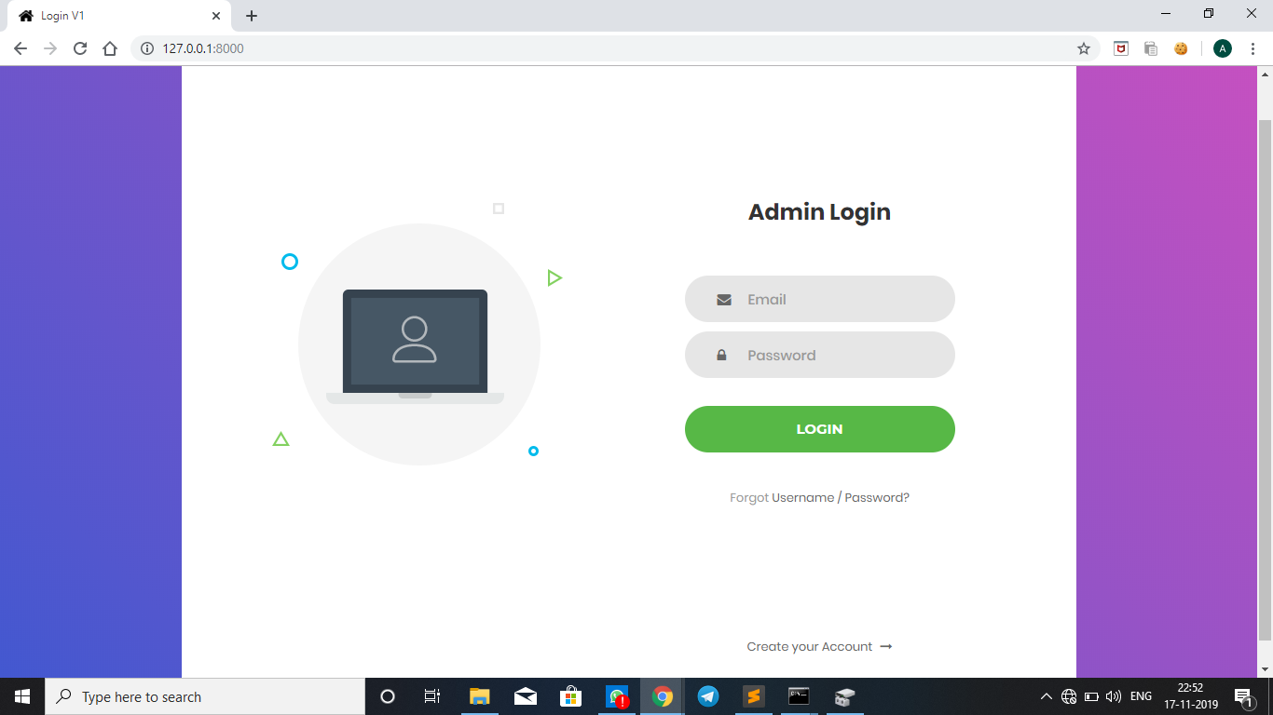

Slide 18
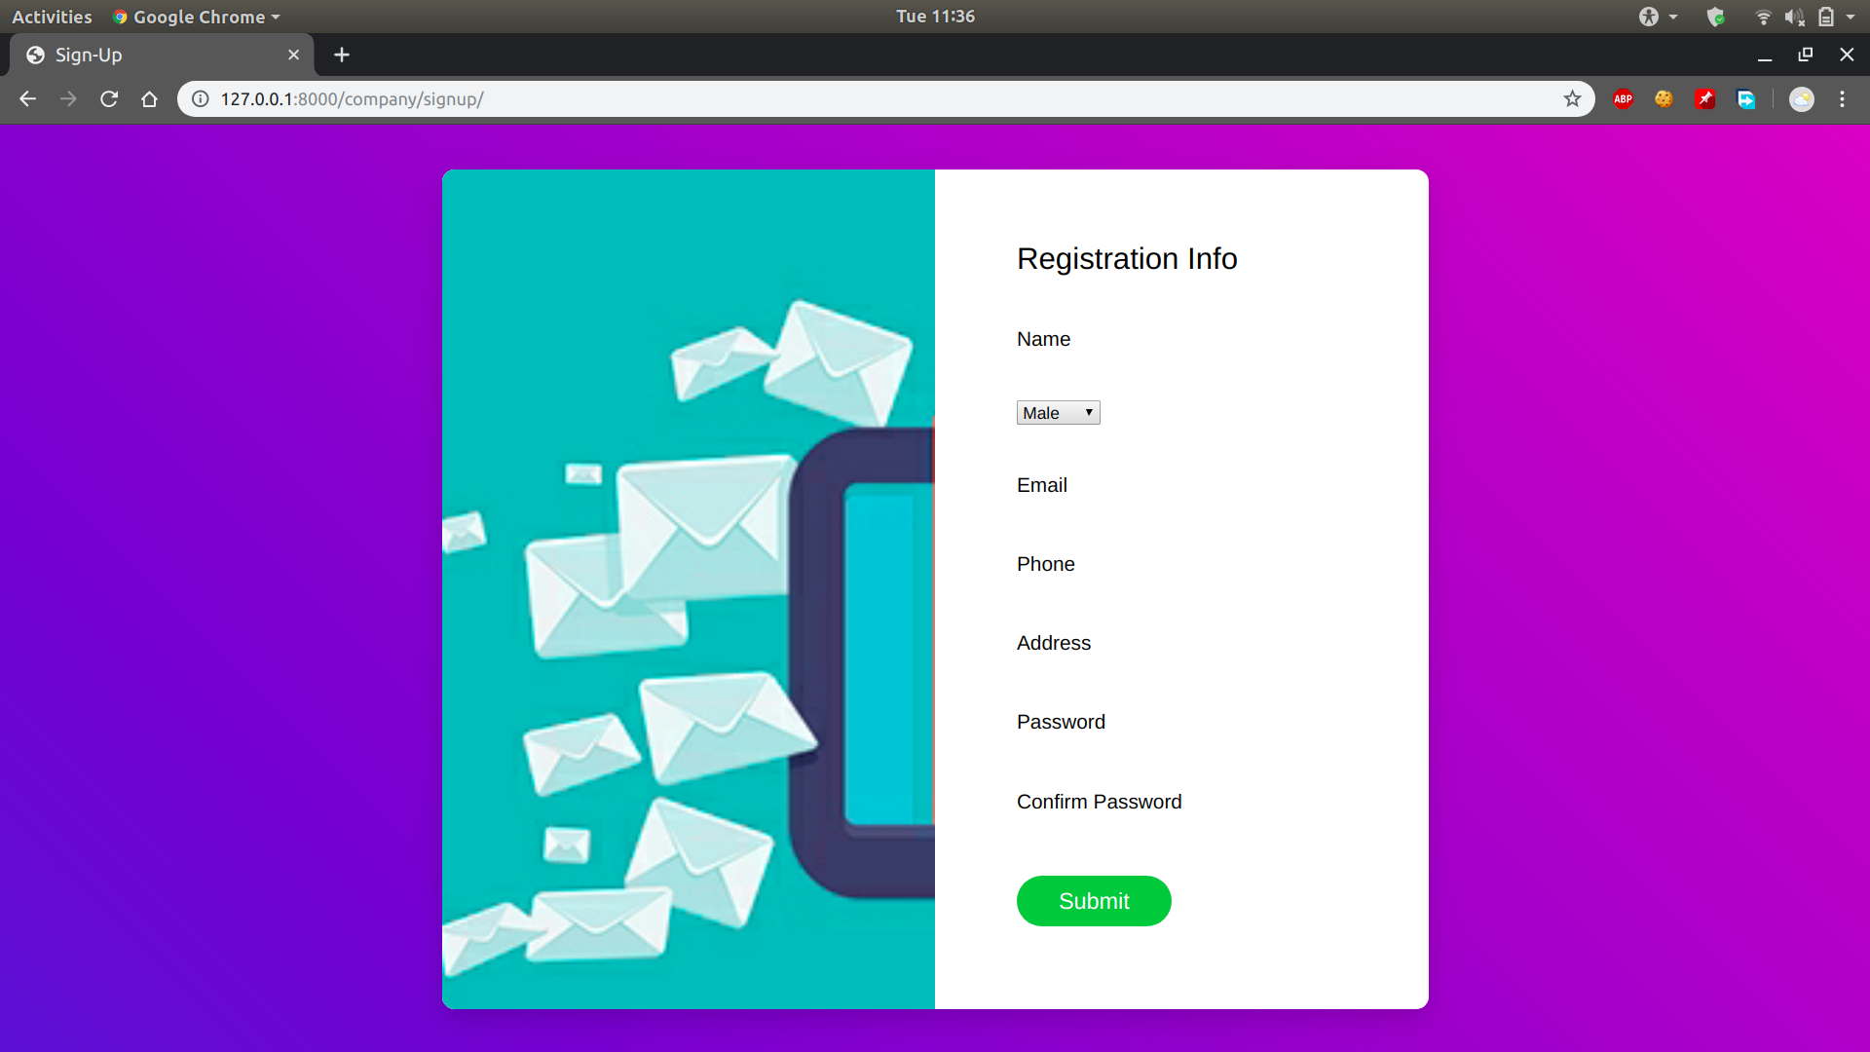

Slide 19
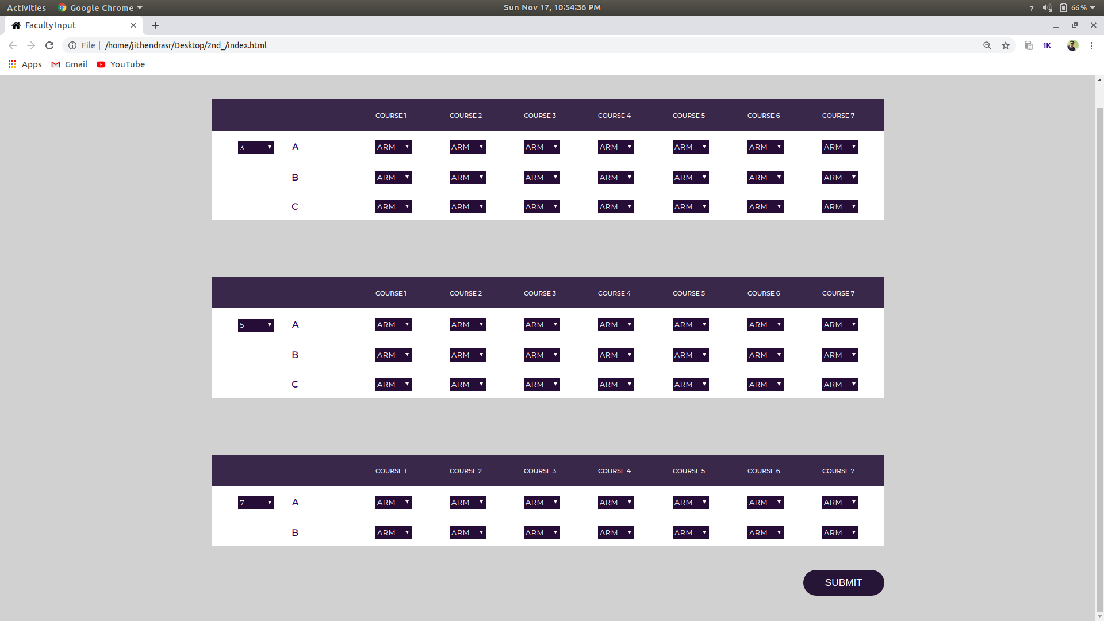

Slide 20
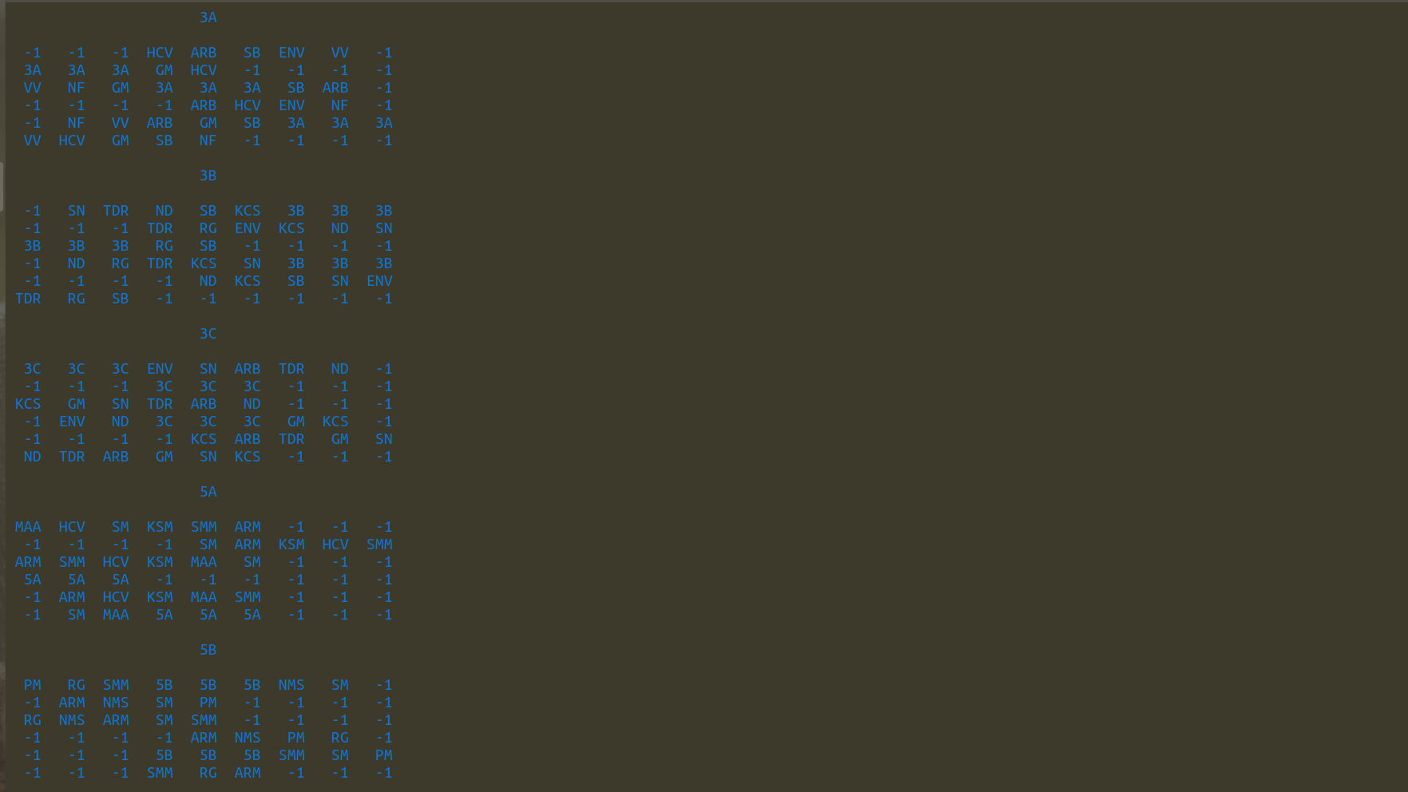

Slide 21
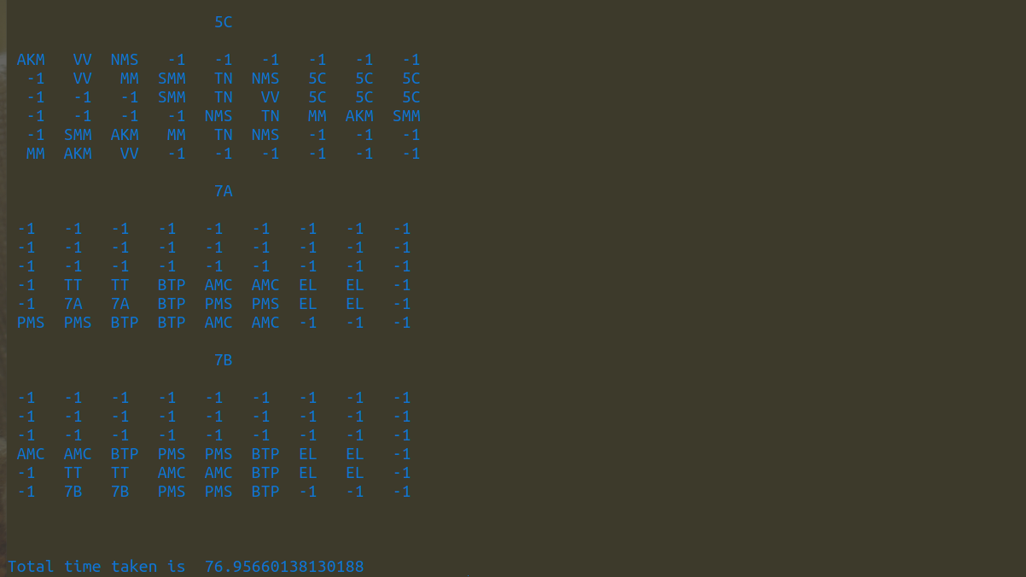

Slide 22
PERFORMANCE
Computational Speed
Input
Output
Multi-processing

Slide 23
System Requirements
»Processor should be Pentium 5 and above
»128 Megabytes of RAM (or more)
»1 Gigabyte of Free Disk Space And some text
»Windows XP or above

Slide 24

FUTURE SCOPE

Slide 25
THANK YOU!

