Slide 1
Review for Final Year Project “Deep Learning Based Detection of Depression”
Project Team Guide
Akshay Suryanarayan Hegde Prof. Ashritha R. Murthy
Ganesh S
Aniket Kharad
Manzoor Ahmed

Slide 2
Introduction
Aim/Statement of the problem
Social media is increasingly used by different levels of age groups.
The practices turn out to be extremely difficult with the growing number of users and their content. This motivates for detecting depression from the user posts by applying AI.
Hence we came up with “Deep Learning Based Detection of Depression”.
Objectives
The first step is to fetch the data from various sources and pre-process the data using NLP into a form that is predictable and analyzable for depression detection.
It is imperative for extracting features from the structured textual data for natural language processing.
With a large pool of features we have to generate models using different machine learning and deep learning techniques.
To analyze and optimize the models for assessment for depressive symptoms of an individual.

Slide 3
Introduction
Introduction to the problem domain
There are multiple ways to detect depression by using text data, audio data, video data, but text data proves to be of more significance as an explosion of users in the social media sites connect various people and they tend to post pictures, comments on these sites. In this project we are considering text data in order to detect depression in individuals
Applications
Monitor Family members mental health
Analyze the data of Depressed People
Clinical treatment design
Design precautions to avoid depression

Slide 4
Introduction
Proposed Solution
Dataset is retrieved by using Automation on Twitter using TWINT
Data is cleaned and features are extracted using NLP
word2vec and glove models are used for word embedding
Machine Learning Models are applied like Random Forest, Naïve Bayes
Deep Learning Models are applied using CNN, CNN + LSTM, CNN + GRU
Result is analyzed with various metrics of accuracy

Slide 5
Literature Review
According to Dey, Sharmishta, et. al., [1] more than 264 million people across the globe suffer from mental health conditions and depression, between 76% to 85% of lower- and middle-income groups don’t receive any treatment for depression. The author also mentions that since the dawn of the beginning of the internet people have begun to dump their thoughts on the Internet which may prove to be a very powerful tool for the diagnosis of a person’s mental health problems.
[1],[2],[3] have given a survey on various algorithms applied on depressions data which includes Machine Learning, Deep Learning, Data Mining etc. also mentioned about various trends in the usage of Random Forest, Hidden Markov Model, Naïve Bayes models for the better analysis of the model. Dey, Sharmishta, et. al., [1] mentions 95% accuracy for Deep Learning models and 92.6% F1-score for Artificial Neural Networks.
Mandar Deshpande, Vignesh Rao [2] have proposed a concrete idea on data extraction and data pre-processing using Natural Language Processing. The model proposed incorporates SVM, Multinomial Naïve Bayes as the primary algorithms. Author has taken into consideration F1-Score, Precision and Recall as the accuracy measures. The results for Multinomial Naïve Bayes are 83% and Support Vector Machine is 79%.

Slide 6
Literature Review
Jana M. Havigerova et.al methodology emphasis more on quantitative linguistic characteristics which are suited based on pronominalization index and readiness to action index in men and sentence complexity and punctuation for women. Making use of this peculiar feature of Text the author has proposed various models.
Tejus R. S. et.al proposed possible CNN + LSTM model and other machine learning models to find stressful tweets from different kinds of datasets. As the paper was under research during early stages of pandemic, it includes comparative study between the stress level and local demographic level disaster against before and during initial days of pandemic. Where it is found out that stress level indicating stress levels had risen by 30 times where as disaster related by 10 times.

Slide 7
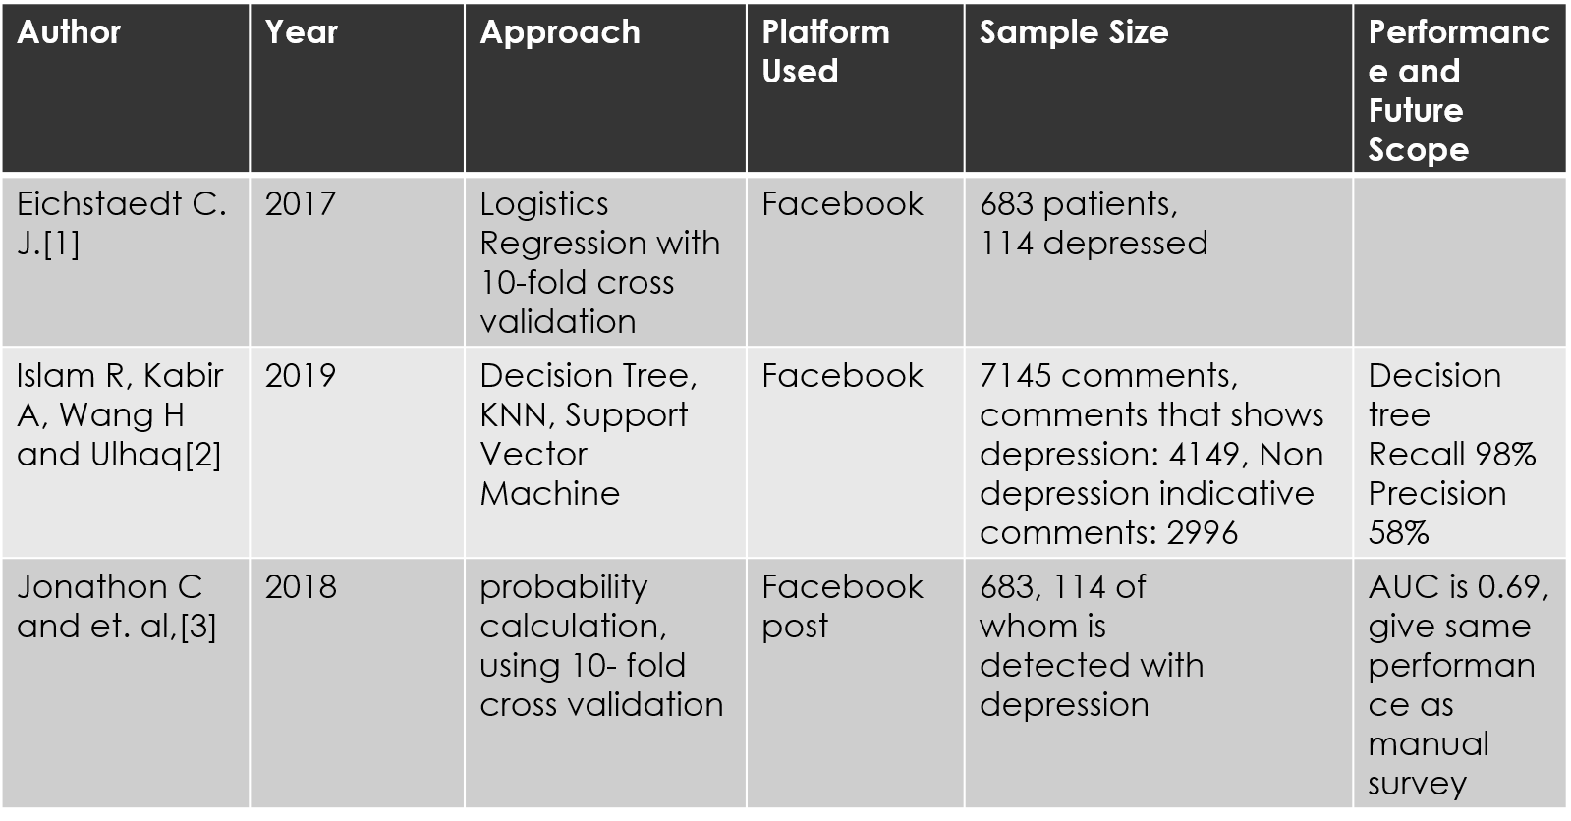
Literature Review

Slide 8
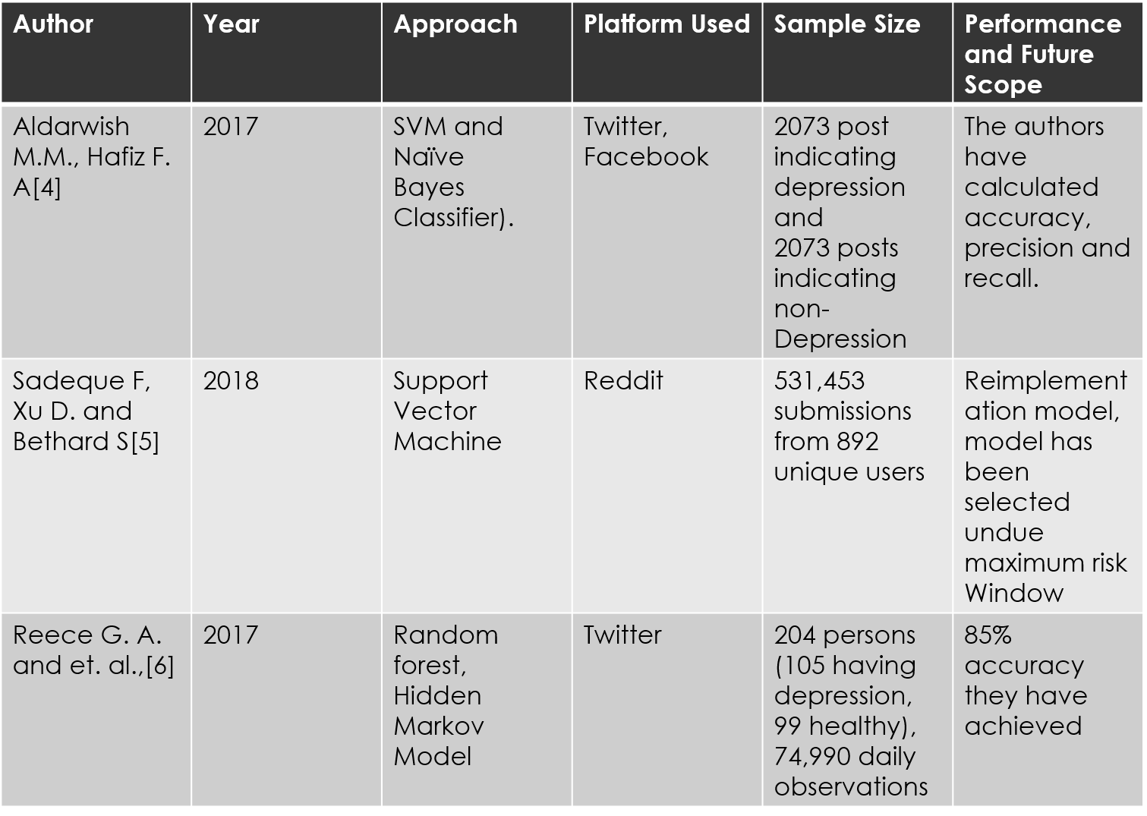

Slide 9
Dataset
There are two datasets used which are as follows
Sample_Dataset.csv from Kaggle which is a huge corpa of tweets
Other dataset is a collection of datasets of various depressive syndromes like depression.csv, PTSD.csv, stress.csv etc.
The latter dataset was extracted using Automation with the help of TWINT tool.

Slide 10
System requirements and analysis
Running on cloud like google colab requires additional use of default GPU’s provided
When training in local machine the minimum use of 4core 64bit machine running on 8GB RAM and 10 GB of additional storage
Environments: Google colab, Anaconda, Jupyter notebook

Slide 11
Tools and technologies
This project has been written using python 3.7 in Jupyter notebook
Use of library include pandas, numpy, keras, genism, matplotlib,
Code editor is visual studio code
Vectorizing neural networks are Word2Vec and GloVe
Jupyter notebooks are used to run google colabs as well

Slide 12
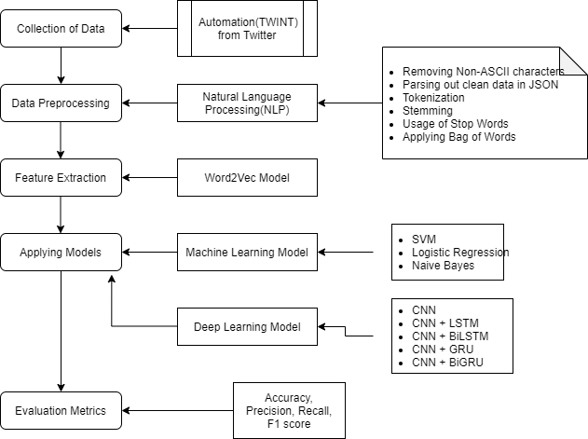
System Design and Implementation

Slide 13
System Design and Implementation(cont)
Models used for Feature Extraction are
Word2Vec Model
GloVe Model
Deep Learning Models used are
CNN
CNN + LSTM
CNN + Bidirectional LSTM
CNN + GRU
CNN + Bidirectional GRU
These models are used with exhaustive set of activation functions, epochs, Learning rate, training set and testing set. The hyperparameters are tuned to get the best performance out of the model.

Slide 14
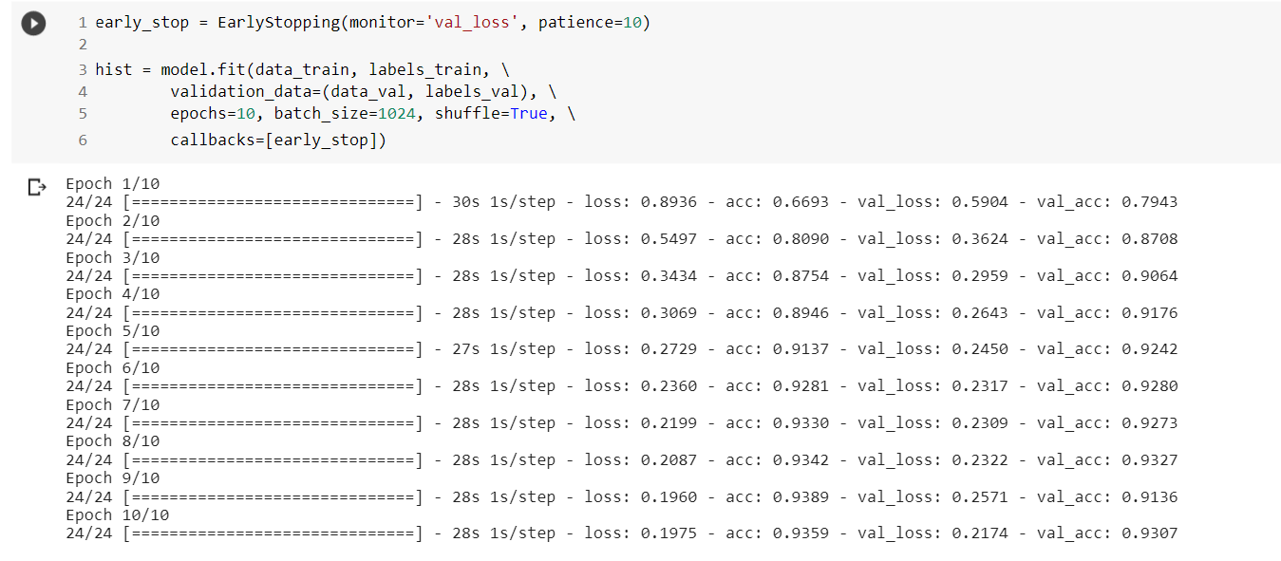
System Design and Implementation(cont)

Slide 15
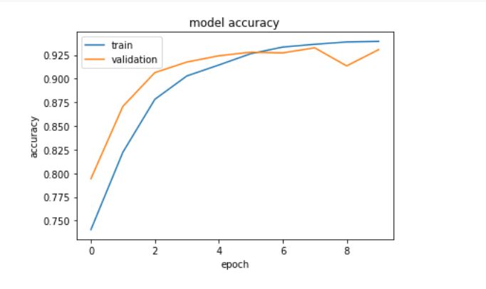
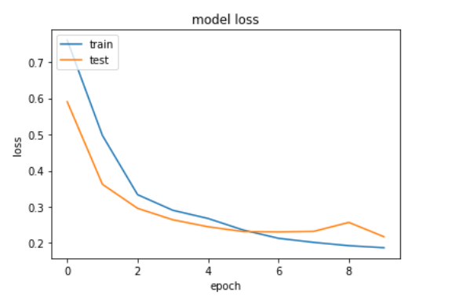
System Testing and Result Analysis

Slide 16
System Testing and Result Analysis
Results for Word2Vec Model and GloVe Model used in Feature extraction.
Model | Accuracy | Loss
Naïve Bayes | 75.99
Random Forest | 85.28
CNN | 94.81 | 0.1683
CNN + LSTM | 94.32 | 0.1736
CNN + BiLSTM | 94.54 | 0.1763
CNN + GRU | 94.81 | 0.1630
CNN + BiGRU | 94.79 | 0.1729
Model | Accuracy | Loss
Naïve Bayes | 75.99
Random Forest | 85.28
CNN | 95.12 | 0.1405
CNN + LSTM | 96.36 | 0.1295
CNN + BiLSTM | 96.63 | 0.1199
CNN + GRU | 96.37 | 0.1295
CNN + BiGRU | 96.48 | 0.1254

Slide 17
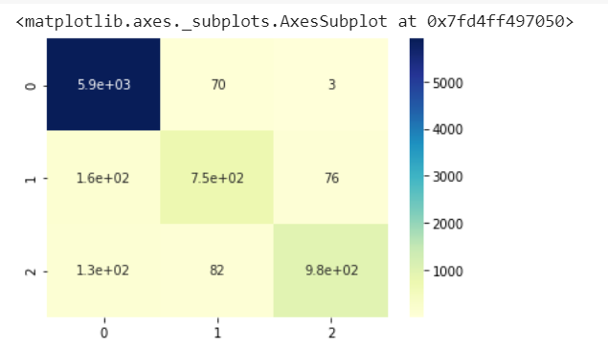
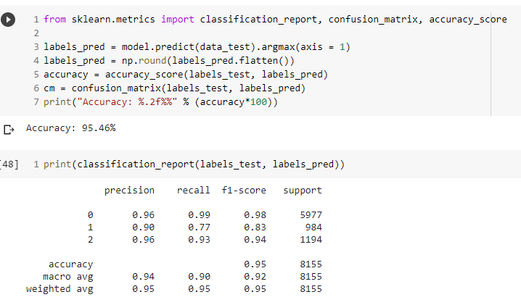
System Testing and Result Analysis
Confusion Matrix and classification report.

Slide 18
Details of Modules/Objectives Completed
Collected the data from Twitter using Automation and analyzed the data.
Processed the raw data and extracted features from the data.
Deployed the features into a matrix which could be easily fed into algorithms for training purposes.
Applied Machine Learning and Deep Learning Models for training purposes.
Comparative analysis of the results sought and visualization of the output.

Slide 19
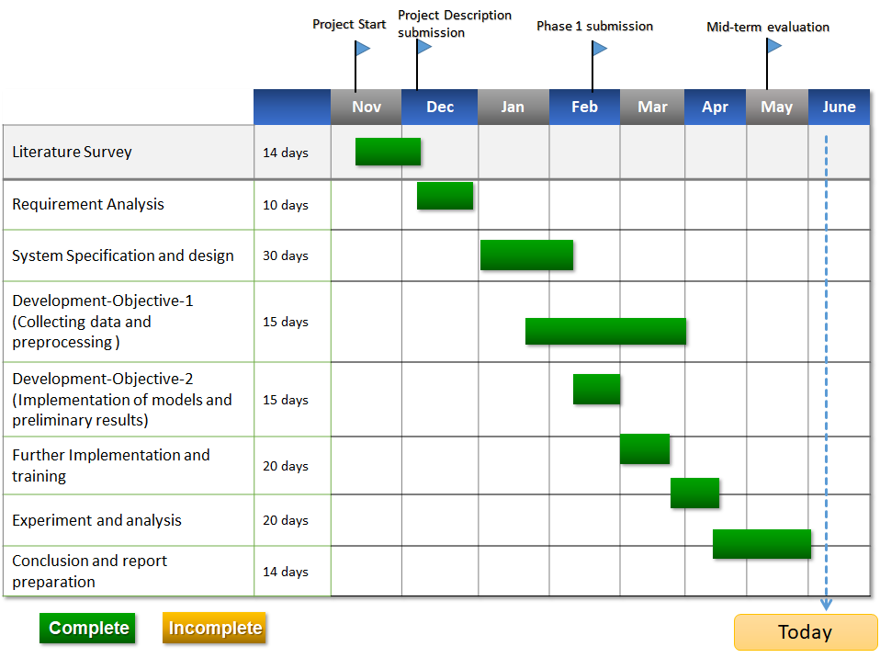
Time Schedule – Gantt Chart

Slide 20
References
[1] DEY, SHARMISTHA, et al. "DEPRESSION DETECTION USING INTELLIGENT ALGORITHMS FROM SOCIAL MEDIA CONTEXT-STATE OF THE ART, TRENDS AND FUTURE ROADMAP."
[2] Deshpande, Mandar & Rao, Vignesh. (2017). Depression detection using emotion artificial intelligence. 858-862. 10.1109/ISS1.2017.8389299.
[3] Islam R, Kabir A, Wang H and Ulhaq A, Depression detection from social network data using machine learning Techniques, Islam et al. Health Inf Sci Syst,vol. 6, No. 8,pp:1-12,2019.
[4] Guo, Hao, et al. "Resting-state functional connectivity abnormalities in first-onset unmedicated depression." Neural regeneration research 9.2 (2014): 153.
[5] Shervin Minaee, Nal Kalchbrenner, Erik Cambria, Narjes Nikzad, Meysam Chenaghlu, Jianfeng Gao, for Deep Learning Based Text Classification: A Comprehensive Review
[6] https://wiki.pathmind.com/word2vec
[7] https://nlp.stanford.edu/projects/glove/
[8] https://code.google.com/archive/p/word2vec/
[9] https://colah.github.io/posts/2015-08-Understanding-LSTMs/
[10] https://www.programmersought.com/article/15814471891/

Slide 21
Thank You

