Slide 1
Review for Final Year Project “Deep Learning Based Detection of Depression”
Project Team Guide
Akshay Suryanarayan Hegde Prof. Ashritha R. Murthy
Ganesh S
Aniket Kharad
Manzoor Ahmed

Slide 2
Introduction
Depression is a health problem related to ones metal state it involves mood swings, stress, anxiety, panic, trauma etc. According to WHO over 264 million people suffer from this which may lead to suicidal thoughts.
People with busy life seem to care less about this state of mind and also with the dawn of pandemic people loosing jobs and life the condition is critical.
Social media is the place where people seek emotional support and help from other Individuals.
Aim/Statement of the problem
Social media is increasingly used by different levels of age groups.
The practices turn out to be extremely difficult with the growing number of users and their content. This motivates for detecting depression from the user posts by applying AI.
Hence we came up with “Deep Learning Based Detection of Depression”.

Slide 3
Introduction
Objectives
The first step is to fetch the data from various sources and pre-process the data using NLP into a form that is predictable and analyzable for depression detection.
It is imperative for extracting features from the structured textual data for natural language processing.
With a large pool of features we have to generate models using different machine learning and deep learning techniques.
To analyze and optimize the models for assessment of depressive symptoms of an individual.
Applications
Monitor Family members mental health
Analyze the data of Depressed People
Clinical treatment design
Design precautions to avoid depression

Slide 4
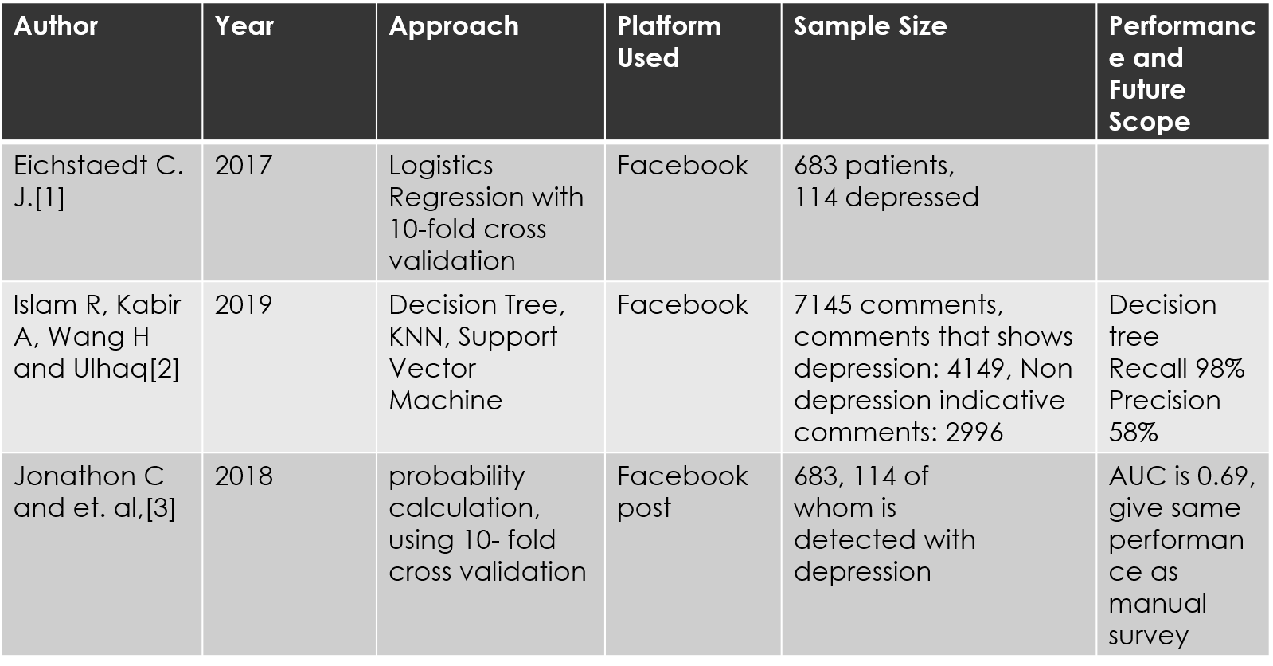
Literature Review

Slide 5
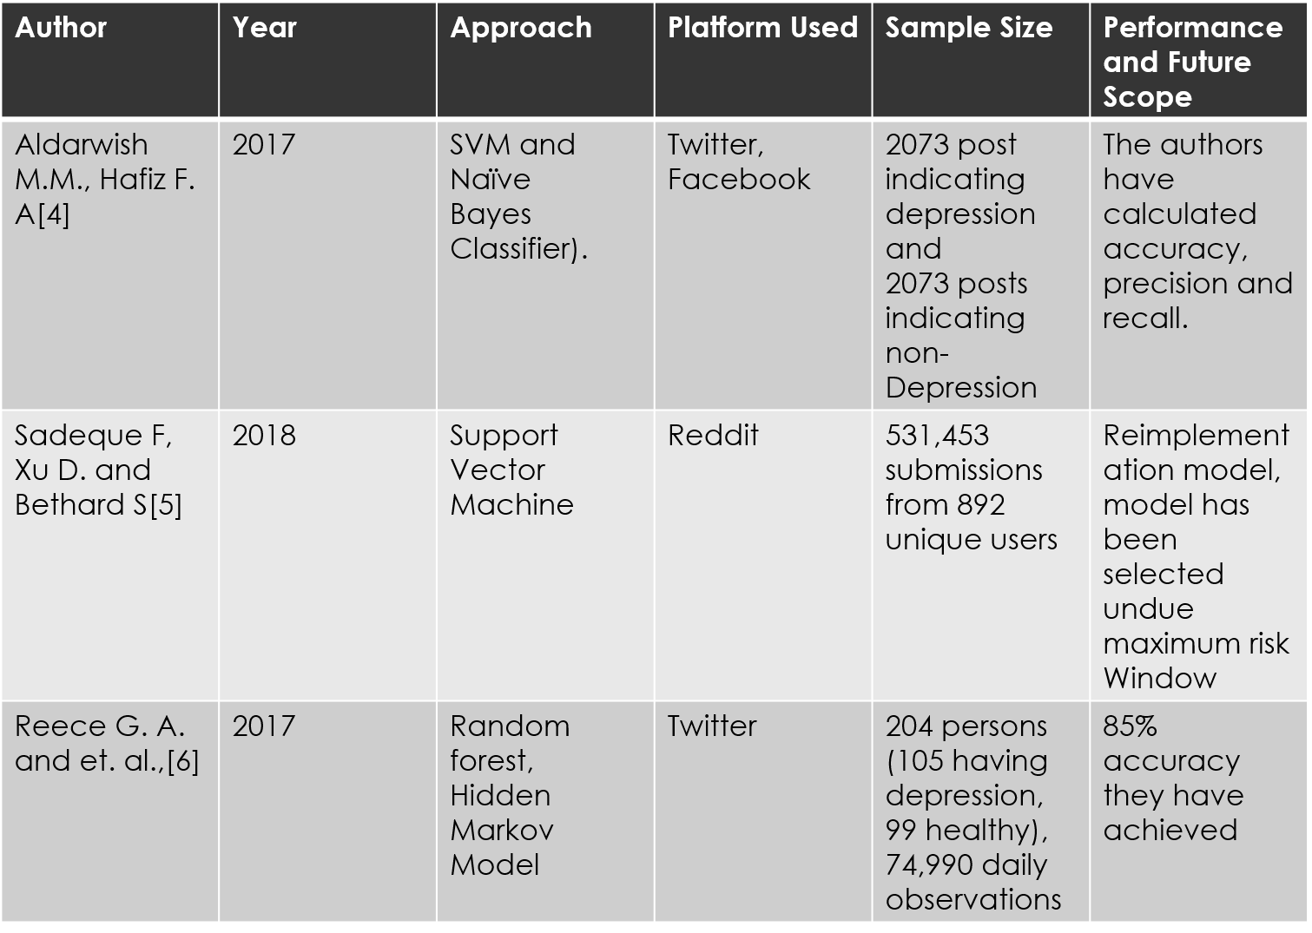

Slide 6
Proposed Solution
Dataset is retrieved by using Automation on Twitter using TWINT
Data is cleaned and features are extracted using NLP
word2vec and glove models are used for word embedding
Machine Learning Models are applied like Random Forest, Naïve Bayes
Deep Learning Models are applied using CNN, CNN + LSTM, CNN + GRU
Result is analyzed with various metrics of accuracy

Slide 7
Dataset
There are two datasets used which are as follows
Sample_Dataset.csv from Kaggle which is a huge corpa of tweets
Other dataset is a collection of datasets of various depressive syndromes like depression.csv, PTSD.csv, stress.csv etc.
The latter dataset was extracted using Automation with the help of TWINT tool.

Slide 8
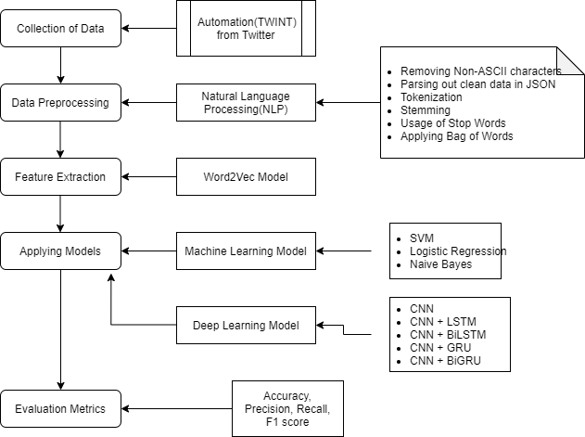
System Design and Implementation

Slide 9
System Design and Implementation(cont)
Models used for Feature Extraction are
Word2Vec Model
GloVe Model
Deep Learning Models used are
CNN
CNN + LSTM
CNN + Bidirectional LSTM
CNN + GRU
CNN + Bidirectional GRU
These models are used with exhaustive set of activation functions, epochs, Learning rate, training set and testing set. The hyperparameters are tuned to get the best performance out of the model.

Slide 10
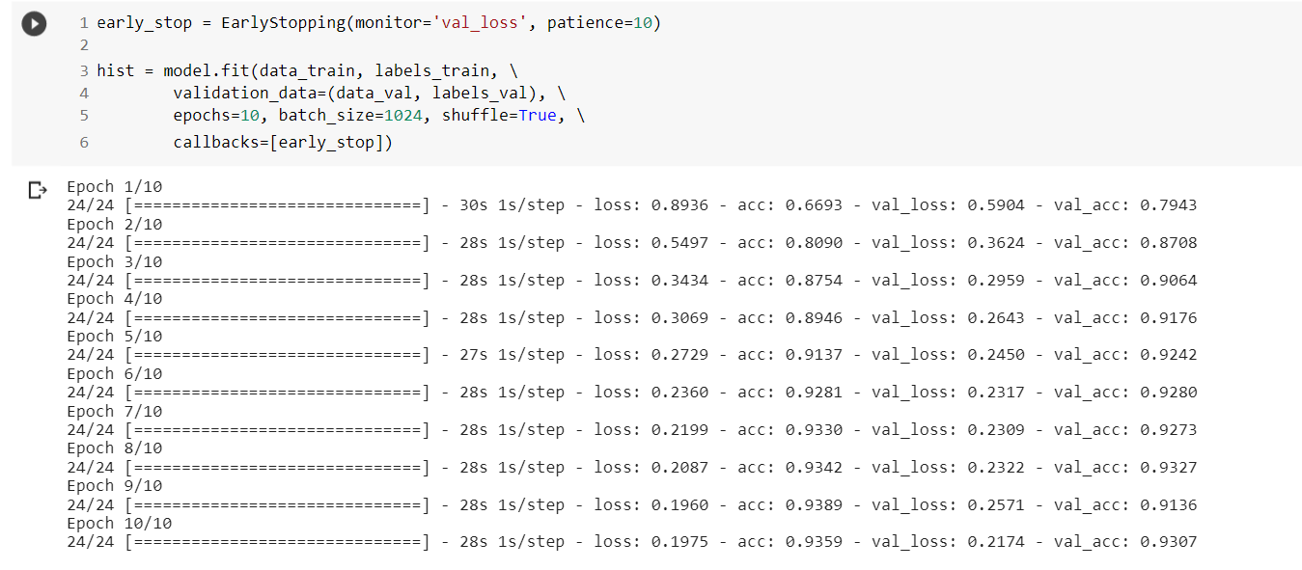
System Design and Implementation(cont)

Slide 11
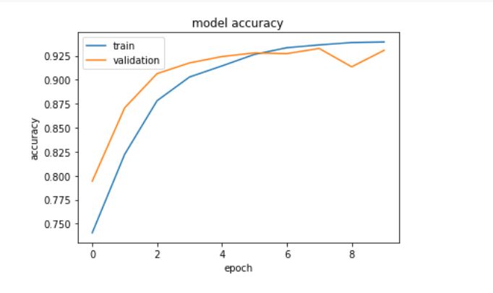
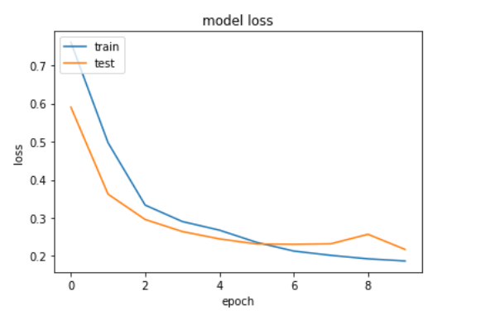
System Testing and Result Analysis

Slide 12
System Testing and Result Analysis
Results for Word2Vec Model and GloVe Model used in Feature extraction.
Model | Accuracy | Loss
Naïve Bayes | 75.99
Random Forest | 85.28
CNN | 94.81 | 0.1683
CNN + LSTM | 94.32 | 0.1736
CNN + BiLSTM | 94.54 | 0.1763
CNN + GRU | 94.81 | 0.1630
CNN + BiGRU | 94.79 | 0.1729
Model | Accuracy | Loss
Naïve Bayes | 75.99
Random Forest | 85.28
CNN | 95.12 | 0.1405
CNN + LSTM | 96.36 | 0.1295
CNN + BiLSTM | 96.63 | 0.1199
CNN + GRU | 96.37 | 0.1295
CNN + BiGRU | 96.48 | 0.1254

Slide 13
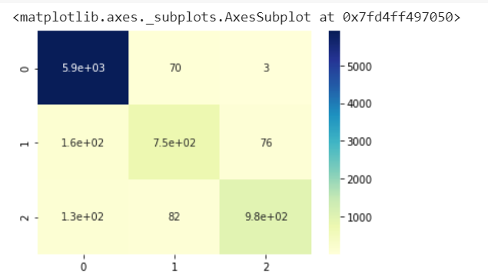
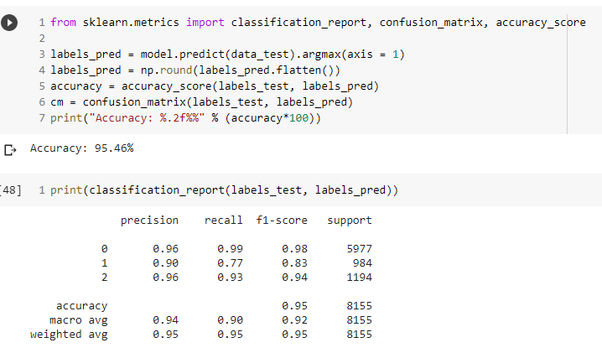
System Testing and Result Analysis
Confusion Matrix and classification report.

Slide 14
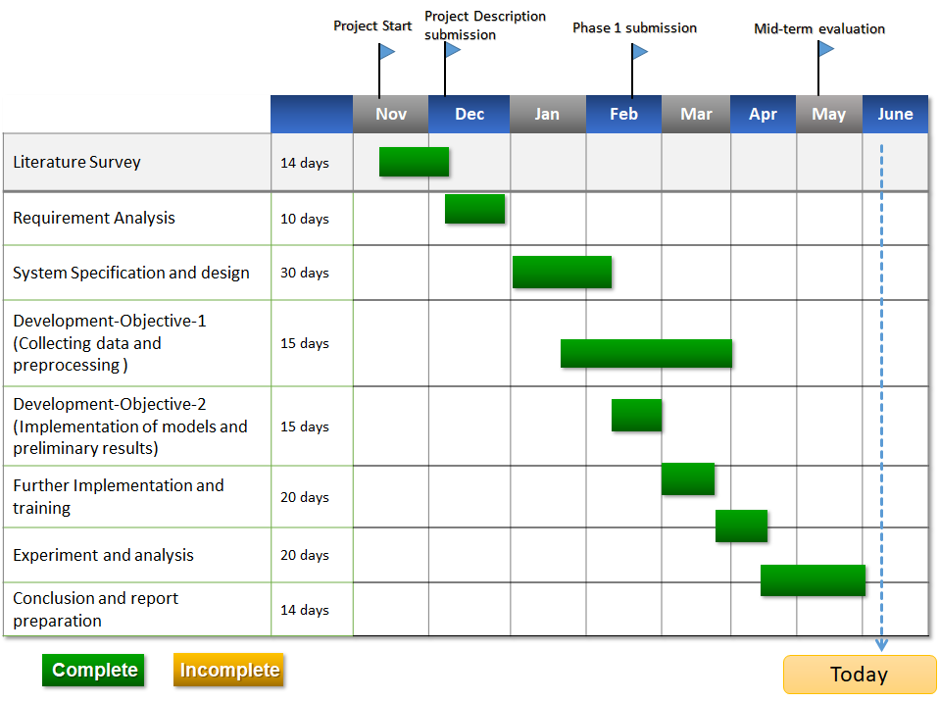
Time Schedule – Gantt Chart

Slide 15
References
[1] DEY, SHARMISTHA, et al. "DEPRESSION DETECTION USING INTELLIGENT ALGORITHMS FROM SOCIAL MEDIA CONTEXT-STATE OF THE ART, TRENDS AND FUTURE ROADMAP."
[2] Deshpande, Mandar & Rao, Vignesh. (2017). Depression detection using emotion artificial intelligence. 858-862. 10.1109/ISS1.2017.8389299.
[3] Islam R, Kabir A, Wang H and Ulhaq A, Depression detection from social network data using machine learning Techniques, Islam et al. Health Inf Sci Syst,vol. 6, No. 8,pp:1-12,2019.
[4] Guo, Hao, et al. "Resting-state functional connectivity abnormalities in first-onset unmedicated depression." Neural regeneration research 9.2 (2014): 153.
[5] Shervin Minaee, Nal Kalchbrenner, Erik Cambria, Narjes Nikzad, Meysam Chenaghlu, Jianfeng Gao, for Deep Learning Based Text Classification: A Comprehensive Review
[6] https://wiki.pathmind.com/word2vec
[7] https://nlp.stanford.edu/projects/glove/
[8] https://code.google.com/archive/p/word2vec/
[9] https://colah.github.io/posts/2015-08-Understanding-LSTMs/
[10] https://www.programmersought.com/article/15814471891/

Slide 16
References
[11] Eichstaedt C. J. Facebook language predicts depression in medical records, Psychological And Cognitive Science, vol. 115, No. 44, pp: 11203– 11208, October 2018.
[12] Islam R, Kabir A, Wang H and Ulhaq A, Depression detection from social network data using machine learning Techniques, Islam et al. Health Inf Sci Syst,vol. 6, No. 8,pp:1-12,2019.
[13] Jonathon C and et. al, Facebook language predicts depression in medical records, PNAS ,vol.115 ,No.44,pp: 11203-11208;October,2018.
[14] Aldarwish M.M., Hafiz F. A. “Predicting Depression Levels Using Social Media”,King SaudUniversity for Health Science National Guard, 2017 IEEE 13th International Symposium on Autonomous Decentralized Systems.
[15] Sadeque F, Xu D. and Bethard S.”Measuring the Latency of Depression Detection in Social Media”,WSDM '18: Proceedings of the Eleventh ACM International Conference on Web Search and Data Mining, pp.: 495-503, October 2018.
[16] Reece G. A. and et. al., Forecasting the onset and course of mental illness with Twitter data, Scientific Reports | 7: 13006.
[17] Tao X., Zhou X., Zhang J and Yong J. Sentiment Analysis for Depression Detection on Social Networks, J. Li et al. (Eds.): ADMA 2016, LNAI 10086, pp. 807–810, 2016.
[18] https://en.wikipedia.org/wiki/Random_forest

Slide 17
Thank You

