Slide 1

Driver Application with AI framework for a Chat-bot
Group Members:
Shiv Kumar Dubey
Kartik Nagesh Pauskar
Shashikant Kumar
Akshay Sreekumar Nair

Slide 2
Agenda
Introduction
Literature Survey
Outcome of Literature Survey
Motivation
Problem Statement
Objectives
Proposed Work
Conclusion
Timeline of Project
Individual Contribution
References

Slide 3
Introduction
This Web application helps a user to book a driver if one has a vehicle but has no-one to drive it, it allows a user to get a driver for many scenarios’ like driver for daily basis, for loading and transferring heavy furniture to a distant place, also off trips and off-roading, etc.
This application also lets you book cars for your journey, whether for daily basis or for somewhere adventurous. It lets you choose from a variety of different cars like Luxurious Premium Cars, Classic Sedans, Micro cars, Electric cars, Cabs and even Off-Roading vehicles.
Now for the technical stuff, we have built this application from the front-end to the back-end and made it user friendly by making it easier for a user to use. The application is loaded with a front-end where the user can interact with the application, can sign-up or login and has a variety of options to make a booking. Also we have a Chat-Bot to make this application even more interactive and easy to use.

Slide 4
Literature Review
Authors​ | Methodology​ | Advantages​ | Limitations​
​Martin Adam, Michael Wessel, Alexander Benlian | ​Research based on AI-based Chabot’s in customer service and their effects on user compliance | Communicating with customers through live chat interfaces has become an increasingly popular means to provide realtime customer service in e-commerce setting | Users might get used to the presented cues and will respond differently over time.
​Amir-reza Asadi, Reza Hemadi | ​Research based on Design and implement a chatbot for e-commerce | ​aim of improving user interaction in social media marketing and making social media marketing more effective utilizing the quick order method | ​NIL
​Siddharth Gupta, Deep Borkar, Chevelyn De Mello, Saurabh Patil | ​Research based on An E-commerce website based chatbot | ​chatbot can make it easier to interact with the website | ​NIL
​Bayan Abu Shawar,Eric Atwell | ​Research based on Chatbots: Are they Really Useful? | ​ Analysis of all dialogues generated and feedback from students revealed that: 1256 users chatted with Alice, 88% of them chatted only once and did not come back to the site; the duration of chatting was short; 17% made positive comments such as: “you are so nice”, “you are clever”, etc, and 24% evaluated it negatively | ​ Jia concluded that the failure of this experiment is down to the pattern matching technique used in Alice which is based on key-word matching without any attempt to understand what is said.
​Ritik | ​Survey | ​Ui ux designed wrt to every category of users | ​Providing location feature as a map would be good.
​Vasu | ​Survey | ​integrating chatbot made it more interactive ,easy to use | ​NIL
​Gaurav | ​Survey | ​Fast retrieval of data | ​Involve more stylish preferences

Slide 5

Outcome of Literature Review
The previous researches conducted stressed on the same fact of efficiency and more effective customer satisfaction with the use of chatbot in a website, which we too adhere to.
We were able to design and build a web application based on the conducted research and make a clean and simple to use web application.

Slide 6
Issues and Challenges
User doesn't know if the service is available in their area yet.
Chatbot available in English language only yet.
Website services are also in English language only yet.

Slide 7
Motivation
Encountered people facing the problem of lack of availability of drivers
This problem created an opportunity
And we decided to tackle and started to implement it right away.
This issue was prevalent in many areas and ignored too. We conducted surveys and concluded to solve this issue using whatever we have in our hands
Also, for better user interaction, Chatbot was also integrated

Slide 8
Problem Statement
Solving problem, especially prevalent in remote places of lack of drivers on hand basis.

Slide 9
Research Objectives
Solve daily-life problems (as mentioned) faced by the people.
Build a user-friendly website, to focus all sorts of users.
Fast response and efficient work.
Secure Database.
Integrate an Effective chat-bot for an interactive web application

Slide 10
Proposed Model

Slide 11
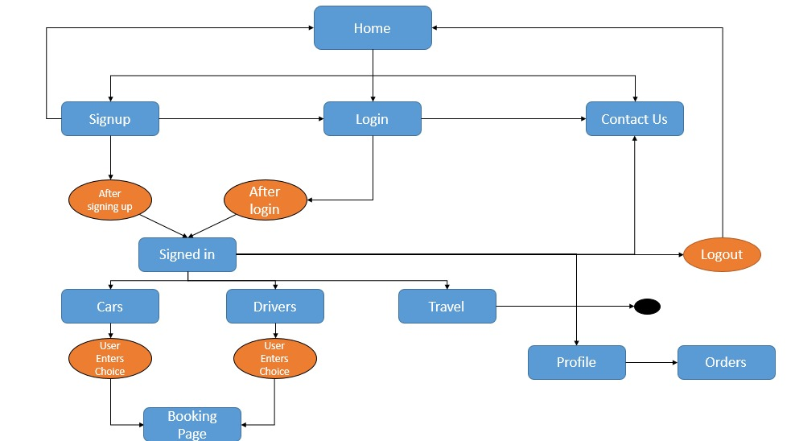
Website

Slide 12
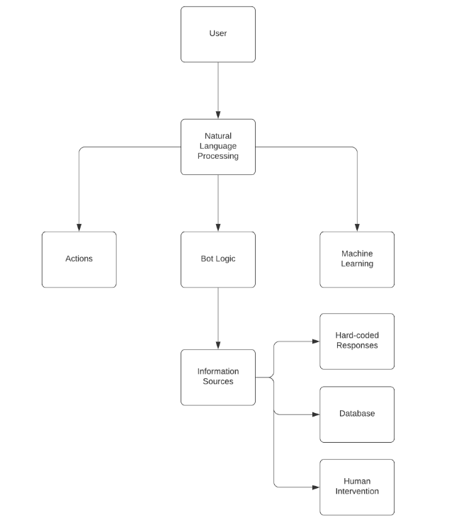
Chatbot

Slide 13
To design an interactive and user friendly interface
To build a modern and intuitive UI design
To design and integrate a Chat-bot to make the application interactive
To build a back-end where user data can be stored safely
To make the application safe and sound, where user the passwords entered by the users are encrypted

Slide 14
Methodology

Slide 15
Front-end
The front-end is written in HTML and CSS and the navigation is the done using JAVASCRIPT, also various modules like NodeJS, ExpressJS, etc. are used.
The application comprises of 10 pages which will guide the user to make the Booking, namely:
The Home page
Sign-Up page
A Login page
Book-a-Car page
Find-a-driver page
Booking page
Signed in page
About Us page
Profile page
My Orders page

Slide 16
Back-end
For Backend we took aid of 7 external modules to fulfill the requirement of our project
Mongoose
BcryptJS
JSON web token
Cookie Parser
Express JS
Validator
Basic Validation
Data Format Validation

Slide 17
Chat-Bot
We have created a framework that will allow users to choose and select the actions they want the Chat-Bot to perform. The bot is loaded with various keywords and quick toggles which makes the process more responsive.

Slide 18
Chatbot in python using natural language processing and Neural networks
Created dataset.
The dataset file consists of three pieces of information- tag,patterns,responses. Patterns specify what the user might have requested, Responses have hard-coded value which the chatbot will respond to and Tag specifies which patterns and responses come under this category
Formatted data for use
Reduce the words to its stem so that we don't lose any performance because it's looking for the exact word. Pass that text to the loads function and as a result we get the json object which is a dictionary essentially in python

Slide 19
Trained Data
Frame Neural Network
Format data for feeding into Neural Network
Tokenized strings into words for parsing the data in an efficient manner.
A neural network needs numerical values; use bag of words . Individual word values to either zero or one depending on if it's occurring in that particular
Work with the training list
work with this training list in order to train the neural network
➢ pre-processing before we get into building the neural network
➢ Random.shuffle the training data
➢ and then we're going to also turn it into a numpy array
➢ and then we're going to split it into x and y values

Slide 20
Build the Neural Network
create a simple sequential model and add a couple of layers. Specify their neurons quantity,activation function,learning rate and other parameters.
Feed data into Neural Network
Compile the model

Slide 21
Create Chatbot application that uses the trained model
Load the model, Read file in reading binary mode
Use a bunch of functions because the feeded data is numerical
A Function to clean up the sentences
a function for getting the bag of words
a function for predicting the class based on the sentence
a function for getting a response
we specify an Error Threshold that allows for a certain uncertainty but if that uncertainty is too high we're not going to take it into a result so threshold
User feeds his data
Output based on calculated probabilities

Slide 22
Future Work
We plan to add a new service to the application, where users can book a vacation or a small trip.
Also, further improvements to be made to the website as conducted in the survey.
Further improvements to the chatbot to be made by,
adding more training data , more patterns, more responses
make text more intense.

Slide 23

Results and Analysis
Designed and built a web application for booking a driver and vehicles based on the need of the client.
Designed it to be responsive making it more interactive.
Used MongoDB as a database for the project along with many important modules for building a back-end for the application.
Integrated a Chat-Bot that can provide necessary information for the ease of the users.

Slide 24
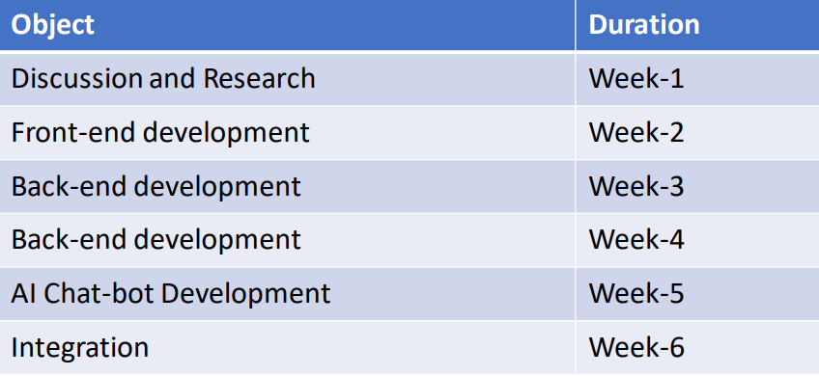
Time Line of Project

Slide 25
Individual Contribution
Kartik Pauskar:
1. Basic Research
2. Front-end Designing – Cars and Drivers page
3. Back-end Design – ExpressJS and Routing
4. Designing the layout commands for Chat-bot Integration
5. Chat-Bot integration
6. Report Making
7. Demo video
Shashikant Kumar:
1. Basic Research
2. Front-end Designing – Profile and Orders page
3. Back-end Design – Mongoose and Routing
4. Building a python chatbot using AI framework
5. Debug Chatbot
6. Report Making
7. Building the presentation
Akshay Sreekumar Nair:
1. Basic Research
2. Front-end Designing – Home and Signed page
3. Back-end Design – Cookie parser and BcryptJS
4. Building a python chatbot using AI framework
5. Chatbot Dataset, building model
6. Report Making
7. Demo video
Shiv Kumar Dubey:
1. Basic Research
2. Accumulate Data Based on Research
3. Front-end Designing – Signup and Login page
4. Back-end Design – Validator and JSON web tokens
5. Report Making
6. Building the presentation

Slide 26
References
[1] Scrip https://www.scirp.org/journal/PaperInformation.aspx?PaperID=77941
[2] Academia https://www.academia.edu/Documents/in/Chatbot
[3] Research Gate https://www.researchgate.net/publication/AC hatbotSystemf or MentalHealthcareBasedonSATC ounselingMethod
[4] Research Gate https://www.researchgate.net/publication/ ProgrammingchallengesofchatbotC urrentandfutureprospective
[5] Ijert https://www.ijert.org/an-analytical-study-and-review-of-open-sourcechatbot-framework-rasa
[6] AI-based Chabot’s in customer service and their effects on user compliance Martin Adam, Michael Wessel, Alexander Benlian.
[7] Design and implement a chatbot for e-commerce Amir-reza Asadi, Reza Hemadi.
[8] An E-commerce website based chatbot Siddharth Gupta, Deep Borkar, Chevelyn De Mello, Saurabh Patil

