Slide 1

Predictive Analysis Approach for Telecom Churns Prediction using various Machine Learning Algorithm
Project Presentation
By
KANAV VASUDEVA
AKSHAYKUMAR KULAL
HARSHAL KADAM
MONISHA V
NAYAN DOND
Notes:
To use this title animation slide with a new image simply 1) move the top semi-transparent shape to the side, 2) delete placeholder image, 3) click on the picture icon to add a new picture, 4) Move semi-transparent shape back to original position, 5) Update text on slide.

Slide 2
DATA SCIENCE LIFECYCLE
01
Problem Statement
02
Data Mining
03
Data Cleaning
04
Data Exploration
05
Feature Engineering
06
Predictive Modeling

Slide 3
INDEX
Problem Statement
Data Exploration
Data Visualization
Data EDA
Feature Engineering
Machine Learning Models
Conclusion

Slide 4
Problem Statement
Customer churn refers to the phenomenon where customers discontinue their relationship or subscription with a company or service provider. It represents the rate at which customers stop using a company's products or services within a specific period. Churn is an important metric for businesses as it directly impacts revenue, growth, and customer retention. Customer churn refers to the phenomenon where customers discontinue their relationship or subscription with a company or service provider. It represents the rate at which customers stop using a company's products or services within a specific period. Churn is an important metric for businesses as it directly impacts revenue, growth, and customer retention.
In the context of the Churn dataset, the churn label indicates whether a customer has churned or not. A churned customer is one who has decided to discontinue their subscription or usage of the company's services. On the other hand, a non-churned customer is one who continues to remain engaged and retains their relationship with the company.
This dataset is used to predict whether a customer is likely to get churn based on the input parameters like gender, total charges, monthly charges ,contract, etc. Each row in the data provides relevant information about the customer.

Slide 5
Problem Solving
In this project, we attempt to bridge the gap by providing a systematic analysis of the various telecom customer records for the purpose of churns prediction.

Slide 6
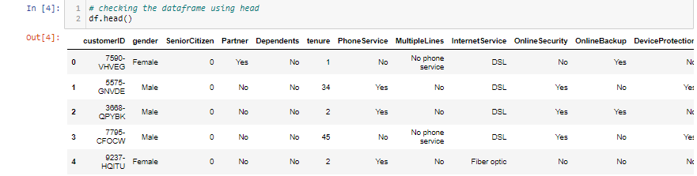
Data Exploration
Data exploration is first step of data analysis used to explore and visualized data to uncover insights from the start or identify areas or pattern to dig into more.

Slide 7
Attribute Information
Customer Id : Customer ID
Gender : Whether the customer is a male or a female
Senior Citizen : Whether the customer is a senior citizen or not (1, 0)
Partner : Whether the customer has a partner or not (Yes, No)
Dependents : Whether the customer has dependents or not (Yes, No)
tenure : Number of months the customer has stayed with the company
Phone Service : Whether the customer has a phone service or not (Yes, No)
Multiple Lines : Whether the customer has multiple lines or not (Yes, No, No phone service)
Internet Service : Customer’s internet service provider (DSL, Fiber optic, No)
Online Security : Whether the customer has online security or not (Yes, No, No internet service)
Online Backup : Whether the customer has online backup or not (Yes, No, No internet service)
Device Protection : Whether the customer has device protection or not (Yes, No, No internet service)

Slide 8
Attribute Information
Device Protection : Whether the customer has device protection or not (Yes, No, No internet service)
Tech Support : Whether the customer has tech support or not (Yes, No, No internet service)
Streaming TV : Whether the customer has streaming TV or not (Yes, No, No internet service)
Streaming Movies : Whether the customer has streaming movies or not (Yes, No, No internet service)
Contract : The contract term of the customer (Month-to-month, One year, Two year)
Paperless Billing : Whether the customer has paperless billing or not (Yes, No)
Payment Method : The customer’s payment method (Electronic check, Mailed check, Bank transfer (automatic), Credit card(automatic))
Monthly Charges : The amount charged to the customer monthly [Numeric value between 18.25 and 118.75]
Total Charges : The total amount charged to the customer[Numeric value between 18.80 and 8684.8]
Churn : Output class Whether the customer churned or not [No : Not Churn, Yes : Churned]

Slide 9
Data Visualization
Data visualization is the graphical representation of information and data in a pictorial or graphical format Data visualization is the graphical representation of information and data in a pictorial or graphical format
Data visualization tools provide an accessible way to see and understand trends, patterns in data, and outliers.
For data visualization we used visualization ML library :-
Matplotlib
Seaborn

Slide 10
Matplotlib
Countblot : Churn Categorical = ['Gender', 'Seniorcitizen', 'Partner', 'Dependents','phoneservice','multiplelines','internetservice','onlinesecurity','onlinebackup','deviceprotection','techsupport','streamingtv','streamingmovies','contract','paperlessbilling','paymentmethod']

Slide 11
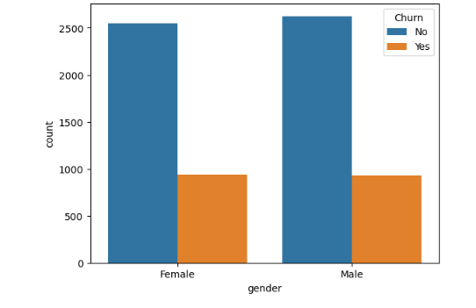
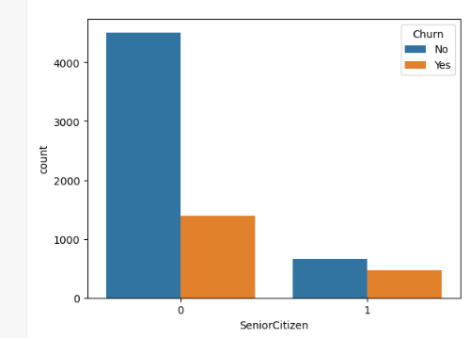
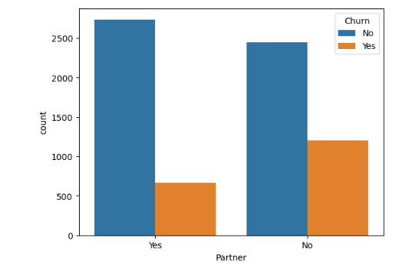
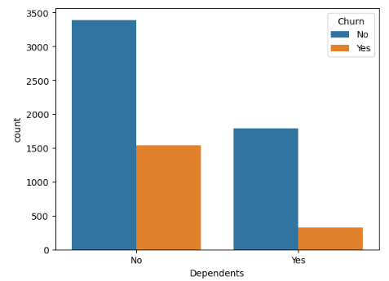
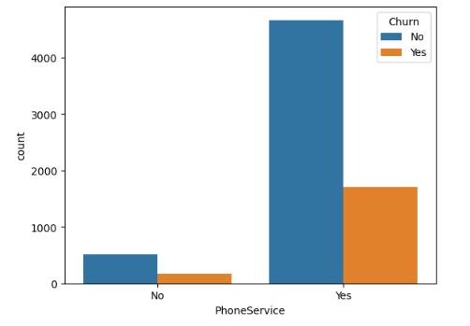
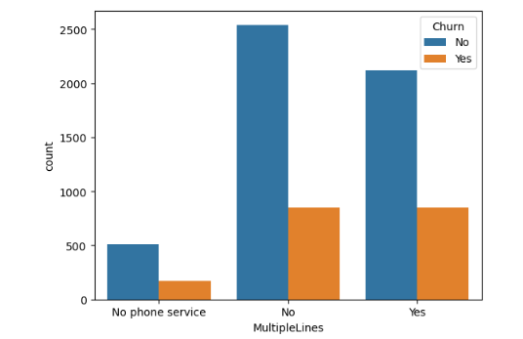

Slide 12
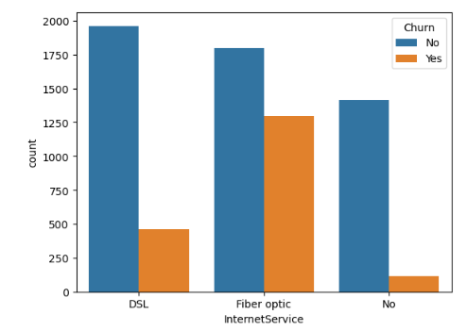
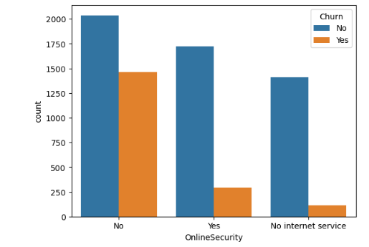
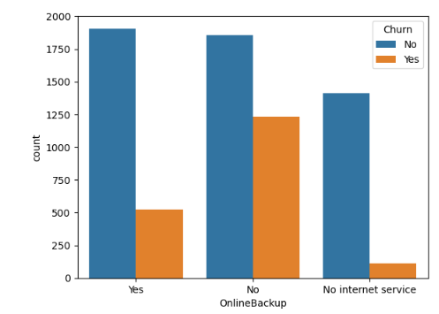
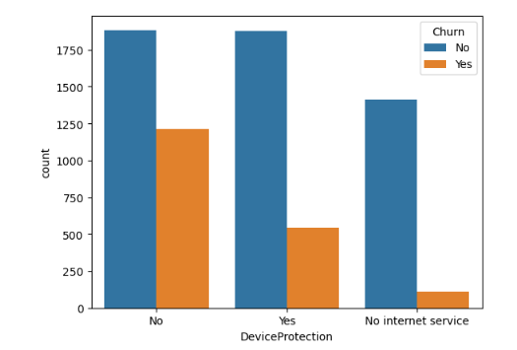
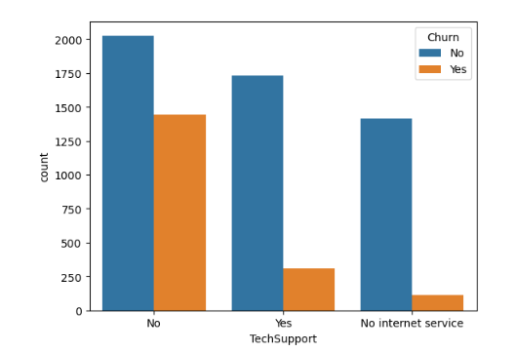
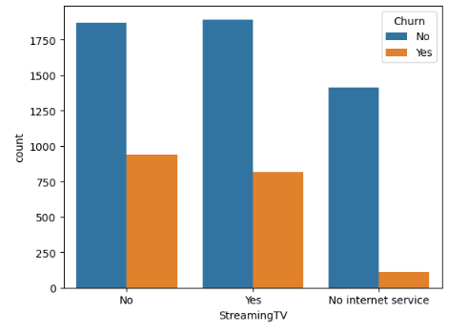

Slide 13
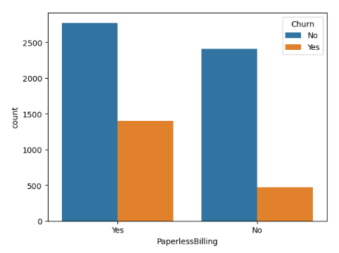
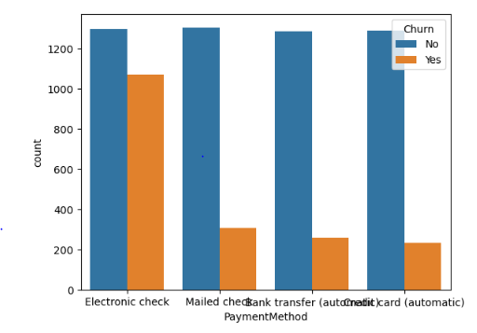
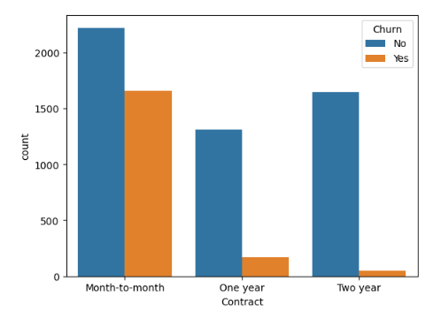
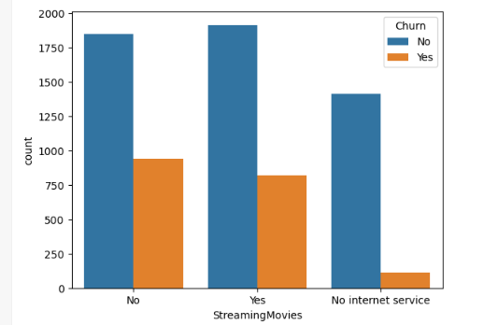

Slide 14
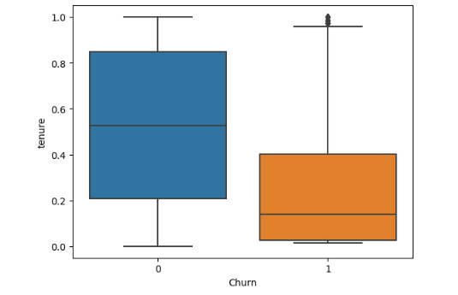
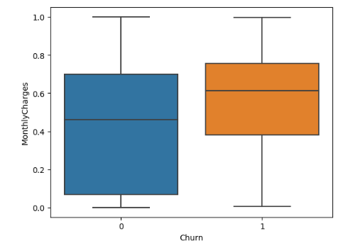
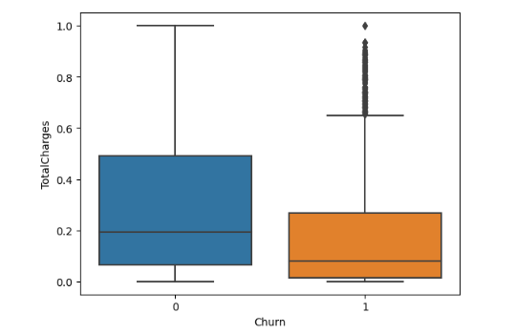
Seaborn
BoxPlot :
continoues = ['tenure','MonthlyCharges','TotalCharges']

Slide 15
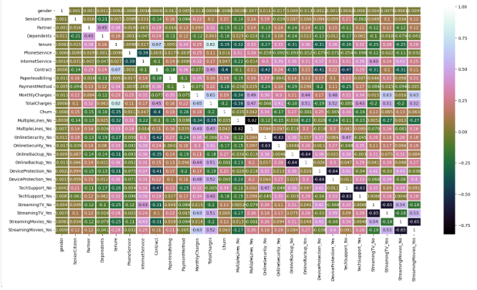
HeatMap
We use
heat map for finding the correlation between all the variables

Slide 16
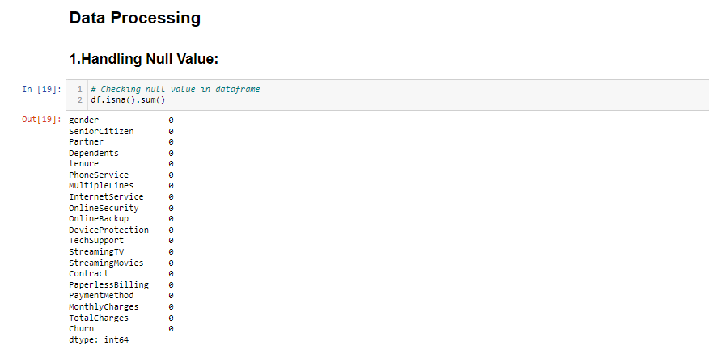
Exploratory Data Analysis:
In our data set there is no null value

Slide 17
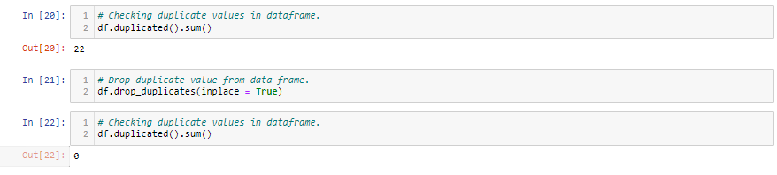
Drop duplicate value

Slide 18
Feature Engineering
For Converting categorical variables into numerical format. We use Label encoding and One Hot coding(Dummification)
Label Encoding :
We do label encoding with these variables are as follows: -
(Partner, Dependents, Phone Service, Paperless Billing, Churn, Gender, Contract, Payment method, Internet Service)
One Hot Coding :
We do One Hot coding encoding with these variables are as follows: -
(Multiple Lines,Online Security,Online, Backup,Device Protection, Tech Support, Streaming TV, Streaming Movies)
Feature Scaling (Normalization):
Normalization is a scaling technique in which values are shifted and rescaled so that they end up ranging between 0 and 1

Slide 19
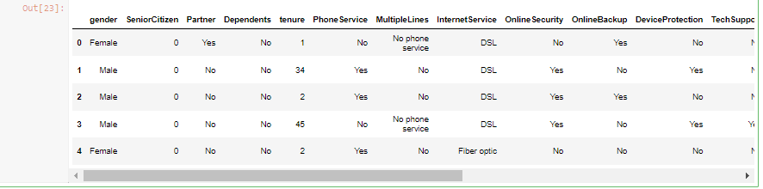
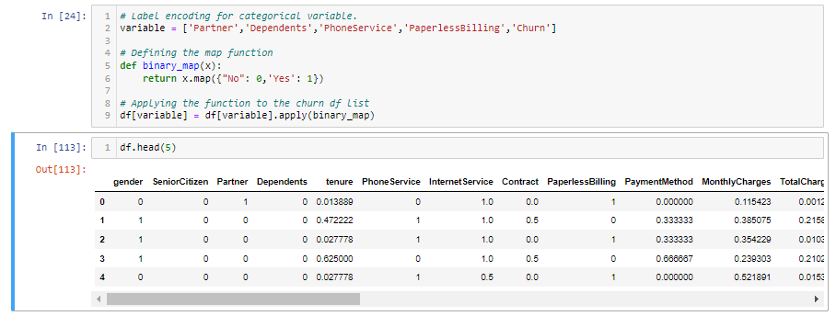
Label Encoding

Slide 20
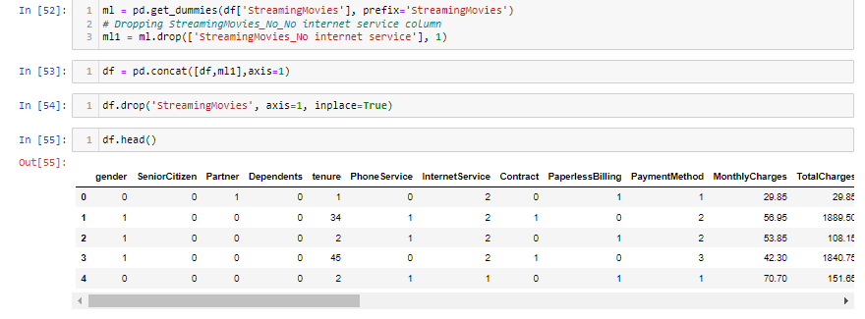
One Hot coding

Slide 21
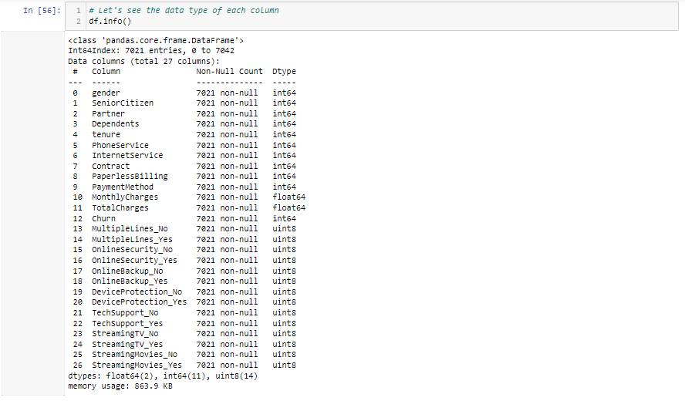
After the label encoding & one hot coding over variable converted into the (int,float,unit8)

Slide 22
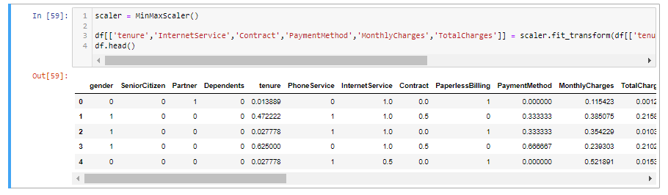
Feature Scaling (Normalization)
In below we are converted higher value into the range Between 0 and 1. for example tenure,InternetService,Contract,PaymentMethod,MonthlyCharges,TotalCharges.

Slide 23
Machine Learning Models
Logistic Regression
Decision Tree
Random Forest
K Neighbors Classifier
Support Vector Machine
Navie Bayes

Slide 24
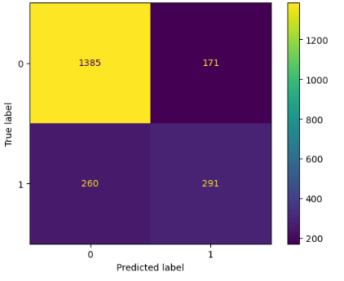
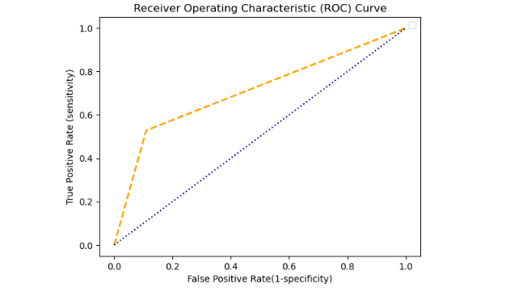
Logistic Regression
Library used : sklearn.linear_model (LogisticRegression)
Accuracy : 79.54%
Recall : 84%
Precision :89%

Slide 25
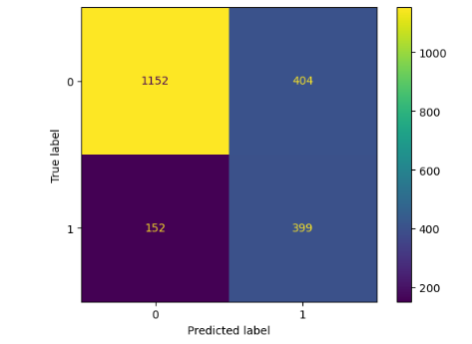
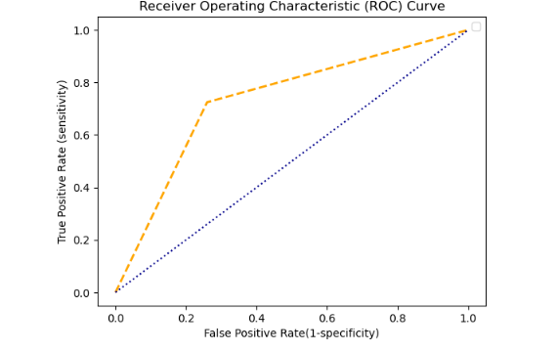
Navie Bayes
Library used : sklearn.linear_model (Gaussian NB)
Split used for training and testing the data : 70-30
Accuracy : 73.61%
Recall : 88%
Precision :74%

Slide 26
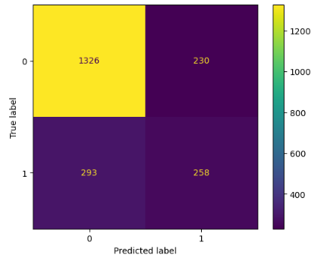
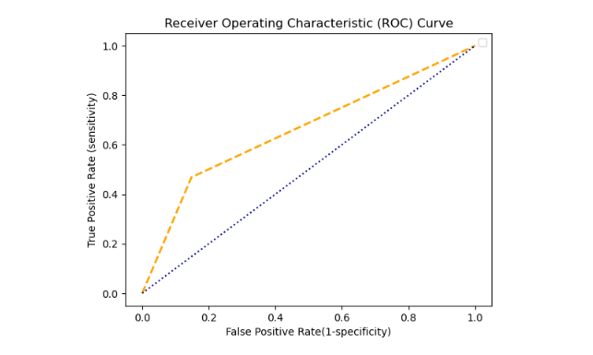
K-Neighbors
Library used : sklearn.neighbors (Kneighbors Classifier)
Split used for training and testing the data : 70-30
Accuracy : 75.17%
Recall : 81%
Precision: 85%

Slide 27
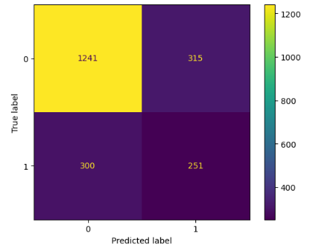
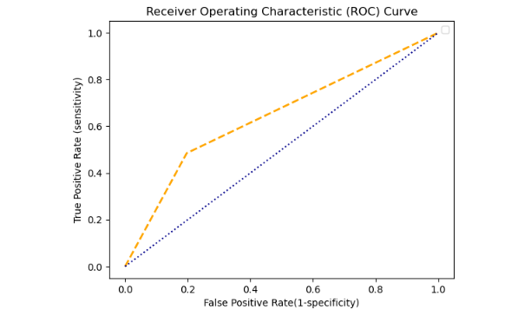
Decision Tree
Library used : sklearn.tree (DecisionTreeClassifier)
Split used for training and testing the data : 70-30
Accuracy : 71.99%
Recall : 81%
Precision : 80%

Slide 28
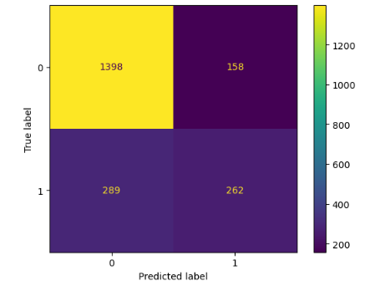
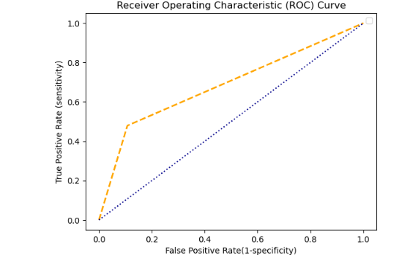
Random Forest
Library used : sklearn.ensemble (RandomForestClassifier)
Split used for training and testing the data : 70-30
Accuracy : 78.45%
Recall : 82%
Precision : 89%

Slide 29
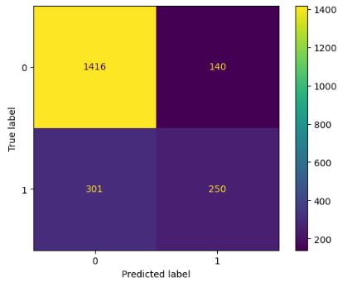
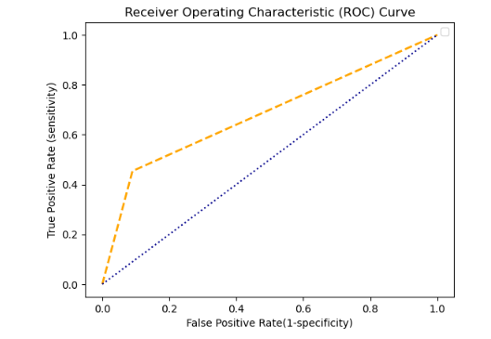
Support Vector Machine
Library used : sklearn.svm (SVC)
Split used for training and testing the data : 70-30
Kernel = ‘rbf’ , c = 1, gamma = 10
Accuracy : 79.06%
Recall : 82%
Precision : 91%

Slide 30
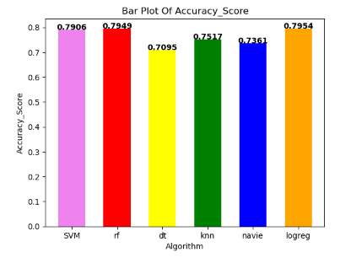
Accuracy Comparison
In Classification all the above model we are getting highest accuracy in Logistic Regression i.e. 79.54%

Slide 31
THANK YOU

