Slide 1
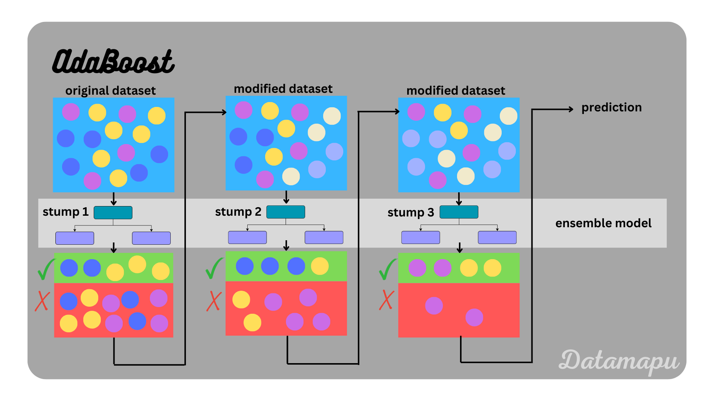
AdaBoost - Overview
Insert image 1 for AdaBoost here

Slide 2
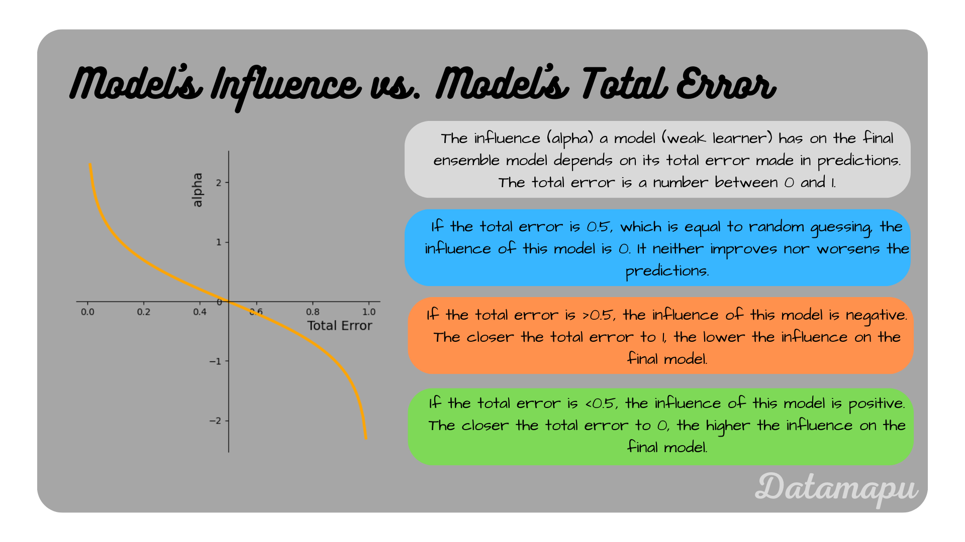
AdaBoost – Model’s Influence vs Model’s Total Error
Insert image 2 for AdaBoost here

Slide 3
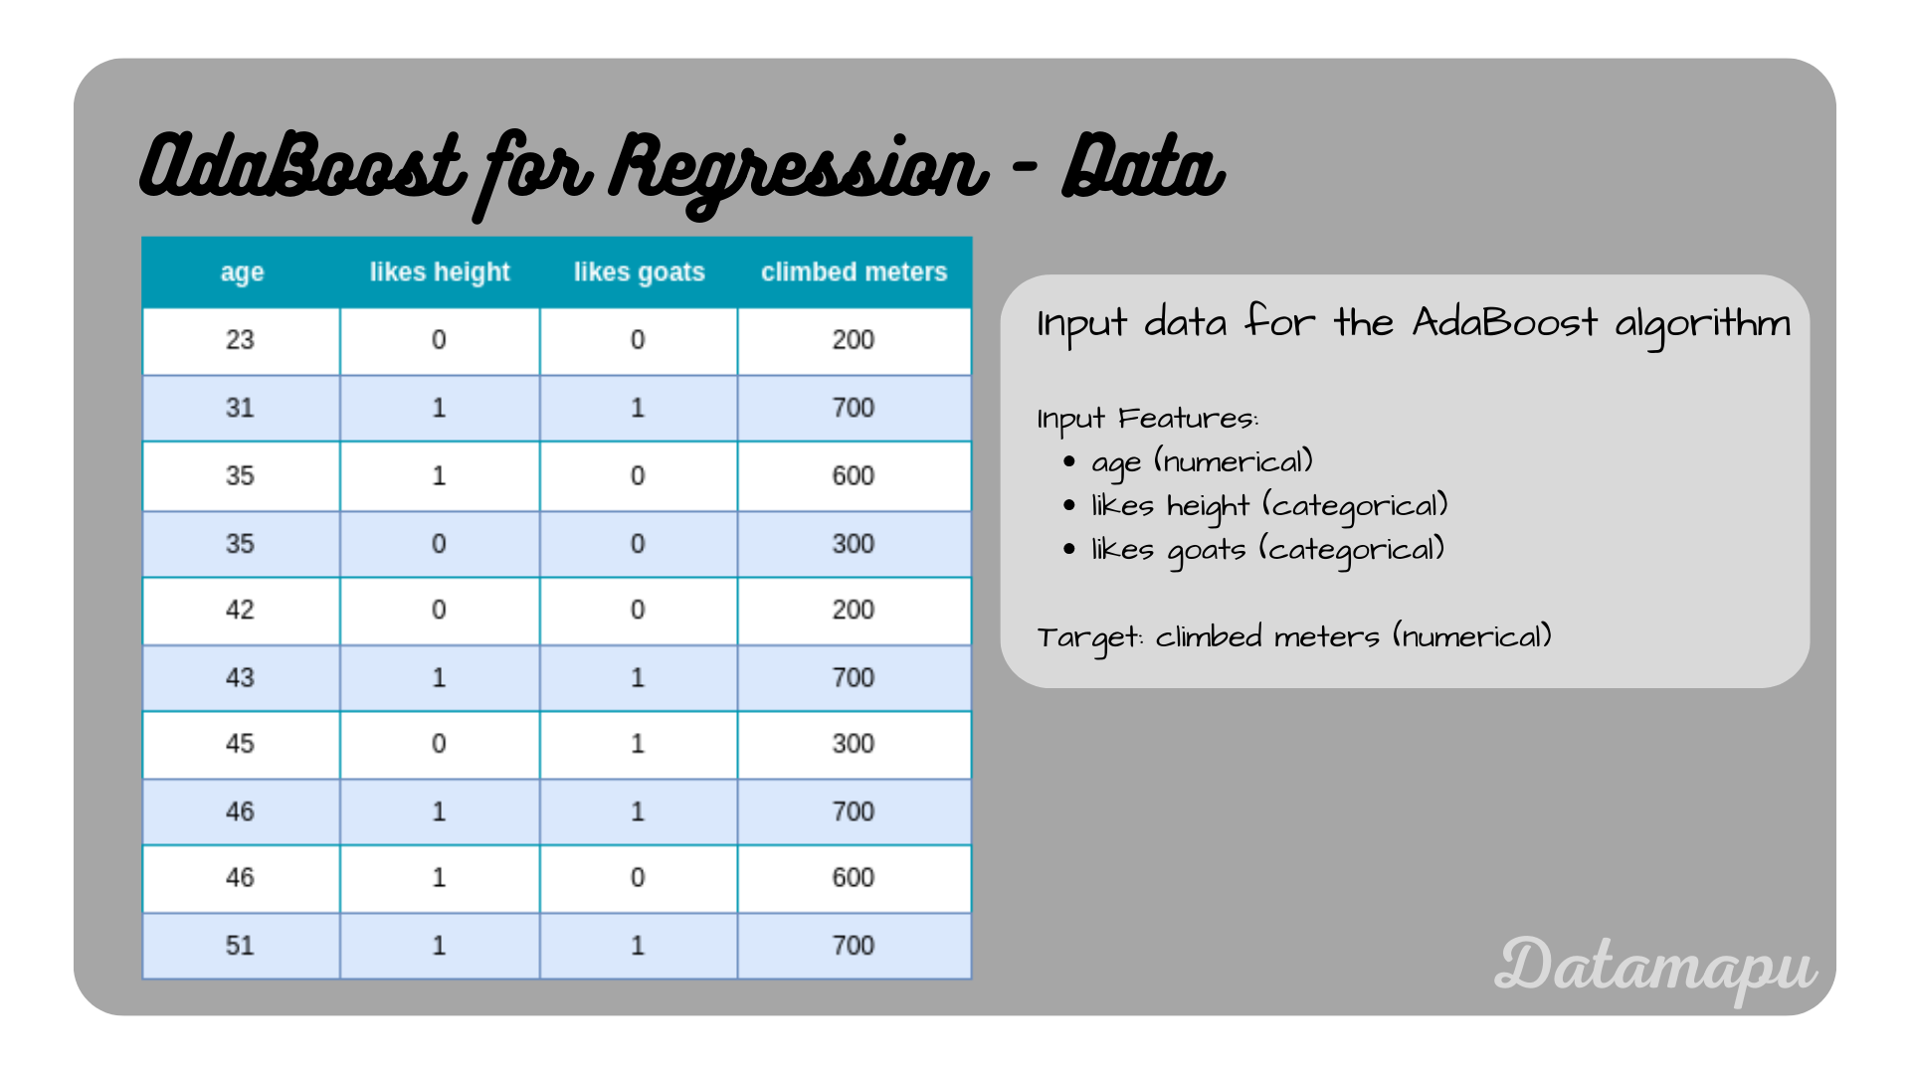
AdaBoost – Regression Dataset
Insert image 3 for AdaBoost here

Slide 4
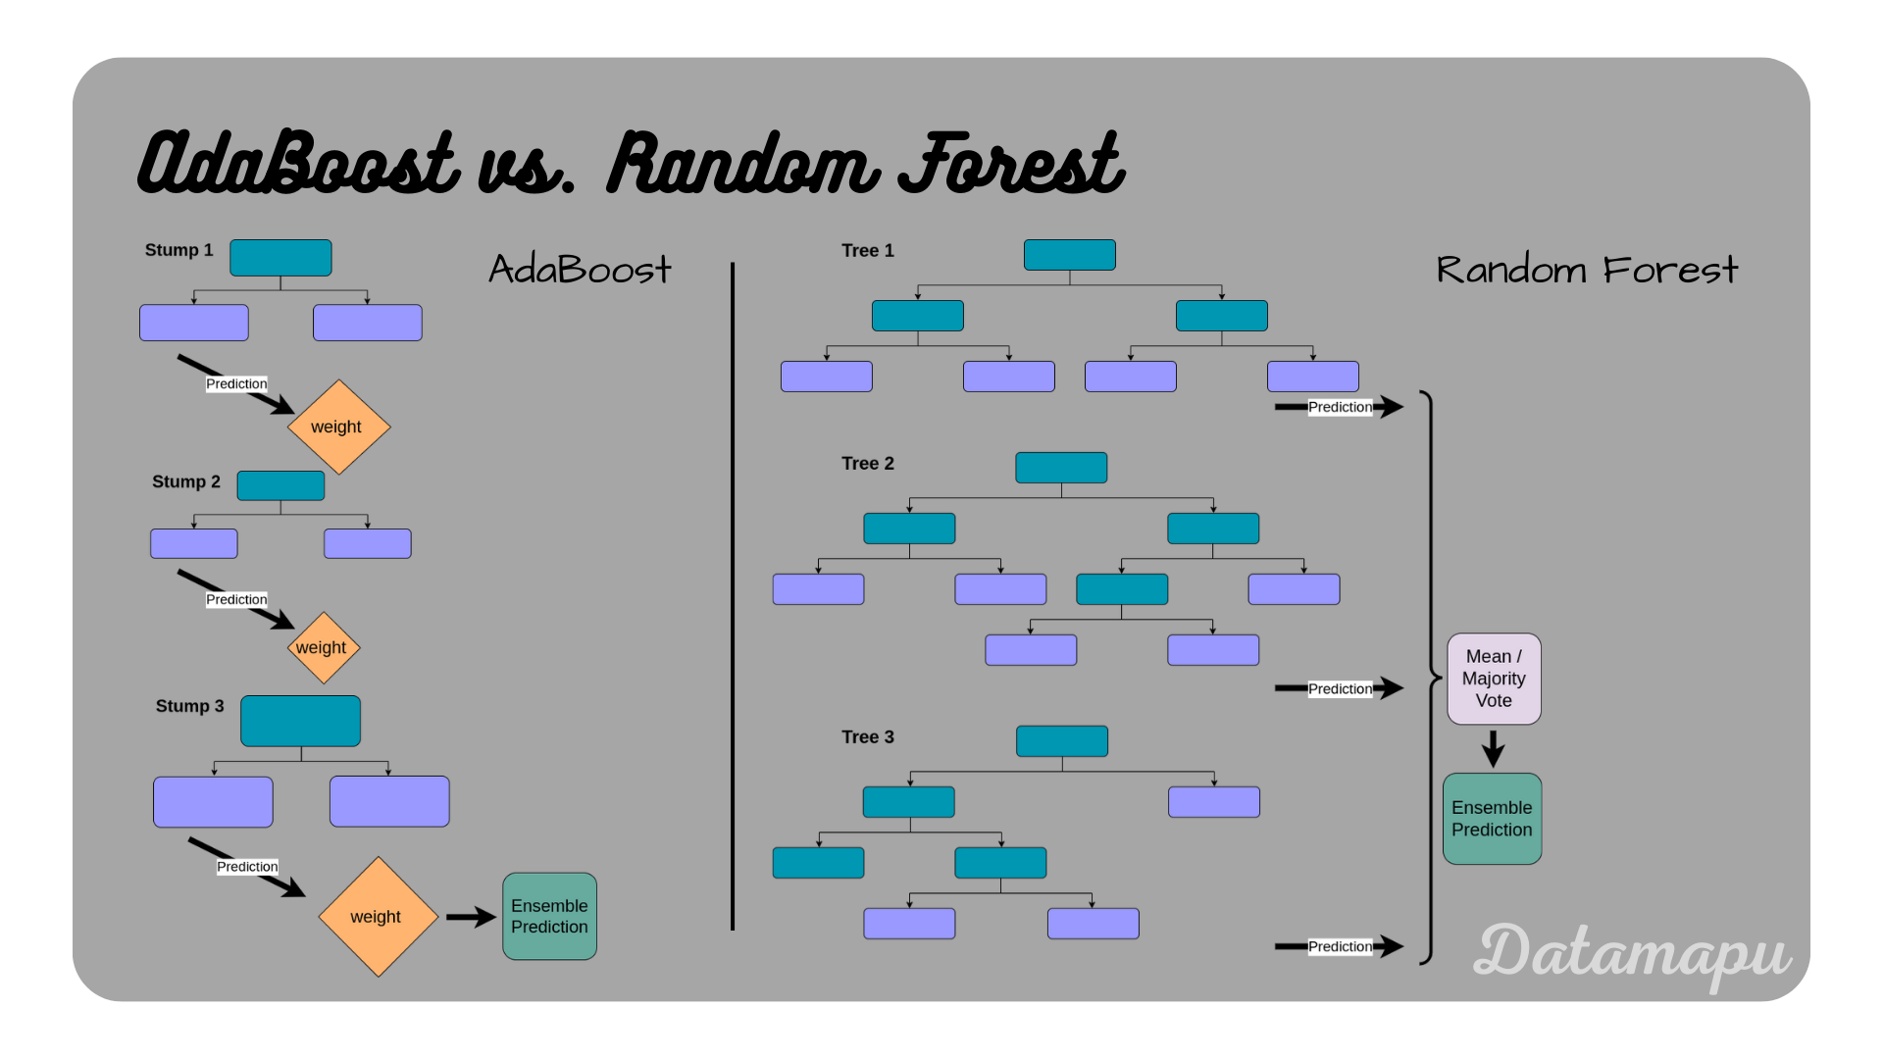
AdaBoost vs Random Forest
Insert image 4 for AdaBoost here

Slide 5
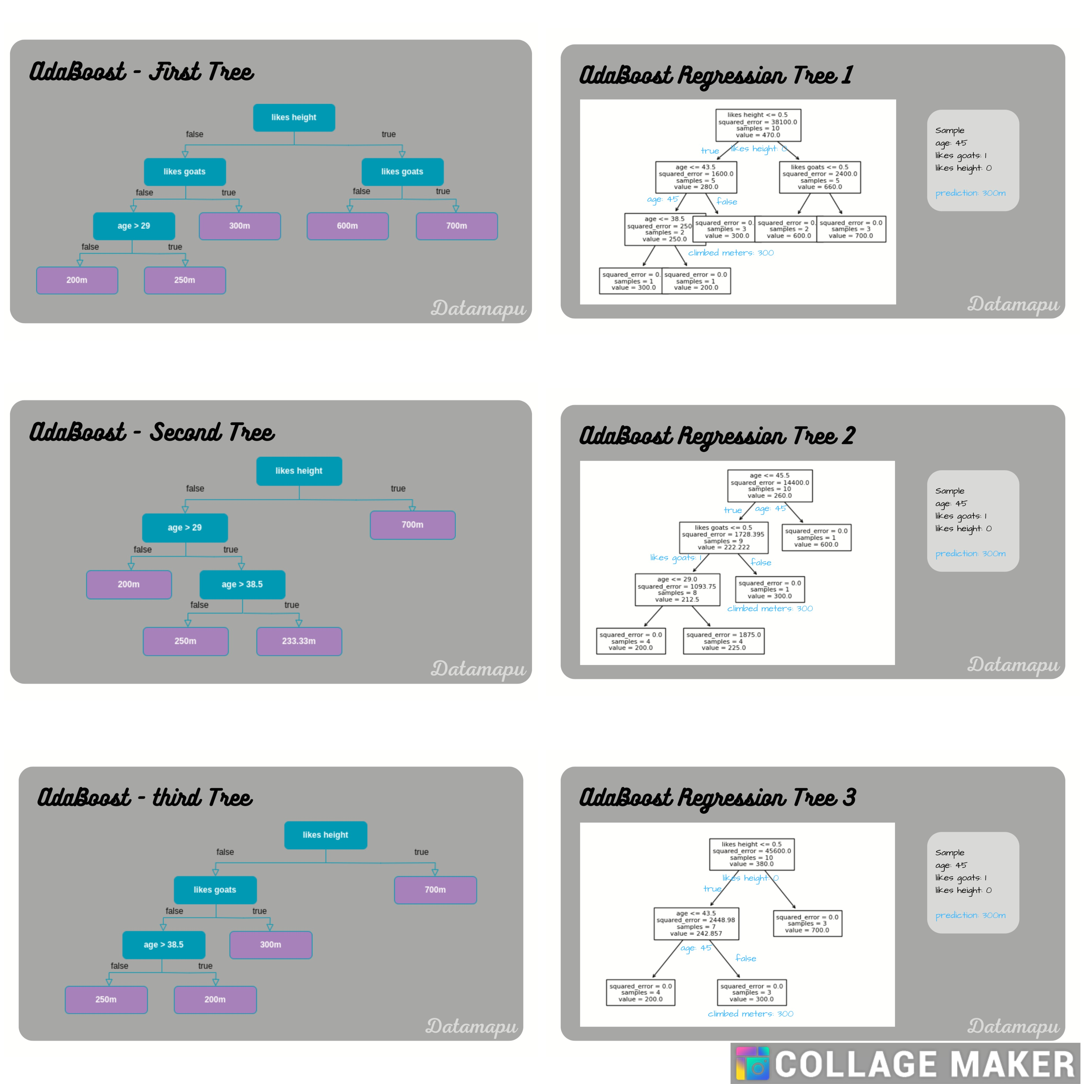
AdaBoost - Trees

Slide 6
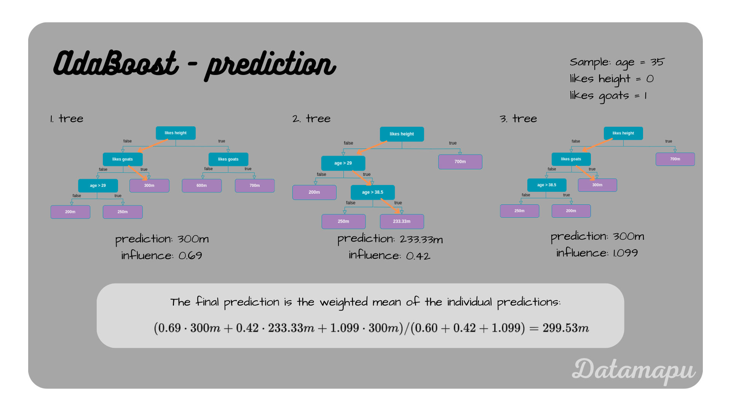
AdaBoost - Trees

Slide 7
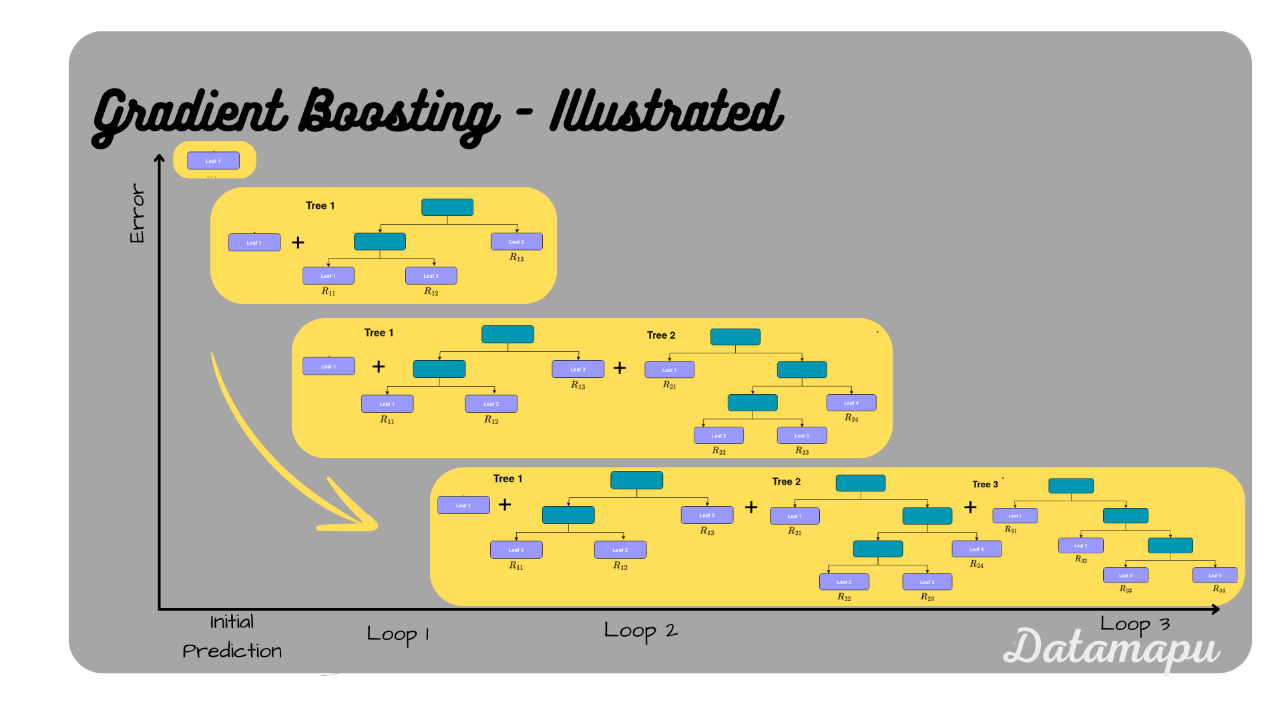
XGBoost

Slide 8
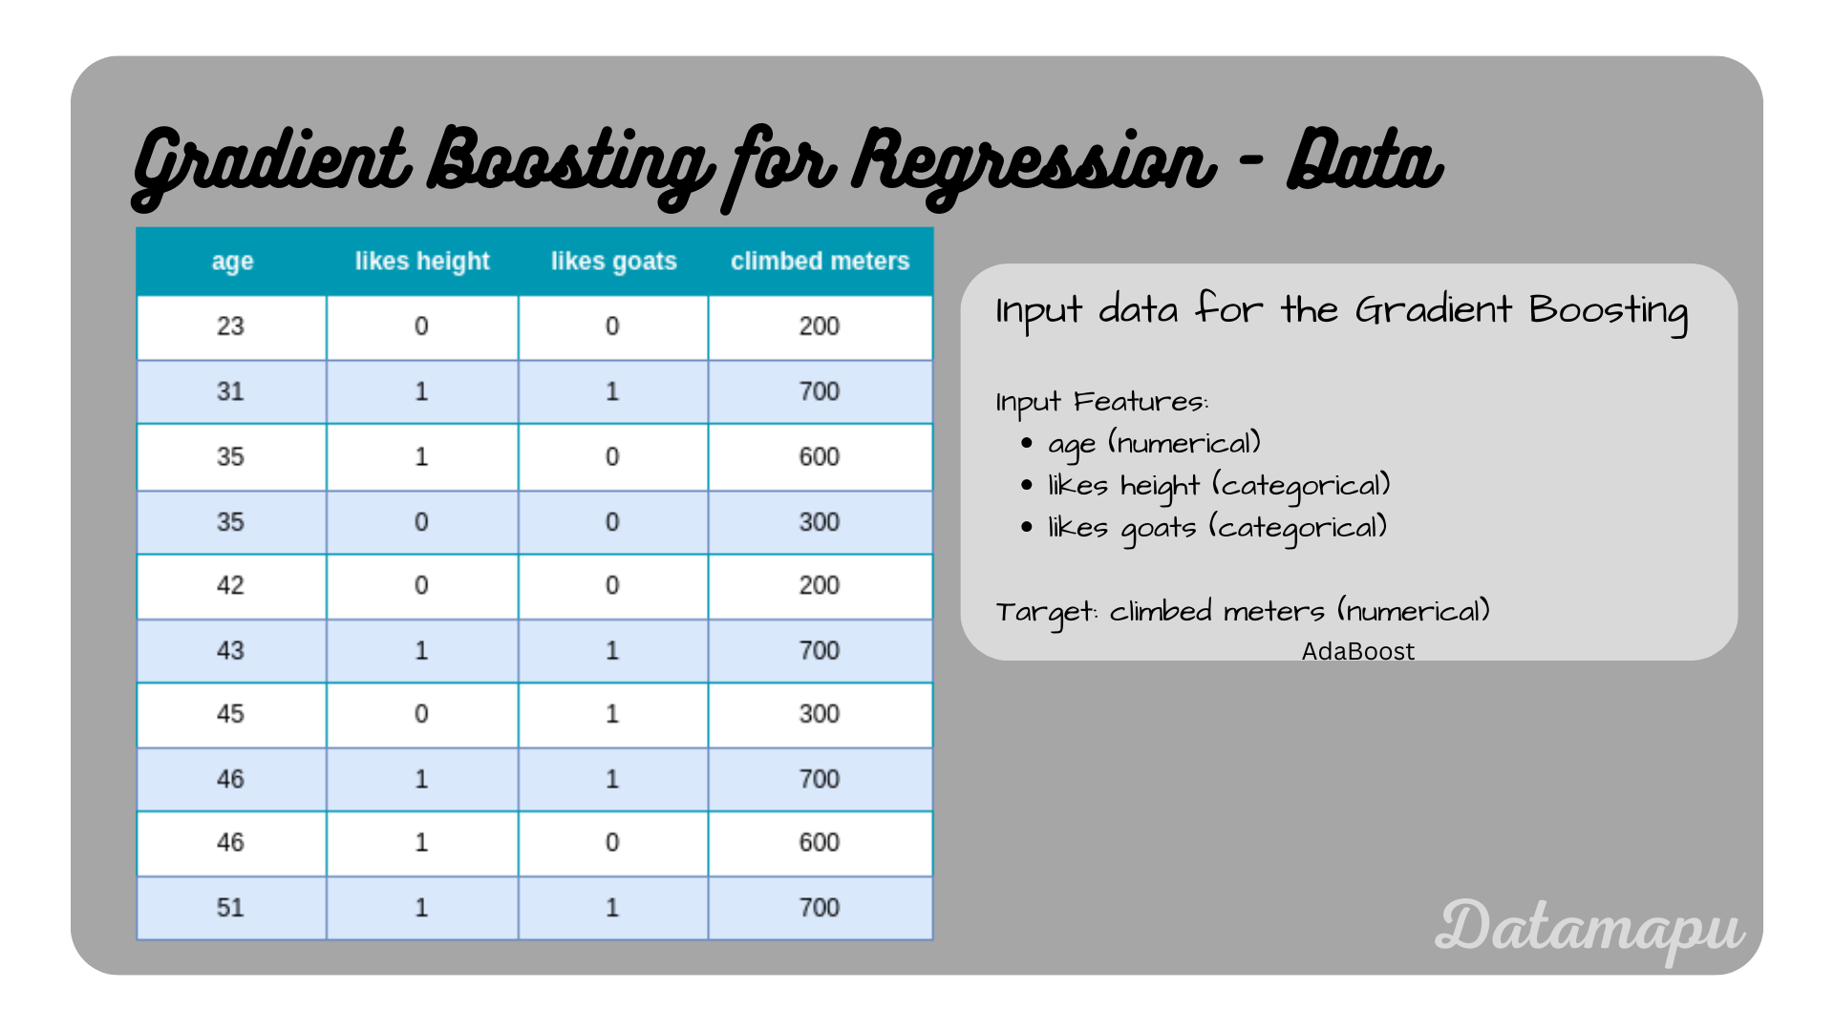
XGBoost – Regression Dataset

Slide 9
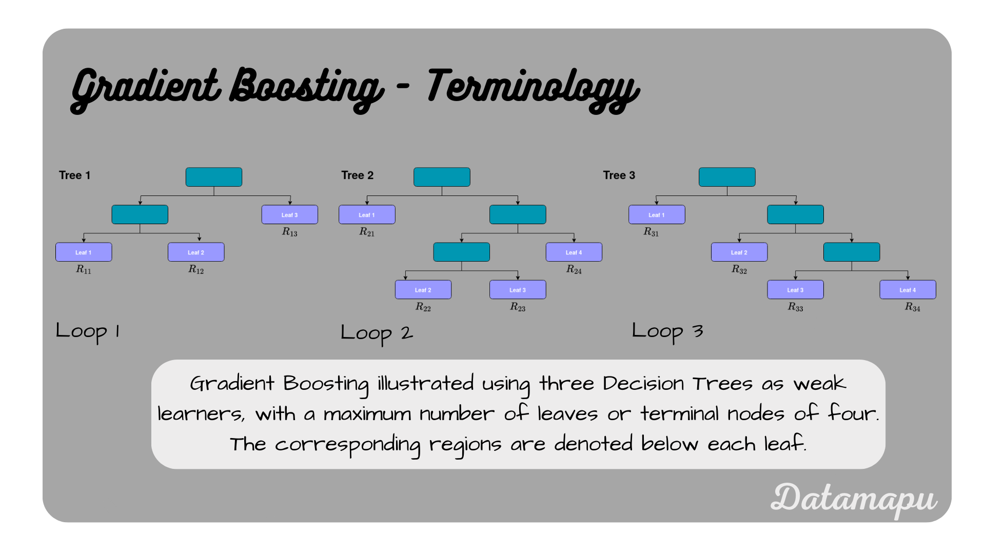
XGBoost - Terminology

Slide 10
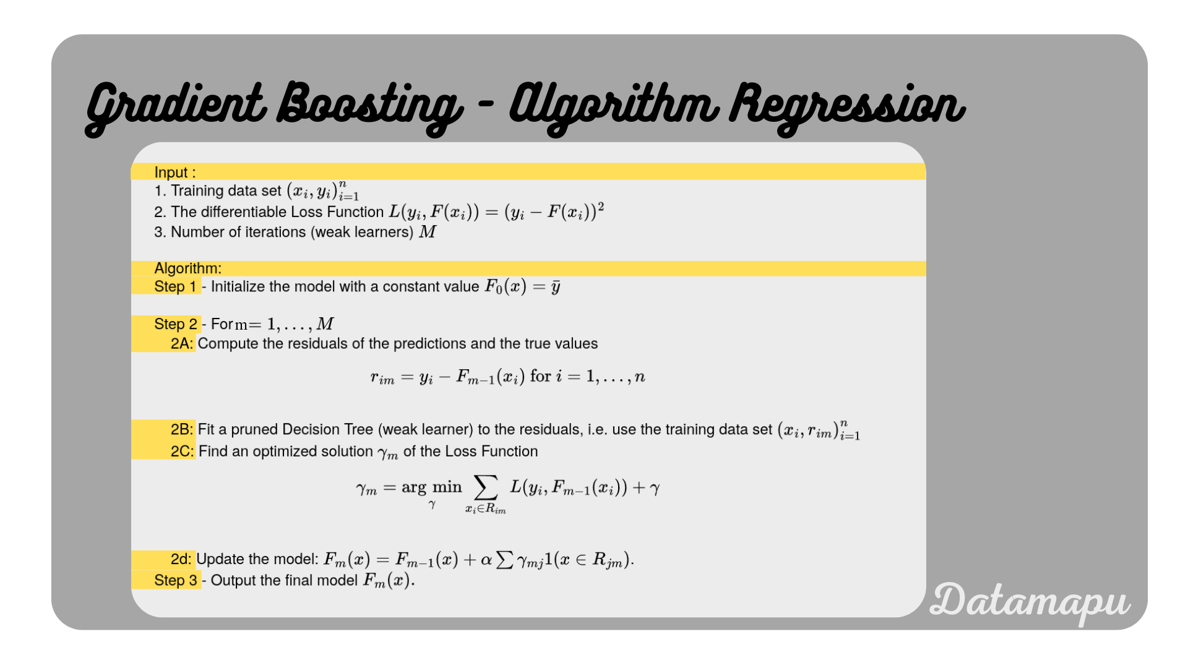
XGBoost - Algorithm

Slide 11
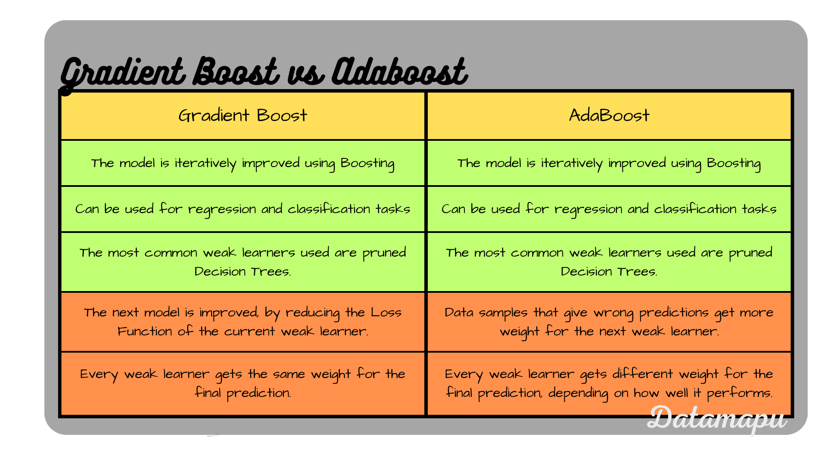
XGBoost Vs Ada Boost

Slide 12
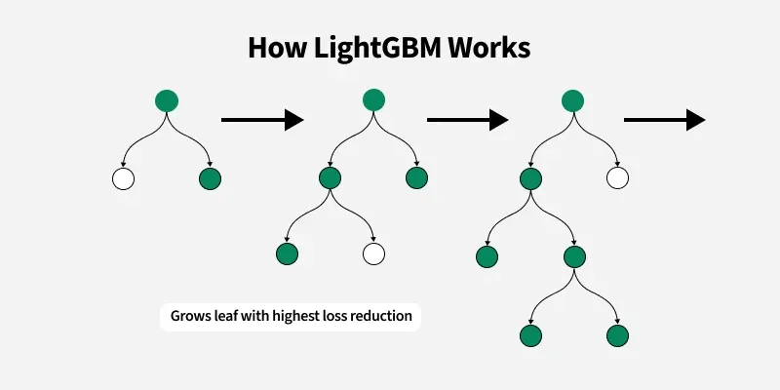
LG Boost – How it works

Slide 13
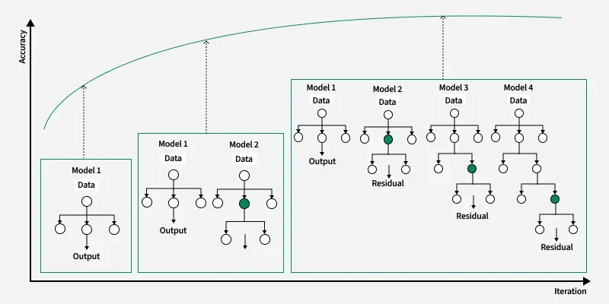
LightGBM - Iterations

Slide 14
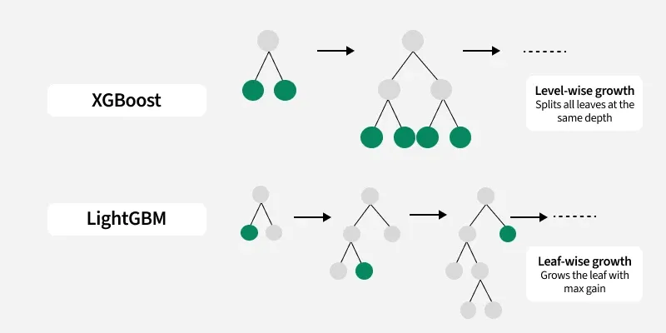
XG vs LG Boost

