Slide 1
How to install a web server (using Apache in XAMPP bundle)
- David Khachaturyan

Slide 2
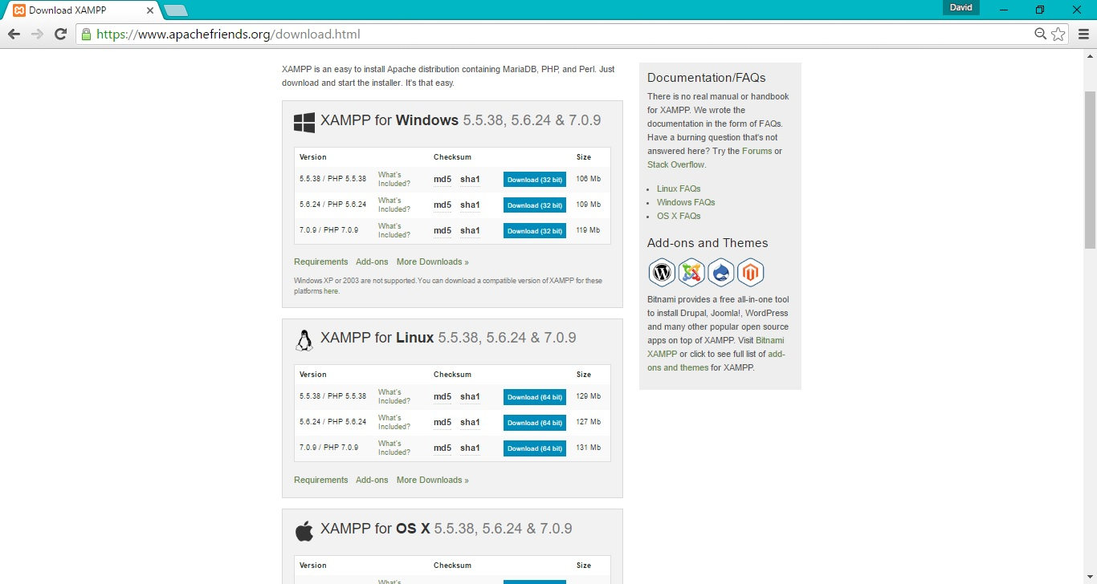
Installing XAMPP
XAMPP is available for Windows, Linux, Mac, OSX
Includes Apache, MySQL, Tomcat, and other modules

Slide 3
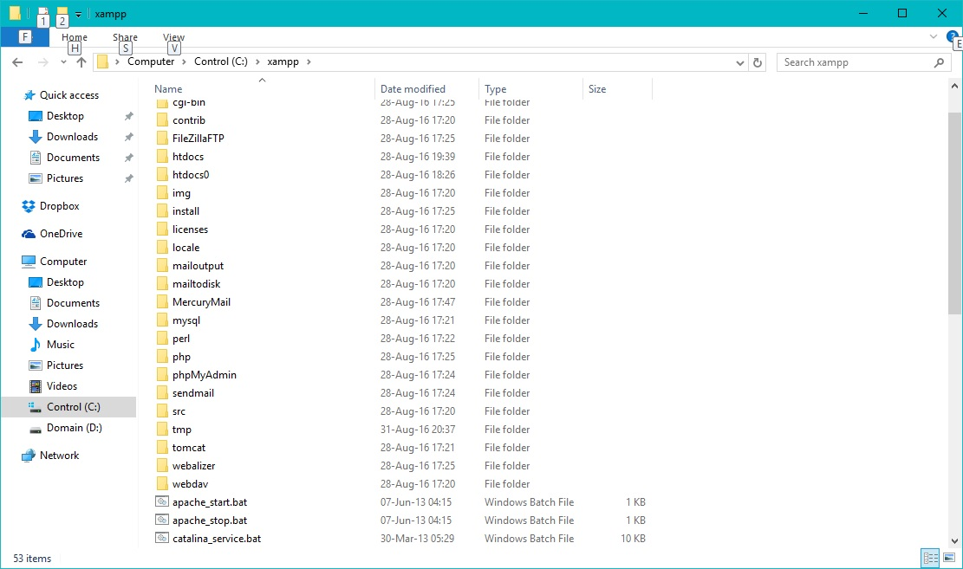
Installing XAMPP
By default installed in C:\xampp

Slide 4
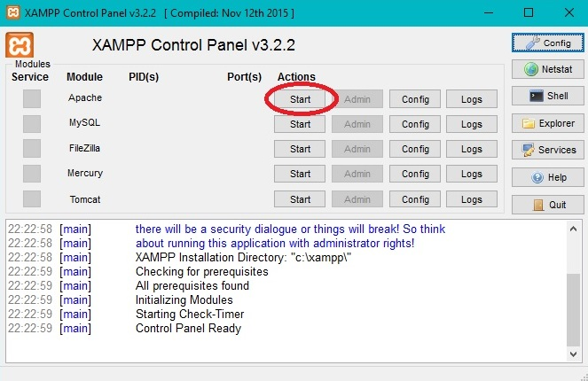
Starting Apache
You can start Apache from the Control Panel

Slide 5
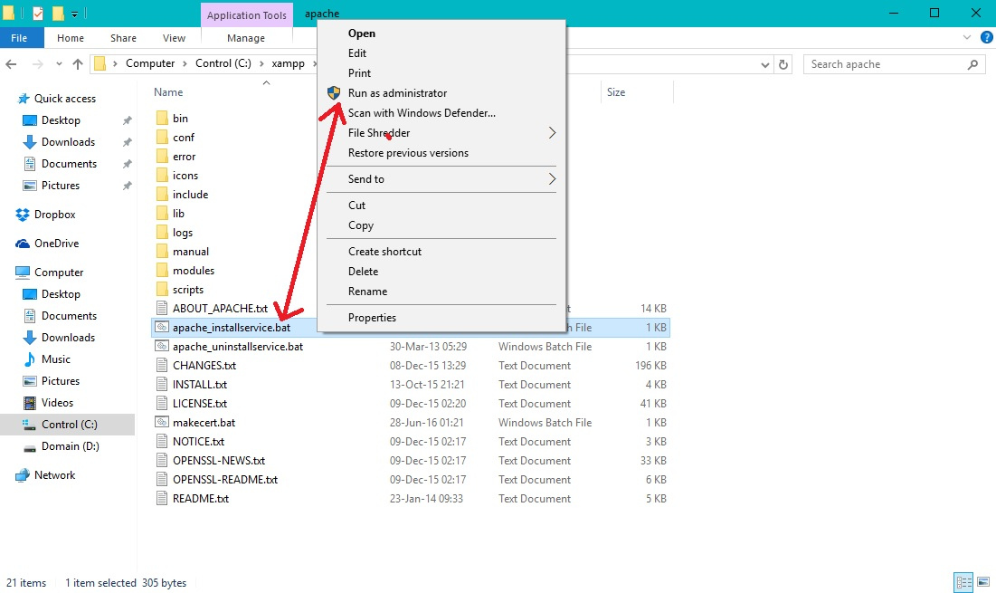
Starting Apache
Or, you can run Apache as a standalone service
Make sure to Run As Administrator (on Windows 10)

Slide 6
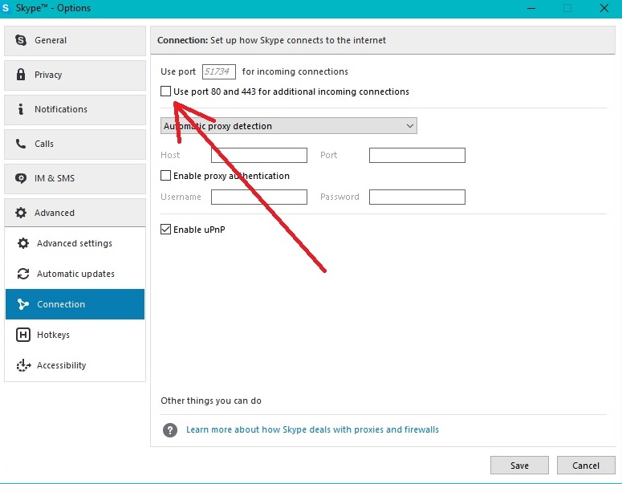
Configuring XAMPP
Possible conflict with Skype
Easiest fix – stop Skype from using ports 80 & 443
Skype –> Options –> Advanced –> Connection –> Uncheck “Use ports 80 & 443”

Slide 7
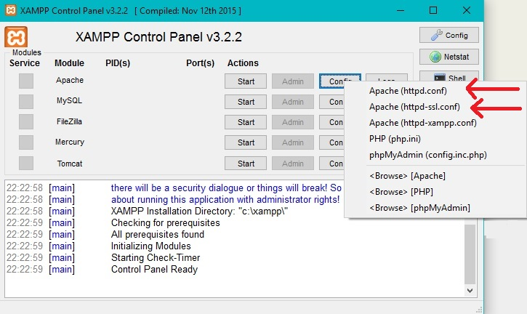
Configuring XAMPP
You can also fix the conflict from Apache side
Edit two Apache config files – httpd.con, and httpd-ssl.conf

Slide 8
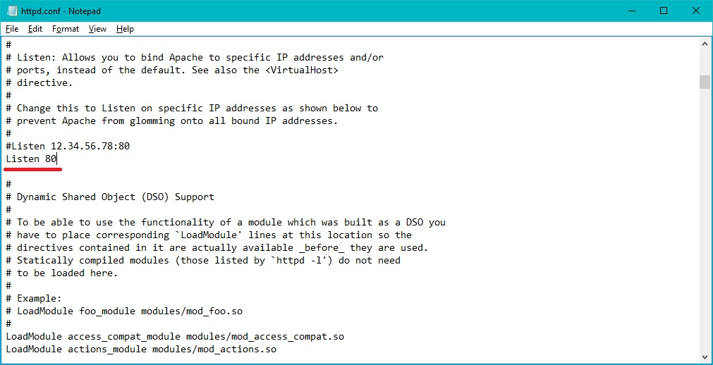
Configuring XAMPP
httpd.conf – search for “80”
Change to 81 or another arbitrary port (two instances)
httpd-ssl.conf - search for “443”
Change to 4433 or another arbitrary port (three instances)

Slide 9
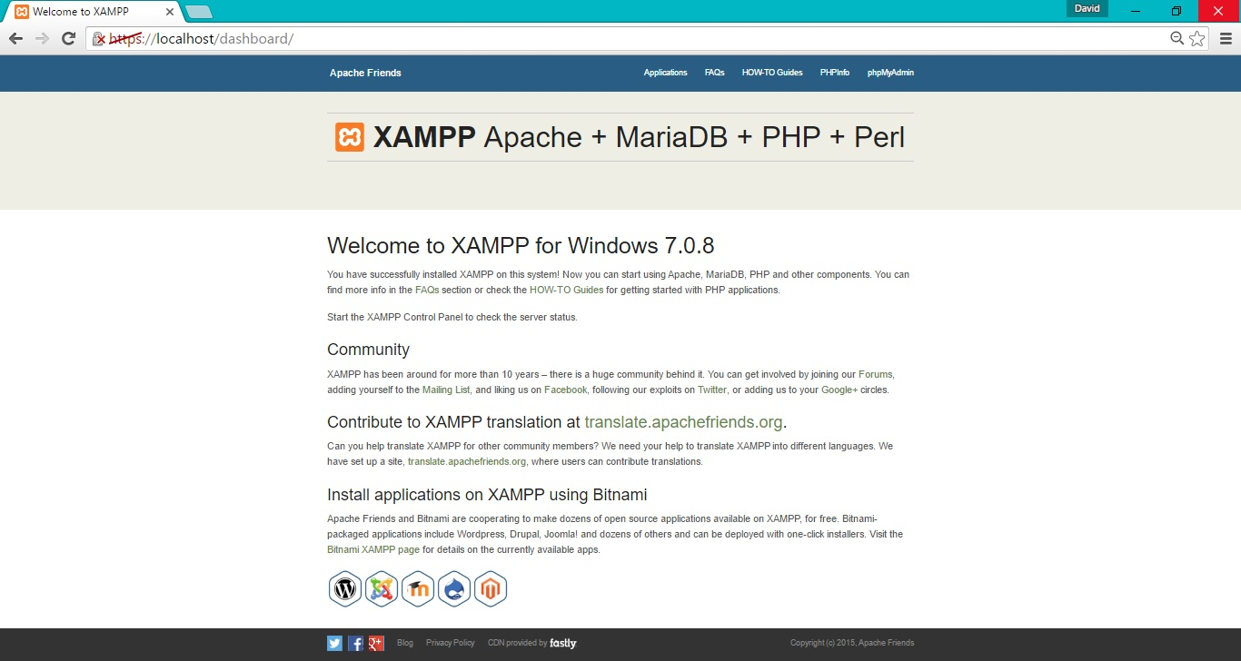
Testing your connection
localhost, or https://localhost will take you to the default webpage
You don’t need it, so delete/rename htdocs folder
Create empty htdocs folder for future web content

Slide 10
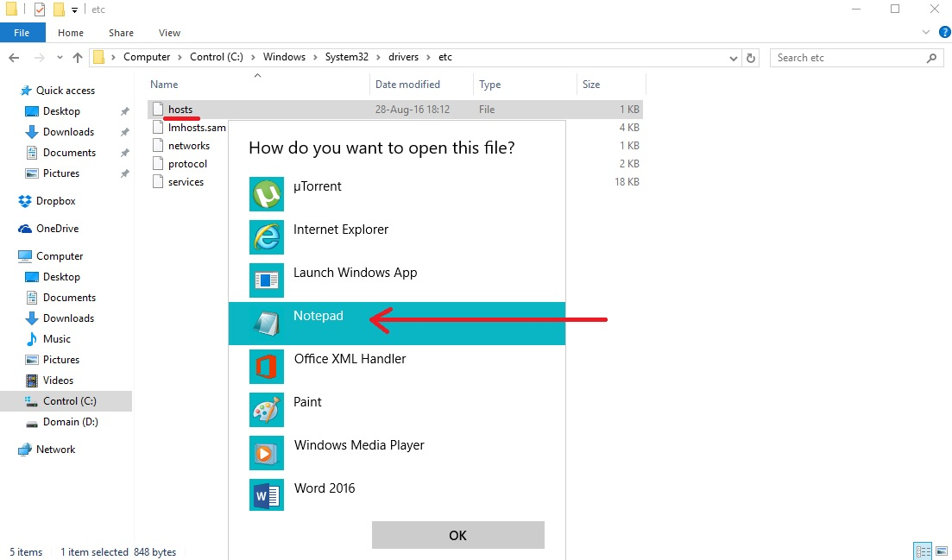
Using custom domain name
You need to edit two files
First is a Windows system file – “hosts”
C:\Windows\System32\drivers\etc
Open with Notepad

Slide 11
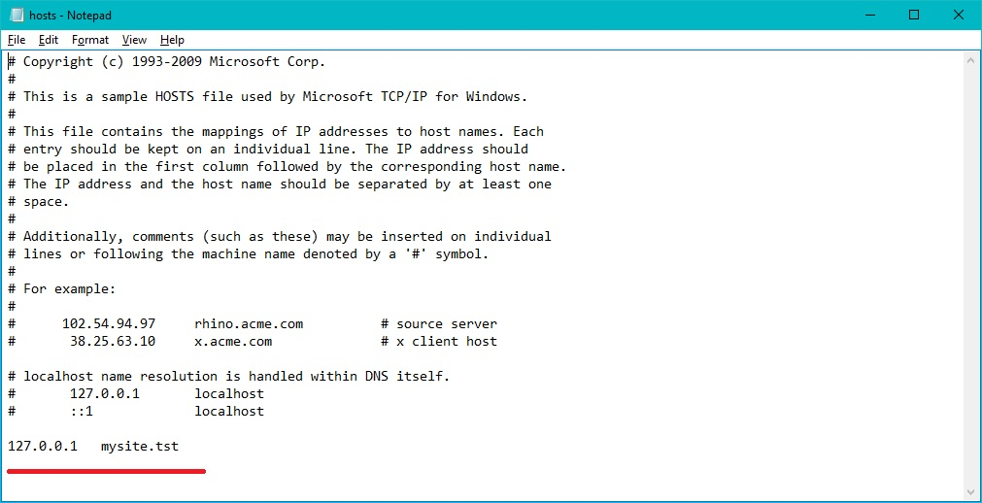
Using custom domain name
You need to edit two files
First is a Windows system file – “hosts”
C:\Windows\System32\drivers\etc
Open with Notepad
Add “127.0.0.1 mysite.tst” to the end of the file

Slide 12
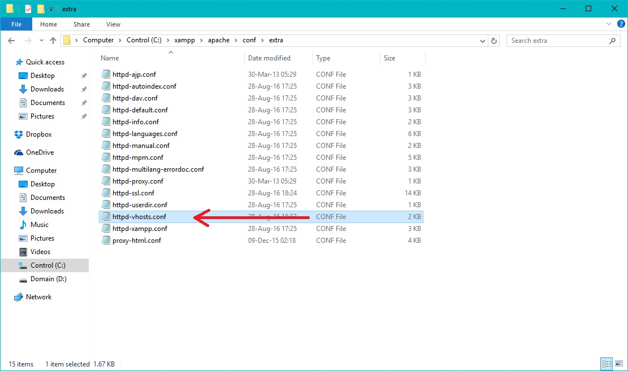
Using custom domain name
You need to edit two files
Second is an Apache config file – httpd-vhosts.conf
C:\xampp\apache\conf\extra

Slide 13
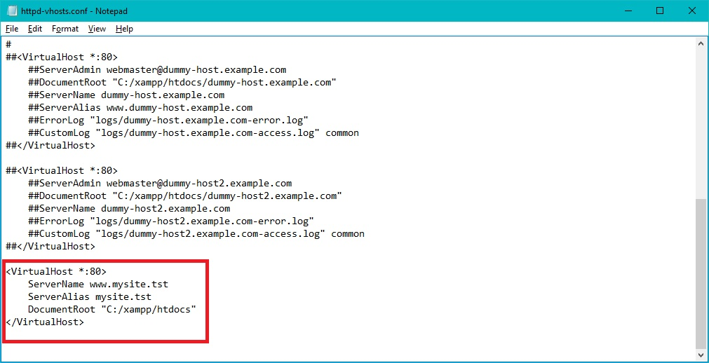
Using custom domain name
You need to edit two files
Second is an Apache config file – httpd-vhosts.conf
C:\xampp\apache\conf\extra
Add following text to the end of the file
<VirtualHost *:80>
ServerName www.mysite.tst
ServerAlias mysite.tst
DocumentRoot "C:/xampp/htdocs"
</VirtualHost>

Slide 14
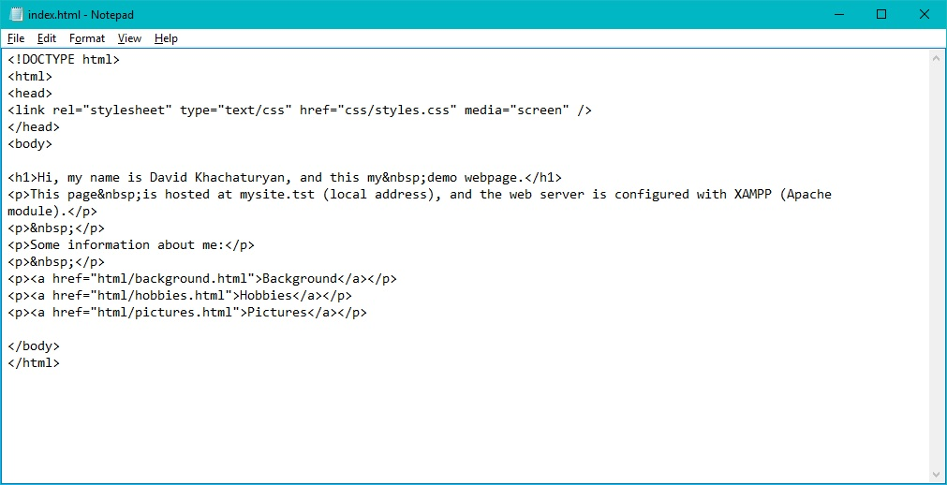
Creating website directory structure
index.html – website homepage, loads when you enter website domain name in your browser

Slide 15
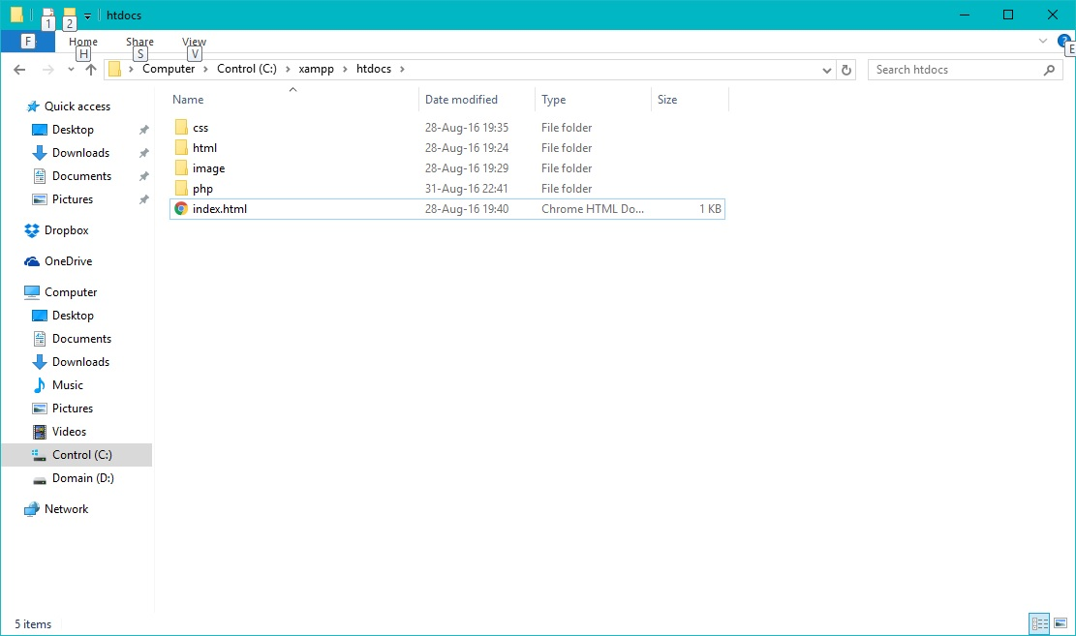
Creating website directory structure
index.html – website homepage, loads when you enter website domain name in your browser
html – folder for html pages
css – folder for Cascading Style Sheets
image – folder for image files
php – folder for PHP code (if you plan on using it)
etc

