Slide 1
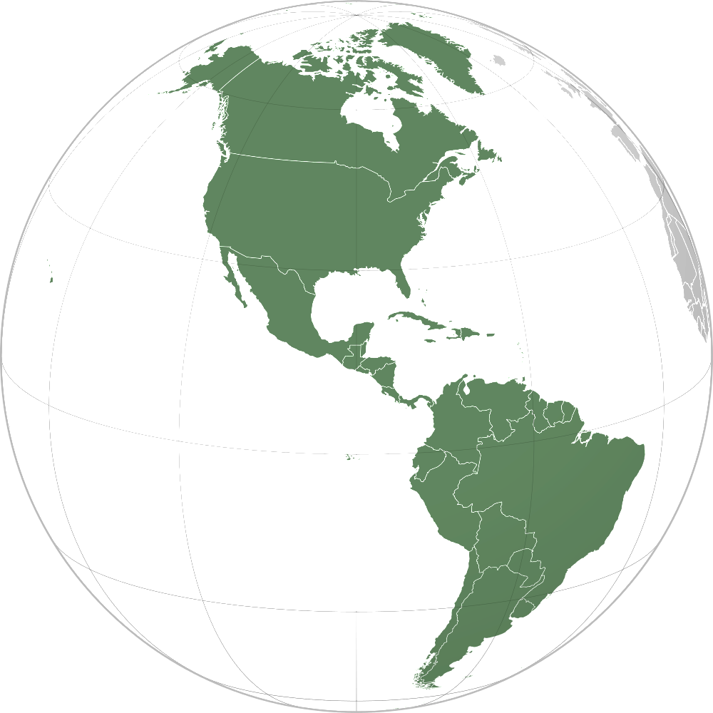

ANALYSIS REPORT GKN Americas Region
Report Title: | FEA for female tulip plug pocket roundness
CAE Request N°: | Date: | Pages: | Enclosures:
#40744 | 5 / APRIL / 2018 | 1 / 6
Identification: | Customer: | Project Name: | Project Number:
 | Honda | ILX plug | DCVJHON
Related Documents: | --
Summary: | Applied Torque = 5000 Nm (10 increments) Contact region for tulip’s tracks & external surface of the rolls
Purpose:
Procedure: | Pre-Processor: Creo Parametric; Simlab; Marc Mentat Processor: Marc Mentat Post-Processor: Marc Mentat; VCollab
Parts: | Models provided: 10323252
Conclusions: | Page 6 presents the stress results after the application of the load. It can be seen that the critical region of the stub is the spline (1050 MPa) followed by the neck radius (700 MPa). FEA results show that none stress value after the 5000Nm application reach the yield limit even in no regions with no heat treatment (as in the plug pocket).
Recommendations: | Validate results and behavior of the tulip obtained from FEA with experimental tests.
Prepared by: | Daniel Angmen
Requested by: | David McCann
Security Rating: | Restricted
Distribution: | D. McCann

Slide 2
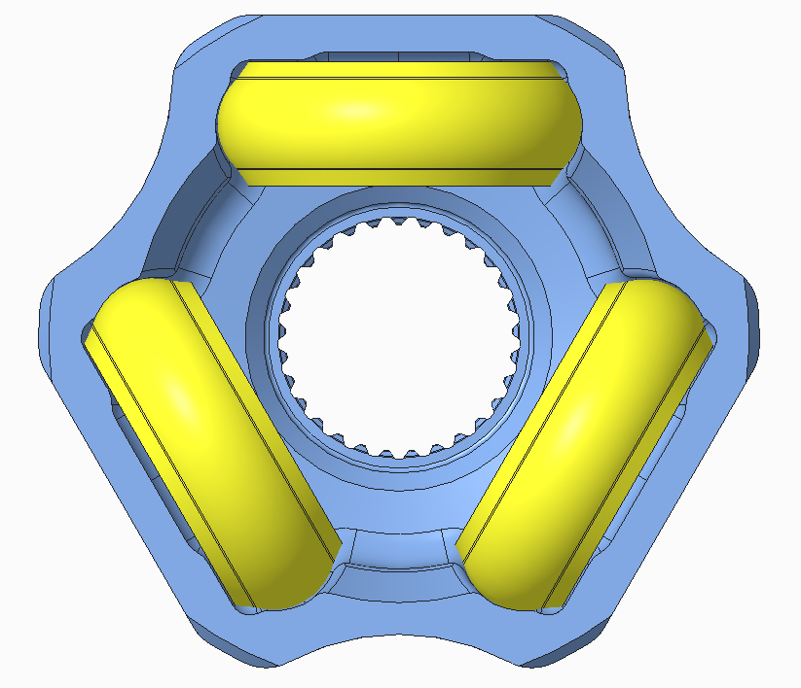
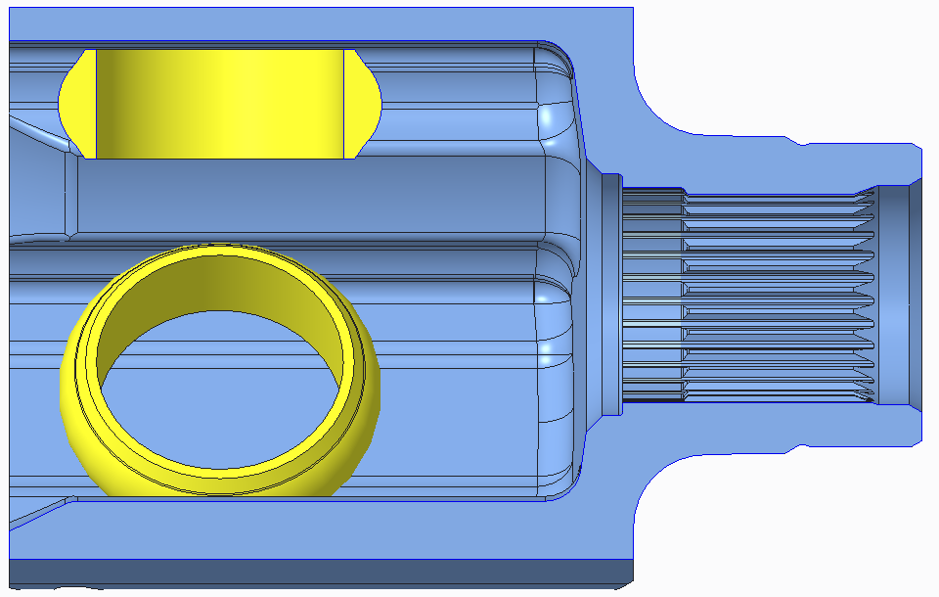
Problem Description
In the present analysis, 5000 Nm torque is applied on the stem of the Tulip 10323252. It is desired to check structural strength at the plug pocket roundness.
Region of interest:
Plug Pocket

Slide 3
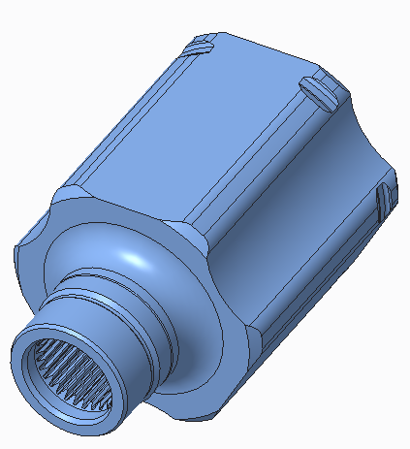
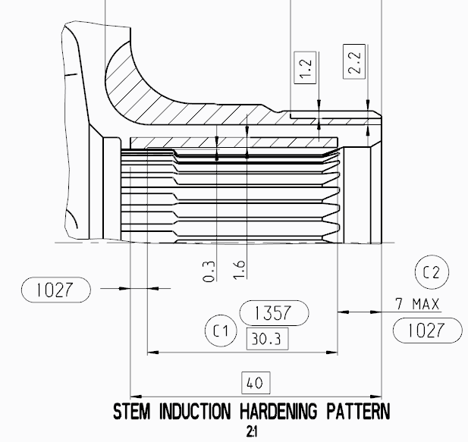

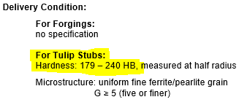




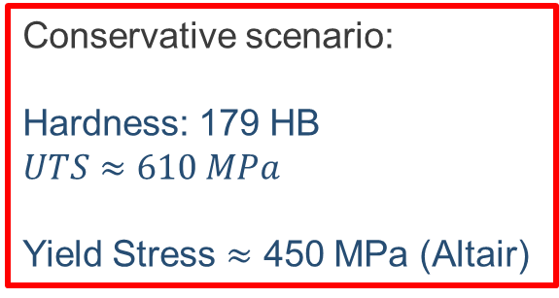
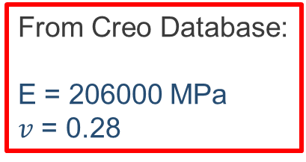
Material Properties
No heat treatment
Conservative scenario:
Hardness: 179 HB
$$UTS≈610 MPa$$
Yield Stress $≈$ 450 MPa (Altair)
From Creo Database:
E = 206000 MPa
$v$ = 0.28

Slide 4
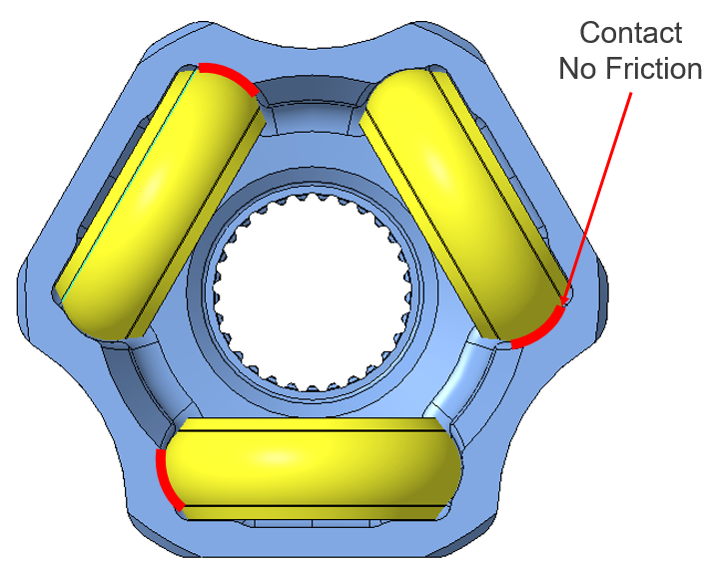
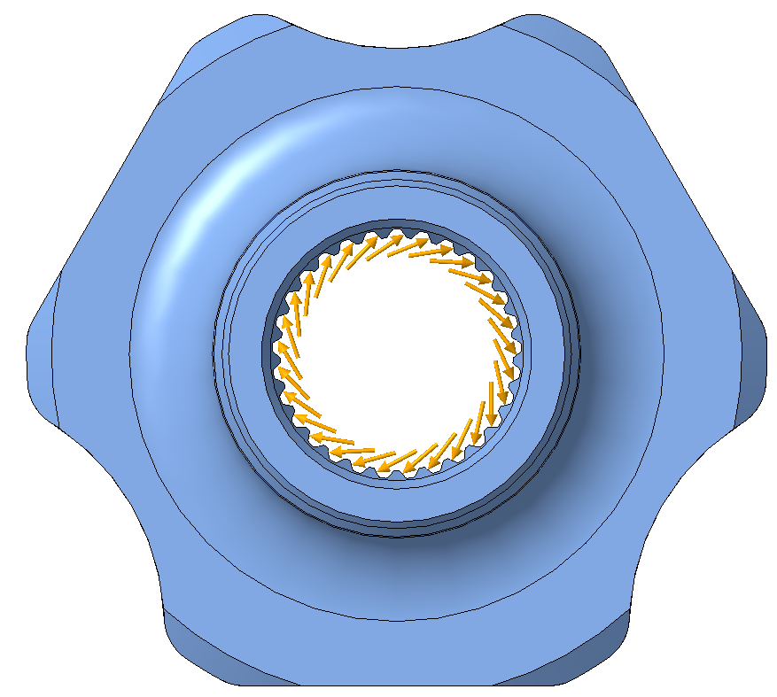
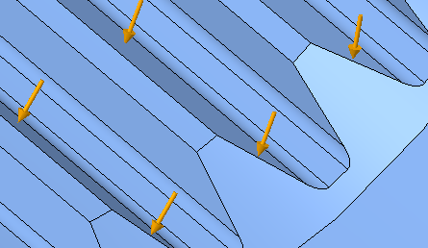
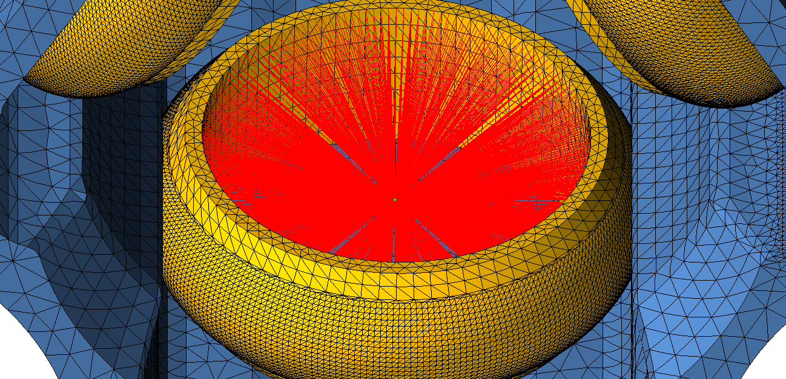
Boundary Conditions
Torque applied on teeth flanks
T = 5000 Nm
Rigid Link Constraint
ALLDOF = 0

Slide 5
FEA Results
Stresses & deflections

Slide 6

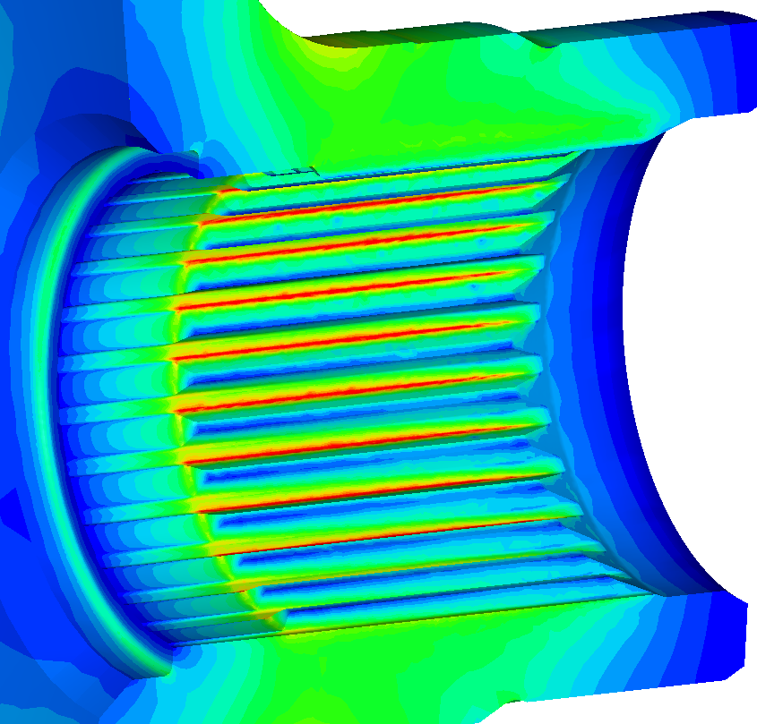
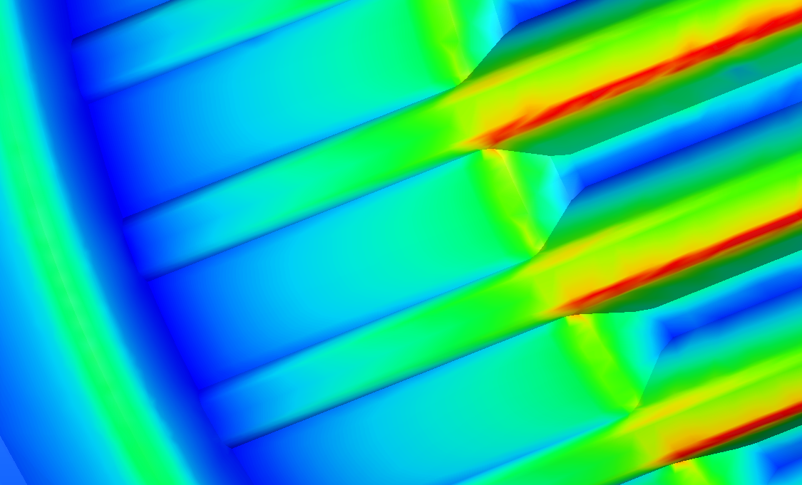
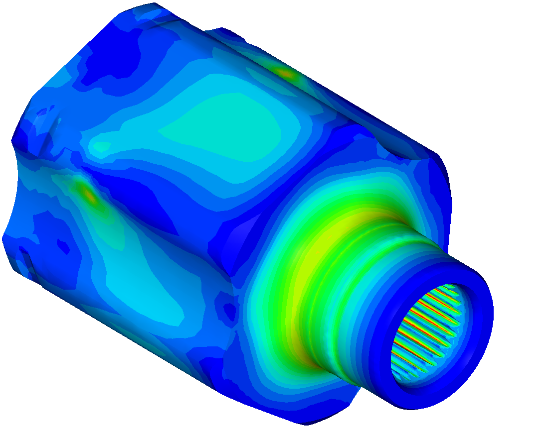
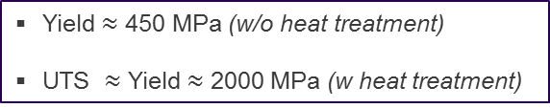
Von Mises Stress [MPa]
Yield $≈$ 450 MPa (w/o heat treatment)
UTS $≈$ Yield $≈$ 2000 MPa (w heat treatment)
1050
700
415

