Slide 1

GOKARAJU RANGARAJU INSTITUTE OF ENGINEERING AND TECHNOLOGY Department of Computer Science and Engineering Realtime Research Project/Societal Related Project
Real-time Pothole Detection System: Mitigating Road Hazards through Image Processing
Under the esteemed Guidance of
- Dr. P. Chandra Sekhar Reddy
(Professor)
Team Members
Sai Priya-22241A0567
Anushka Kumar-22241A0570
K. Sannitha-22241A0586
Surugu Akshaya-22241A05C1
Sneha Padhi-22241A05C2

Slide 2
Contents
Abstract
Literature Survey
Gaps in the Existing System
Proposed System
System Architecture
Design – UML Diagrams
Requirements
Implementation (50%)

Slide 3
Abstract
Our roads are riddled with a hidden danger: potholes. These ubiquitous menaces threaten drivers, cyclists, and pedestrians alike. In just 2022, they were linked to over 4,400 tragic fatalities.
We propose a revolutionary solution that leverages the power of cutting-edge image processing. Our system harnesses the capabilities of computer vision and machine learning, employing real-time pothole identification. At its core lies a sophisticated convolutional neural network (CNN), meticulously trained on a vast collection of diverse road images. This empowers our system to achieve precise detection, even when faced with challenging weather conditions.
By incorporating transfer learning techniques and utilizing advanced models like YOLO (You Only Look Once), we push the boundaries of existing pothole detection methods. Our system possesses the remarkable ability to differentiate between harmless road imperfections and genuine hazards, ensuring a robust and reliable solution.

Slide 4
Literature Survey
S.No. | Title of The Paper & Year | Authors | Methodology & Metrics | Datasets Used | Observed Shortcomings/ Gaps in The Paper
1 | Pothole Detection System using deep learning (2021) | Samir Berjaoui, Anas Al-Shaghouri, Rami Alkhatib | 2D imaging & 3D reconstruction evaluated with Deep Learning (SSD-TF, YOLOv3, YOLOv4). YOLOv4 achieves best accuracy (mAP 85.39%) & speed (FPS) at 832x832 resolution. | Online database with 431 images. Combined: Lebanese roads (344) & web sources (312, mostly dashcam). | more complexity, less accuracy, less user-friendly, less robust to variations.
2 | Detection and segmentation of concrete pothole based on Image Processing (2020) | Mingxing Gao, Xu Wang, Shoulin Zhu, Peng Guan | Texture, grayscale, morphology features + SVM for vehicle data. Evaluated with Recall, Precision, Accuracy, F1. | Images collected from agricultural and pastoral areas of Inner Mongolia, China. The exact number of images is not specified. | Image quality, Generalizability, External factors, Processing time, Feature selection, Sandy soil.
3 | Real-time machine learning based approach for Pothole detection (2021) | Oche Alexander Egaji, Gareth Evans, Mark Graham Griffiths, Gregory Islas | Naive Bayes, Logistic Regression, KNN, SVM, Random Forest evaluated on k-fold CV with Accuracy, Precision, Recall, F1, AUC. | Phone/car sensor data (various routes) split into 2-second windows for training a classifier. | Data imbalance, real-world variations

Slide 5
Literature Survey
S.No. | Title of The Paper & Year | Authors | Methodology & Metrics | Datasets Used | Observed Shortcomings/ Gaps in The Paper
4 | Pothole detection system design with proximity sensor to provide motorcycle with warning system and increase road safety. (2020) | Hadistian Muhammad Hanif , Zener Sukra Lie, Winda Astuti , Sofyan Tan | Sensors (Proximity, ToF, Gyro, Hall Effect) + Arduino for distance, voltage, gyro, speed. | Roboflow and Kaggle Pothole Detection Dataset | Limited detection range, potential error in speed measurement, dependency on controlled conditions, complexity in implementation.
5 | PotSpot: Participatory sensing-based monitoring system for pothole detection using deep learning (2021) | Susmita Patra, Asif Iqbal Middya, Sarbani Roy | Participatory sensing & custom CNN (TensorFlow Lite) achieve 97.5% accuracy on 3424 road images (InceptionV3, VGG16, VGG19). | 3424 road images dataset collected from real world scenarios | data quality issues, user participation, and scalability concerns
6 | Application of various YOLO Models for Computer Vision-Based Real-Time Pothole Detection (2021) | Sung-Sik Park, Van-Than Tran, Dong-Eun Lee | YOLOv4/Tiny/v5 & AlexNet on 665 image dataset (mAP_0.5, Precision, Recall). | collection of 665 images captured at 720 × 720 resolution | Limited detection in certain conditions, manual labelling requirement, dependency on hardware resources, generalisation limitations.

Slide 6
Literature Survey
S.No. | Title of The Paper & Year | Authors | Methodology & Metrics | Datasets Used | Observed Shortcomings/ Gaps in The Paper
7 | PotNet: Pothole detection for autonomous vehicle system using Convolutional Neural Network. (2020) | Deepak Kumar Dewangan, Satya Prakash Sahu | CNN (camera, Raspberry Pi) achieves 99.02% accuracy (Specificity 99.01%, Sensitivity 99.03%, Precision 98.03%, F1 98.33%). | public dataset named "Nienaber Potholes" accessed from Kaggle | Camera Calibration Needed, Distance Measurement Challenges
8 | A Real-time Pothole Detection Based on Deep Learning Approach (2021) | Yeoh Keng Yik, Nurul Ezaila Alias, Yusmeeraz Yusof and Suhaila Isaak | YOLOv3 (Webcam, Multiprocessing) - mAP 65.05% (Precision 0.9%, Recall 0.45%). | 330 pothole images used to train the YOLOv3 model for real-time pothole detection | Calibration, Small Dataset, Low Power, Precision-Recall Tradeoff
9 | DeepBus: Machine Learning based Real Time Pothole Detection system for smart transportation using IoT (2020) | Kashish Bansal, Kashish Mittal, Gautam Ahuja, Ashima Singh, Sukhpal Singh Gill | Accelerometer, Gyroscope, Random Forest tree-> Real-time map (86.8% Accuracy, 83.7% Precision, Rec, F1). | custom dataset was created for training the pothole detection system | Misclassifications, limited pothole severity detection, smartphone dependency

Slide 7
Literature Survey
S.No. | Title of The Paper & Year | Authors | Methodology & Metrics | Datasets Used | Observed Shortcomings/ Gaps in The Paper
10 | Intelligent Real Time Pothole Detection and Warning System for Automobile Applications Based on IoT Technology (2020) | M.S. Kamalesh, Bharatiraja Chokkalingam, Jeevanantham Arumugam, Gomathy Sengottaiyan, Shanmugavadivel Subramani, Mansoor Ahmad Shah | Pi3, AWS, GSM/GPS, Accel, uC (ADXL345, Atmega328p) -> Image Processing, IoT. Tests across conditions. GPS in AWS (XYZ for potholes). | Not specifically mentioned | Processing power, network reliance, and potential device failures (ultrasonic). Optimal accuracy at 30 km/h.
11 | YOLOv8-Based Visual Detection of Road Hazards: Potholes, Sewer Covers, and Manholes (2023) | Om Khare, Shubham Gandhi, Aditya Rahalkar, Sunil Mane | YOLOv8 (norm, aug, hypertune) on Roboflow's Intel "Pothole Detection" (mAP). | Roboflow Universe "Pothole Detection" dataset and trained on a dashboard camera perspective. | Requires diverse training data and further testing in various conditions.
12 | Pothole Detection and Dimension Estimation System using Deep Learning (YOLO) and Image Processing (2020) | Pranjal A. Chitale, Kaustubh Y. Kekre, Hrishikesh R. Shenai, Ruhina Karani, Jay P. Gala | YOLO, Image Processing, Triangular Similarity (mAP, IoU) - Custom India/Foreign Road Dataset. | Custom Dataset (Indian and Foreign Roads) | Limited Dataset Size, Dependency on Camera Angle, Performance Variability with Environmental Factors

Slide 8
Literature Survey
S.No. | Apps | Publishers | Methodology & Metrics | Observed Shortcomings/ Gaps in The Paper
13 | Pothole Radar | JCL Apps | Centralized database stores all user marked potholes using gps and notify when a pothole is nearby | not user friendly, bad UI, only uses GPS to find potholes marked by users priorly not real-time detection.
14 | RoadBounce Pothole Guard | Definitics | Mounts in car, detects potholes and clicks pictures, records GPS location & severity. Generates report after your drive | relying solely on phone sensors might not detect all potholes, especially smaller ones
15 | Pothole Patrol | UMSEBENZI PATROL (PTY) LTD | Allows road users to report potholes in their area | Slow loading times, lack of response to issues, and excessive data collection

Slide 9
Gaps in Existing System
Absence of Notification Integration: Users aren't promptly alerted about detected potholes, causing safety risks.
Fragmented Landscape: Multiple apps and websites, not all recognized by authorities, create confusion and discourage reporting.
Limited Functionality: Lack of real-time tracking and navigation integration slows down repairs.
Unreliable Data: Inconsistent user reporting and missing verification mechanisms make prioritizing repairs difficult.
Accessibility Barriers: Language barriers and technological illiteracy exclude some citizens from reporting.
Low Public Awareness: Limited government support keeps public awareness low, resulting in fewer people using these tools.

Slide 10
Proposed System
Building upon the identified problem of pothole-related accidents, our project proposes a real-time pothole detection system leveraging image processing techniques. This system aims to revolutionize traditional, time-consuming methods by offering an automated, proactive solution.
Core Functionalities:
Image Acquisition: A camera mounted on a vehicle captures continuous footage of the road surface.
Deep Learning-based Detection: The captured images are fed into a Convolutional Neural Network (CNN) specifically trained to identify potholes. This CNN, dubbed SPFVN-Yolo v7, leverages deep learning algorithms for:
High Accuracy: Precise pothole detection with minimal false positives or negatives, even in challenging lighting or weather conditions.
Sophisticated Pattern Recognition: Differentiation between genuine potholes and other road irregularities, ensuring only actual hazards are flagged.
Severity Assessment: The system goes beyond simple detection by assessing the severity of each pothole identified. This data provides valuable insights for prioritizing road maintenance efforts.

Slide 11
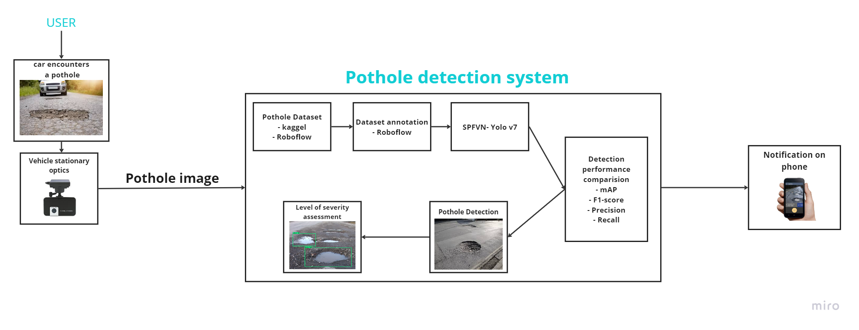
System Architecture

Slide 12
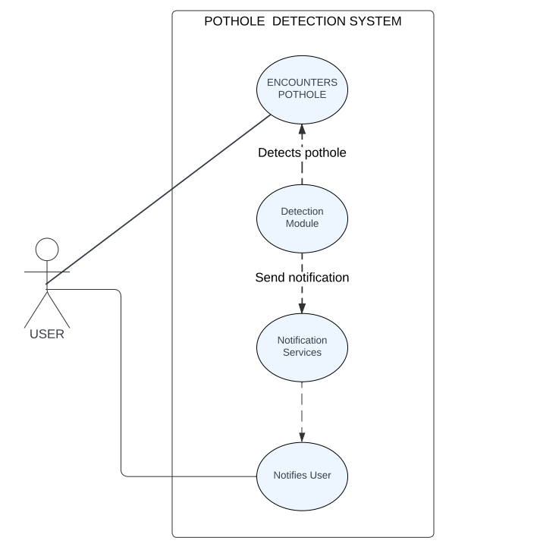
Design – UML Diagrams
Use Case Diagram

Slide 13
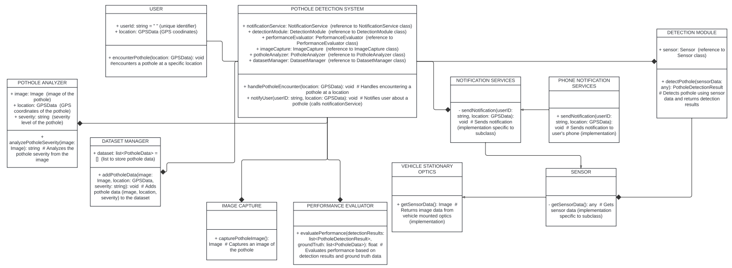
Design – UML Diagrams
Class Diagram

Slide 14
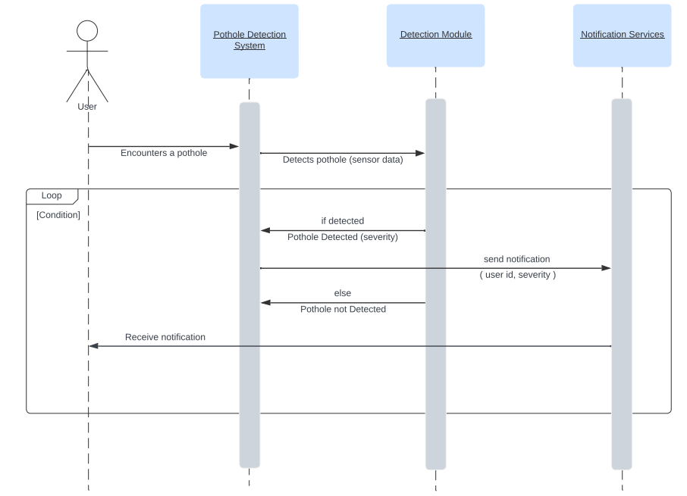
Design – UML Diagrams
Sequence Diagram – Full Stack/ Web Applications

Slide 15
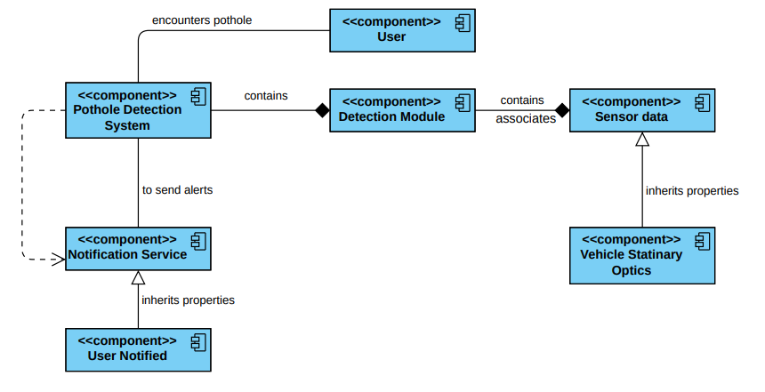
Design – UML Diagrams
Component Diagram

Slide 16
Requirements
Software Requirements:
Python and Machine Learning libraries (TensorFlow, PyTorch)
OpenCV (for image processing)
Flutter (Cross-Platform Development)
Dart (Programming Language for developing flutter applications)
Flask/Django (Create Web Application).
Hardware Requirements:
Processing Unit: GPU or VPU for real-time image or sensor data processing.
Sensors: Cameras to capture road surface image.
Connectivity: Internet Connection

Slide 17
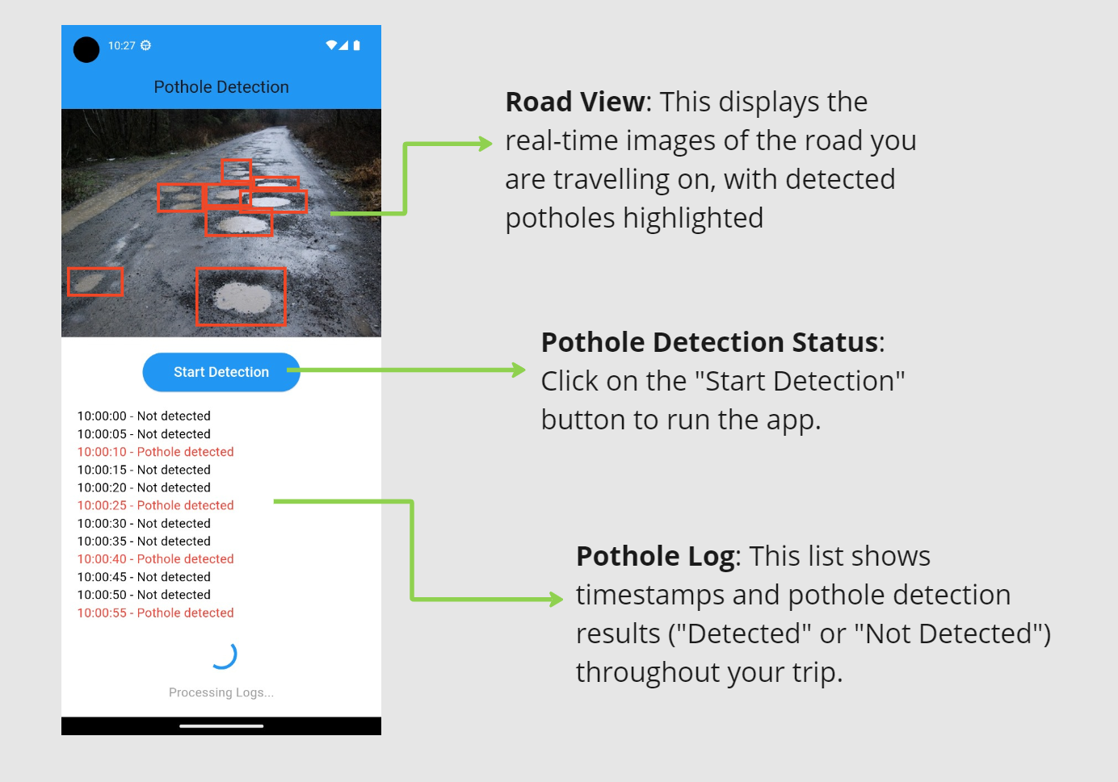
Implementation
Execution of Program

Slide 18

THANK YOU
Any Queries

