Slide 1
Task 09: stakeholder mapping
ACTIVITY : Smart city with all vehicles as E-vehicles
A smart city with all-electric vehicles involves a complex ecosystem of stakeholders. Each stakeholder has unique interests, concerns, and potential impacts on the project. Here's a breakdown of key stakeholders and their likely

Slide 2
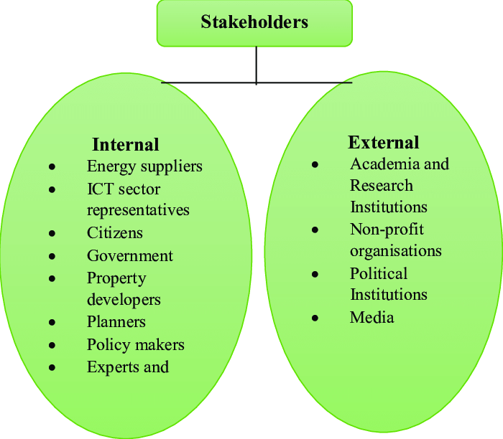

Slide 3
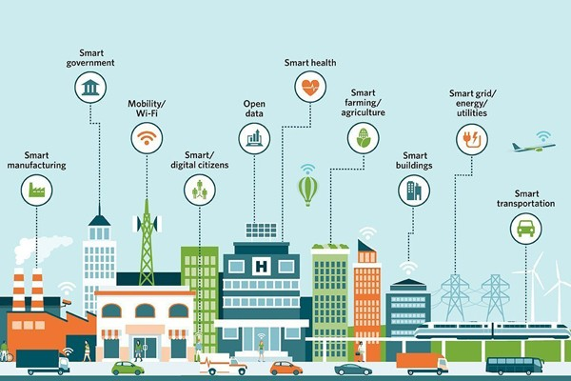
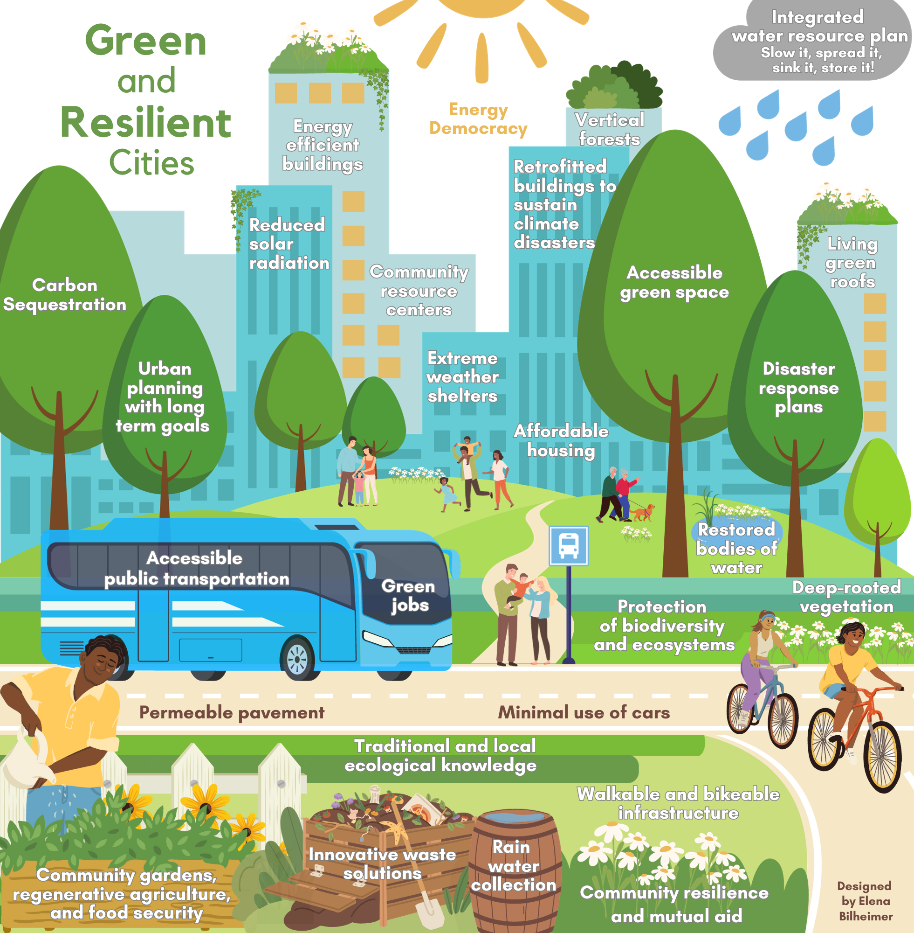
City Administration: Responsible for overall city planning, infrastructure development, and policy implementation.
interests: Improved air quality, reduced noise pollution, energy efficiency, and enhanced public health
Concerns: Initial investment costs, grid capacity, charging infrastructure development, and public acceptance.
Transportation Department: Oversees transportation planning, traffic management, and public transit.
* Interests: Reduced congestion, improved mobility, and sustainable transportation options.

Slide 4
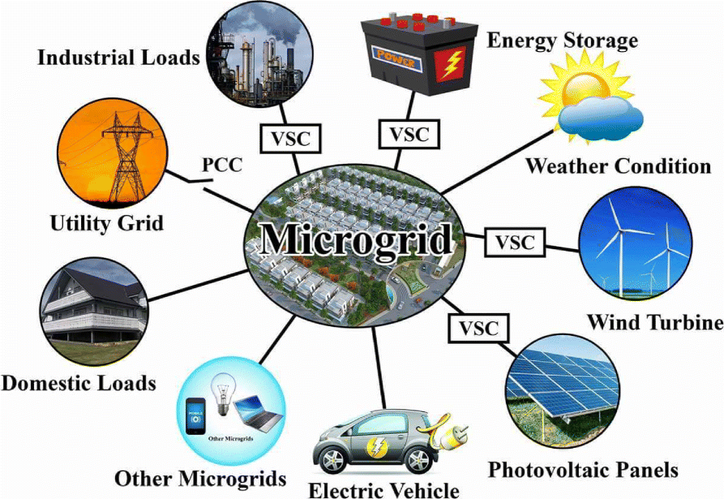
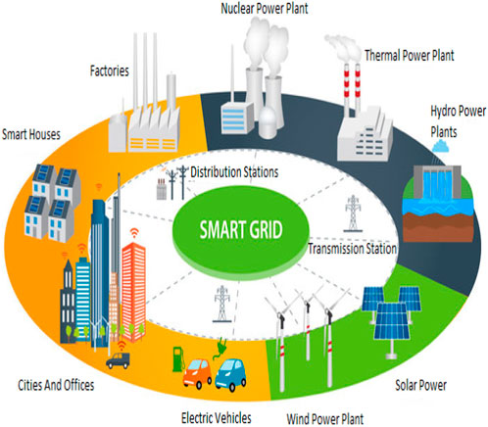
Concerns: Transition costs for existing fleet, charging infrastructure availability, and integration with public transportation systems.
Energy Department: Responsible for energy supply, distribution, and grid management.
* Interests: Increased electricity demand, grid stability, and renewable energy integration.
* Concerns: Grid capacity, peak load management, and pricing strategies Private Sector

Slide 5
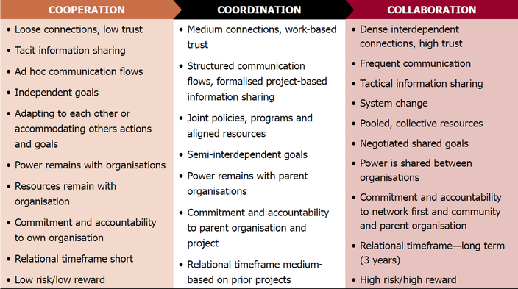
key Considerations
Collaboration and Coordination: Effective stakeholder engagement and collaboration are crucial for successful implementation.
Incentives and Policies: Government incentives, such as tax credits, rebates, and infrastructure investments, can significantly influence adoption.
* Public Education: Raising awareness

