Slide 1
Getting Started with Python & Elementary Programming
Akshaya Kumar Dash

Slide 2
Getting Started with Python
Python program executed from interpreter
Modes:
Interactive Mode (`>>>`)
Script Mode (save as `.py`, run file)
Tools: Command line & IDLE (IDE),VSCode etc.
Console Input & Output
Input → from keyboard
Output → to monitor

Slide 3
First Python Program
print("Welcome to Python")
print("Python is fun")
`print()` → displays text
Strings must be in quotes
Exit Python → `CTRL+Z` + Enter (Windows)

Slide 4
Comments & Indentation
Comments
`#` → single-line comment
`''' ... '''` → multi-line comment
Indentation matters!
Wrong indentation → error
Python is case-sensitive

Slide 5
Special Characters in Python
'()' → function calls
# , '" "'→ comments
‘ ‘ or '' '' → strings
No semicolon (';') needed at line end

Slide 6
Mathematical Computations
Example:
print(3 + 4)
print(3 - 4)
print(3 * 4)
print(3 / 4)
Operators: '+ - * /'
Expressions follow mathematical precedence
Operators: '+ - /'
Expressions follow mathematical precedence

Slide 7
Programming Style & Documentation
Write clean, readable code
Guidelines:
Use meaningful names
Proper spacing → '3 + 4 * 2' not '3+4*2'
Add comments for clarity
Helps with debugging & teamwork

Slide 8
Programming Errors
Syntax Errors → violate grammar rules
e.g., missing quotes, misspelling 'print'
Runtime Errors → crash during execution
e.g., division by zero, invalid input
Logic Errors → program runs but produces wrong result
e.g., wrong formula

Slide 9
Elementary Programming
Write & run simple programs
Read input from console
Use variables, constants, operators
Apply expressions & precedence

Slide 10
Writing a Simple Program
print("Enter two numbers:")
a = eval(input())
b = eval(input())
print("Sum is", a + b)
Use 'input()' for user entry
Use 'eval()' to evaluate numeric input

Slide 11
Identifiers & Variables
Identifiers: names for variables/functions
Rules: start with letter/underscore, case-sensitive
Variables: store values
Example: 'radius = 10'
Assignment: '='

Slide 12
Simultaneous Assignment
Assign multiple variables in a single statement
Increases readability
Reduces number of lines of code
Syntax:
var1, var2, ..., varn = exp1, exp2, ..., expn

Slide 13
Constants & Data Types
Named Constants:
PI = 3.14159
- Numeric Types: 'int', 'float', 'complex'
- Operators: '+ - / // % '

Slide 14
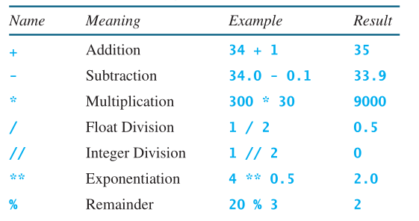
Operations

Slide 15
Operator Precedence
Order:
'**' (exponent)
'* / // %'
'+ -'
If an expression contains several multiplication, division, and remainder operators, they are applied from left to right.
Use parentheses '()' to override

Slide 16
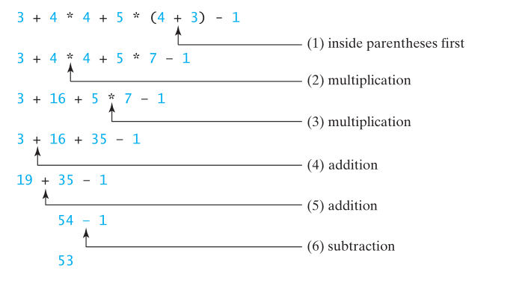
Example

Slide 17
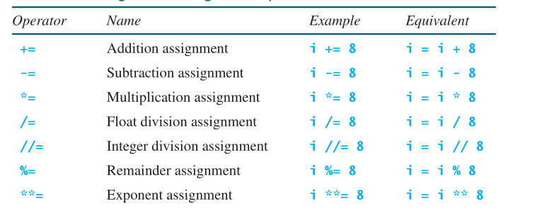
Augmented Assignment Operators
The operators +, -, *, /, //, %, and ** can be combined with the assignment operator (=) to form augmented assignment operators.

Slide 18
Type Conversion and rounding
Automatic promotion: int + float → float.
int(x) truncates, not rounds.
round(x) uses banker’s rounding (ties go to nearest even).
For strict downward or upward rounding, use math.floor() / math.ceil().

