Slide 1
BellaBeat Leaf – Health Tracker
Akshaya Udayakumar
Nanditha Valsaraj
Sushma Challa

Slide 2

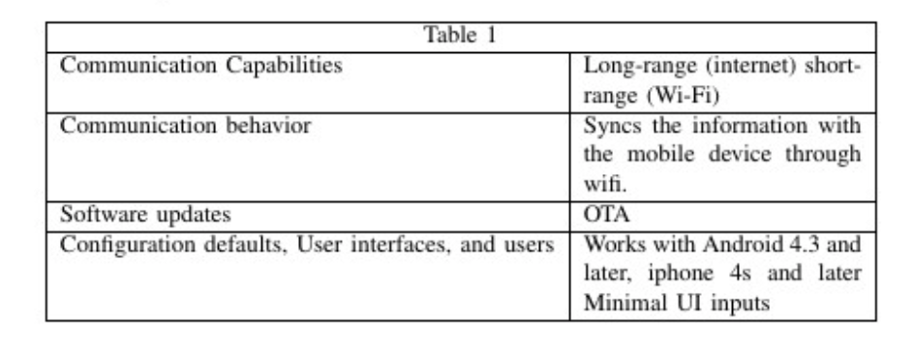

DEVICE DESCRIPTION
The device uses Bluetooth low energy to communicate and interact with the mobile application.
The Leaf has a 14-day memory. The LEAF collects the data and syncs it via wireless with the LEAF application in the phone.
It measures 1.9x1.18x0.51 inches and weighs 0.635 ounce. The Leaf runs on a CR2032 coin cell battery that need to be replaced every few months. It's water-resistant but not waterproof.

Slide 3
PRIVACY POLICIES & PRACTICES
In the privacy policy, it is stated that there are data which are collected from the user with consent and which are collected automatically by the application or the device. Information such as name, age, email id, weight, etc. are collected with the consent of the user. But there are other data which are collected automatically by the application.
Information collection like collecting the device type, IP address, location data, unique mobile id and other applications installed in the mobile device. Also another concern is the non existence of information security guarantee by the manufacturer. They do not provide a secure environment for the data they collect from the devices and do not provide a warrant that personal data will be protected against, loss, misuse, or alteration by third parties.
Manufacturer use these collected data for registration with the services, communication, preventing misuses, providing features available, ensuring the technical functionality and security of the Service, improving customer service, protecting our rights, managing service, develop, improve, and protect the Service, audit and analyze the Service.

Slide 4
ANALYSIS OF NETWORK PACKETS
Our first step towards analyzing the device is to check whether the network packet has been secured by encryption. In the case of Leaf it is found that the network packets are not encrypted and hence we are able to freely analyze the contents of the packets once captured.
Packet name | Details in the Packet
ADV_IND | Packet header – Advertising address, length and reserved flag. Advertising data – Device name, type, flags, manufacturer specifics. CRC
SCAN_REQ | Access address, Packet header – Randomized flag, PDU type, scanning and advertising address, CRC.
SCAN_RSP | Packer header, scan response data – length, type, Custom UUID., CRC
CONNECT_REQ | Packet header, Initiator and advertiser address, Link layer data(access address, window size, interval, latency, etc.), CRC

Slide 5
ANALYZING SECURITY OF THE DEVICE
The packets are sent over the network without being encrypted, which gives us a possibility to do reverse engineering and send packets from the BLE Sniffer to the device.
The application sends weekly report to email ID registered in the account. This email is sent in plain text to the user, which makes it vulnerable to man-in-the-middle attacks. If the attacker knows how the Leaf works, he may be able to feed incorrect data to the user through these emails.
The physical address advertised in the Bluetooth packets by the device is not randomized which makes it easier for the attacker to determine the location of the user.

