Slide 1

psychological effects after covid
Akshaya MS
MSCCS(DA)
Rollno:03

Slide 2

Objective
The objective of this Python project is to conduct a comprehensive analysis of a dataset focused on the psychological effects of COVID-19. The dataset contains various columns related to individuals' demographics, work-related factors, and their psychological well-being during the pandemic. The main aim is to find the preference of the individuals on their working method after affected by covid.

Slide 3
DATASET
age
gender
occupation
LINE_OF_WORK
Age group of the person
Gender of the person
Occupation/sector where the person works
The line of work performed
by the person
time_bp
time_Dp
easeof_online
home_env
The time spent on work before pandemic
The time spent on work
during pandemic
Rating of work going online
Liking of home environment
prod_inc
sleep_bal
new_skill
fam_connect
Rating Productivity Increase
The rating of sleep cycle
Whether any new skill was learnt
Rating how well the person connected with his family
relaxed
self_time
like_hw
dislike_hw
Rating of how relaxed the person is feeling
Rating how much self time was procured
Liking of working from Home
Disliking Working from Home

Slide 4
DATASET
prefer
X
certaindays_hw
Preference of the person to work from home/office
Custom Column
Liking whether certain days of working from home is needed
time_bp.1
travel_new
net_diff
Custom Column
Custom Column
Custom Column

Slide 5
methodology
Preprocess the data
visualization
Missing values and duplicate columns in the dataset is handled​
The dataset is visualized for the understanding to the data
MODELBUILDING
interpretation
Builds predictive models or classification models using machine learning algorithms..
Analyses the results obtained from the model and formulate conclusions.

Slide 6

preprocessing
The column ‘line_of_work’ contained null values which were replaced using mode.
​The columns ‘Unnamed:19’, ‘travel+work’ and ‘time_bp.1’ are actually duplicates of the existing columns. Hence those are removed.
For some entries in 'line_of_work’, we have 'Architect' instead of 'Architecture'. So transformed those data into 'Architecture’.
The column ‘age’ string values are converted to numerical.
The columns like ’prefer’, ‘gender’, ‘occupation’, ‘line_of_work’, and ‘certaindays_hw’ containing string values are converted into unique code values (transformation).
The columns 'like_hw' and 'dislike_hw’ have values within a huge range. Hence normalization (min-max normalization) is done.

Slide 7
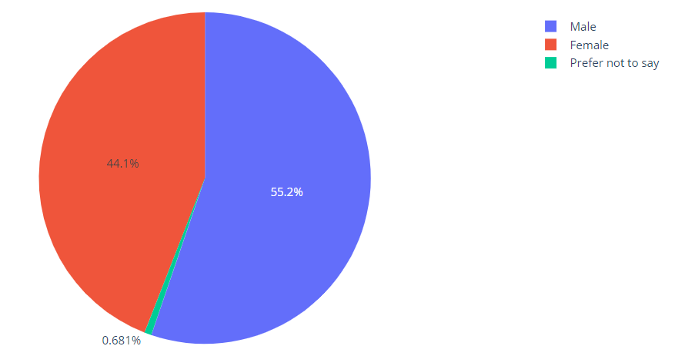
VISUALIZATION OF THE DATA
DISTRIBUTION OF GENDER​
The majority of the respondents are males (55.2%)of the total, while females account for 44.4%. There is a very small percentage (0.4%) that identifies as 'Other’.

Slide 8
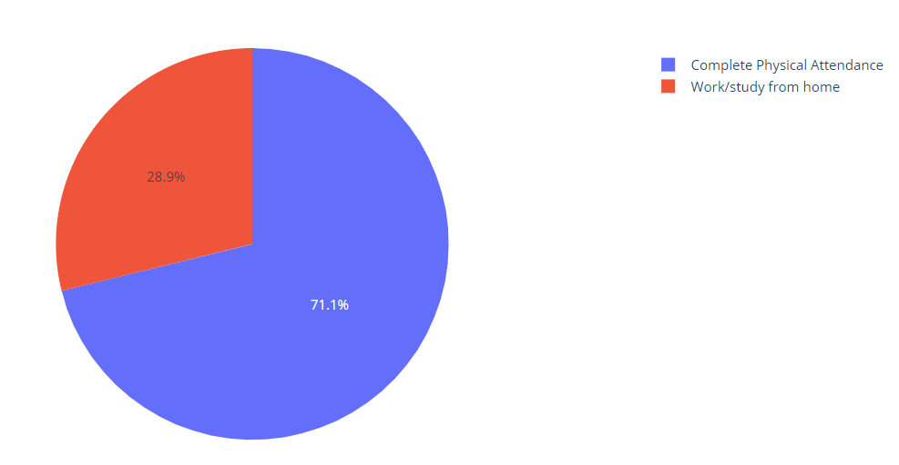
VISUALIZATION OF THE DATA
DISTRIBUTION OF PREFERENCES​
A large proportion of the respondents (71.1%) prefer complete physical attendance, while 28.9% prefer a mix of both online and physical attendance.

Slide 9
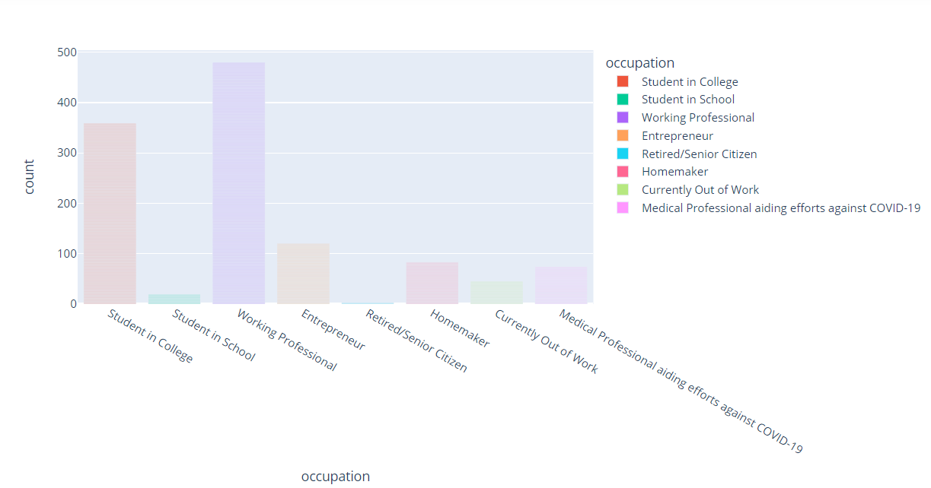
VISUALIZATION OF THE DATA
OCCUPATION ​
The most common occupation among the respondents is 'Working Professional', followed by 'Student in College'. The 'Other' category also has a significant number of respondents.

Slide 10
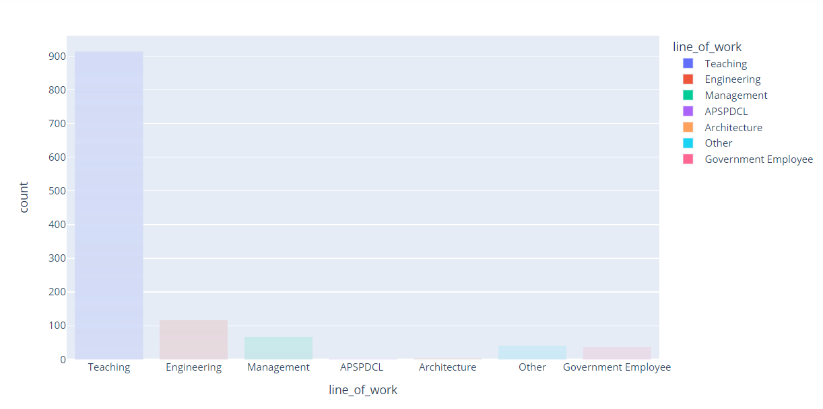
VISUALIZATION OF THE DATA
LINE OF WORK DISTRIBUTION ​
Teaching is the most common line of work among the respondents, followed by 'Engineering/Architecture' and 'Other'.

Slide 11
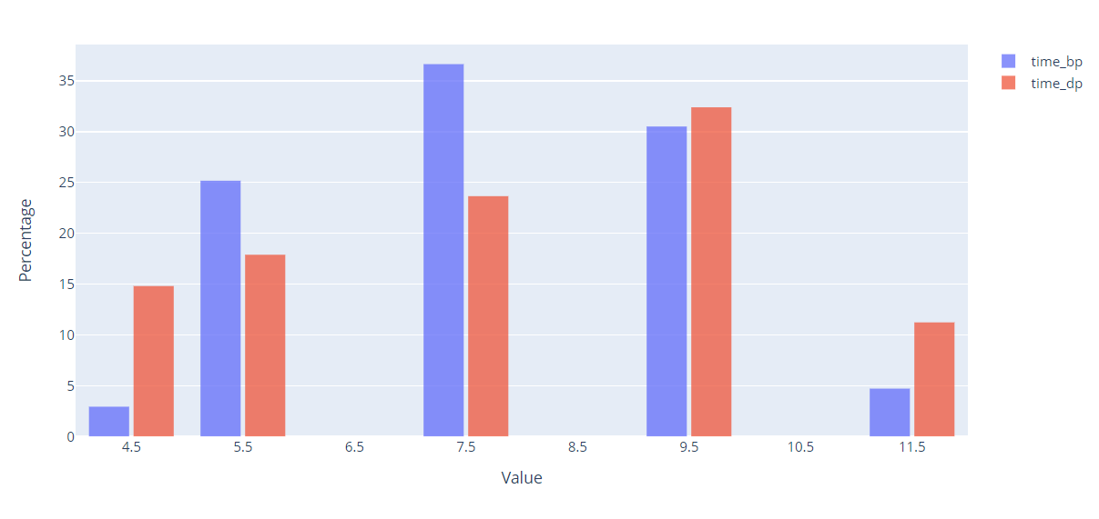
VISUALIZATION OF THE DATA
DISTRIBUTION OF time_bp & time_dp
The most common time spent before the pandemic is around 7 hours, with a significant number of respondents also spending around 9 hours.
The most common time spent during the pandemic is 9 hours, with a significant number of respondents also spending around 7 hours.

Slide 12
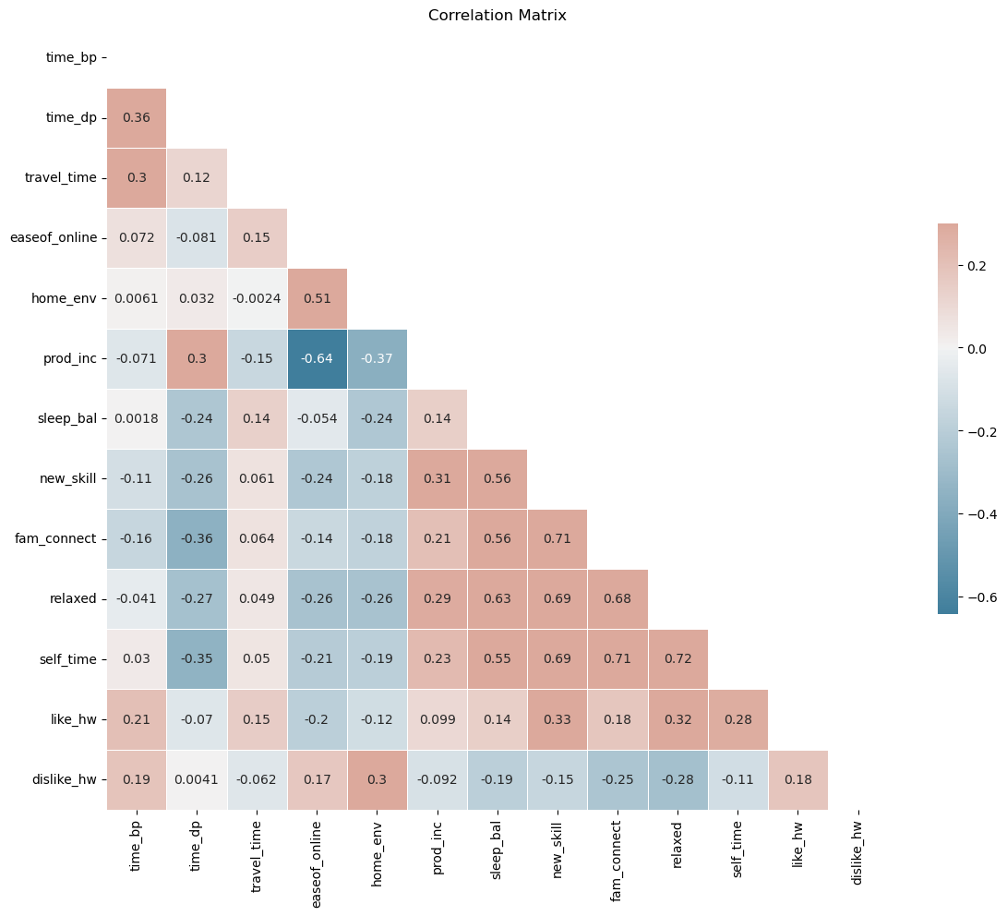
VISUALIZATION OF THE DATA
CORRELATION MATRIX OF VARIABLES
This shows the correlation among all the attributes of the dataset.

Slide 13
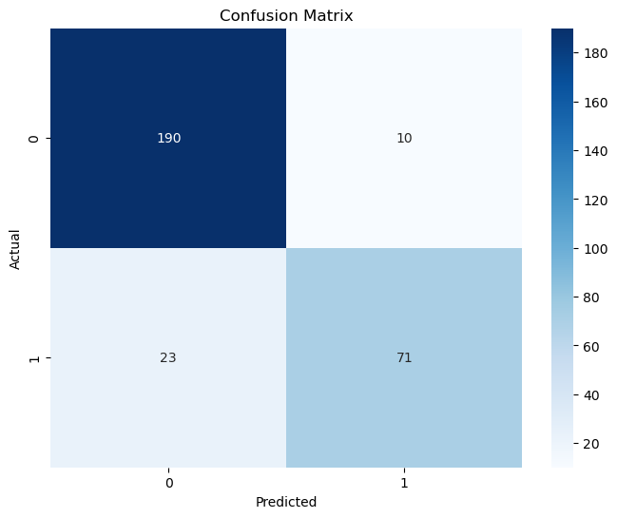
Model BUILDING
1. Logistic regression
The trained logistic regression model is used to predict the target values for the test set based on the features in xtest.
These predictions can then be compared to the actual target values (ytest) to evaluate the model's performance.
The logistic regression model has an accuracy of 88.77% on the test set. The precision, recall, and F1-score are also quite good, suggesting that the model is performing well at identifying both classes.

Slide 14
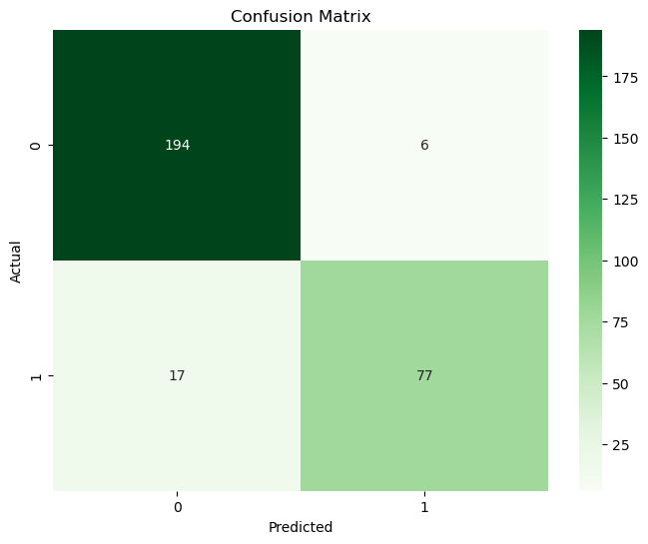
Model BUILDING
2. RANDOM FOREST
It is widely used for both classification and regression tasks. It is also an ensemble model that combines the predictions of multiple decision trees to make more accurate and robust predictions.
The Random Forest model has an accuracy of 98.29% on the test set more than Logistic Regression Model. The precision, recall, and F1-score are also quite good, suggesting that the model is performing well at identifying both classes.

Slide 15
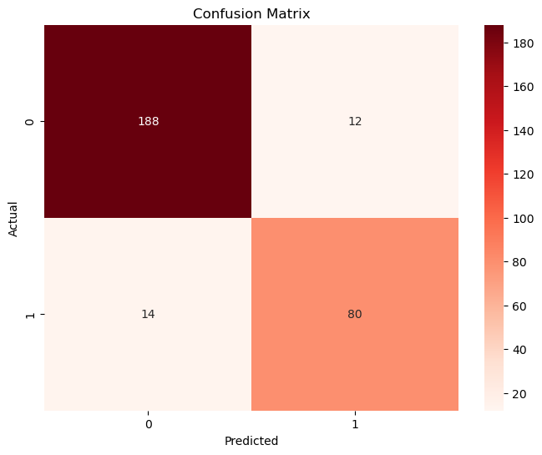
Model BUILDING
3. DECISION TREE CLASSIFIER
It is a supervised machine learning algorithm used for both classification and regression tasks. It is a tree-like structure where each internal node represents a decision or a test on a feature, each branch represents an outcome of the test, and each leaf node represents a class label (in classification) or a numerical value (in regression)
The Decision Tree model has an accuracy of 91.15% on the test set more than Logistic Regression Model and Random Forest.

Slide 16
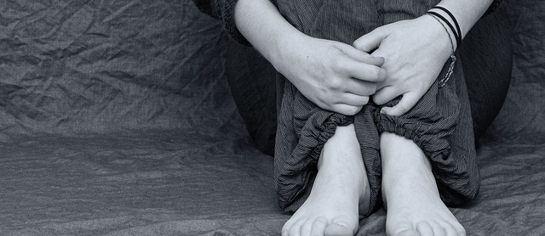
Summary
Among the three models built under classification, the decision tree gives the highest accuracy when compared to the other two models.
Decision trees make decisions by recursively splitting the dataset into subsets based on the values of input features, ultimately arriving at a prediction or decision at the leaf nodes. Random Forest is built upon the foundation of decision trees.

